Slide 1
Status Report of the
DIRAC Experiment - PS 212
L. Nemenov (CERN – JINR)
SPSC – 21 October 2014

Slide 2








DIRAC Collaboration
CERN
Geneva, Switzerland
Tokyo Metropolitan University
Tokyo, Japan
Czech Technical University
Prague, Czech Republic
IFIN-HH
Bucharest, Romania
Institute of Physics ASCR
Prague, Czech Republic
JINR
Dubna, Russia
Nuclear Physics Institute ASCR
Rez, Czech Republic
SINP of Moscow State University
Moscow, Russia
INFN-Laboratori Nazionali di Frascati
Frascati, Italy
IHEP
Protvino, Russia
University of Messina
Messina, Italy
Santiago de Compostela University
Santiago de Compostela, Spain
KEK
Tsukuba, Japan
Bern University
Bern, Switzerland
Kyoto University
Kyoto, Japan
Kyoto Sangyo University
Kyoto, Japan
Zurich University
Zurich, Switzerland

Slide 3
π⁺K⁻ and π⁻K⁺ atom
Long-lived π⁺π⁻ atom analysis
π⁺π⁻ atom analysis
K⁺K⁻ pair analysis
proton - antiproton pair analysis
π⁺μ⁻ and π⁻μ⁺ pair analysis
K⁺π⁻, K⁻π⁺, π⁺π⁻, K⁺K⁻ atom production analysis
at p_{p}=24GeV/c and p_{p}=450GeV/c
8. Letter of Intent
9. Further works
Contents

Slide 4
Theoretical motivation
ElectroWeak L_{EW}
Standard Model
strong:
L_{QCD}
SU(2)_{L}×U(1)
local gauge theory
SU(3)_{c}
Strong interaction: L_{QCD} = L_{sym} + L_{sym-break} (m_{q} ≠ 0)
(chiral symmetry)
HIGH energy
(small distance)
Q>>
Q<<
LOW energy
(large distance)
perturbative QCD:
L_{QCD} (q,g)
Interaction → „weak“ (asympt. freedom)
Method: expansion in coupling
Checks only L_{sym} (m_{q}≪ 0) !
non-perturbative QCD:
L_{eff} (GB: π,K,η); L_{lattice} (q,g)
Interaction → „strong“ (confinement) Methods: 1) Chiral Perturbation Theory
2) Lattice Gauge Theory
Checks L_{sym} as well as L_{sym-break} !
spontaneously
broken symmetry
quark-
condensate
4

Slide 5
1. π⁺K⁻ and π⁻K⁺ atoms
Published paper: Physics Letters B 735 (2014) 288
“First πK atom lifetime and πK scattering length measurements”
In this paper, characteristic πK pairs from πK atom breakup in the Ni target have been observed, as many as
178±49 (3.6σ) πK atomic pairs as well as
653±42 produced πK atoms
Based on these results, the first measurement of the πK atom lifetime has been deduced
and the first measurement of the S-wave isospin-odd πK scattering length
The result was obtained using 2/3 of the existing statistics with low and medium background in the scintillation fiber detector.

Slide 6
π⁺K⁻ and π⁻K⁺ atoms
The procedure to process and analyse pairs with high background (in the remaining 1/3 of total statistics) has been developed using large statistics of π⁺π⁻ pairs.
The same analysis will be used for Kπ-atoms, because the multiplicity in all detectors is the same for ππ and Kπ triggers.
To enlarge the Kπ atomic pair statistics, the 2007 K⁻π⁺ and K⁺π⁻ atom data, collected on Pt target, will be reprocessed. The expected significance of the expected number of atomic pairs measured in 2007 and 2009-2010 runs will be around 5 standard deviations. This work and dedicated publication will be finished in October 2015.

Slide 7
2. Long-lived π⁺π⁻ atom analysis

Slide 8
Theoretical motivation
ππ scattering length
In ChPT the effective Lagrangian, which describes the ππ interaction, is an expansion in terms:
(tree) (1-loop) (2-loop)
G. Colangelo, J. Gasser and H. Leutwyler, Nucl. Phys. B603 (2001) 125, using ChPT (2-loop) & Roy equations:
These results (precision) depend on the low-energy constants (LEC) l₃ and l₄:
Lattice gauge calculations from 2006 provided values for these l₃ and l₄.

Slide 9
Theoretical motivation
Lattice calculations of l₃, l₄
• 2006: l₃, l₄ … first lattice calculations
• 2012: 10 collaborations: 3 in USA, 5 in Europe and 2 in Japan
• J. Gasser, H. Leutwyler: model calculation (1985)
l₃=2.9±2.4, l₄ =4.3 ±0.9
• Lattice calculations of these constants have been done in 20 works.
Best result (BMW): l₃=2.6±0.5st ±0.4sy, l₄ =3.8 ±0.4st ±0.2sy
Therefore, the theoretical pion-pion scattering length precision can be improved.
The best experimental results on the scattering length have a precision better than 4%.

Slide 10
Method of A_{2π} observation and measurement
Target Ni 98 μm
A_{2π}
π⁺
p
(n_{A})
Atomic pairs
24 GeV/c
(N_{A})
π⁻
Interaction point
Ni
π⁺
p
(N_{C})
π⁻
Coulomb pairs
24 GeV/c
Δ,ρ,ω,…
π⁺
π⁺
p
Non-Coulomb pairs
24 GeV/c
π⁻
η, η’,…
π⁺
Interaction point
π⁰
p
π⁺
24 GeV/c
Accidental pairs
p
π⁻
11/10/2014

Slide 11
Coulomb pairs and atoms
For charged pairs from short-lived sources and with small relative momenta Q , Coulomb final state interaction has to be taken into account.
This interaction increases the production yield of the free pairs with Q decreasing and creates atoms.
π⁺π⁻, Κ⁺π⁻, Κ⁻π⁺,
Κ⁺Κ⁻, π⁺μ⁻, π⁻μ⁺
(π⁺π⁻), (Κ⁺π⁻), (Κ⁻π⁺),
(Κ⁺Κ⁻), (π⁺μ⁻), (π⁻μ⁺)
Coulomb pair
Atom
There is a precise ratio between the number of produced Coulomb pairs (N_{C}) with small Q and the number of atoms (N_{A}) produced analogously (to Coulomb pairs):

Slide 12
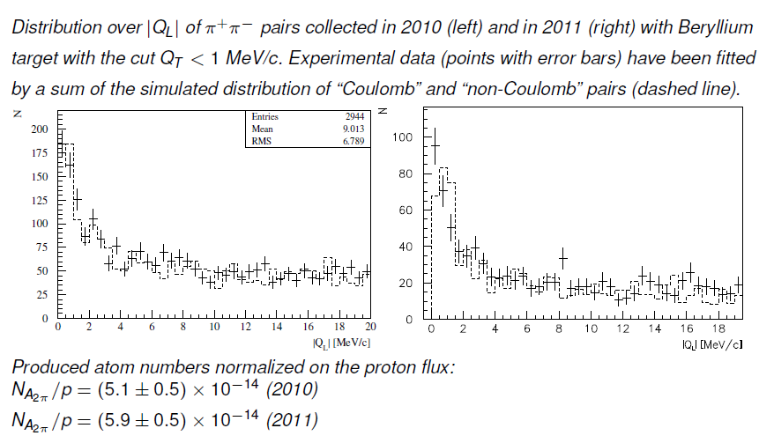
Measurement of A_{2π} production rate in p-Be interactions
Q
Q_{T}
Q
π⁺
π⁺
P_{∑,LS}
π⁻
Q_{L}
π⁻

Slide 13
π⁺π⁻ atom lifetime
π⁺π⁻ atom (pionium) is a hydrogen-like atom consisting of π⁺ and π⁻ mesons:
E_{B} = -1.86 keV, r_{B} = 387 fm, p_{B} ≈ 0.5 MeV/c
π⁺
π⁰
The π⁺π⁻ atom lifetime is dominated by the decay into π⁰ π⁰ mesons:
π⁻
π⁰
a₀ and a₂ are the ππ S-wave scattering lengths for isospin I=0 and I=2.
≠ 0 for l = 0
A_{2π}(1s, 2s,…, ns)
π⁰π⁰
= 0 for l ≠ 0
γ
π⁰π⁰
A_{2π}(np)
A_{2π}(1s, 2s,…(n-1)s)
The np state lifetime depends on the transition np 1s, 2s,…, (n-1)s probability.
This probability is about 3 orders of magnitude less than for ns π⁰π⁰.

Slide 14
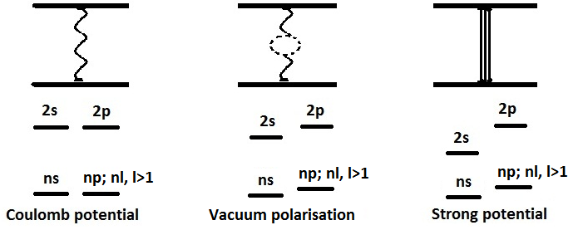
Energy splitting measurement
A_{2π} Energy Levels
For Coulomb potential,
E depends only on n
J. Schweizer
[PL B (2004)]
higher order QED
Notation:
G.V.Efimov et al.
Sov.J.Nucl.Phys. (1986)
CONCLUSION: one parameter (2a₀+a₂) allows to calculate all values

Slide 15




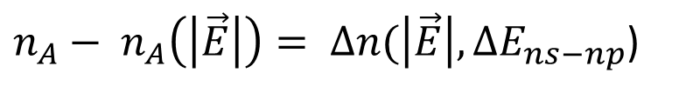



Energy splitting measurement
In the static electric field there will be Stark mixing between the ns and the np wave functions.
$τ_{np} ⇒ τ_{np}^{eff}(\left|\vec{E}\right|, ∆E_{ns−np})< τ_{np}$
$$\vec{E}$$
= 0
$$n_{A}$$
$$\vec{E}$$
$$n_{A}(\vec{E})$$
$$⇒$$
$$τ_{np}$$
$$τ_{np}^{eff}$$
Be
Pt
Be
Pt
$n_{A}− n_{A}\left(\left|\vec{E}\right|\right)= ∆n(\left|\vec{E}\right|,∆E_{ns−np}$)
Only relative abundances of different atomic quantum states are taken from theory.
56

Slide 16
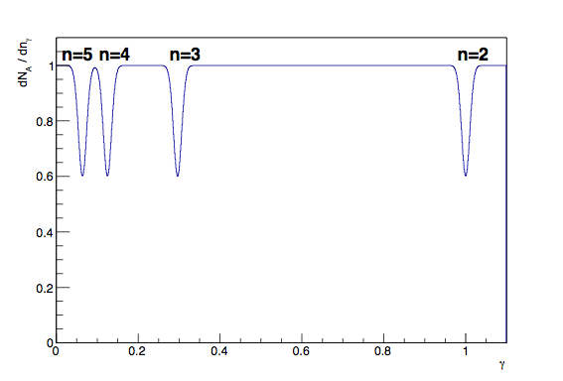


Energy splitting measurement
In a periodic electric field, there will be oscillations between ns and np states, if the external field frequency will coincide with ns np frequency.
$$−$$
$$ω_{ns−np}={γ_{n}ω}_{lab}$$
No theoretical input!

Slide 17
Method for observing long-lived π⁺π⁻ atom with breakup Pt foil
Be target103 μm
MagneticField
Pt foil 2.1 μm
Magnetic Field
π⁺
100 mm
Atomic, Coulomb, non-Coulomb and accidental pairs
Q_{Y}=
12.9MeV/c
24 GeV/c
p
Δ,ρ,ω,η,η’…
π⁻
Interaction point
B_{X}=0.25T
π⁺
Breakup
Excitation
π⁺
24 GeV/c
1s, 2s,…→2p, 3p, 4p, …
p
Q_{Y}=
2.3MeV/c
Atomic pairs
Long-lived states
Be
π⁻
Interaction point
N_{A}*≈5%
N_{A}*≈2.8%
Pt
for
γ =16
l(2p) = 5.6 cm, l(3p) = 19 cm, l(4p) = 43 cm, l(5p) = 84 cm, l(6p)=144 cm
l(2s) = 0.11 mm, l(3s) = 0.38 mm, l(4s) = 0.89 mm, l(5s) = 1.74 mm, l(6s)=3 mm

Slide 18
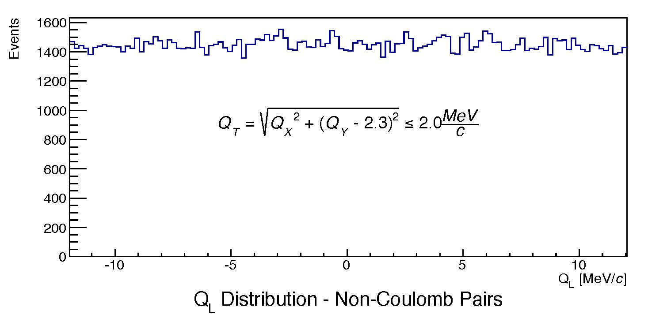
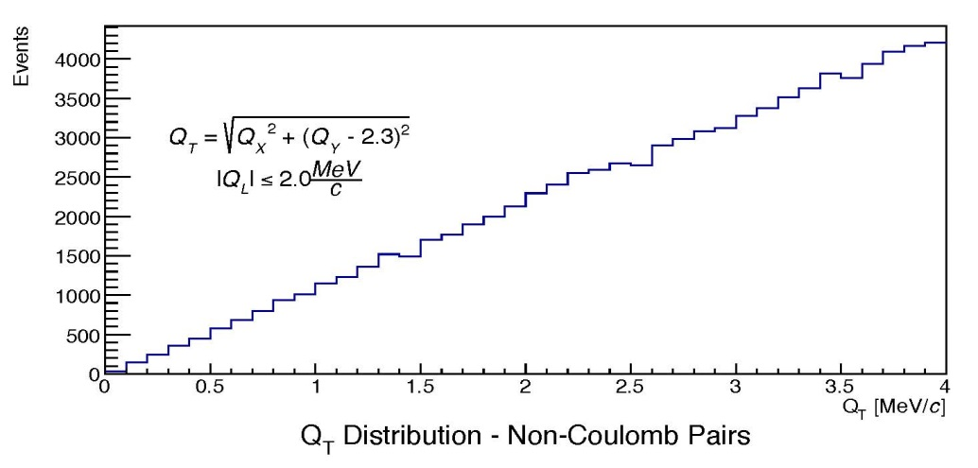
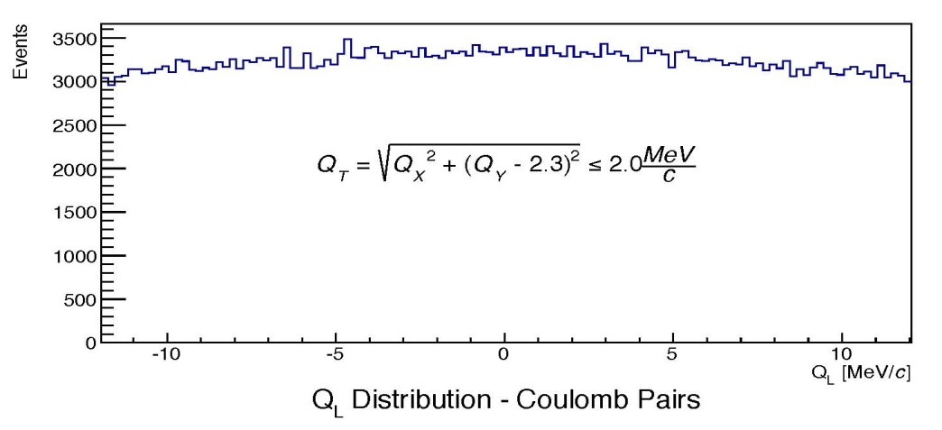
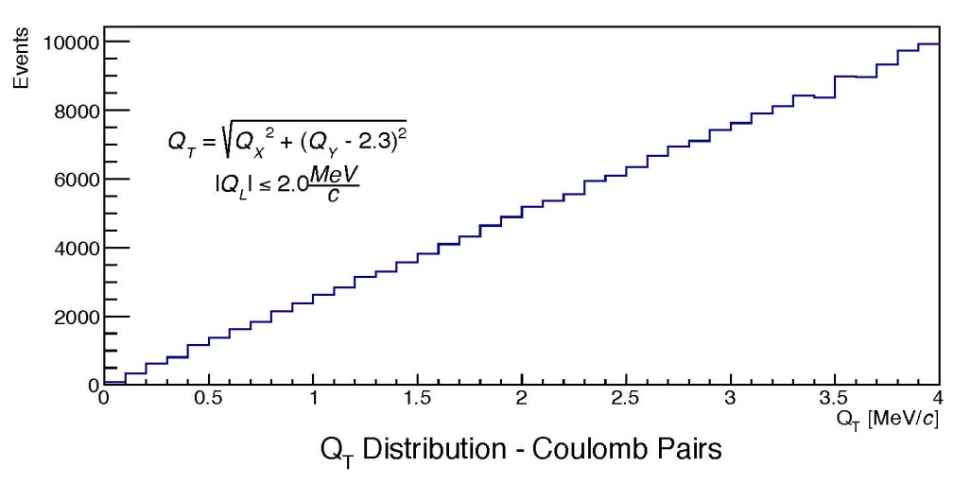
Simulation of π⁺π⁻ pairs for long-lived A_{2π} observation
Q_{L}
Atomic pairs
Q_{L}(MeV/c)
Atomic pairs
Q_{T}(MeV/c)

Slide 19
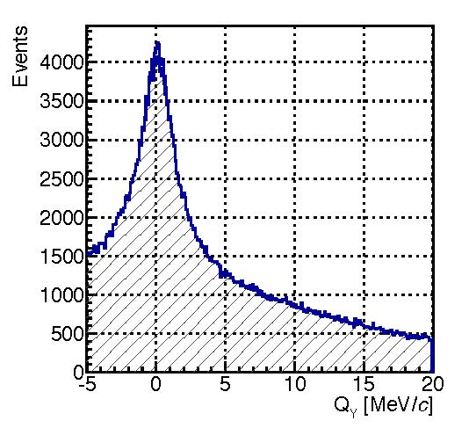
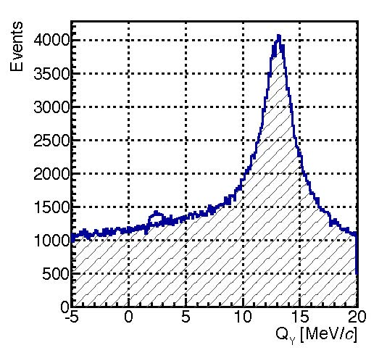
The background reduction with magnetic field for long-lived A_{2π} observation
V. Yazkov
Q_{y} distribution of “atomic pairs” (signal) above the background of π⁺π⁻ Coulomb pairs
produced in Beryllium target, without (left) and with (right) magnet used in 2012 run.
Selected events with the cut:
Expected signal (atomic pairs) from broken up long-lived π⁺π⁻ atoms
Simulation without magnet
Simulation with magnet

Slide 20
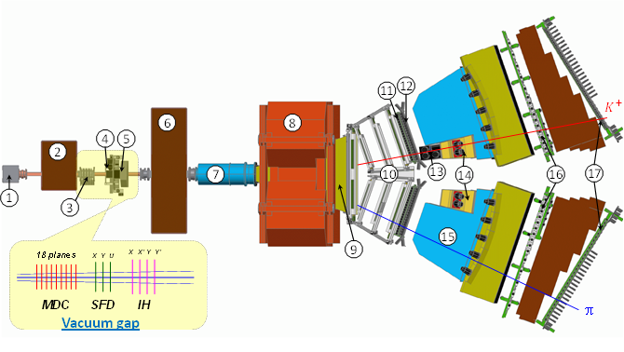
DIRAC upgraded Experimental setup
1 Target station ; 2 First shielding; 3 Micro Drift Chambers; 4 Scintillating Fiber Detector; 5 Ionization Hodoscope; 6 Second Shielding; 7 Vacuum Tube; 8 Spectrometer Magnet; 9 Vacuum Chamber; 10 Drift Chambers; 11 Vertical Hodoscope; 12 Horizontal Hodoscope; 13 Aerogel Čerenkov; 14 Heavy Gas Čerenkov; 15 Nitrogen Čerenkov; 16 Preshower; 17 Muon Detector
M. Pentia IFIN-HH

Slide 21
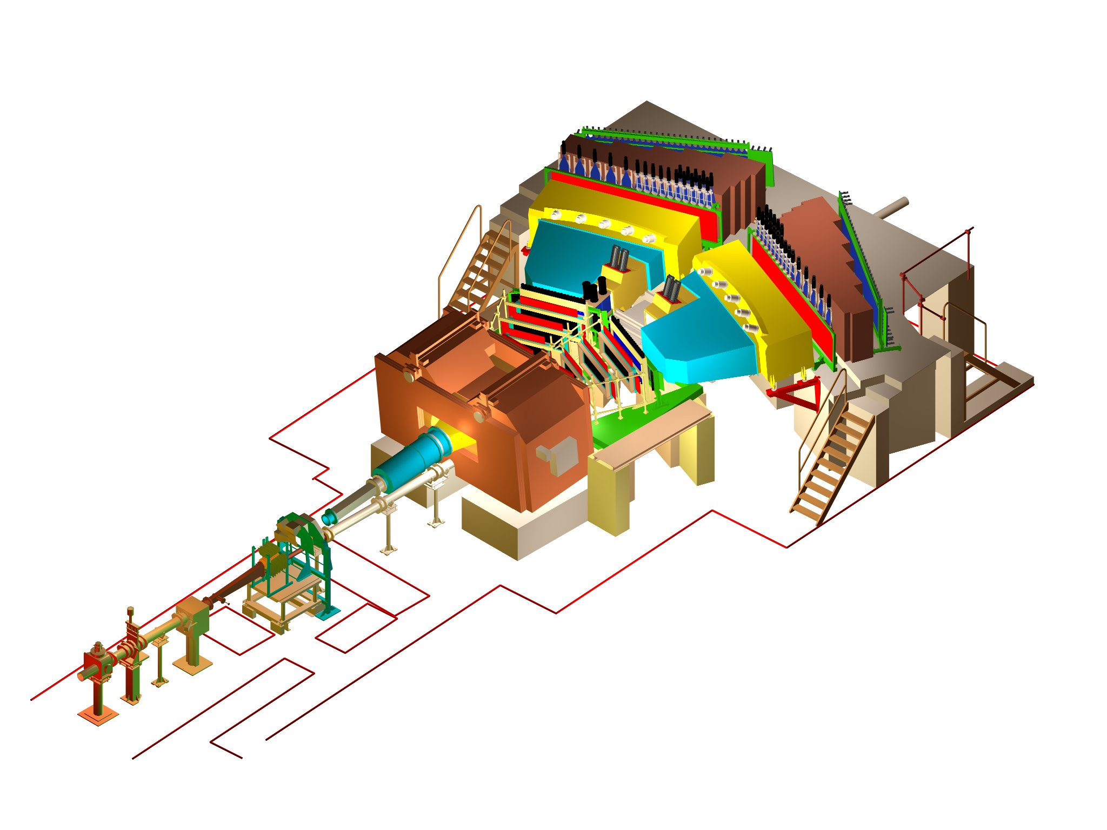
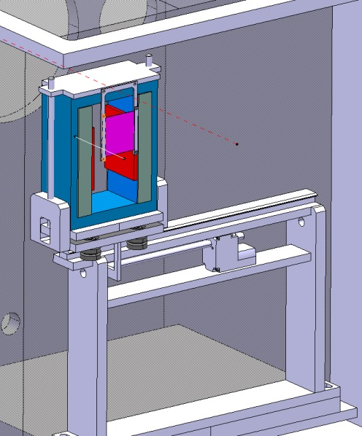
DIRAC upgraded Experimental setup
BLUE … magnet yoke
GREY … magnet poles
RED … magnet shimming
PURPLE … Pt foil
Notes:
21

Slide 22
Magnet impact on Q_{y} distribution for e⁺e⁻ pairs
Real data
Be
Pt
Magnetic Field
e⁺
12.9 MeV/c
Q_{Y}=
12.9MeV/c
Q_{y}(GeV/c)
e⁻
12.9 Mev/c
e⁺
2.3 MeV/c
Q_{Y}=
2.3MeV/c
e⁻
Q_{y}(GeV/c)
Peak at Q_{y}=2.3MeV/c evaluated after subtraction of the mirrored left side part.
11/10/2014
22

Slide 23
Long-lived π⁺π⁻ atoms
Simulated distributions of "Coulomb", "non-Coulomb" and atomic pairs over Q_{T}
for |Q_{L}|<2 MeV/c

Slide 24
Long-lived π⁺π⁻ atoms
Experimental (real data) and simulated distributions over |Q_{L}|
for Q_{T}<0.5 MeV/c
~5.9σ

Slide 25
Long-lived π⁺π⁻ atoms
Experimental (real data) and simulated distributions over |Q_{L}|
for Q_{T}<1.0 MeV/c
~7.8σ

Slide 26
Long-lived π⁺π⁻ atoms
Experimental (real data) and simulated distributions over |Q_{L}|
for Q_{T}<1.5 MeV/c
~5.5σ

Slide 27
Long-lived π⁺π⁻ atoms
The results of the data with low and medium background (2/3 of existing data) are presented in the Table. The experimental distributions of events on Q_{L} were analysed at 3 values of Q_{T} cuts (column 1), where Q_{L} (Q_{T}) is the longitudinal (transverse) component of the relative momentum Q in the ππ c.m.s. In this analysis the distributions are fitted with a sum of Coulomb and non-Coulomb pairs generated in the Be target and atomic pairs originating from the breakup of long-lived atoms in the Pt foil placed at a 100mm distance from the Be target. The numbers of detected atomic pairs as well as total atomic pairs are shown in columns 2 and 4. The last column shows the sum of the Coulomb and non-Coulomb pairs (background) in the signal region: Q_{L} < 1.5MeV/c.
Q_{T} cut | n_{A} | Selection efficiency | n_{A}^{tot} | Background for Q_{L}≤1.5 MeV/c
Q_{T}<0.5 MeV/c | 159±27 (~5.9σ) | 0.365 | 436±74 | 690
Q_{T}<1.0 MeV/c | 415±53 (~7.8σ) | 0.795 | 522±67 | 2775
Q_{T}<1.5 MeV/c | 433±78 (~5.5σ) | 0.945 | 458±83 | 6360

Slide 28
Long-lived π⁺π⁻ atoms (cont.)
The DIRAC Collaboration plans to finish this analysis and to submit a corresponding preprint
"First observation of the long-lived π⁺π⁻ atoms" in February 2015.
In 2015, we will study the possibility to evaluate a lower limit for the Lamb shift based on the existing data.
In 2015 we intend to process the 2011 data.

Slide 29
3. π⁺π⁻ atom analysis
The π⁺π⁻ atom data analysis will be finished in 2015 using statistics with low, medium and high background (about 30000 atomic pairs).
A publication of the evaluated atom lifetime is scheduled before July 2016.
The measurement of multiple scattering in Be, Ni and Pt targets with about 0.5% accuracy will be accomplished and published before July 2016.

Slide 30
K⁺K⁻ Coulomb pairs and K⁺K⁻ atoms
For charged pairs from short-lived sources and with small relative momenta Q , Coulomb final state interaction has to be taken into account.
Κ⁺Κ⁻
(Κ⁺Κ⁻)
Coulomb pairs
Atoms
There is a precise ratio between the number of produced Coulomb pairs (N_{C}) with small Q and the number of atoms (N_{A}) produced analogously (to Coulomb pairs):
From K⁺K⁻ analysis the Coulomb pair distribution on Q will be obtained, allowing to extract the total number of produced K⁺K⁻ atoms.

Slide 31
4. K⁺K⁻ pair analysis
A search for K⁺K⁻ Coulomb pairs in the 2010 data will be performed. The number of K⁺K⁻ atoms, which are produced together with these Coulomb pairs, will be extracted.
In the first part of the work, until July 2015, we will analyse about
8000 K⁺K⁻ pairs with total lab momenta 2.8 to 6.0 GeV/c, corresponding to 1/3 of the statistics.
If a signal is observed, Coulomb pairs will also be searched for in the higher momentum range from 6.0 to 9.6 GeV/c (about 2400 pairs).

Slide 32
5. Proton – antiproton pair analysis
DIRAC will perform a search for proton−antiproton Coulomb pairs, thus proton−antiproton atoms, with the same strategy as in the K⁺K⁻ case (see previous section).
The search for proton−antiproton Coulomb pairs in the lower momentum region will be finished before May 2016.

Slide 33
6. π⁺μ⁻ and π⁻μ⁺ pair analysis
Analogously, the 2010 data will be investigated with respect to π⁺μ⁻ and π⁻μ⁺ Coulomb pairs, to extract the number of πμ atoms, produced together with these Coulomb pairs. The analysis will be finished in January 2015.
In presence of a signal, the 2011 and 2012 data will be processed in order to improve statistics.

Slide 34
7. K⁺π⁻, K⁻π⁺, π⁺π⁻ and K⁺K⁻ atom production in p-nucleus
interaction at proton momentum 24 GeV/c and 450 GeV/c
A DIRAC note will be presented in January 2015 on the simulation of the inclusive production of K⁺, K⁻, π⁺ and π⁻ in p-nucleus interaction at 24 GeV/c and 450 GeV/c, to be compared with dedicated experimental data.
The yields of K⁺π⁻, K⁻π⁺ and π⁺π⁻ atoms in p-nucleus interaction at proton momenta 24 GeV/c and 450 GeV/c will then be calculated.

Slide 35
The atom yields for DIRAC at 24 GeV/c and 450 GeV/c
p_{p} at θ_{lab} | π⁺π⁻ atom | K⁻π⁺ atom | K⁺π⁻ atom
p_{p}=24 GeV/c at θ_{lab}=5.7º | 190∙10⁻¹¹ | 22∙10⁻¹¹ | 52∙10⁻¹¹
p_{p}=450 GeV/c at θ_{lab}=4.0º | 3400∙10⁻¹¹ | 810∙10⁻¹¹ | 850∙10⁻¹¹
p_{p}=24 GeV/c at θ_{lab}=5.7º (DIRAC acceptance) | 120∙10⁻¹¹ | 1.3∙10⁻¹¹ | 3.1∙10⁻¹¹
p_{p}=450 GeV/c at θ_{lab}=4.0º (DIRAC acceptance) | 1900∙10⁻¹¹ | 88∙10⁻¹¹ | 97∙10⁻¹¹
yield ratio (DIRAC acceptance) | 16 | 68 | 31

Slide 36
8. Letter of Intent
Preparation of a Letter of Intent about the investigation of dimeson atoms at SPS energy before November 2015

Slide 37
9. Further works
µ⁺µ⁻ pair analysis: Monte-Carlo simulations will be used to study
- before the end of 2015 - the possibility to observe µ⁺µ⁻ Coulomb pairs. If the calculated results are promising, DIRAC will analyze the existing experimental data (2001-2003 and 2007-2012) to search for µ⁺µ⁻ Coulomb pairs. These pairs allow to evaluate the number of µ⁺µ⁻ atoms, produced together with Coulomb pairs.
Cross section evaluation:
Use of experimental data from 2007-2012 to measure production cross sections for K⁺π⁻, K⁻π⁺, π⁺π⁻ atoms in proton interaction with Be, Ni and Pt nuclei - in 2016
Instrumental publication:
DIRAC intends to submit a preprint “Updated DIRAC spectrometer at CERN PS for the investigation of ππ and Kπ atoms” before the end of 2014. This paper will cover details of the different detectors and discuss the overall performance of the spectrometer.

Slide 38
Thank you
Simulation of K⁺ and K– production cross section
M. Gugiu

Slide 40
Additional slides
Simulation of K⁺ and K– production cross section
M. Gugiu

Slide 41
Physics motivation
π⁺π⁻ atom: lifetime & scattering length
... published by DIRAC, Physics Letters B 704 (2011), 24.
11/10/2014
Notes:
41

Slide 42
Experimental results
K→3π:
2009 NA48/2 (EPJ C64, 589)
plus additional 3.4% theory uncertainty
Ke4:
2010 NA48/2 (EPJ C70, 635)
π⁺π⁻ atom:
2011 DIRAC (PLB 704, 24)
11/10/2014
Notes:
42

Slide 43
Experimental results with additional theoretical constraints
K→3π:
2009 NA48/2 (EPJ C64, 589)
...with ChPT constraint between a₀ and a₂:
plus additional 2% theory uncertainty
Ke4:
2010 NA48/2 (EPJ C70, 635)
...with ChPT constraint between a₀ and a₂:
Ke4 & K→3π:
2010 NA48/2 (EPJ C70, 635)
Remark: the results didn’t include theory uncertainty
11/10/2014
Notes:
43

Slide 44
π⁺π⁻ atom lifetime and decay lengths
n | τ_{2π} (10⁻¹¹sec) |  | Decay length A_{2π} in L.S. (cm) for γ=16
 |  |  | (λ_{ns}=c ∙ γ ∙ τ_{nl})
 | s (l=0) | p (l=1) | s (l=0) | p (l=1)
 | τ_{ns}=τ_{1s}∙ n³
1 | 2.9 ∙10⁻⁴ | - | 1.39∙10⁻³ | -
2 | 2.32∙10⁻³ | 1.17 | 1.11∙10⁻² | 5.6
3 | 7.83∙10⁻³ | 3.94 | 3.76∙10⁻² | 19
4 | 1.86∙10⁻² | 9.05 | 8.91∙10⁻² | 43
5 | 3.63∙10⁻² | 17.5 | 1.74∙10⁻¹ | 84
6 | 6.26∙10⁻² | 29.9 | 3.01∙10⁻¹ | 144
7 | 9.95∙10⁻² | 46.8 | 4.77∙10⁻¹ | 225
8 | 1.48∙10⁻¹ | 69.3 | 7.13∙10⁻¹ | 333
Breakup foil | Thick (μm) | 2p | 3p | 4p | 5p | 6p | 7p
Pt (Z=78) | 1.0 | 0.4147 | 0.6895 | 0.8553 | 0.9324 | 0.9667 | 0.9828
 | 1.5 | 0.6084 | 0.8526 | 0.9446 | 0.9765 | 0.9889 | 0.9944
 | 2.0 | 0.7422 | 0.9244 | 0.9743 | 0.9895 | 0.9951 | 0.9975
Platinum foils:
The breakup probability for np states and different thicknesses
(A_{2π} momentum P_{A}=4.5GeV /c and A_{2π} lifetime τ = 3.0·10⁻¹⁵s)

Slide 45

Lamb shift measurement with external magnetic field
See: L. Nemenov, V. Ovsiannikov, Physics Letters B 514 (2001) 247.
Impact on atomic beam by
external magnetic field B_{lab} and Lorentz factor γ
…. relative distance between
π⁺ and π⁻ in A_{2π} system
π⁻
…. laboratory magnetic field
π⁺
…electric field in A_{2π} system

Slide 46
Dependence of A_{2π} lifetime τ_{eff} for 2p-states of the electric field E strength
where:
B_{Lab} = 2 Tesla

Slide 47
Resonant enhancement of the annihilation rate of A_{2π}
L.Nemenov, V.Ovsiannikov, E.Tchaplyguine, Nucl. Phys. (2002)
l₀
In Lab. System:
In CM System:
at resonance:
γ_{A}
γ_{res}

Slide 48
y-beam position (run 2012)
Pt foil edge position
7.5 mm from the beam axis
Proton beam position when the IH slabs single counts increase on factor 2 due to the halo beam interaction with the Pt foil
(no Be target).
Y

Slide 49
DIRAC setup characteristics and experimental conditions
The relative angle of the secondary channel relative to proton beam | 5.7±1°
Solid angle | 1.2•10⁻³ sr
Dipole magnet | B_{max} = 1.65 T BL = 2.2 Tm
Spectrometer
Relative resolution on the particle momentum in L.S. |  | 3•10⁻³
Precision on Q-projections (experimental measurement) | σ_{QX} = σ_{QY} = 0.5 MeV/c | σ_{QL} = 0.5 MeV/c (ππ) σ_{QL} = 0.9 MeV/c (πΚ)

Slide 50
Experimental conditions (run 2012)
Primary proton beam | 24 GeV/c
Beam intensity | (3.0 ÷3.3)·10¹¹ proton/spill
Spill duration | 450 ms
Secondary particles intensity (single count of one IH plane) | ≈7·10⁶ particle/spill
Be target
Target thickness | 103 μm
Radiation thickness | 2.93·10⁻⁴ X₀
Probability of inelastic proton interaction | 2.52·10⁻⁴

Slide 51
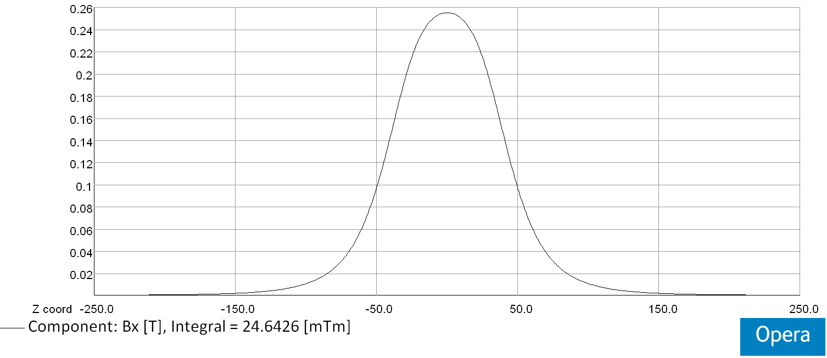
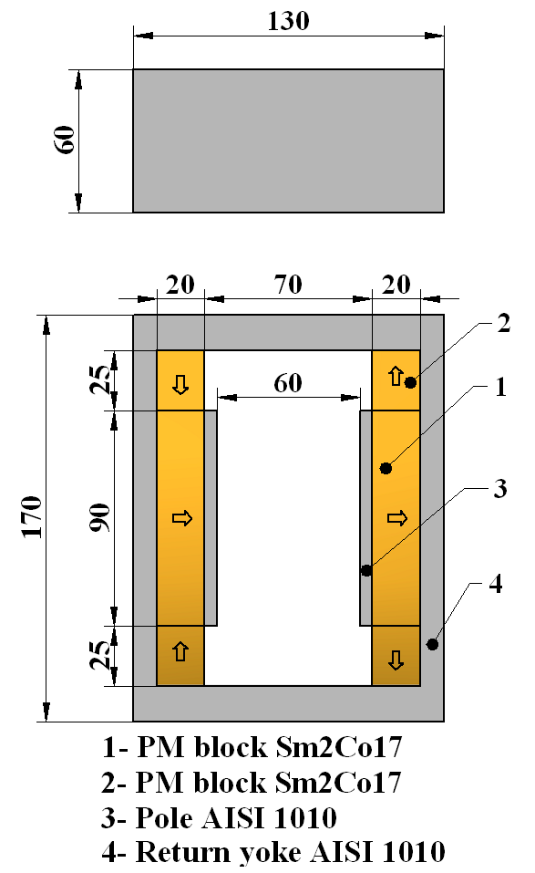
Magnet
Layout of the dipole magnet (arrows indicate the direction of magnetization)
Horizontal field distribution along z-axis at X=Y=0mm
∫Bx(0,0,z)dz = 24.6x10⁻³ [Tm]

Slide 52
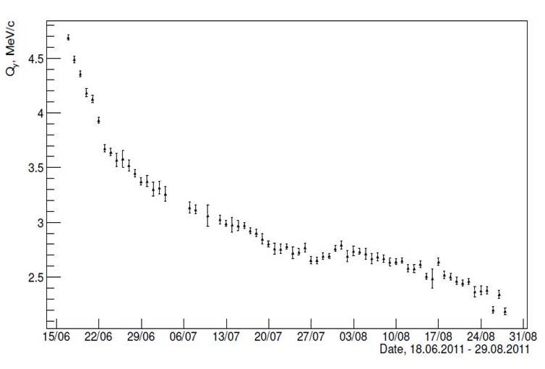
Degradation of old magnet
New magnet behaviour
Old magnet (Nd-Fe-B), 2011
New magnet (Sm-Co), 2012
The position of the second peak in Q_{Y} distributions of e⁺e⁻ pairs versus dates.
11/10/2014
52

Slide 53
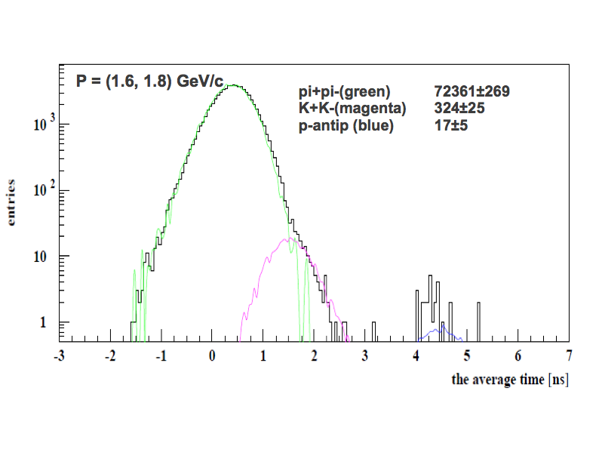
Search of K⁺K⁻ and p-antiproton pair using Time Of Flight. Low momentum range
π⁺π⁻(green) 72361±269
K⁺K⁻(magenta) 324±25
p-antip(blue) 17±5
average Time Of Flight [ns]
22/10/13
39

Slide 54
A_{2π} and A_{πΚ} production

Slide 55
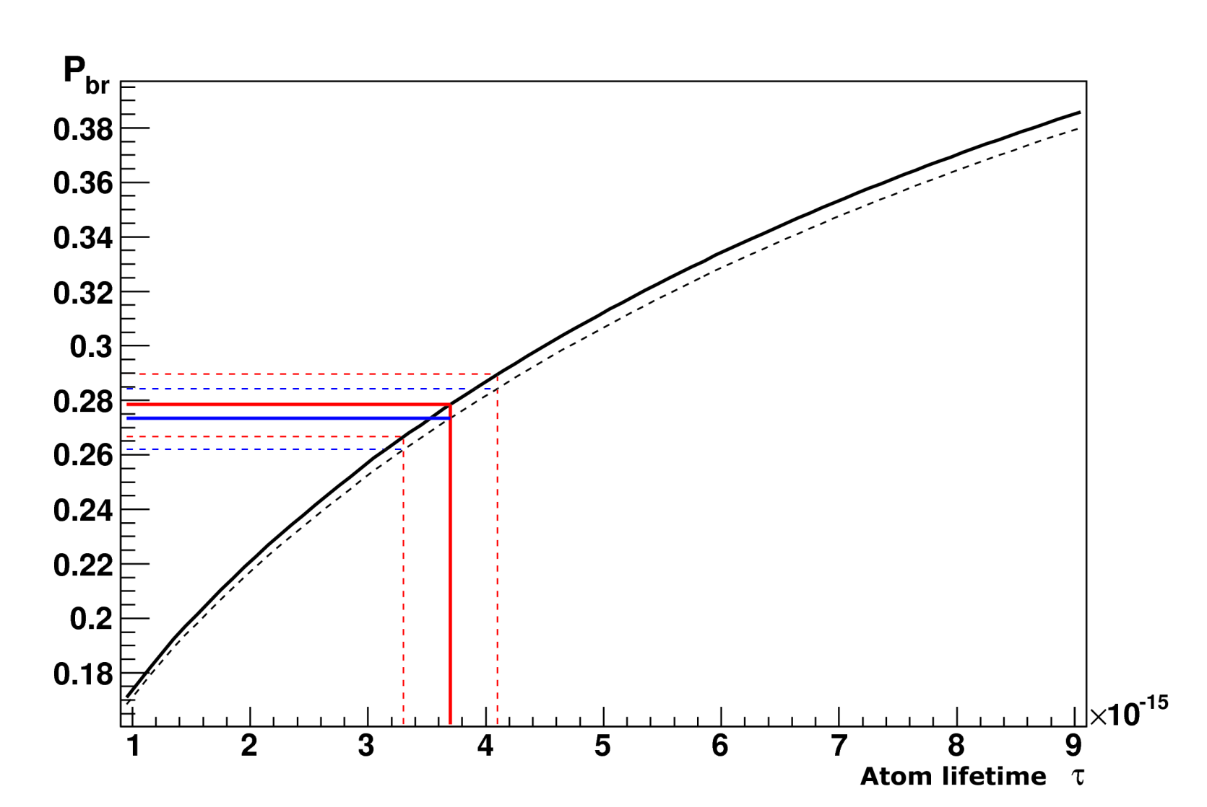
Break-up dependencies P_{br} from atoms lifetime for Κ⁺π⁻ atom (A_{Κπ}) and Κ⁻π⁺ atom (A_{πΚ})
P_{br} values corresponding to τ_{1S}^{th}
Atom | s, μm | P_{br} | P_{br}-σ | P_{br}+σ
A_{πΚ} | 98 | 0.274 | 0.263 | 0.285
A_{πΚ} | 108 | 0.278 | 0.267 | 0.290
A_{Κπ} | 98 | 0.269 | 0.258 | 0.280
A_{Κπ} | 108 | 0.273 | 0.262 | 0.284
Probability of break-up as a function of lifetime in the ground state for A_{πΚ} (solid line) and A_{Κπ} atoms (dashed line) in Ni target of thickness 108 μm.
Average momentum of A_{Κπ} and A_{πΚ} are 6.4 GeV/c and 6.5 GeV/c accordingly.

Slide 56
Κ⁺Κ⁻ atom and its lifetime
The A_{2π} lifetime is strongly reduced by strong interaction (OBE, scalar meson f₀ and a₀) as compared to the annihilation of a purely Coulomb-bound system (K⁺K⁻).
τ (A_{2K}→ ππ,πη) | K⁺K⁻ interaction
1.2×10⁻¹⁶ s [1] | Coulomb-bound
8.5×10⁻¹⁸ s [3] | momentum dependent potential
3.2×10⁻¹⁸ s [2] | + one-boson exchange (OBE)
1.1×10⁻¹⁸ s [2] | + f₀’ (I=0) + πη-channel (I=1)
2.2×10⁻¹⁸ s [4] | ChPT
K⁺K⁻ interaction
complexity
References:
[1] S. Wycech, A.M. Green, Nucl. Phys. A562 (1993), 446;
[2] S. Krewald, R. Lemmer, F.P. Sasson, Phys. Rev. D69 (2004), 016003;
[3] Y-J Zhang, H-C Chiang, P-N Shen, B-S Zou, PRD74 (2006) 014013;
[4] S.P. Klevansky, R.H. Lemmer, PLB702 (2011) 235.

