Slide 1
Experimental check of precise
predictions of QCD using
π⁺K⁻ , K⁺π⁻ and π⁺π⁻ atoms
L. Nemenov (JINR, DIRAC collaboration)
SPSC, October 2018

Slide 2








DIRAC Collaboration
CERN
Geneva, Switzerland
Tokyo Metropolitan University
Tokyo, Japan
Czech Technical University
Prague, Czech Republic
IFIN-HH
Bucharest, Romania
Institute of Physics ASCR
Prague, Czech Republic
JINR
Dubna, Russia
Nuclear Physics Institute ASCR
Rez, Czech Republic
SINP of Moscow State University
Moscow, Russia
INFN-Laboratori Nazionali di Frascati
Frascati, Italy
IHEP
Protvino, Russia
University of Messina
Messina, Italy
Santiago de Compostela University
Santiago de Compostela, Spain
KEK
Tsukuba, Japan
Bern University
Bern, Switzerland
Kyoto University
Kyoto, Japan
Kyoto Sangyo University
Kyoto, Japan
Zurich University
Zurich, Switzerland

Slide 3
Contents
1. Experimental check of QCD using π⁺K⁻ , π⁻ K ⁺ and π⁺π⁻ atoms.
2. Long-lived π⁺π⁻ atom lifetime first measurement
and possibility to check of QCD predictions.
Investigation of K ⁺K ⁻ Coulomb pairs and K ⁺K ⁻
atoms production .
4. Proton-antiproton pair analysis as the new physical method to investigate the particle production in the coordinate space.
5. The short-lived π⁺π⁻ atom lifetime measurement.
6. High precision measurement of the multiple scattering
in Be, Ti, Ni and Pt.

Slide 4

QCD Lagrangian and its prediction
The QCD Lagrangians use the SU(3)_{L}*SU(3)_{R} and SU(2)_{L}*SU(2)_{R} chiral symmetry breaking.
L(u,d,s) = L(3) = L_{sym}(3)+ L_{sym.br.}(3)
L_{sym.br.} is proportional to m_{q}
L(u,d) = L(2) = L_{sym}(2) + L_{sym.br.}(2)
QCD provides cross sections with 1% precision
Perturbation theory is working at high momentum transfer Q.
Unitarity condition.
At large Q, contribution of L_{sym.br.} to the cross section is proportional to 1/Q⁴. Therefore these experiments checked only the L_{sym} prediction precision.
  To check the total L(3) Lagrangian predictions, we must study the
  low momentum transfer Q processes.
Tools: Lattice calculations and Chiral Perturbation Theory (ChPT)
Lattice----- L(3), L(2) ChPT------Effective Lagrangians.
10/16/18

Slide 5
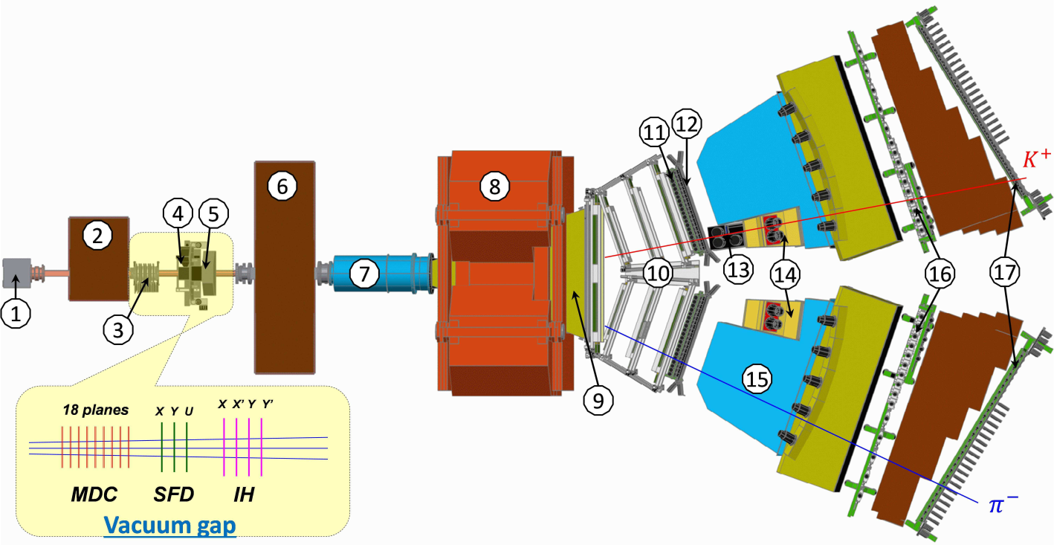
DIRAC setup, experimental and theoretical data
10/16/18

Slide 6
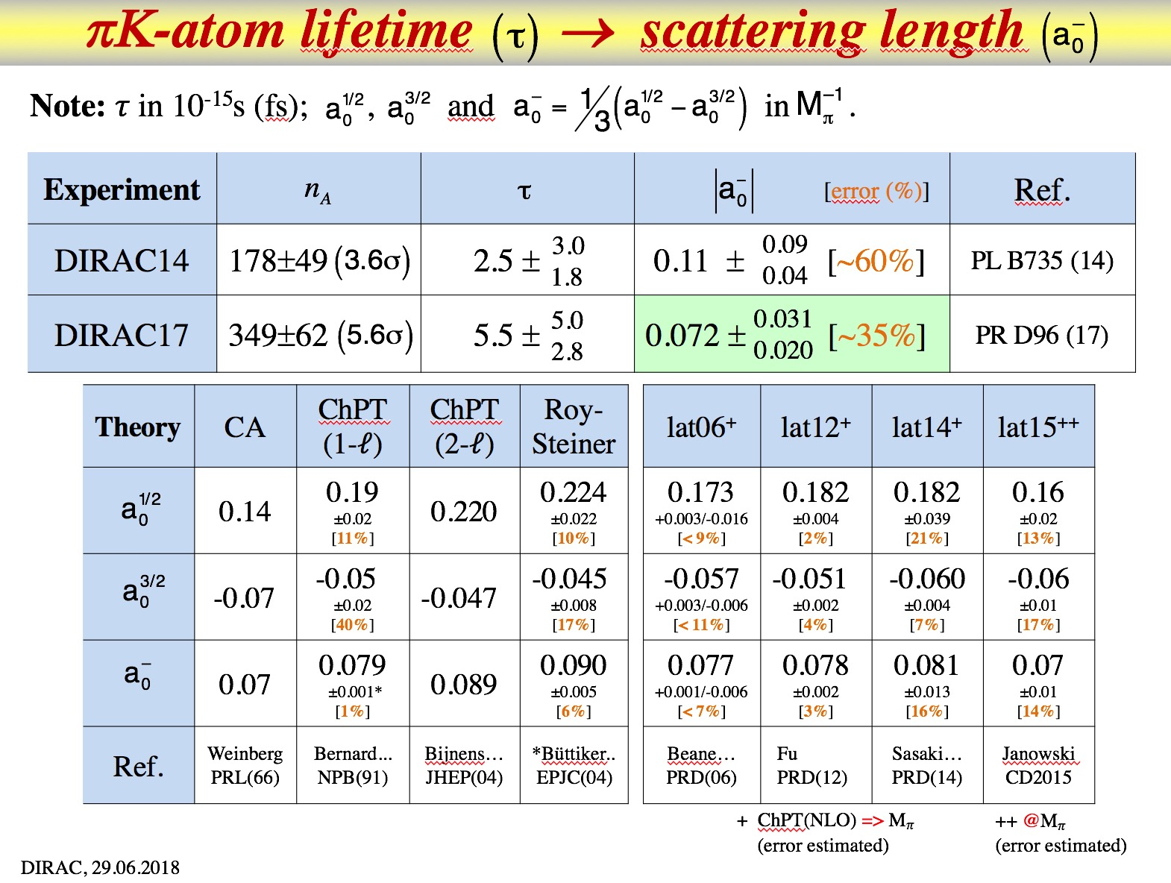

Slide 7
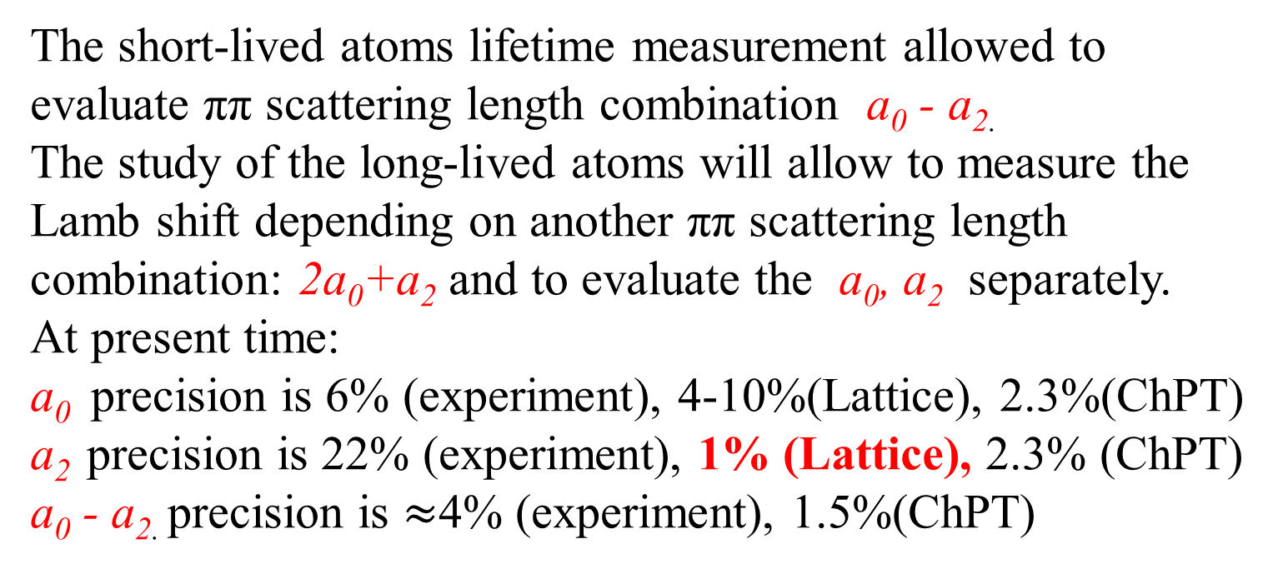
QCD and Chiral Lagrangian predictions check with long-lived π⁺π⁻ atoms
The DIRAC collaboration Phys.Lett.(2015) observed 436±61 pion pairs from the long-lived (τ ≥ 1×10⁻¹¹ sec) π⁺π⁻ atom breakup in Pt foil(Phys.Lett.(2015).
The short-lived atoms lifetime measurement allowed to evaluate ππ scattering length combination a₀ - a_{2.}
The study of the long-lived atoms will allow to measure the Lamb shift depending on another ππ scattering length combination: 2a₀+a₂ and to evaluate the a₀, a₂ separately.
At present time:
a₀ precision is 6% (experiment), 4-10%(Lattice), 2.3%(ChPT)
a₂ precision is 22% (experiment), 1% (Lattice), 2.3% (ChPT)
a₀ - a_{2.} precision is $≈$4% (experiment), 1.5%(ChPT)

Slide 8
π⁺π⁻ atom lifetime
π⁺π⁻ atom (pionium) is a hydrogen-like atom consisting of π⁺ and π⁻ mesons:
E_{B} = -1.86 keV, r_{B} = 387 fm, p_{B} ≈ 0.5 MeV/c
π⁺
π⁰
The π⁺π⁻ atom lifetime is dominated by the decay into π⁰ π⁰ mesons:
π⁻
π⁰
a₀ and a₂ are the ππ S-wave scattering lengths for isospin I=0 and I=2.
≠ 0 for l = 0
A_{2π}(1s, 2s,…, ns)
π⁰π⁰
= 0 for l ≠ 0
γ
π⁰π⁰
A_{2π}(np)
A_{2π}(1s, 2s,…(n-1)s)
The np state lifetime depends on the transition np 1s, 2s,…, (n-1)s probability.
This probability is about 3 orders of magnitude less than for ns π⁰π⁰.

Slide 9
The π⁺π⁻ atoms production in Be target
Fig. 1 Method to observe long-lived A^{L}_{2π} by means of a breakup foil (Pt). Most (70%) of the produced π⁺π⁻ atoms decay and 6% are ionized in the Be target. 6% are long-lived and 18% are short-lived atoms.
10/16/18

Slide 10
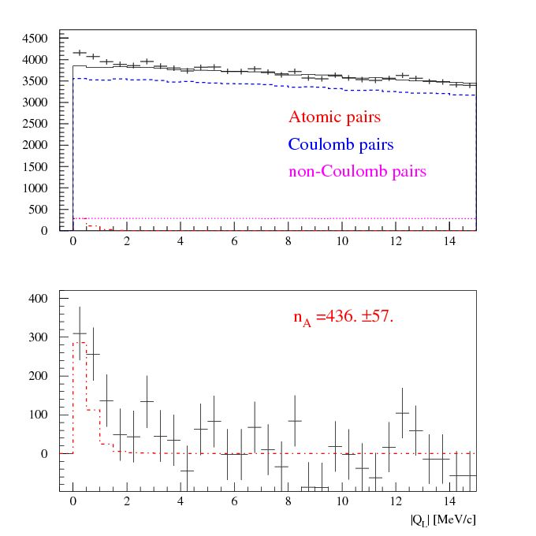
Experimental |Q_{L}| distributions of π⁺π– pairs
|Q_{L}| distribution of π⁺π– pairs
for Q_{T} <2.0 MeV/c
a) The experimental distribution (points with statistical error) and the simulated background (solid line).
b) The experimental distribution after background subtraction (points with statistical error) and the simulated distribution of atomic pairs (dot-dashed line).
The fit procedure has been applied to the 2-dimensional (|Q_{L}|, Q_{T} ) distribution.
a)
b)
10/16/18

Slide 11
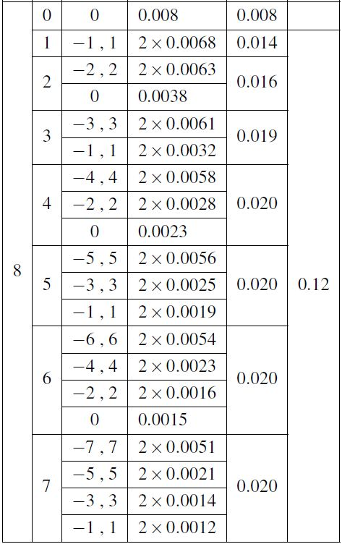
Atomic states population for n=8
10/16/18

Slide 12
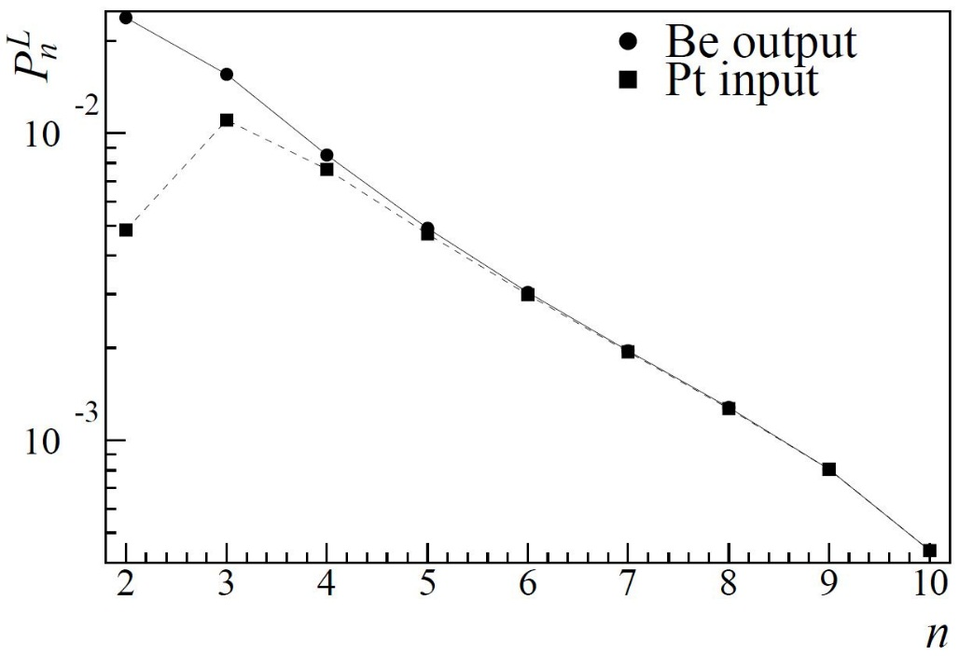
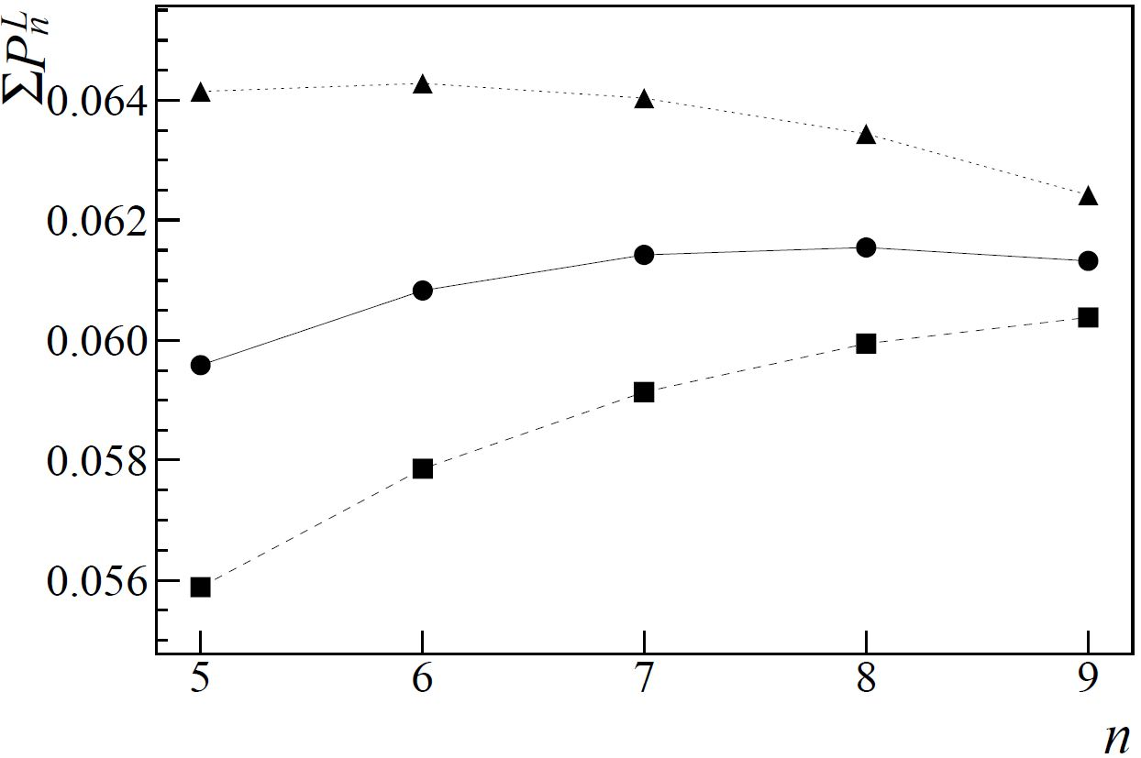


Population of long-lived states
Summed populations of all long-lived atomic states at the exit of the Be target as a function of n used for “tail” estimation. For each n, the two upper curves show the sum of state populations for the given n plus different “tail” estimations calculated from populations for n and n-1 (exponential “tail” – ●, hyperbolic “tail” – ▲). The lower curve (■) presents the sum of the population for the given n plus the population for n+1 instead of the “tail”.
Populations of long-lived states versus n, summed over l and m, at the exit of the Be target (●) and at the Pt foil entry (■).
10/16/18

Slide 13
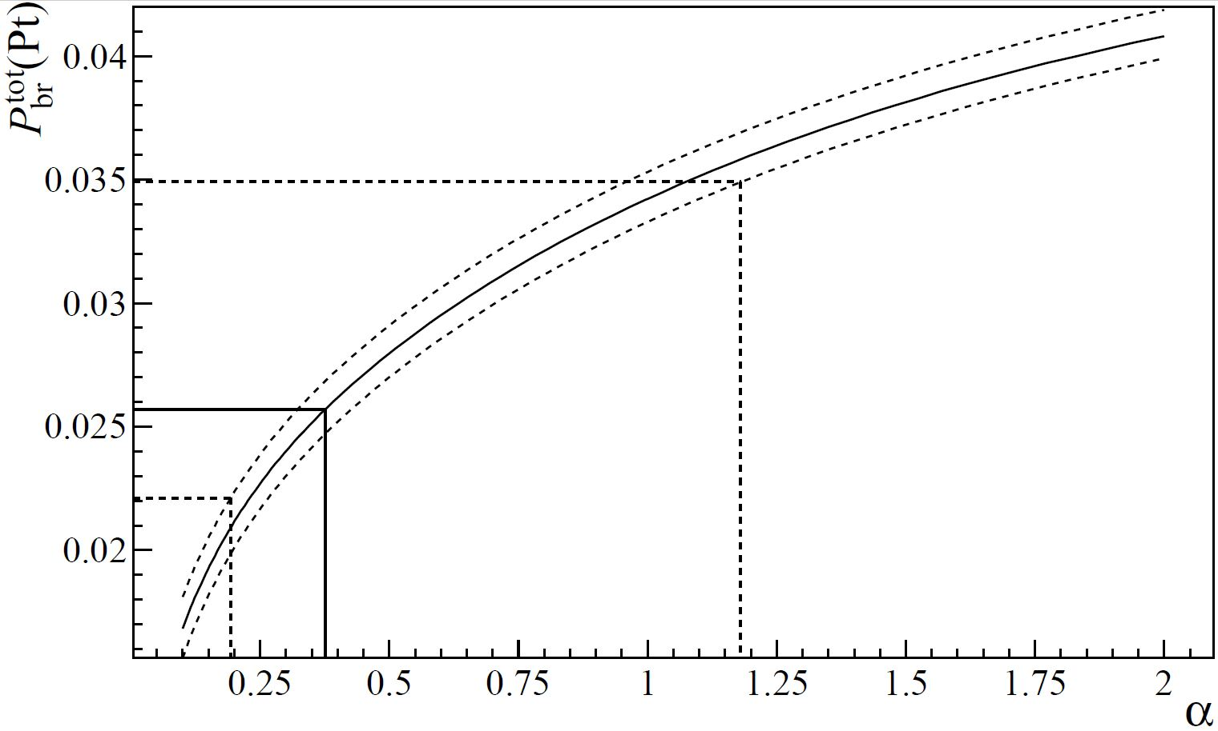


Breakup probability
Probability calculated as a function of α . The horizontal lines correspond to the measured value together with the total errors. The value α = 1, which corresponds to pure QED calculations, is within the error band of the measurement.
10/16/18

Slide 14
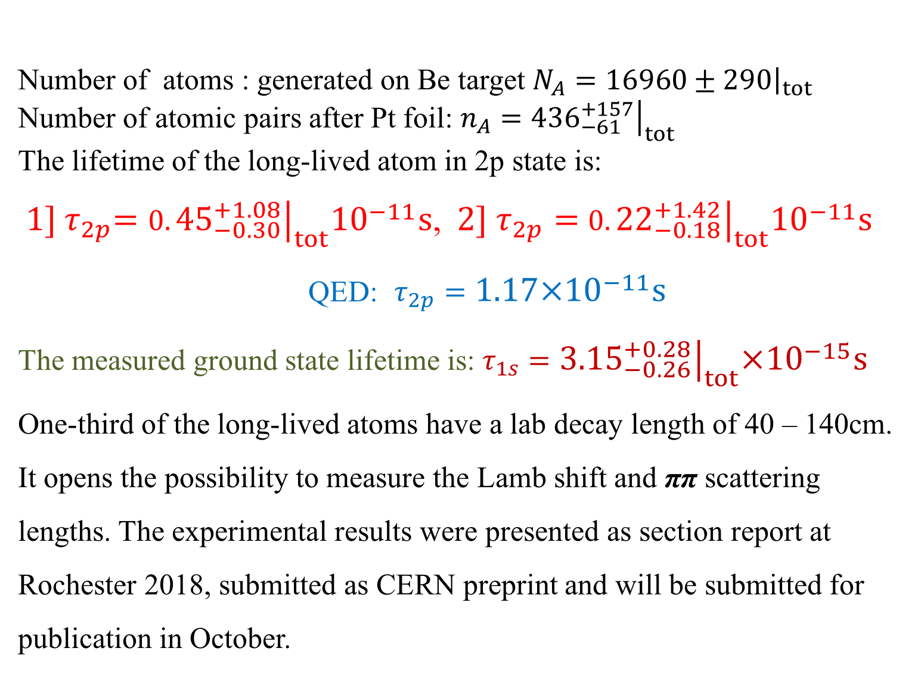
Lifetime of long-lived π⁺π⁻ atoms
Number of atoms : generated on Be target $N_{A}={\left.16960±290\right|}_{tot}$
Number of atomic pairs after Pt foil: $n_{A}={\left.{436}_{−61}^{+157}\right|}_{tot}$
The lifetime of the long-lived atom in 2p state is:
${ 1] τ}_{2p}=$ $0.{\left.{45}_{−0.30}^{+1.08}\right|}_{tot}{10}^{−11}s$, ${2] τ}_{2p}=$ $0.{\left.{22}_{−0.18}^{+1.42}\right|}_{tot}{10}^{−11}s$
QED: $τ_{2p}=1.17×{10}^{−11}s$
The measured ground state lifetime is: $τ_{1s}={\left.{3.15}_{−0.26}^{+0.28}\right|}_{tot}×{10}^{−15}s$ One-third of the long-lived atoms have a lab decay length of 40 – 140cm. It opens the possibility to measure the Lamb shift and ππ scattering lengths. The experimental results were presented as section report at Rochester 2018, submitted as CERN preprint and will be submitted for publication in October.
10/16/18

Slide 15
KK Coulomb pairs and KK atoms
For charged pairs from short-lived sources and with small relative momenta Q , Coulomb final state interaction has to be taken into account.
This interaction increases the production yield of the free pairs with Q decreasing and creates atoms.
Κ⁺Κ⁻
Coulomb pair
Atom
There is a precise ratio between the number of produced Coulomb pairs (N_{C}) with small Q and the number of atoms (N_{A}) produced simultaneously with Coulomb pairs:
10/16/18

Slide 16
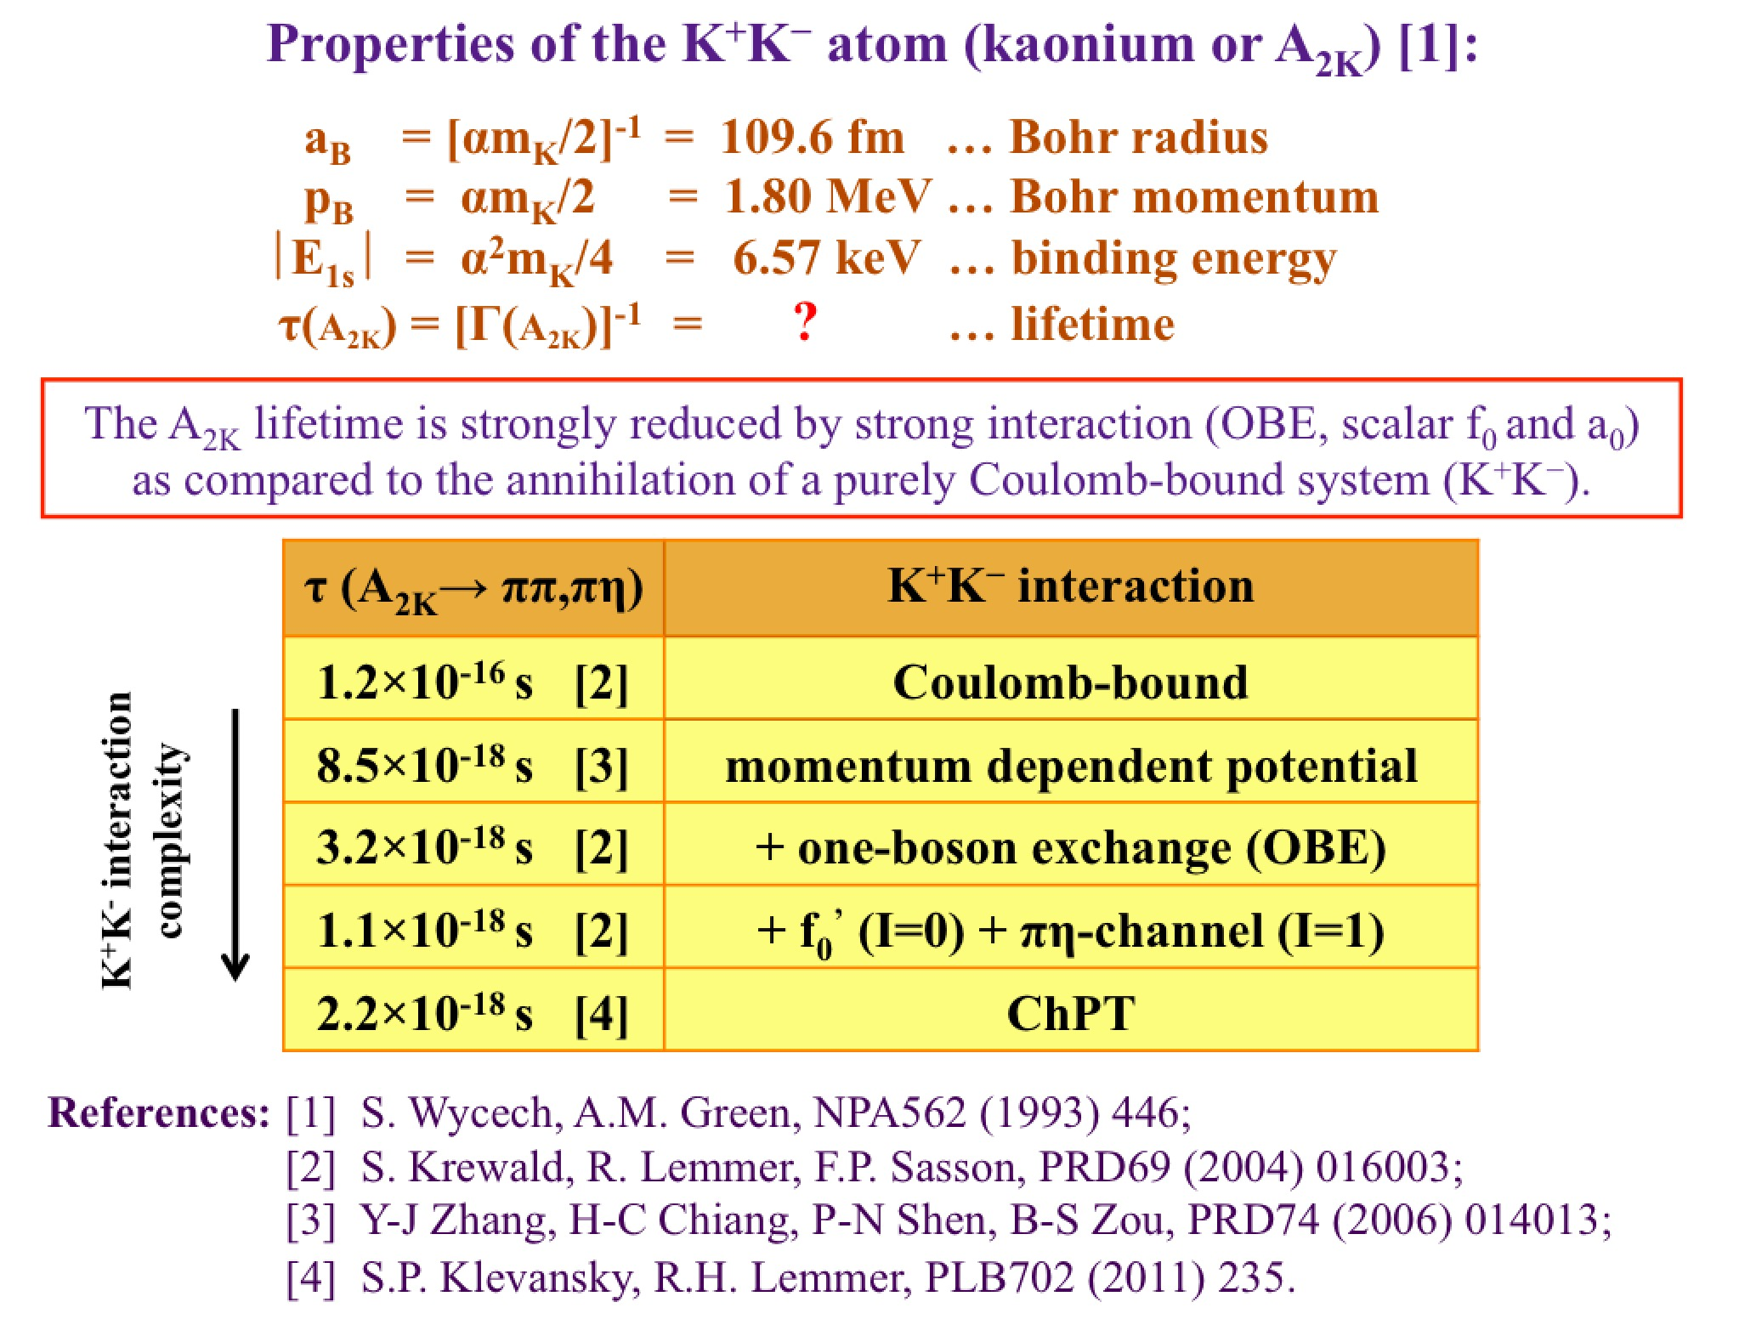
K⁺K– atom and its lifetime
10/16/18

Slide 17
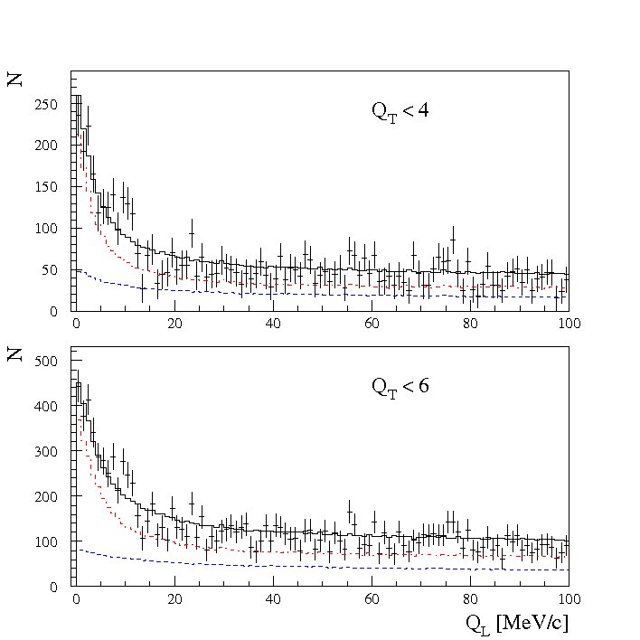
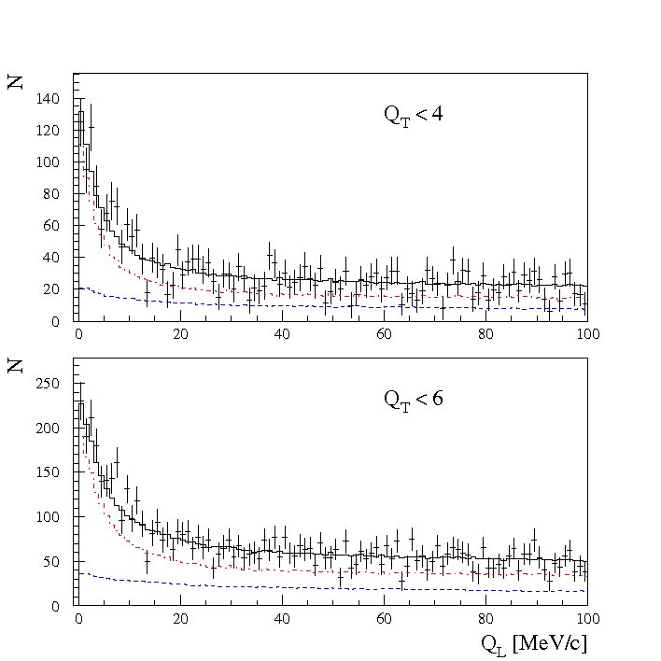
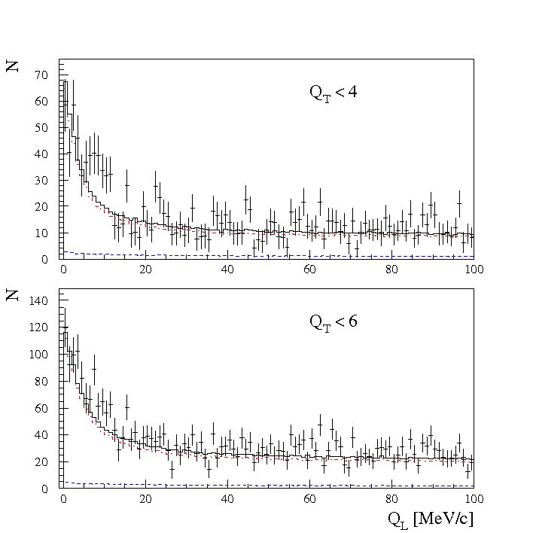
K⁺K⁻ Coulomb pairs.
30%
K⁺K– pairs
(from initial sample)
50%
K⁺K– pairs
70%
K⁺K– pairs
10/16/18

Slide 18
DIRAC Collaboration
Predicted number of K⁺K⁻ pairs with Q_{t} < 4 MeV/c and Q_{t} < 6 MeV/c according to fits of Q_{l} distributions of given samples
 | Q_{t} < 4 MeV/c | Q_{t} < 6 MeV/c
k70: | 13906 | 31457
k50: | 12666 | 28653
k30: | 14834 | 33556
average: | 13802 | 31222
k70, k50, k30 – samples with ratio of at least 70%, 50%, 30% of K⁺K⁻ pairs in individual momentum and time intervals
10/16/18

Slide 19
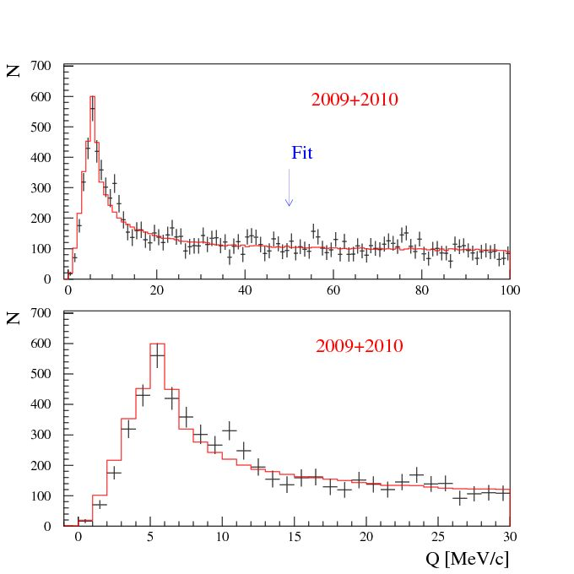
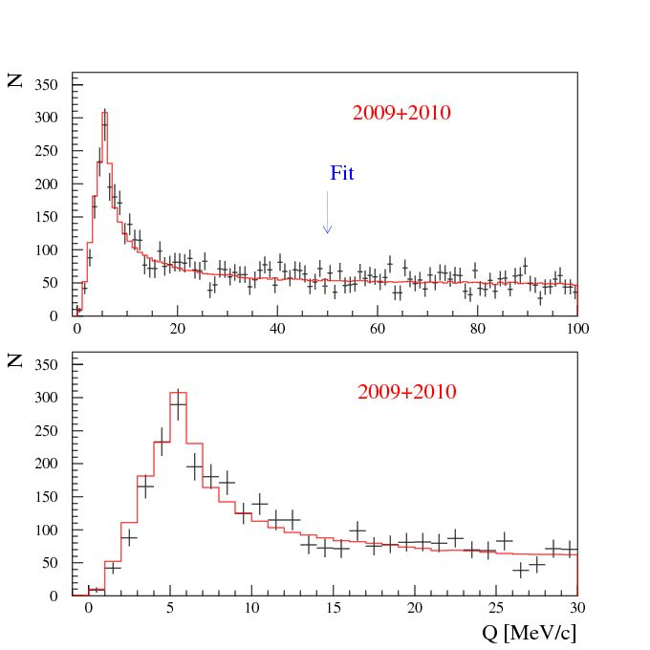
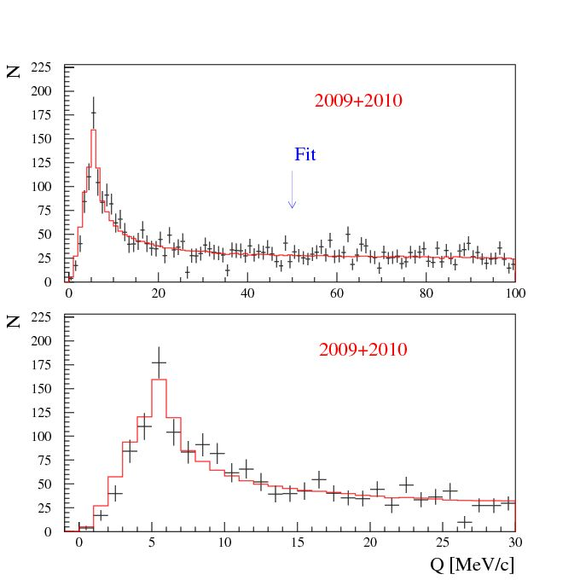
DIRAC Collaboration
10/16/18

Slide 20
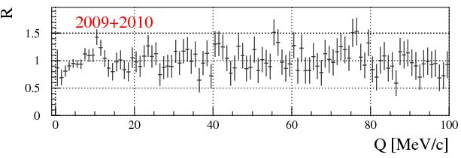

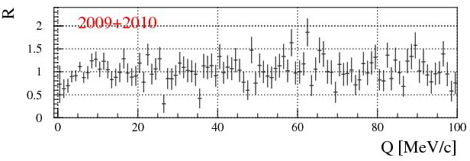
DIRAC Collaboration
30%
K⁺K– pairs
(from initial sample)
50%
K⁺K– pairs
70%
K⁺K– pairs
10/16/18

Slide 21



















































$$u$$
$$u$$
$$K^{+}$$
$$\overline{s}$$
$$K^{+}$$
$$s$$
$$\overline{s}$$
$$K^{−}$$
$$s$$
$$ϕ$$
$$\overline{u}$$
$$\overline{s}$$
$$u$$
$$s$$
$$u$$
$$s$$
$$d$$
$$d$$
$$p$$
$$K^{−}$$
$$p$$
$$\overline{u}$$
$$u$$
$$u$$
$$Λ(1520)$$
$$u$$
$$π^{0}$$
$$d$$
$$π^{−}$$
$$\overline{u}$$
$$\overline{u}$$
$$u$$
$$K^{∗+}$$
$$u$$
$$d$$
$$K^{∗0}$$
$$u$$
$$K^{+}$$
$$K^{+}$$
$$\overline{s}$$
$$\overline{s}$$
$$\overline{s}$$
$$\overline{s}$$
$$s$$
$$s$$
$$K^{−}$$
$$K^{−}$$
$$\overline{u}$$
$$\overline{u}$$
$$u$$
$$u$$

Slide 22
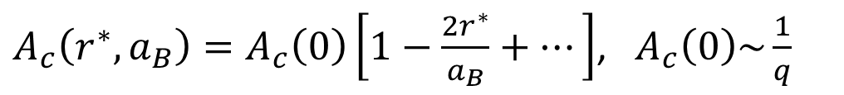
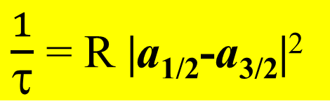
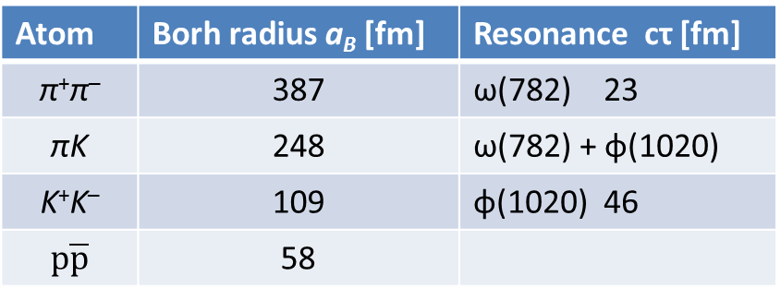
Coulomb correlations
Atom | Borh radius a_{B} [fm] | Resonance cτ [fm]
π⁺π– | 387 | ω(782) 23
πK | 248 | ω(782) + φ(1020)
K⁺K– | 109 | φ(1020) 46
$$p\overline{p}$$ | 58
 | Z | A | Nublear radius [fm]
Be | 04 | 9.012 | 2.56
Ni | 28 | 58.69 | 4.78
Pt | 78 | 195.08 | 7.13
Coulomb correlation with account of size of pair production region $r^{∗}$
$A_{c}\left(r^{∗},a_{B}\right)=A_{c}\left(0\right)\left[1−\frac{2r^{∗}}{a_{B}}+…\right]$, ${ A}_{c}\left(0\right)\sim \frac{1}{q}$
Point-like Coulomb correlation
10/16/18

Slide 23
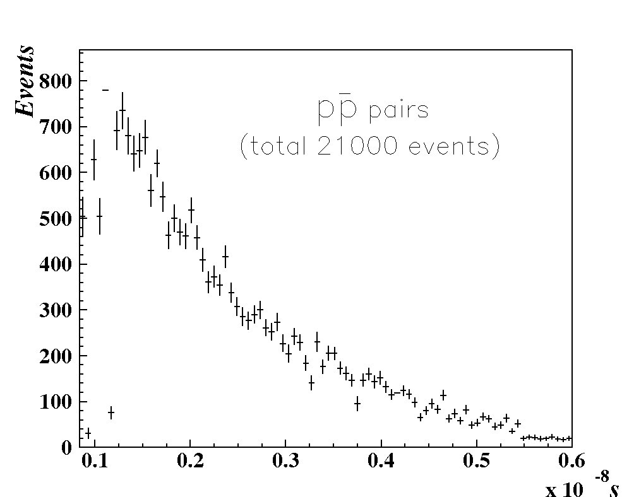
Number of p-antiproton pairs
10/16/18

Slide 24
KK Coulomb pairs, KK atoms and proton-antiproton pairs.
1. In April 2019 the theoretical investigation of KK pairs and KK atoms production will be finished.
2. In June 2019 the preliminary measurement of the KK atoms number generated simultaneously with detected KK pairs will be evaluated.
3. In October 2019 the dedicated paper will be submitted.
4. The experimental conditions needed for the KK atoms lifetime measurement on SPS and LHC will be
formulated.
5. The proton-antiproton Coulomb pairs investigation will be done in June 2019.
10/16/18

Slide 25
Thank you
10/16/18

Slide 26
Measurement of the πK scattering length
The S-wave πK scattering lengths a_{1/2} and a_{3/2} in the chiral symmetry world are zero. Therefore the scattering length values a_{1/2} and a_{3/2} are very sensitive to the L_{sym.br.}(3).
For Lattice QCD the πK interaction at threshold is a relatively simple process. It gives πK scattering length values with an average precision of 5%.
This precision will be improved in the near future.
There is only one experimental data: DIRAC collaboration observed 349±62 πK atomic pairs (Phys.Rev.Lett. 2016) and measured |a_{1/2}-a_{3/2}| with an average precision of 34% (Phys.Rev.D 2017).
10/16/18

Slide 27
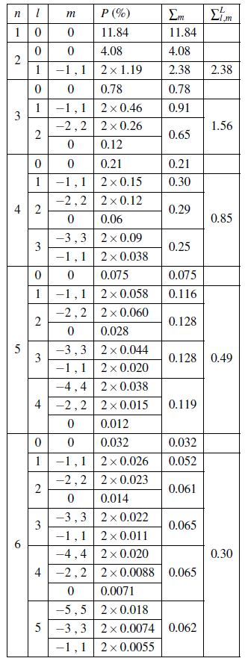
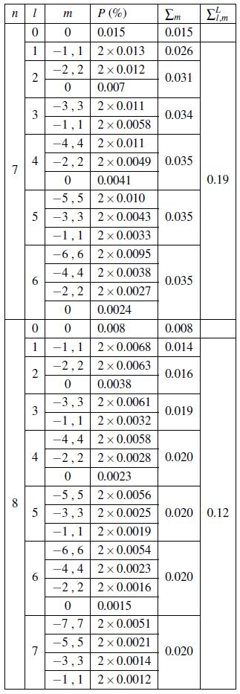


Atomic states population
Table 1: Population P of atomic states with the quantum numbers n, l and m at the exit of the 103 μm thick Be target. The calculations are performed for the average atom momentum 4.44 GeV/c and the ground state lifetime
. is the population summed over the quantum number m, and the long-lived state population summed over l and m. All numbers are given in % of the total number N_{A} of produced atoms.

Slide 28
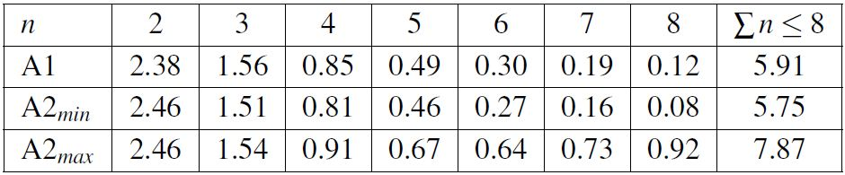
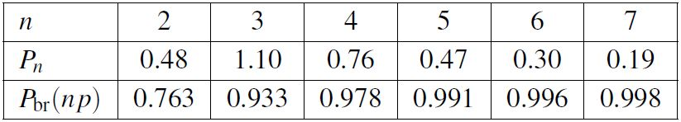
DIRAC Collaboration
Table 2: Summed populations of long-lived atomic states versus n given in % of the total number of produced A_{2π} in the Be target. The values are calculated in approach 1 (A1) and minimum/maximum values in approach 2 (A2_{min}/A2_{max}).
Table 3: P_{n} (in %) is the population of long-lived atomic states versus n (summed over l and m) at the entry in the Pt foil. P_{br}(np) is the breakup probability of the A_{2π} np states in the 2.1μm thick Pt foil. The values are calculated in approach 1 for the average atom momentum 4.44 GeV/c and the ground state lifetime τ = 3.15∙10⁻¹⁵ s.
10/16/18

Slide 29
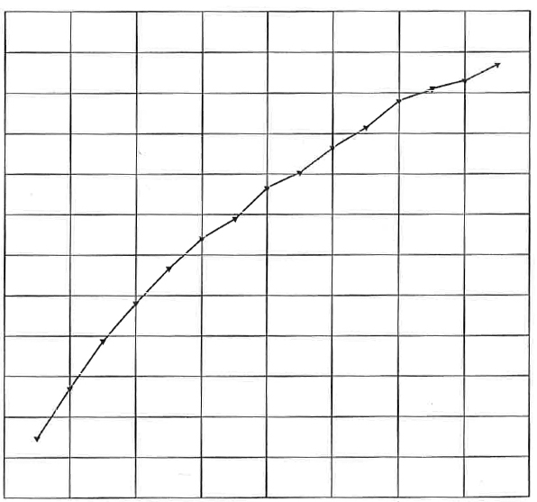
Κ⁺Κ⁻ atoms ionization probability
28 μm Pt
x 10⁻²
3.9
3.5
3.1
2.7
2.3
1.9
1.5
Ionization Probability
0 1 2 3 4
Life time τ in 10^{–18} s
Κ⁺Κ⁻ atoms Lorentz factor is γ = 18
Notes:
29

Slide 30
30%
50%
70%

Slide 31
30%
50%
70%

Slide 32
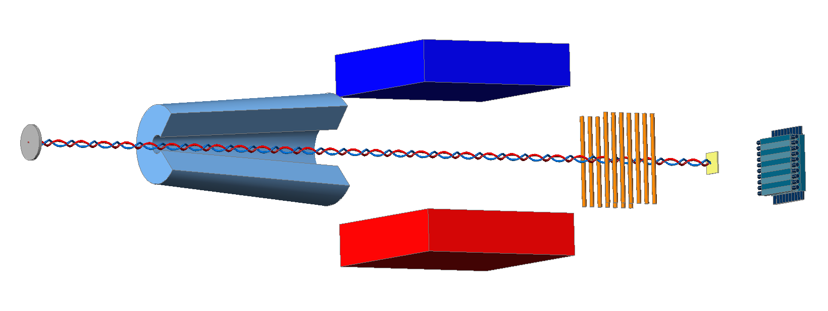
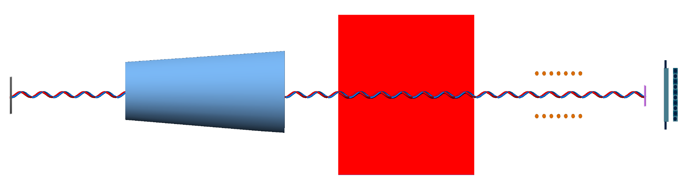
DIRAC future Experimental setup
Forward Detectors
Collimator
Pt foil
Resonators
proton beam
Secondaries
10/16/18

Slide 33
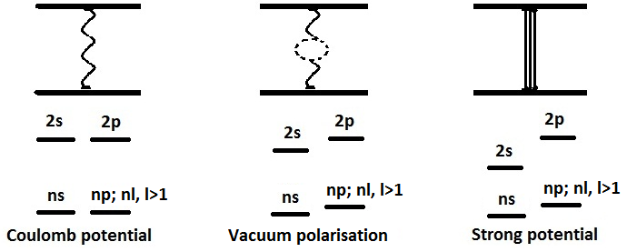
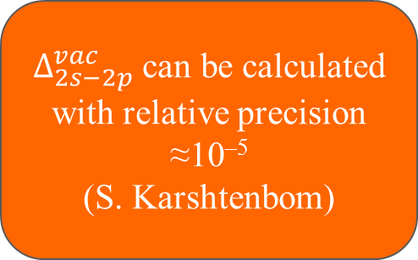
Energy splitting measurement
A_{2π} Energy Levels
$Δ_{2s−2p}^{vac}$ can be calculated with relative precision ≈10^{–5}
(S. Karshtenbom)
For Coulomb potential,
E depends only on n
higher order QED
Notation:
J. Schweizer
[PL B (2004)]
G.V.Efimov et al.
Sov.J.Nucl.Phys. (1986)
CONCLUSION: one parameter (2a₀+a₂) allows to calculate all values

Slide 34
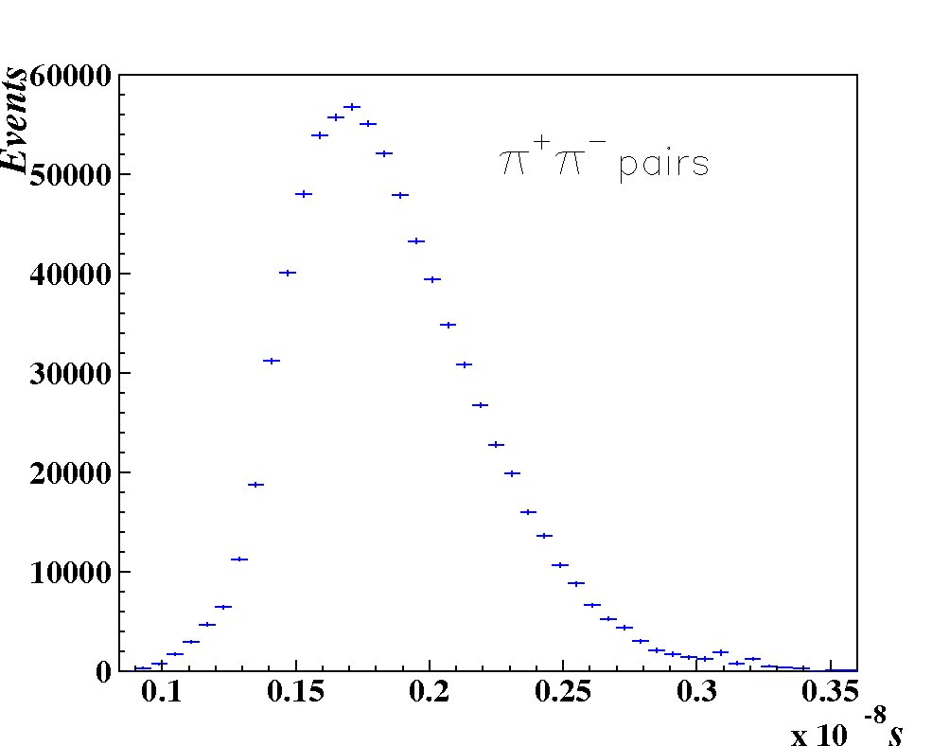
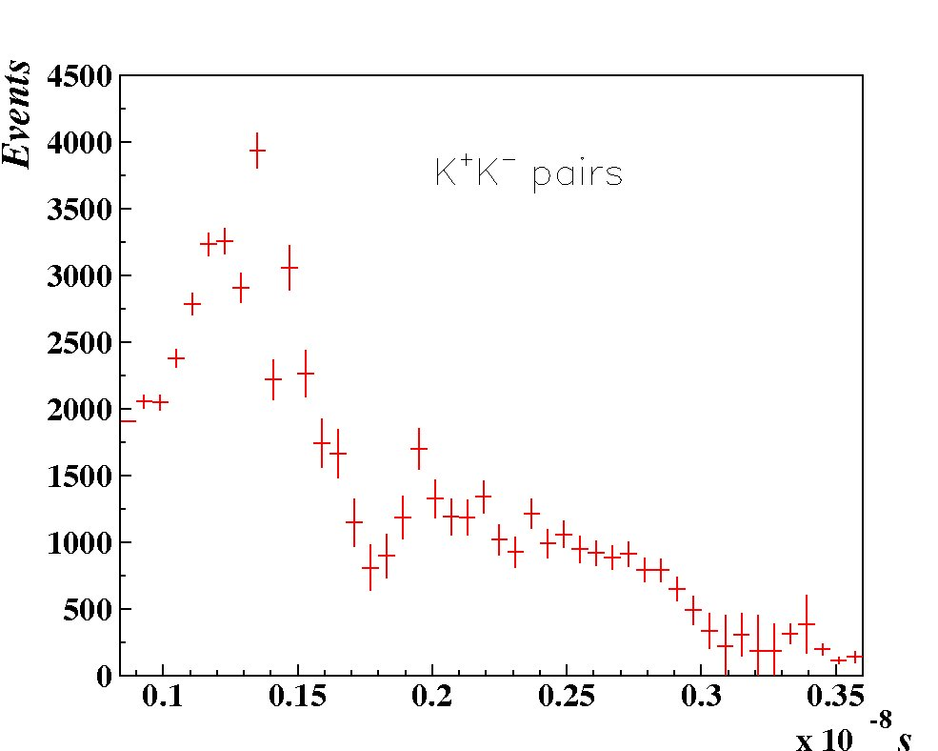
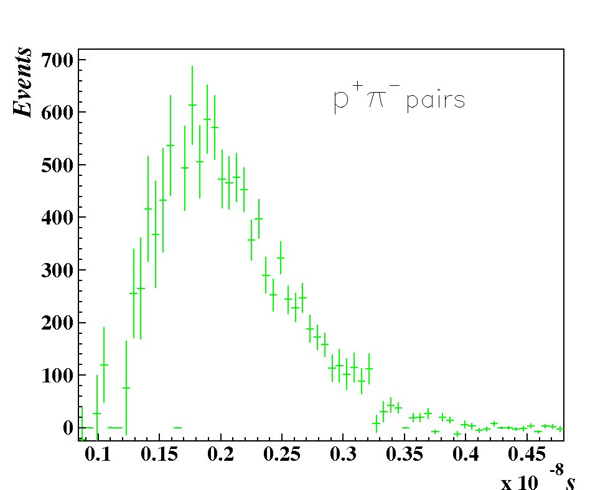
Number of atomic pairs
10/16/18

Slide 35
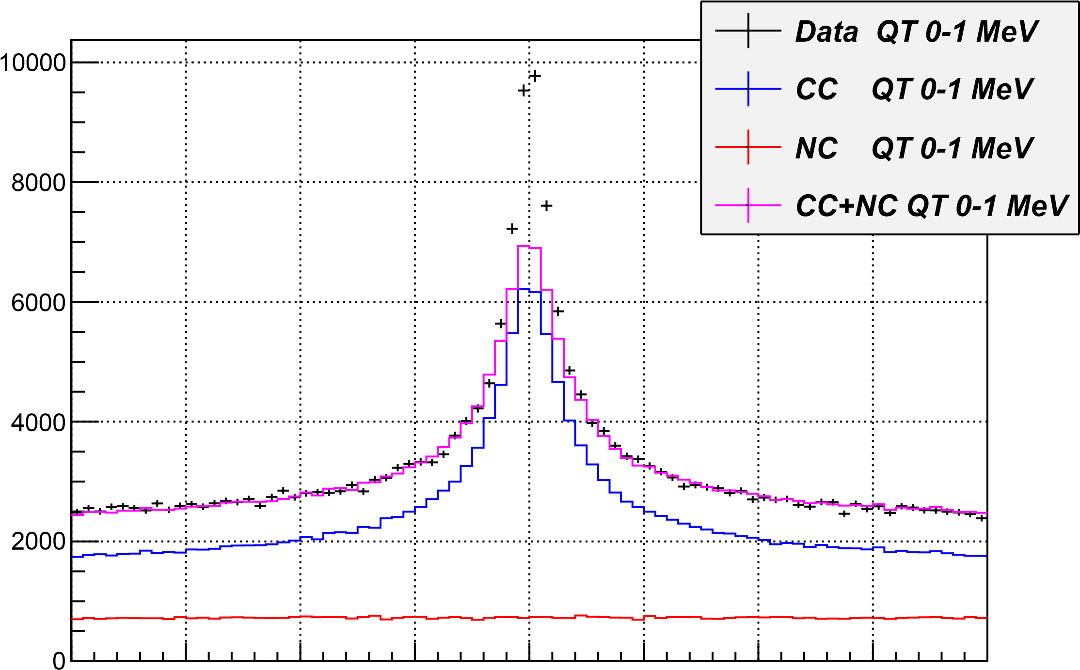
-20 -15 -10 -5 0 5 10 15 20
Q_{l} for Q_{T} between 0-1 MeV (accidentals subtracted) MeV/c

Slide 36
K⁺K⁻ pair analysis
K⁺K⁻ Coulomb pairs signal
N
2009 + 2010
Distribution of K⁺K⁻ pairs in the RUN 2009 + 2010 over the full pair momentum in laboratory system.
10/16/18
P[MeV/c]

Slide 37
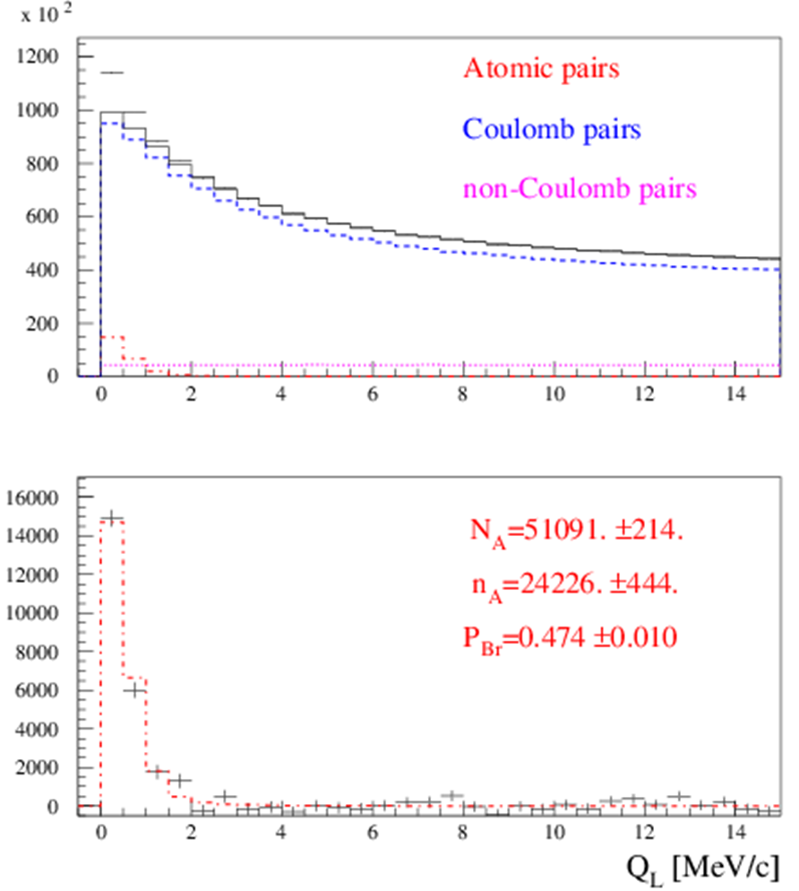
III. The short-lived π⁺π⁻ atom lifetime measurement
Preliminary results on the short-lived atom lifetime measurement based on all available 2008-2010 data are presented in Fig. 1 and 2.
Fig.1. Distribution over |Q_{L}| for events, selected with criterion
Q_{T} < 4 MeV/c. Fractions of atomic, Coulomb and non-Coulomb pairs were obtained by fitting the distri-bution over (|Q_{L}|,Q_{T}) with criteria: |Q_{L}|<15 MeV/c, Q_{T} < 4 MeV/c.
N_{A}, n_{A} and P_{br}. are the number of produced atoms, detected atomic pairs and probability of the atoms breaking in the target respectively.
10/16/18

Slide 38
III. The short-lived π⁺π⁻ atom lifetime measurement
Preliminary results on the short-lived atom lifetime measurement based on all available 2008-2010 data are presented in Fig. 1 and 2.
Fig.1. Distribution over |Q_{L}| for events, selected with criterion
Q_{T} < 4 MeV/c. Fractions of atomic, Coulomb and non-Coulomb pairs were obtained by fitting the distri-bution over (|Q_{L}|,Q_{T}) with criteria: |Q_{L}|<15 MeV/c, Q_{T} < 4 MeV/c.
N_{A}, n_{A} and P_{br}. are the number of produced atoms, detected atomic pairs and probability of the atoms breaking in the target respectively.
10/16/18

