Slide 1
DIRAC experiment (PS212)
A.Benelli
JINR, Zurich University
MESON 2012 Conference, Krakov, June, 2012.

Slide 2








DIRAC collaboration
CERN
Tokyo Metropolitan University
Czech Technical University
IFIN-HH
Institute of Physics ASCR
JINR
Nuclear Physics Institute ASCR
SINP of Moscow State University
INFN-Laboratori Nazionali di Frascati
IHEP
University of Messina
Santiago de Compostela University
KEK
Bern University
Kyoto University
Zurich University
Kyoto Sangyou University

Slide 3
ChPT predicts s-wave scattering lengths:
Kπ :
1-loop approx.
a_{1/2} = 0.19 + 0.02 a_{3/2} = -0.05 + 0.02
a_{1/2-} a_{3/2} = 0.238+-0.002 P. Büttiker et al. 2004
2-loop approx.
a_{1/2}- a_{3/2} = 0.267
ππ :
a₀ = 0.220 + 0.005
a₂ = -0.0444 + 0.0010
a₀ – a₂ = 0.265 + 0.004
V.Bernard, N. Kaiser, U. Meissner 1991
G. Colangelo et al.,
Nucl. Phys. B 603 (2001) 125
J. Bijnens, P.P. Donthe, P.Talavera 2004
τ = (2.9 + 0.1) fs
Roy-Steiner equations :
a_{1/2}- a_{3/2} = 0.269 + 0.015
P. Buttiker et al 2004
τ = (3.7 + 0.4) fs

Slide 4
The main DIRAC aim is the accurate measurement
of ππ scattering lenghts and the
first measurement of πk scattering lenghts
Aππ lifetime measurement
observation of Kπ atoms and their lifetime measurement
long lived atoms observation

Slide 5
DIRAC setup
Upgraded DIRAC setup
MDC - microdrift gas chambers, SFD - scintillating fiber detector, IH – ionization hodoscope. DC - drift chambers , VH – vertical hodoscopes, HH – horizontal hodoscopes, Ch – nitrogen Cherenkov , PSh - preshower detectors , Mu - muon detectors
Modifided parts

Slide 6
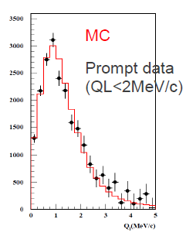
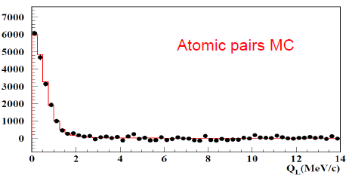
PS
magnet
target
MDC
SFD
IH
p (24 GeV)
DCs
target
π⁺
VH HH
A_{2π}
-
(n_{A})
p
(N_{A})
π⁻
Notes:
6

Slide 7
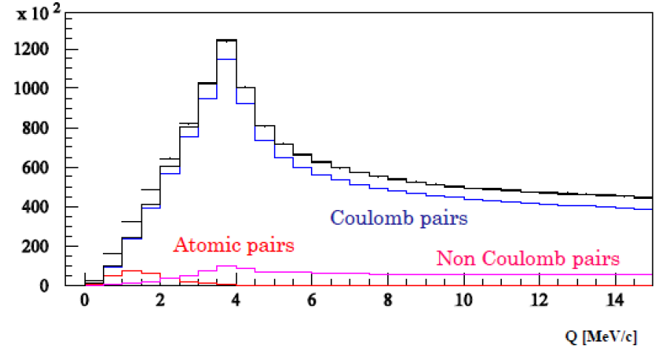
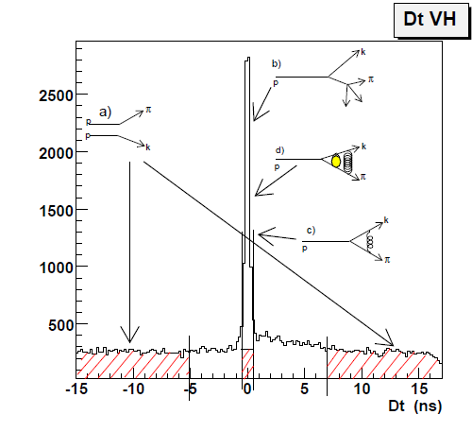
π⁺
(N_{CC})
p
π⁻
Δ,ρ,ω,…
Coulomb pairs
π⁺
π⁻
(N_{CC})
p
Coulomb pairs
η, η’,…
π⁺
π⁰
π⁺
(N_{NC})
p
Non-Coulomb pairs
π⁻
K
η, η’,…
p
π
π⁰
X
π⁺
p
π⁺
(N_{ACC})
p
π⁻
Accidental pairs

Slide 8
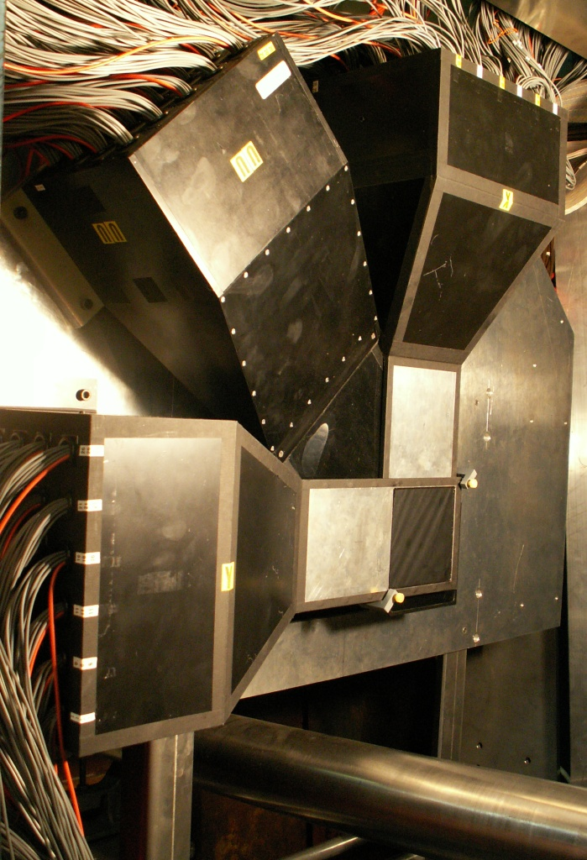
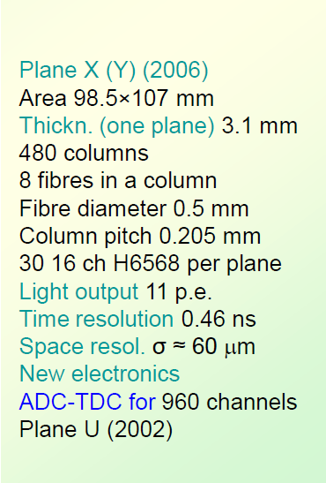
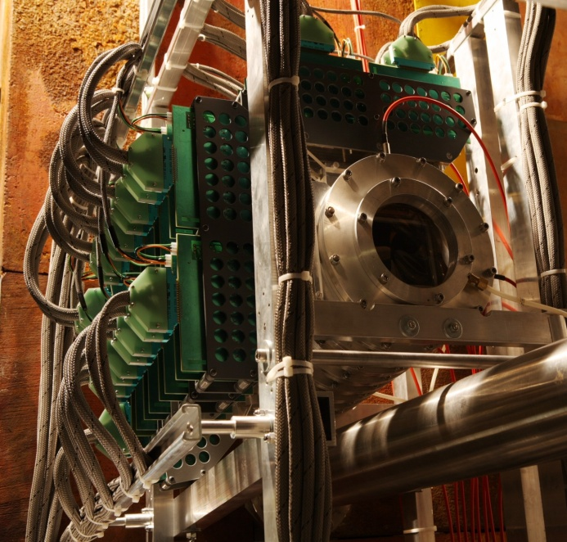
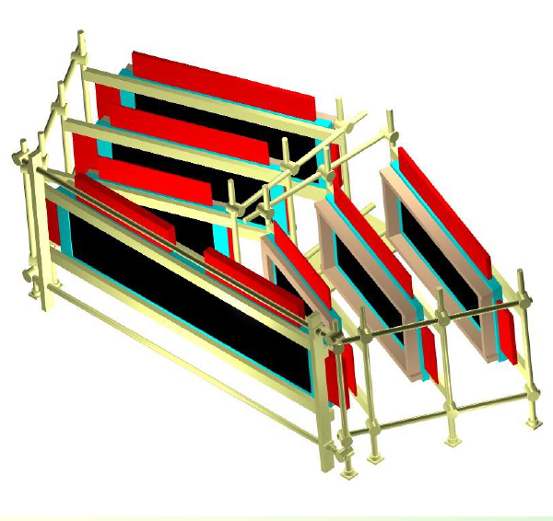
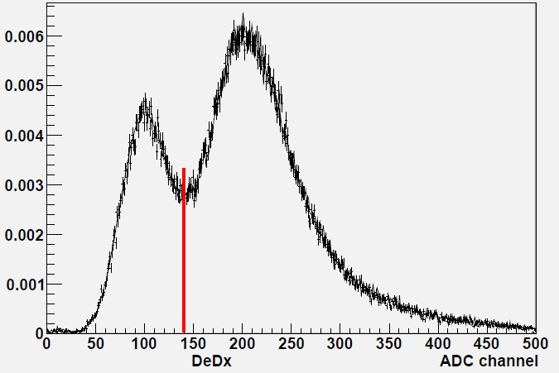
(2003: GEM-MSGC)
TRACKING
Scintillation fibres detector
Micro Drift Chambers
18 planes : X, Y, U Area: 80x80 mm
Gas mixture: Ar(0.33)+ iC₄H₁₀(0.66)+H₂O(0.01)
Anode pitch: 2.5 mm
32 wires in a plane
Sell size: 2.5x2 mm
Drift time: 26 ns
Time resolution < 1ns
Space resolution < 80μm
2 tracks resolution <200μm
Read-out time < 3μs
Drift chambers
DC1:2x80x40 cm
DC2: X,Y 80x40 cm
DC3: X,Y 112x40 cm
DC4: X,Y,X,Y 128x40cm
Both arms : 2016 ch
Anode pitch: 10mm
Cell:10x10cm
Cathode 20 μm
carbon-coated mylar
Anode wires: 50 μm
Copper-beryllium alloy
Drift velocity: 50 μm/ns
Amplitude: 1 mA
Pulse width: 20 ns
Resolution: 90 μm
Ionisation Hodoscope

Slide 9
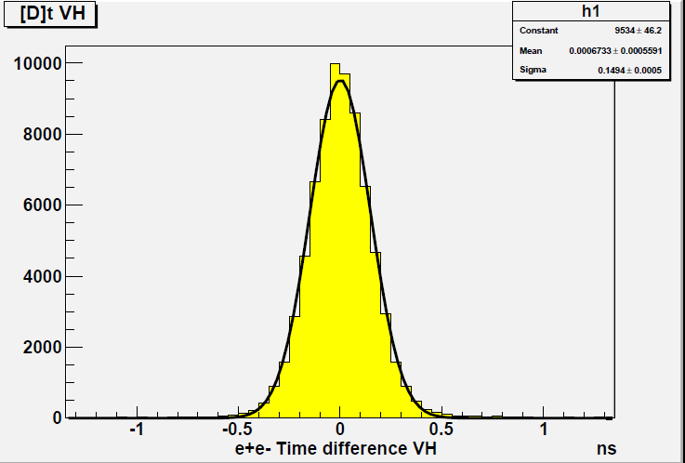
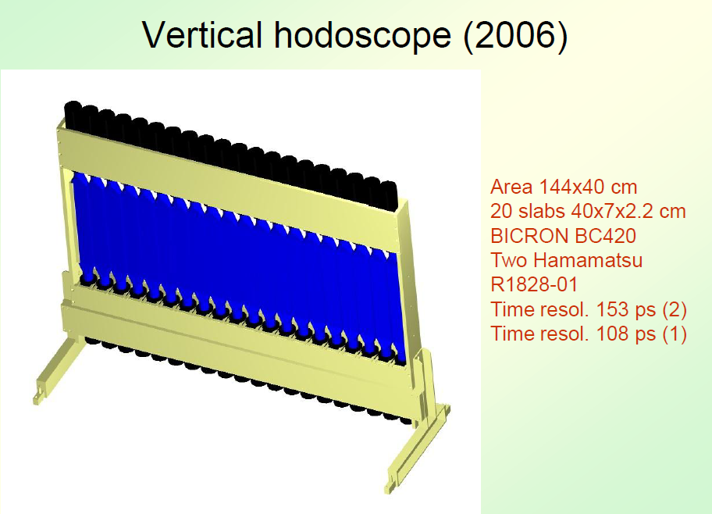
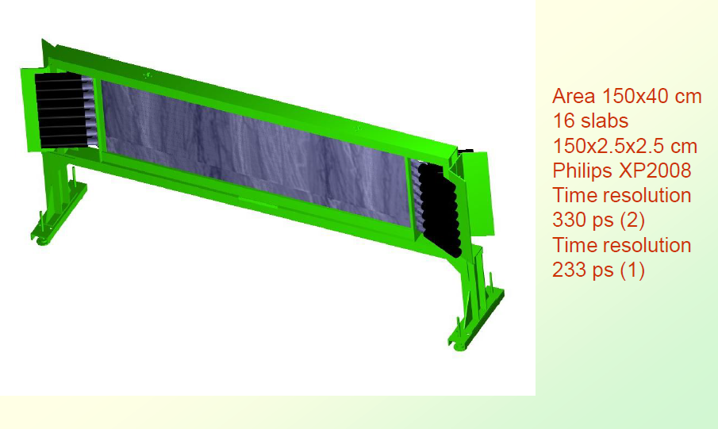
Vertical Hodoscope
Horizontal Hodoscope
Trigger requests tracks coplanarity

Slide 10
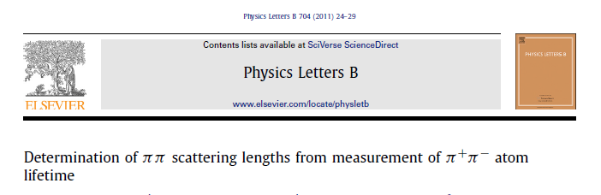
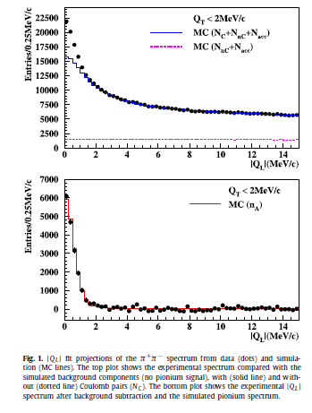
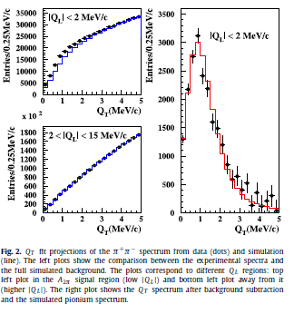
n_{A} = 21227 + 407

Slide 11
Published results on π π atom: lifetime & scattering length
DIRAC data | τ_{1s} (10⁻¹⁵s) value stat syst theo* tot | |a₀ – a₂| value stat syst theo* tot | Reference
2001 |  |  | PL B 619 (2005) 50
2001-03 |  |  | PL B 704 (2011) 24
* theoretical uncertainty included in systematic error
NA48 | K-decay | a₀ – a₂ value stat syst theo tot | Reference
2009 | K_{3π} |  | EPJ C64 (2009) 589
2010 | K_{e4} & K_{3π} |  | EPJ C70 (2010) 635
Notes:
11

Slide 12
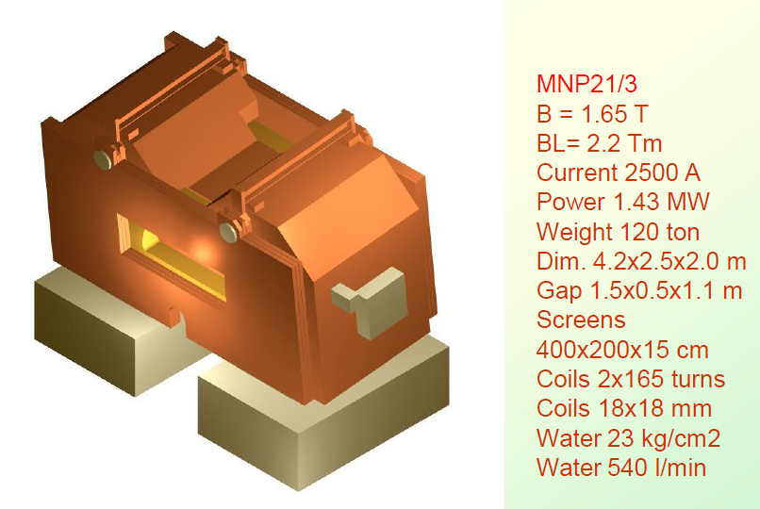
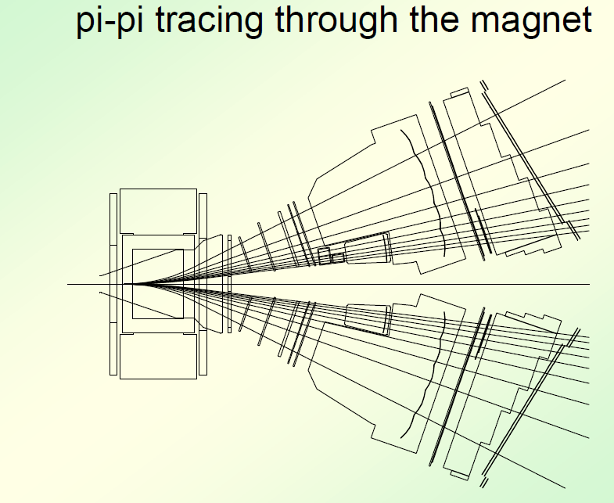
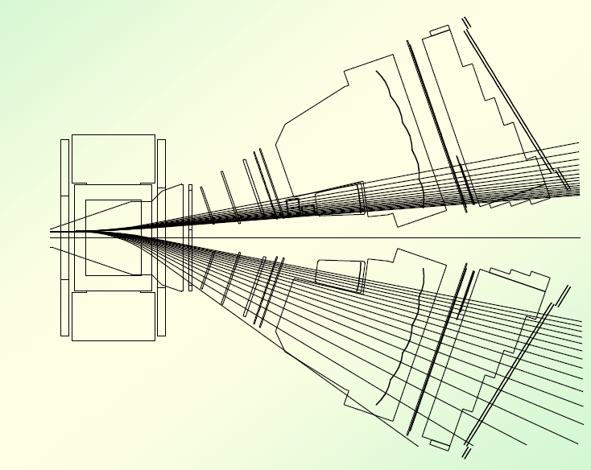
ππ and kπ geometrical acceptance
π
π
k
π

Slide 13
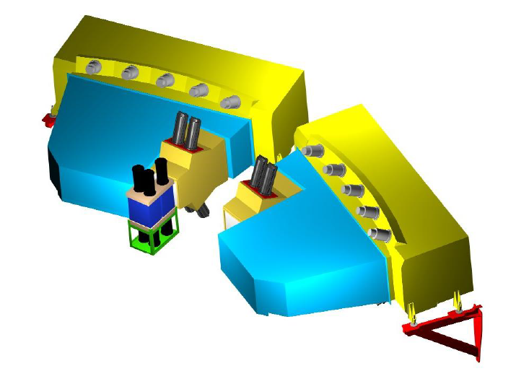
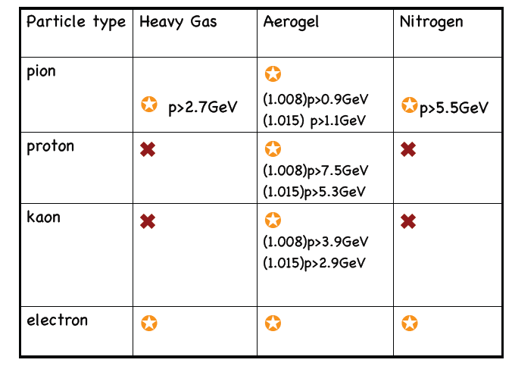
Cherenkov detectors
Heavy Gas
Nitrogen Counter
Aerogel
(1.008)p>1.1GeV
(1.015)p>0.9GeV

Slide 14
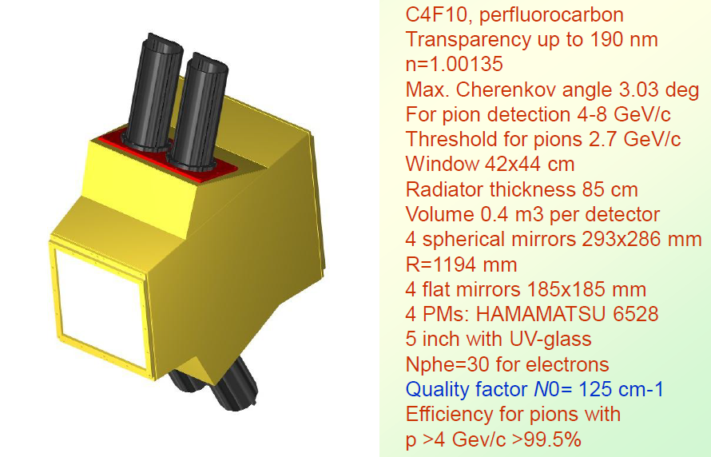
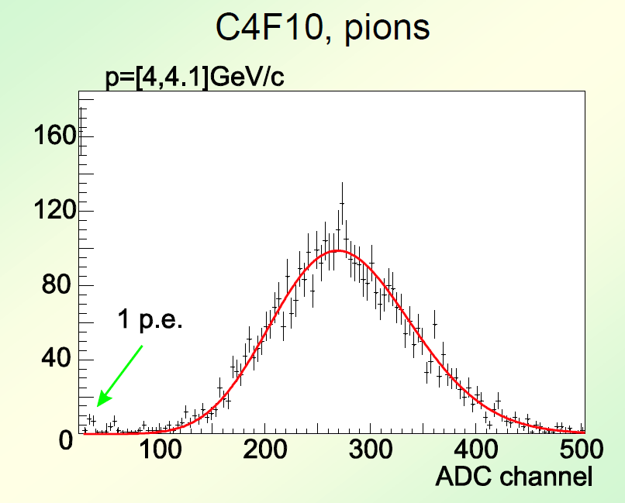
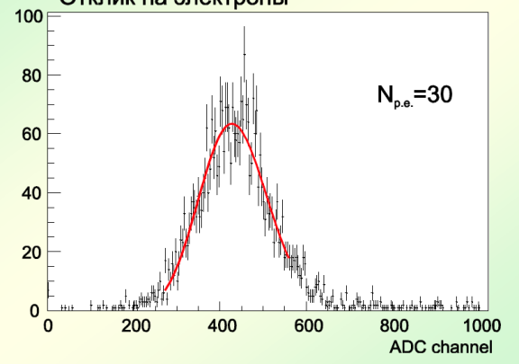
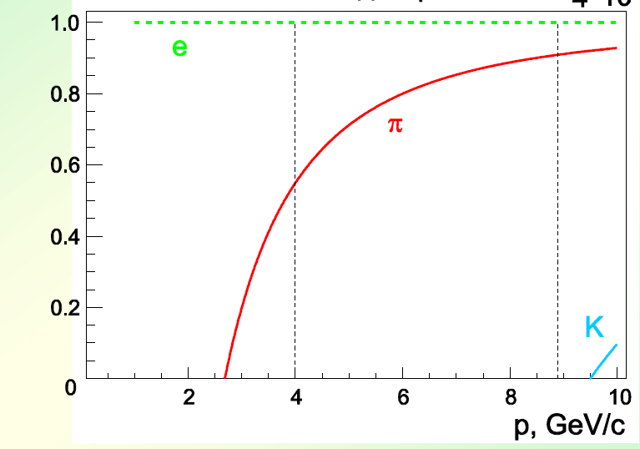
Heavy Gas Cerenkov detector
Pion response
Electron response
Light vs momentum

Slide 15
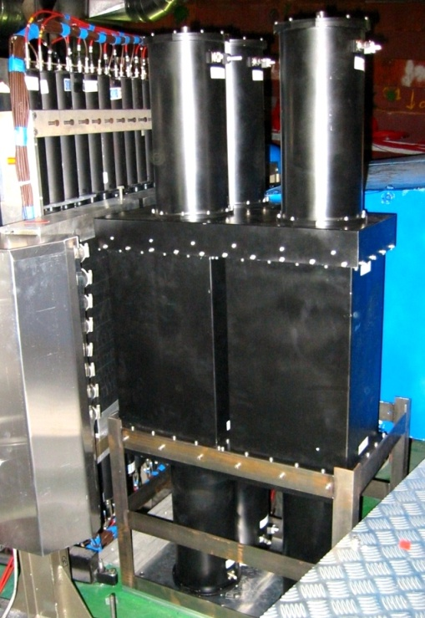
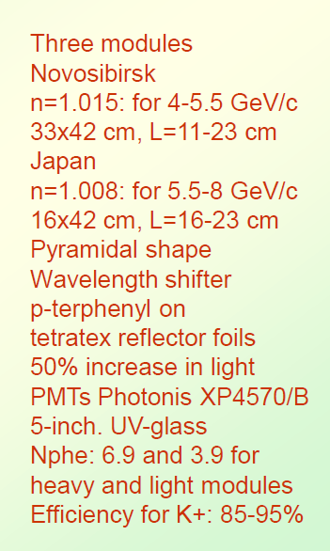
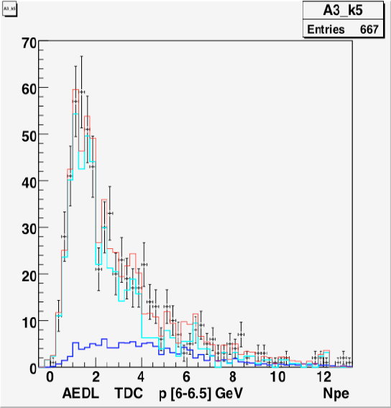
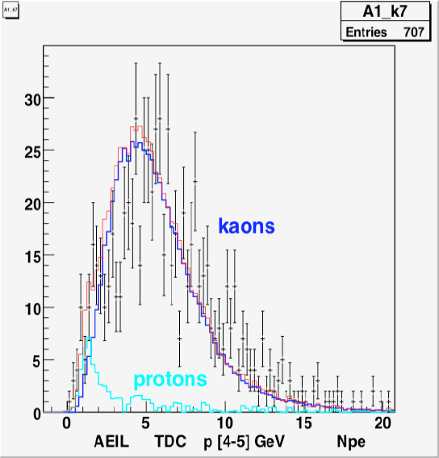
Aerogel Cerenkov detector
Aerogel
n=1.008 module
n=1.015 module
protons
kaons

Slide 16
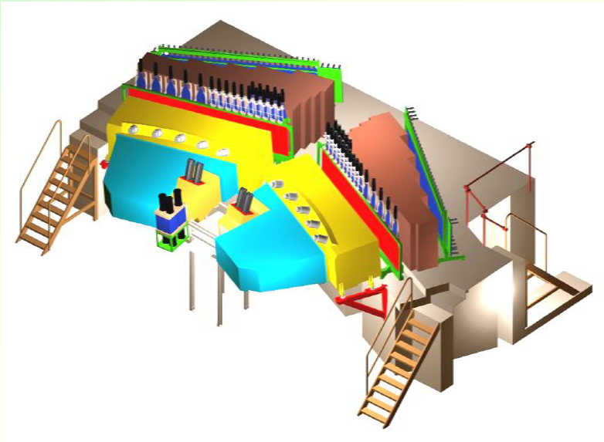

Slide 17
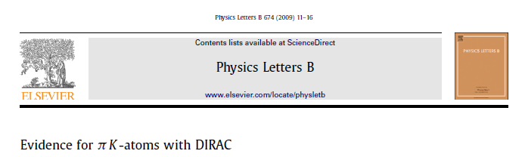
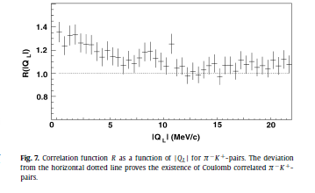
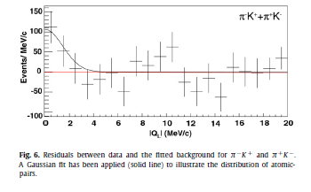
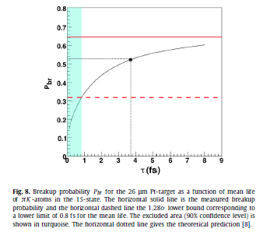
n_{Aπk} = 173+54 3.2 σ
τ > 0.8 fs
90% CL

Slide 18
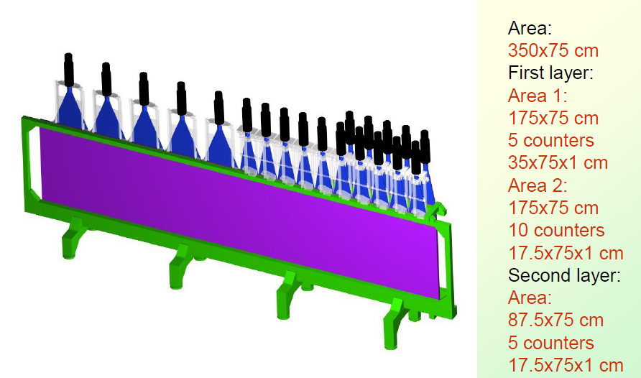
Preshower detector
Cut efficiency :
12.5% e⁺e⁻
97.5% ππ
e⁺e⁻ subtraction
97.8% ππ

Slide 19
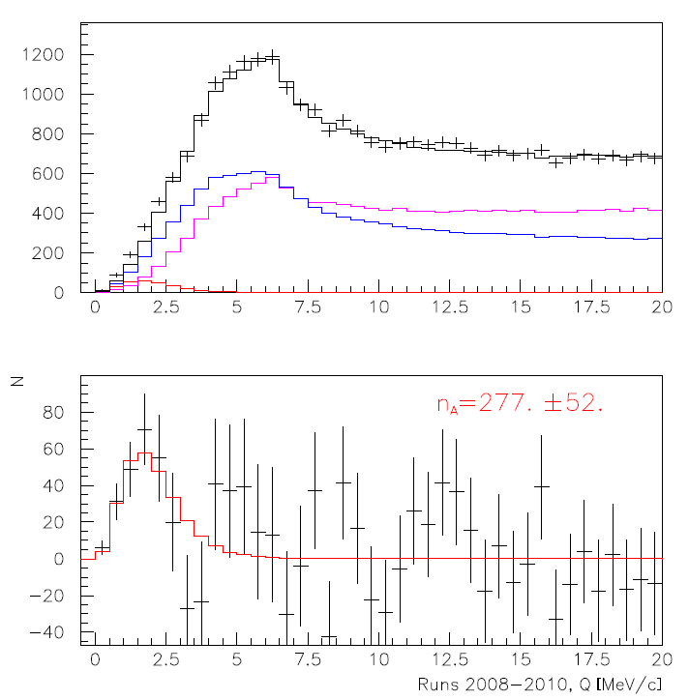
π⁻K⁺ and π⁺K⁻ prompt pairs
Run 2008-2010, statistics with low and medium background (⅔ of all statistics). Point-like production of all particles. The e⁺e‒ background was not subtracted.
Coulomb pairs
non-Coulomb pairs
Atomic pairs
5.3 σ
26% relative error on |a_{1/2}-a_{3/2}|

Slide 20
π⁺π‒ prompt pairs
Coulomb pairs
Coulomb pairs
non-Coulomb pairs
non-Coulomb pairs
Atomic pairs
Atomic pairs
Run 2008-2010, statistics with low and medium background
(⅔ of all statistics). Point-like production of all particles. The e⁺e‒ background was not subtracted.

Slide 21
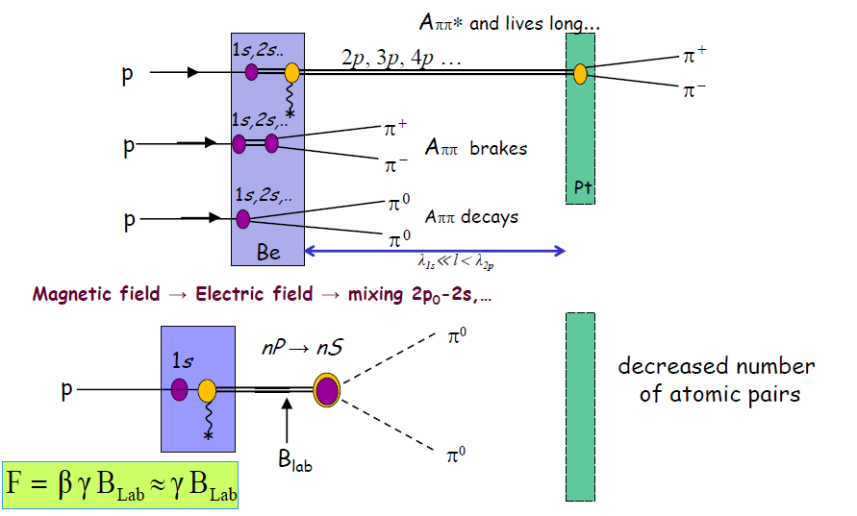
Long lived atoms
In order to measure an other combination of scattering length : 2a₀+a₂
2011-2012 data taking
A_{ππ}
& CC and NC
*
The A_{2π} decay in the p-state is forbidden by angular momentum conservation.
The lifetime of the A_{2π} atom in the 2p state (τ_{2p}=1.17 ·10⁻¹¹ s) is determined by the 2p–1s radiative transition with a subsequent annihilation from 1s state
(τ_{1s}=3 ·10⁻¹⁵ s): π⁺ + π⁻ → π⁰ + π⁰

Slide 22
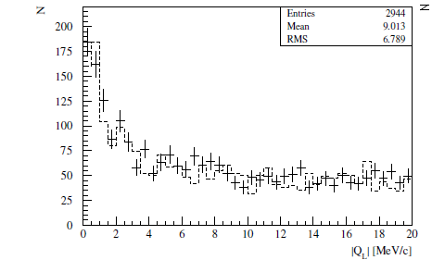
2010-2011 : Production of A_{2π} in Beryllium target
Distribution over |Q_{L}| of π⁺π⁻ pairs collected in 2010-2011 with Beryllium target
with the cut Q_{T}<1 MeV/c. Experimental data (points with errors) have been fitted
by a sum of simulated CC and NC pairs (dashed line).
Produced atoms normalized on the proton flux : N_{A2π} = (5.1 + 0.5) x 10 ⁻¹⁴

Slide 23
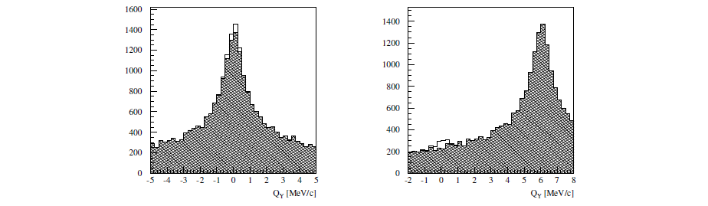
Simulation of the permanent magnet at the target
Simulated atomic pairs from long lived atoms(light area) over Q_{Y} above the background
of pp pairs produced in the Beryllium target with cuts |Q_{X}, Q_{L}|<1MeV/c (hatched area).
On the left side without the magnet and on the right with the magnet used during 2011.
Atomic pairs from long lived atoms
y
x
z

Slide 24
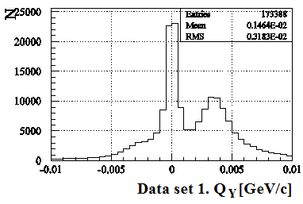
2011 data : Experimental distribution of e⁺e⁻ over Q_{Y}
1
2
Pairs generated on Be target before magnet
2
1
Pairs generated after magnet

Slide 25
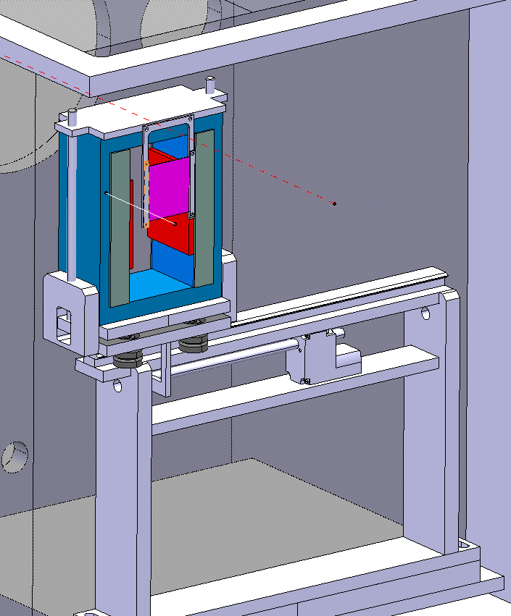
Magnet for 2012 run
2 new magnets:
Sm₂Co₁₇, high resistivity against radiation, B=0.26T, expected signal > 9 sigma.
New retracting device allows to replace magnet fast.
BLUE … magnet yoke
GREY … magnet poles
RED … magnet shimming
PURPLE … Pt foil

Slide 26
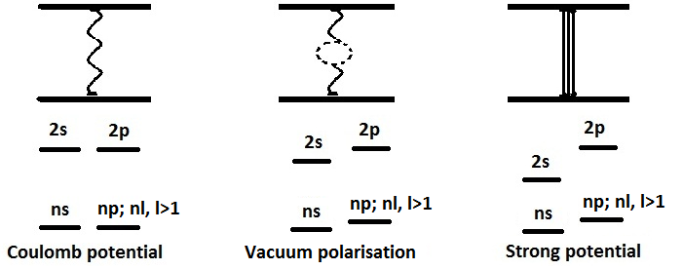






Energy splitting in theory
Electromagnetic corr.
Δ E^{em} _{2s-2p} = -0.012 eV
The observation of ππ atom long-lived states opens the future possibility to measure the energy difference between ns and np states ΔE(ns-np) and the value of ππ scattering lengths |2a₀+a₂|.

Slide 27
ΔE in practice .. observation method
The lifetime of the np-states is about 10³ larger than the ns-states, so it is possible to measure the energy difference of these levels by exerting an electric field (Stark effect) on the atom and tracking the field dependence of the decay probability.
The influence of an magnetic field on the A_{2π} atom lifetime opens the possibility to measure the splitting between 2s and 2p levels.
Pt foil

Slide 28
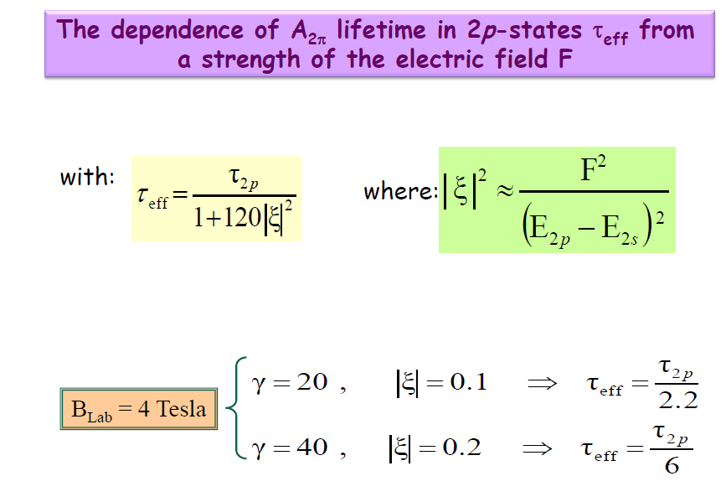
SPS (450 GeV) : yield of A_{2π} and A_{kπ} will increase
of a factor 20 per proton-nucleus interaction.

Slide 29
Thank you for your attention

Slide 30
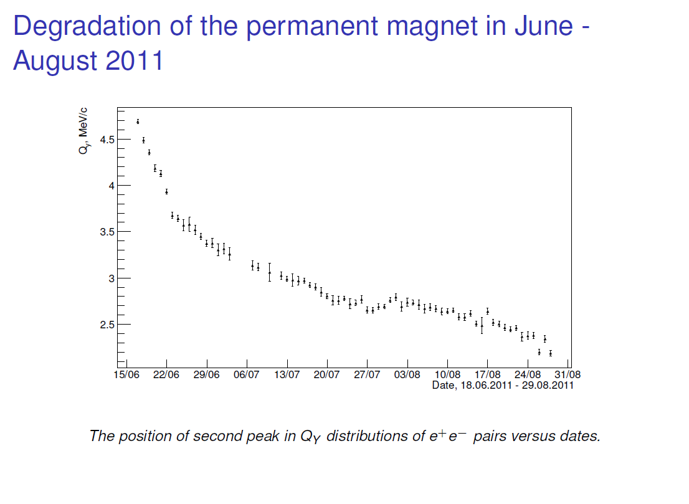

Slide 31
