Slide 1
Experimental checks of low energy QCD precise predictions using π⁺π⁻, K⁺π⁻ and K⁻π⁺ atoms
Leonid Nemenov
JINR Dubna
Prague 26.11.2012

Slide 2
Outline
Low-energy QCD precise predictions
Lattice calculation precise predictions
Results on the ππ scattering lengths measurement
Search for K⁺π⁻ and K⁻π⁺ atoms
Status of the long-lived ππ atom states observation. Prospects of the Lamb-shift measurement.
New prospects of DIRAC at SPS CERN

Slide 3








DIRAC collaboration
CERN
Geneva, Switzerland
Tokyo Metropolitan University
Tokyo, Japan
Czech Technical University
Prague, Czech Republic
IFIN-HH
Bucharest, Romania
Institute of Physics ASCR
Prague, Czech Republic
JINR
Dubna, Russia
Nuclear Physics Institute ASCR
Rez, Czech Republic
SINP of Moscow State University
Moscow, Russia
INFN-Laboratori Nazionali di Frascati
Frascati, Italy
IHEP
Protvino, Russia
University of Messina
Messina, Italy
Santiago de Compostela University
Santiago de Compostela, Spain
KEK
Tsukuba, Japan
Bern University
Bern, Switzerland
Kyoto University
Kyoto, Japan
Zurich University
Zurich, Switzerland
Kyoto Sangyou University
Kyoto, Japan

Slide 4
Theoretical motivation
Standard Model
L_{weak}
L_{QED}
L_{QCD}
HIGH energy
(small distance)
Q>>
Q<<
LOW energy
(large distance)
L_{QCD} = L_{sym} + L_{non-sym}
(chiral symmetry)
perturbative QCD:
L_{QCD} (q,g)
Interaction → „weak“
(asympt. freedom):
expansion in coupling.
Check only L_{sym} (m_{q}<<)
chiral sym. & breaking:
L_{eff} (GB: π,K,η)
Interaction → „strong“
(confinement) - but:
expansion in mom. & mass.
Check L_{sym} as well as
L_{non-sym}
spontaneously
broken symmetry
quark-
condensate

Slide 5
Theoretical status
In ChPT the effective Lagrangian, which describes the ππ interaction, is an expansion in (even) terms:
(tree) (1-loop) (2-loop)
Colangelo et al. in 2001, using ChPT (2-loop) & Roy equations:
These results (precision) depend on the low-energy constants (LEC) l₃ and l₄:
Lattice gauge calculations from 2006 provided values for these l₃ and l₄.
Because l₃ and l₄ are sensitive to the quark condensate,
precision measurements of a₀, a₂ are a way
to study the structure of the QCD vacuum.

Slide 6
ππ scattering
ChPT predicts s-wave scattering lengths:
The expansion of in powers of the quark masses starts with the linear term:
where
is the quark condensate, reflecting the property of QCD vacuum.
The estimates indicate values in the range 0 < < 5
Measurement of ⇒ improved the value of

Slide 7
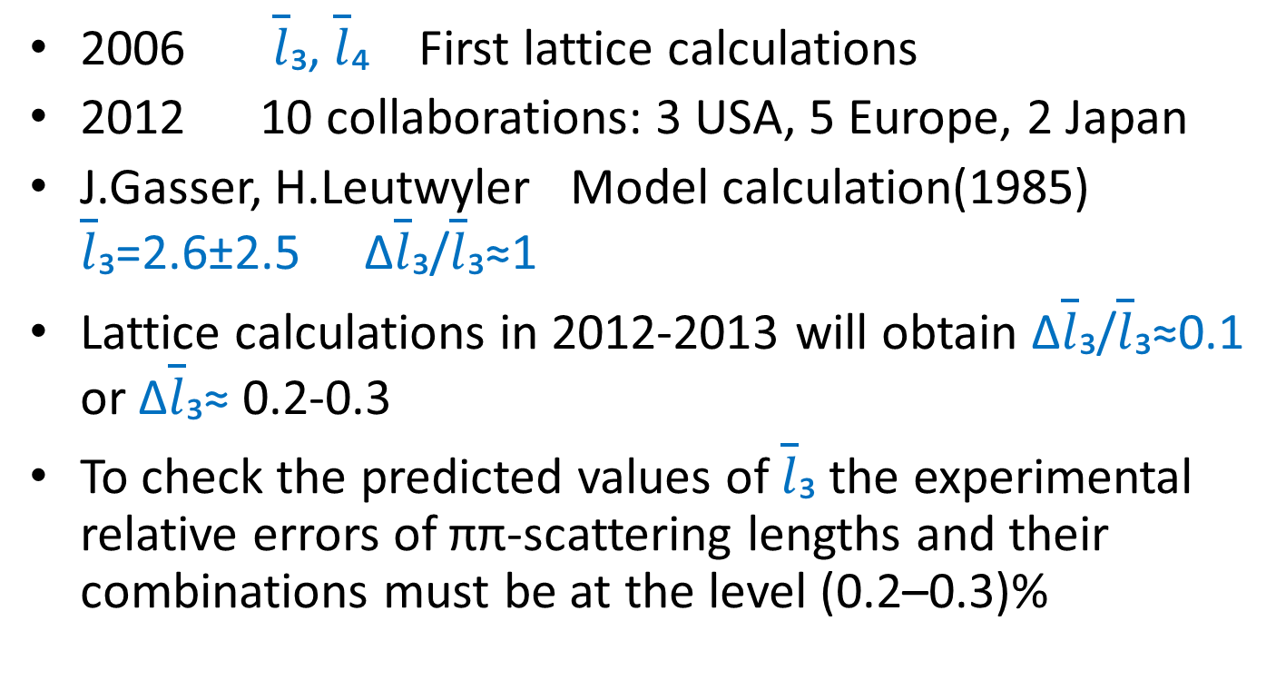
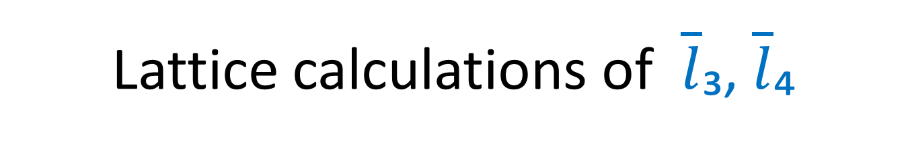
Lattice calculations of $\overline{l}$₃, $\overline{l}$₄
2006 $\overline{l}$₃, $\overline{l}$₄ First lattice calculations
2012 10 collaborations: 3 USA, 5 Europe, 2 Japan
J.Gasser, H.Leutwyler Model calculation(1985) $\overline{l}$₃=2.6±2.5 Δ$\overline{l}$₃/$\overline{l}$₃≈1
Lattice calculations in 2012-2013 will obtain Δ$\overline{l}$₃/$\overline{l}$₃≈0.1 or Δ$\overline{l}$₃≈ 0.2-0.3
To check the predicted values of $\overline{l}$₃ the experimental relative errors of ππ-scattering lengths and their combinations must be at the level (0.2–0.3)%

Slide 8
Pionium lifetime
Pionium (A_{2π}) is a hydrogen-like atom consisting of π⁺ and π⁻ mesons:
E_{B}=-1.86 keV, r_{B}=387 fm, p_{B}≈0.5 MeV
The lifetime of π⁺π⁻ atoms is dominated by
the annihilation process into π⁰ π⁰:
π⁺
π⁰
π⁰
π⁻
a₀ and a₂ are the ππ S-wave scattering lengths for isospin I=0 and I=2.
If

Slide 9
K⁺π⁻ and K⁻π⁺ atoms lifetime
Kπ-atom (A_{Kπ}) is a hydrogen-like atom consisting of K⁺ and π⁻ mesons:
E_{B}= -2.9 keV r_{B} = 248 fm p_{B} ≈ 0.8 MeV
The Kπ-atom lifetime (ground state 1S), τ=1/Γ is dominated by the annihilation process into K⁰π⁰:
K⁺
π⁰
K⁰
π⁻
**
(**) J. Schweizer (2004)
From Roy-Steiner equations:
If

Slide 10
Coulomb pairs and atoms
Strong interaction
π⁺
Κ⁺
π⁺
Κ⁺
π⁺
μ⁺
p
nucleus
π⁻
π⁻
Κ⁻
Κ⁻
μ⁻
π⁻
For small Q there are Coulomb pairs :
π⁺π ⁻, πK, K⁺K⁻, πµ C-pairs
π⁺π ⁻, πK, K⁺K⁻, πµ atoms
The production yield strongly increases for smaller Q

Slide 11
Method of A_{2π} observation and measurement
Target Ni 98 μm
π⁺
p
A_{2π}
(n_{A})
Atomic pairs
24 GeV/c
(N_{A})
π⁻
Interaction point
π⁺
Coulomb correlated
pairs
p
(N_{C})
π⁻
24 GeV/c
Δ,ρ,ω,…
π⁺
π⁺
p
Non-Coulomb pairs
24 GeV/c
π⁻
η, η’,…
π⁺
Interaction point
π⁰
p
π⁺
24 GeV/c
Accidental pairs
p
π⁻

Slide 12
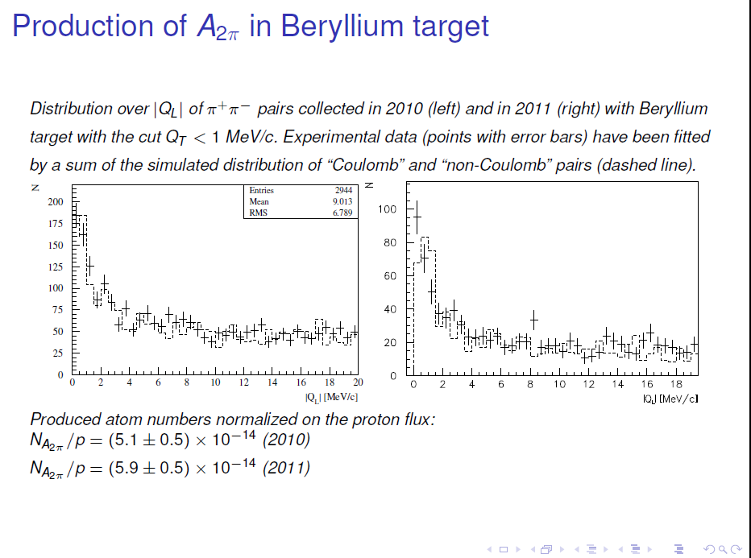

Slide 13
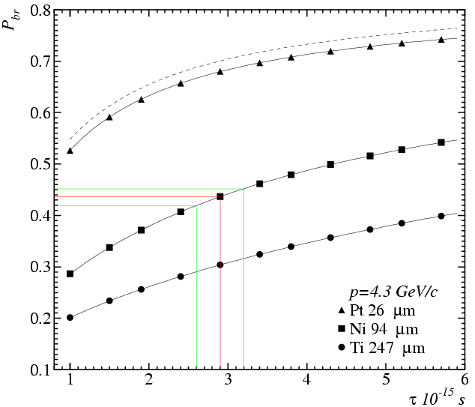
Break-up probability
Solution of the transport equations provides one-to-one dependence of the measured break-up probability (P_{br}) on pionium lifetime τ
Cross section calculation precision 0.6%
All targets have the same thickness in radiation lengths 6.7*10⁻³ X₀
There is an optimal target material for a given lifetime

Slide 14
DIRAC setup
Upgraded DIRAC setup
MDC - microdrift gas chambers, SFD - scintillating fiber detector, IH – ionization hodoscope. DC - drift chambers , VH – vertical hodoscopes, HH – horizontal hodoscopes, Ch – nitrogen Cherenkov , PSh - preshower detectors , Mu - muon detectors
Modifided parts

Slide 15
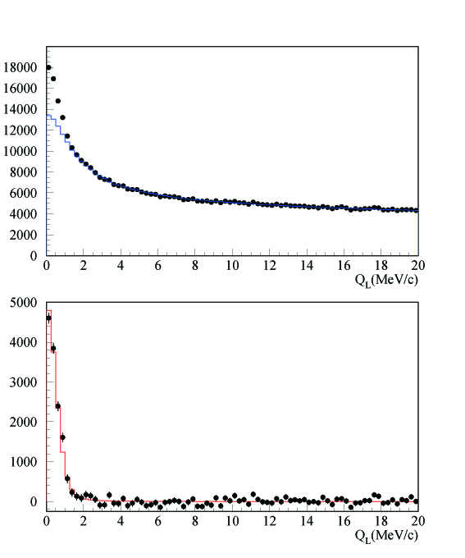
DIRAC results with GEM/MSGC
Q_{L} distribution
←All events
←After background
subtraction

Slide 16
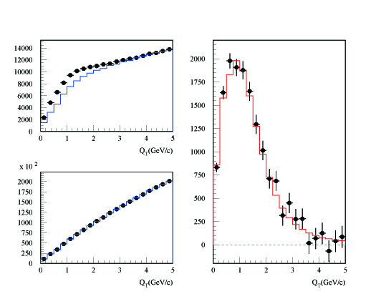
DIRAC results with GEM/MSGC
Q_{T} distribution
←After background
subtraction for Q_{L}<2MeV/c
Q_{L}<2 MeV/c
Q_{L}>2 MeV/c

Slide 17
Comparition with other experimental results
K→3π:
2009 NA48/2 (EPJ C64, 589)
...without constraint between a₀ and a₂:
and 3.4%
theory uncertainty
...with ChPT constraint between a₀ and a₂:
and 2%
theory uncertainty
Ke4:
2010 NA48/2 (EPJ C70, 635)
...without constraint between a₀ and a₂:
...with ChPT constraint between a₀ and a₂:
Notes:
17

Slide 18
Published results on π π atom: lifetime & scattering length
DIRAC data | τ_{1s} (10⁻¹⁵s) value stat syst theo* tot | |a₀ – a₂| value stat syst theo* tot | Reference
2001 |  |  | PL B 619 (2005) 50
2001-03 |  |  | PL B 704 (2011) 24
* theoretical uncertainty included in systematic error
NA48 | K-decay | a₀ – a₂ value stat syst theo tot | Reference
2009 | K_{3π} |  | EPJ C64 (2009) 589
2010 | K_{e4} & K_{3π} |  | EPJ C70 (2010) 635
Notes:
18

Slide 19
New data on ππ atom production

Slide 20
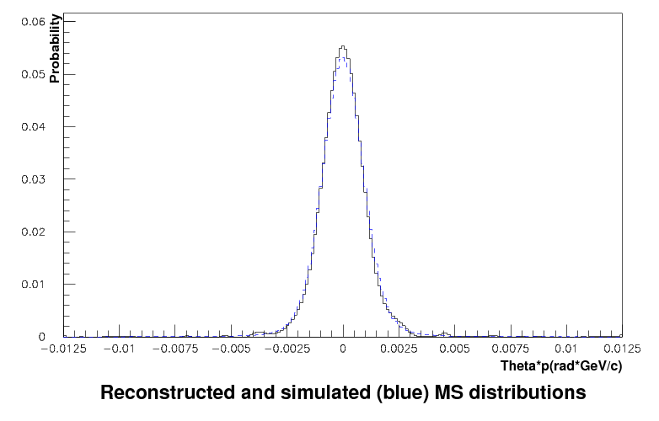
Multiple scattering measurement
100 mkm Ni target

Slide 21
π⁺π⁻ data
Statistics for measurement of |a₀-a₂| scattering length difference and expected precision
Year | n_{A} | δ_{stat} (%) | Δ_{syst} (%) | δ_{syst} (%) MS | δ_{tot} (%)
2001-2003 | 21000 | 3.1 | 3.0 | 2.5 | 4.3
2008-2010 * | 24000 | 3.0 | 3.0 | 2.5 | 4.3
2001-2003 2008-2010 | 45000 | 2.1 | 3.0 (2.1) | 2.5 (1.25) | 3.7 (3.0)
* There is 40% of data with a higher background whose implication is under investigation.
21

Slide 22
πK scattering
What new will be known if πK scattering length will be measured?
The measurement of the s-wave πK scattering lengths would test our understanding of the chiral SU(3)_{L} × SU(3)_{R} symmetry breaking of QCD (u, d and s quarks), while the measurement of ππ scattering lengths checks only the SU(2)_{L} × SU(2)_{R} symmetry breaking (u, d quarks).
This is the principal difference between ππ and πK scattering!
Experimental data on the πK low-energy phases are absent

Slide 23
Q_{L} distribution for K⁺π⁻ pairs

Slide 24
Q_{L} distribution for π⁺K⁻ pairs

Slide 25
Long-lived π⁺π⁻ atoms
The observation of ππ atom long-lived states opens the future possibility to measure the energy difference between ns and np states ΔE(ns-np) and the value of ππ scattering lengths |2a₀+a₂|.
If a resonance method can be applied for the ΔE(ns-np) measurement, then the precision of ππ scattering length measurement can be improved by one order of magnitude relative to the precision of other methods.
25

Slide 26

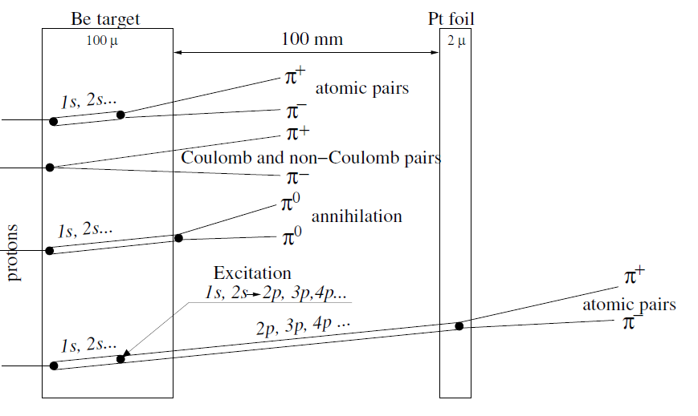

Slide 27
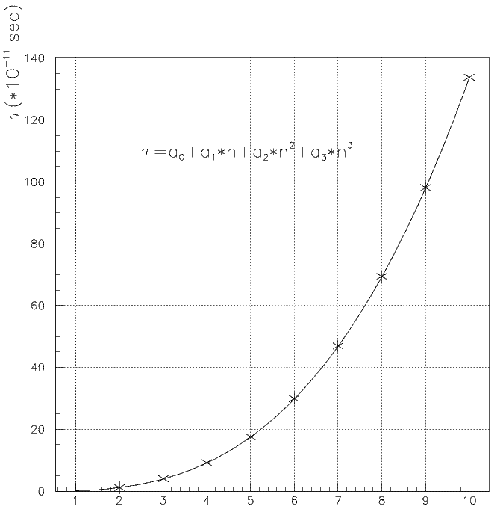
A_{2π} lifetime, τ, in np states
M. Pentia
n_{H} | τ_{H} •10⁸ s | τ_{2π} •10¹¹ s | Decay length A_{2π} in L.S. cm for γ=16.1
2p | 0.16 | 1.17 | 5.7
3p | 0.54 | 3.94 | 19
4p | 1.24 | 9.05 | 44
5p | 2.40 | 17.5 | 84.5
6p | 4.1 | 29.9 | 144
7p |  | 46.8* | 226
8p |  | 69.3* | 335
* - extrapolated values
CERN, Geneva - Monday 26, September, 2011

Slide 28
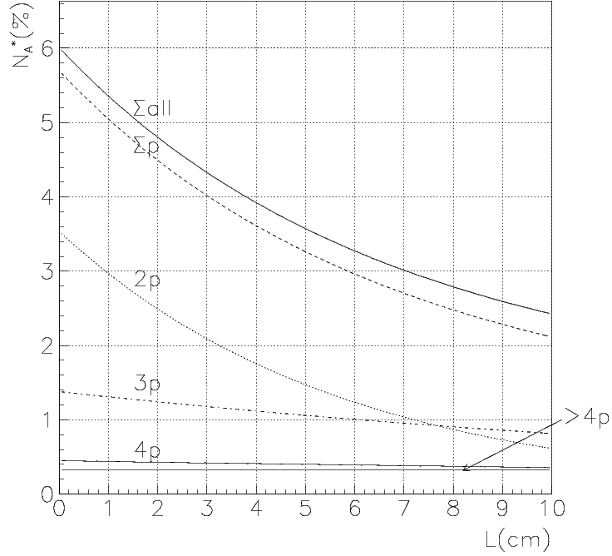
“Long-lived A_{2π}” yield and quantum numbers
L. Afanasev; O. Gorchakov (DIPGEN)
Atomic pairs from “long-lived A_{2π}” breakup in 2μm Pt.

Slide 29
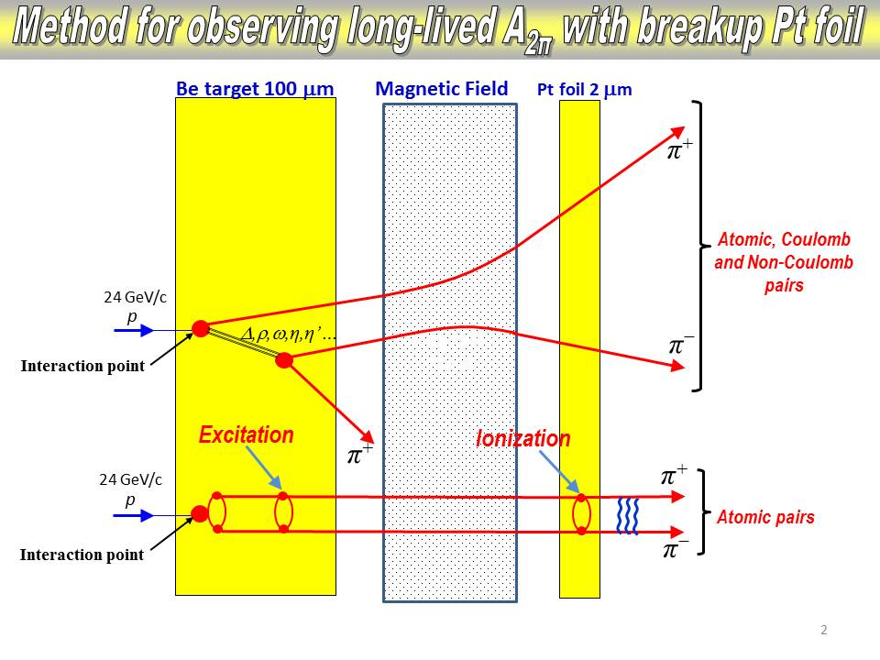

Slide 30
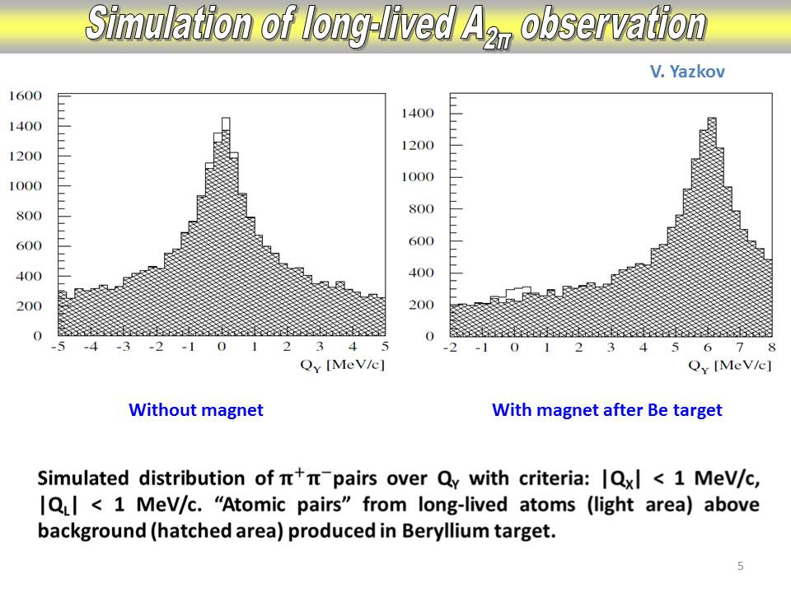

Slide 31
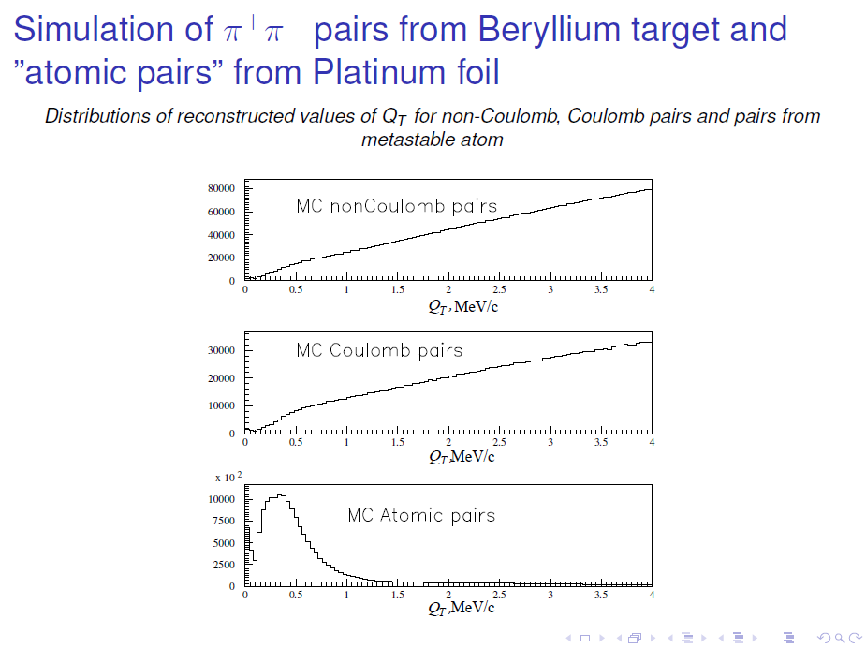

Slide 32
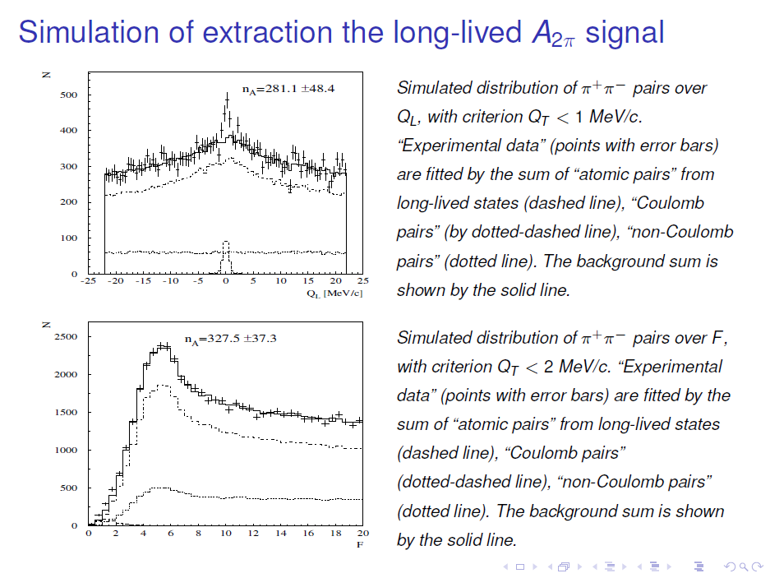

Slide 33
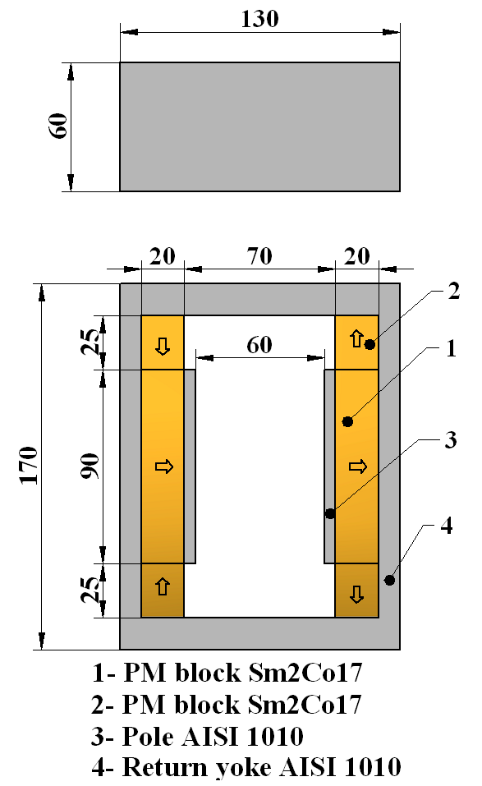
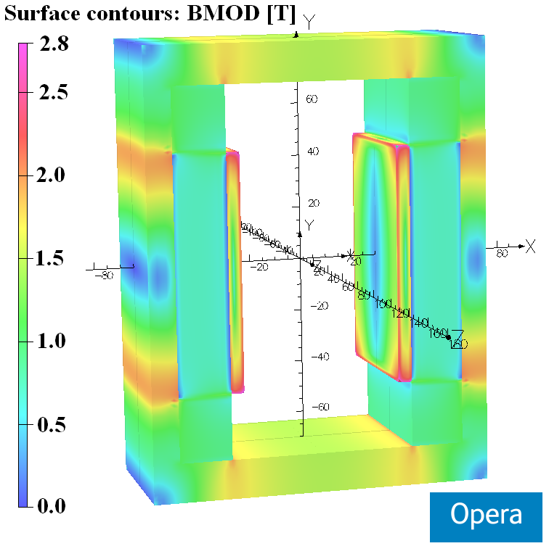
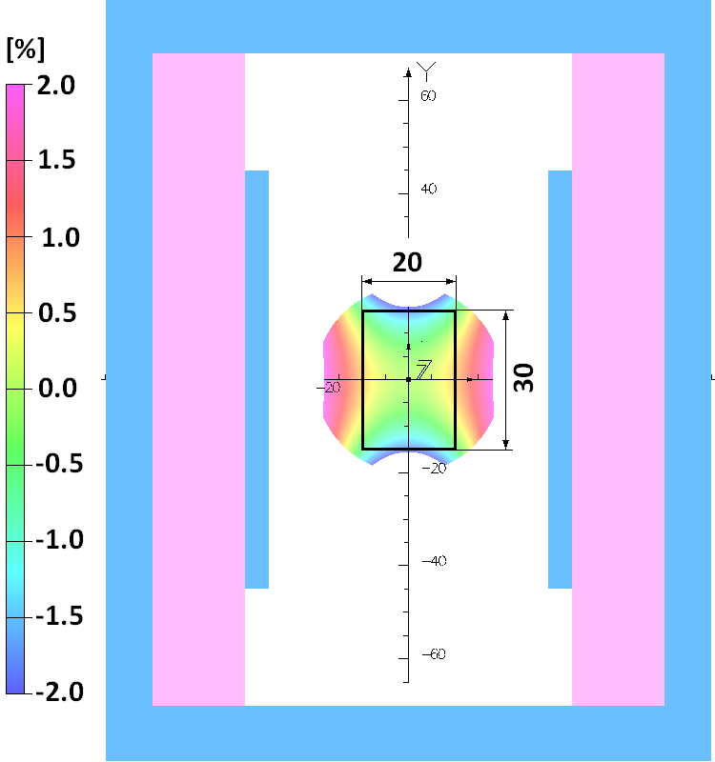
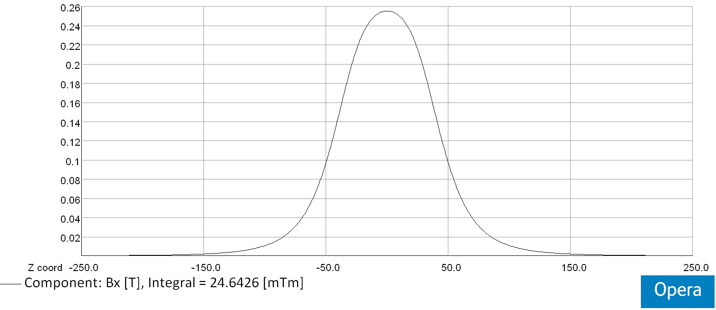
Magnet design
Layout of the dipole magnet
(arrows indicate the direction of magnetization)
Integrated horizontal field homogeneity
inside the GFR X×Y = 20 mm × 30 mm:
∆∫Bxdz/ ∫Bx(0,0,z)dz [%]
Opera 3D model
with surface field distribution
Horizontal field distribution along z-axis at X=Y=0 mm
∫Bx(0,0,z)dz= 24.6×10⁻³ [T×m]

Slide 34
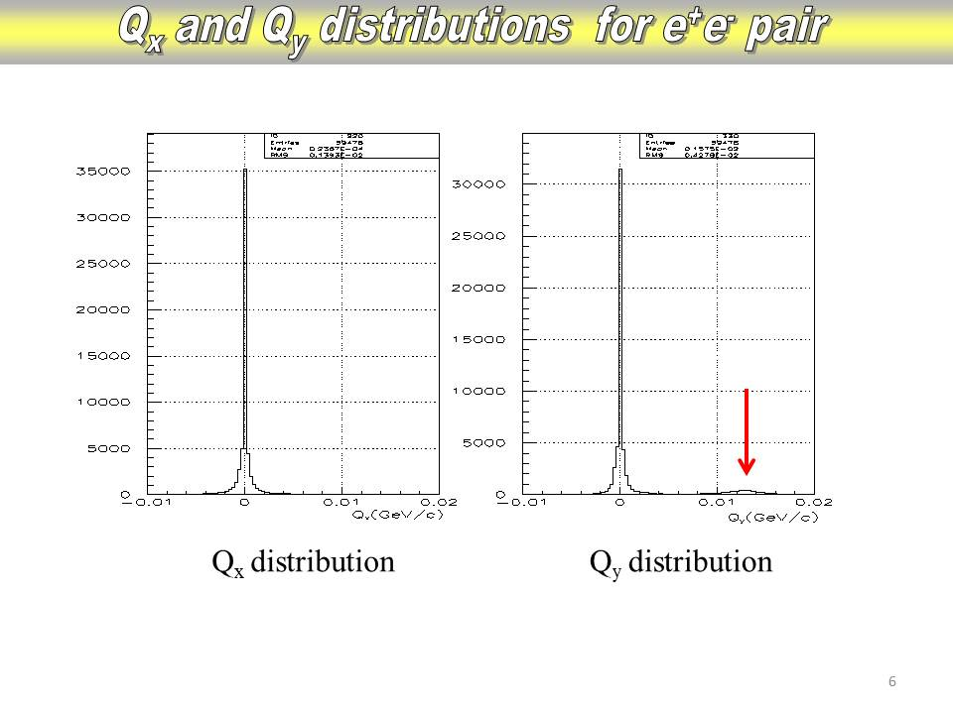

Slide 35
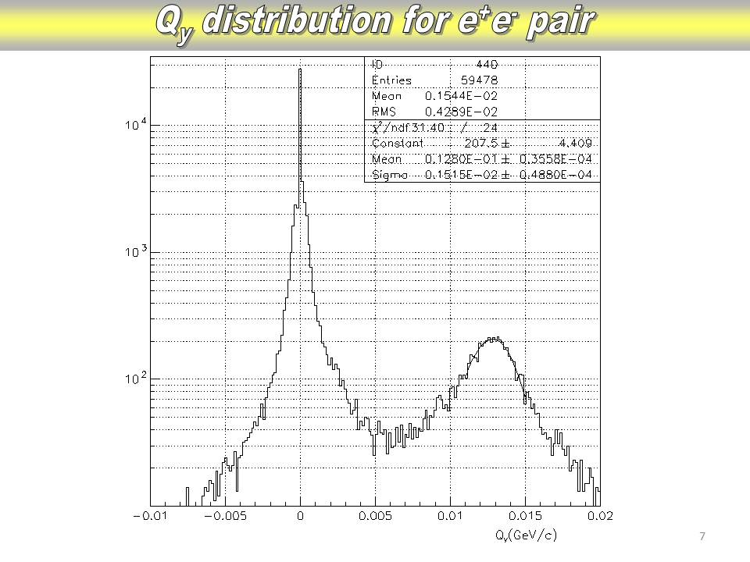

Slide 36
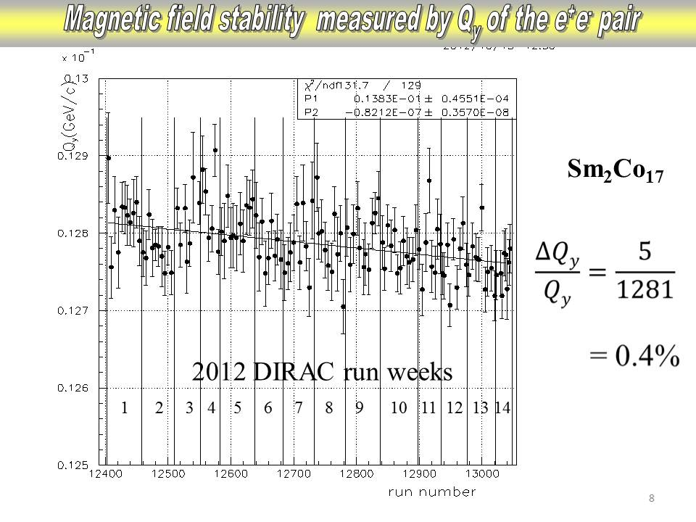

Slide 37
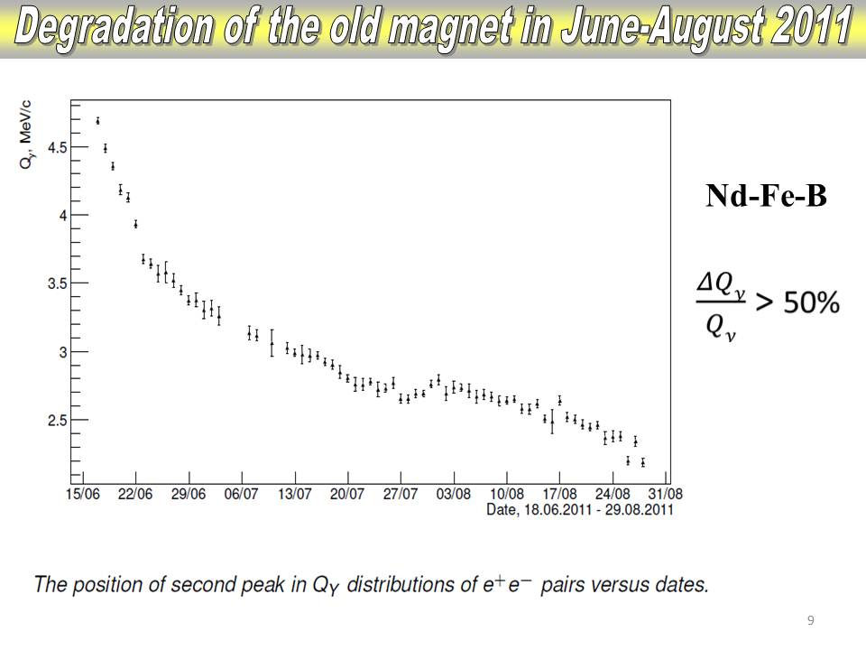

Slide 38

Lamb shift measurement with external magnetic field
See: L. Nemenov, V. Ovsiannikov, Physics Letters B 514 (2001) 247.
Impact on atomic beam by
external magnetic field B_{lab} and Lorentz factor γ
…. relative distance between
π⁺ and π⁻ in A_{2π} system
π⁻
…. laboratory magnetic field
π⁺
…electric field in A_{2π} system

Slide 39
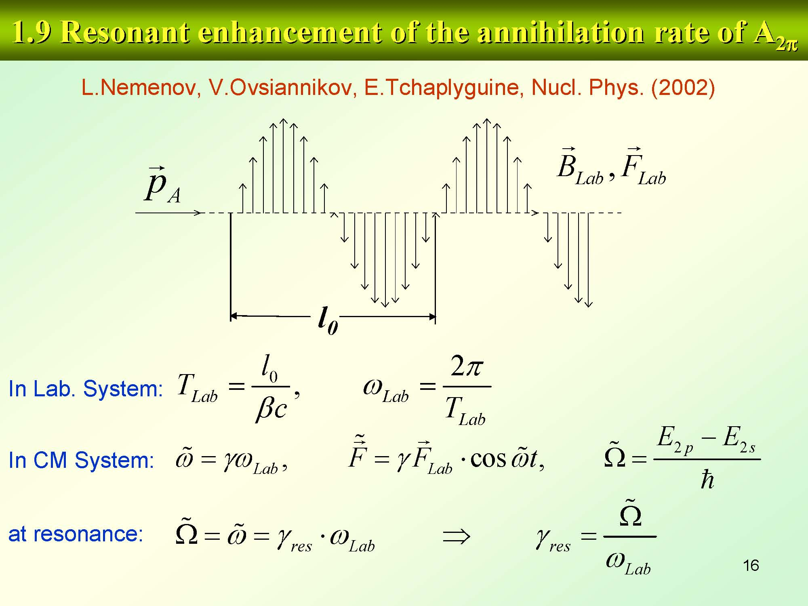

Slide 40
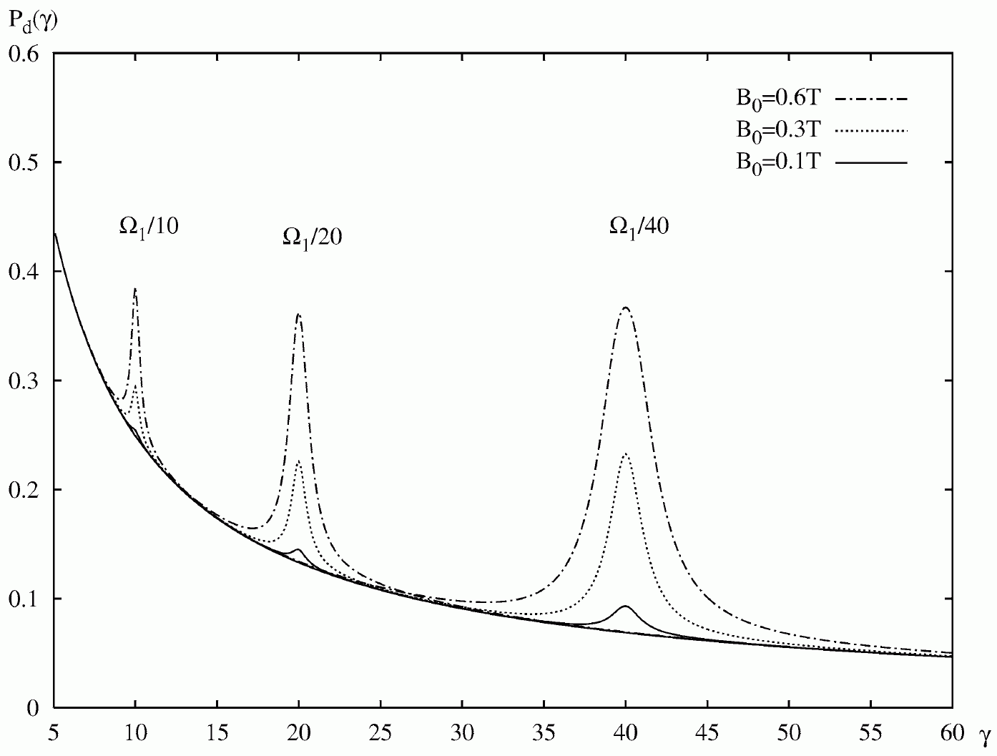
Resonant enhancement
40

Slide 41
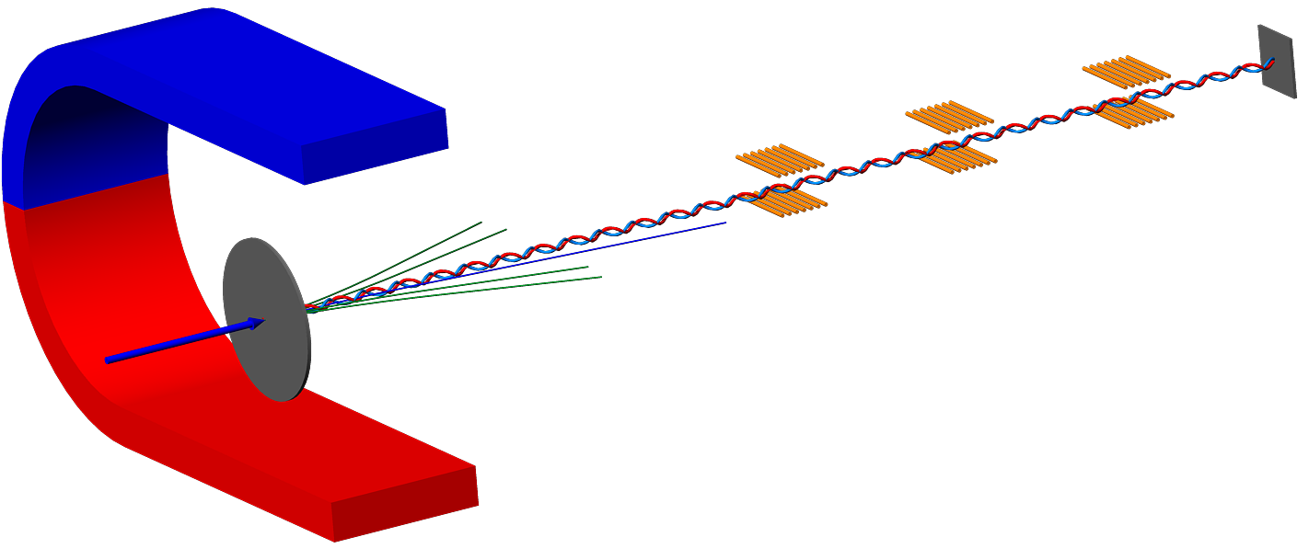
Resonant method
Resonators
π⁺
π⁰
π⁰
π⁰
π⁻
A*_{2π} A*_{πμ} A*_{πK}
π⁰
π⁰
π⁰
Pt foil
Proton beam
p
Charged secondary
γ_{res1}
γ_{res2}
γ_{res3}
γ_{res4}

Slide 42
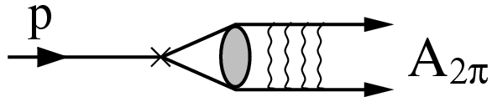
A_{2π} and A_{πK} production

Slide 43
A_{2π} and A_{πK} production on PS and SPS at CERN

Slide 44
A_{2π} and A_{πK} production on PS and SPS at CERN
 | Yield ratio
π⁺π⁻ atoms | 17
π⁺K⁻ atoms | 35
K⁺π⁻ atoms | 27
The ratio of π⁺π⁻, π⁺K⁻ and K⁺π⁻ atom yields at the proton momenta 450 GeV/c and angle 4◦ to the yields at the proton momenta 24 GeV/c and angle 5.7◦.

Slide 45
Conclusion
DIRAC experiment on PS CERN measured π⁺π⁻ atom lifetime with precision about 9%. With the existing additional statistic the lifetime will be measured with precision about 6% and ππ scattering lengths with accuracy about 3%.
The existing statistics allows to measure the Kπ cross section production.
The statistics obtained in 2011 and 2012 allows to observe the long-lived π⁺π⁻ atoms

Slide 46
Conclusion
The same setup on SPS CERN will allow:
To measure the Kπ atom lifetime with precision better than 10% and to perform the first measurement of Kπ scattering lengths
To measure the Lamb shift of π⁺π⁻ atom.

Slide 47
Thank you for your attention

Slide 48
πK scattering lengths
I. ChPT predicts s-wave scattering lengths:
V. Bernard, N. Kaiser,
U. Meissner. – 1991
A. Rossel. – 1999
J. Bijnens, P. Talaver. – April 2004
II. Roy-Steiner equations:
P.Büttiker et al. − 2004

Slide 49
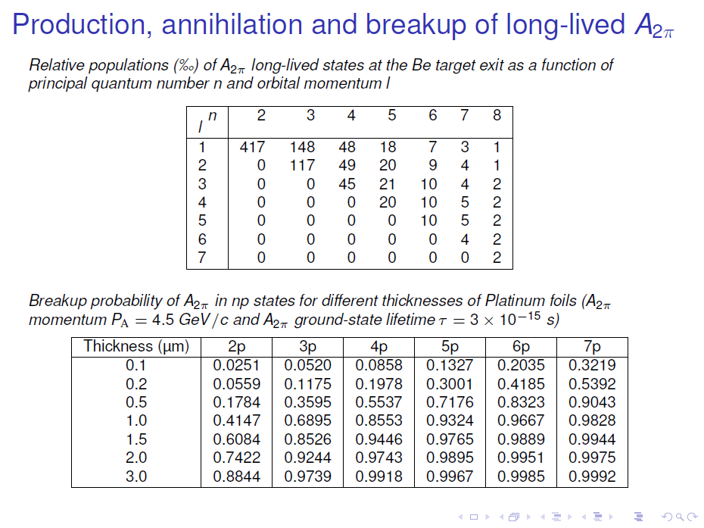

Slide 50
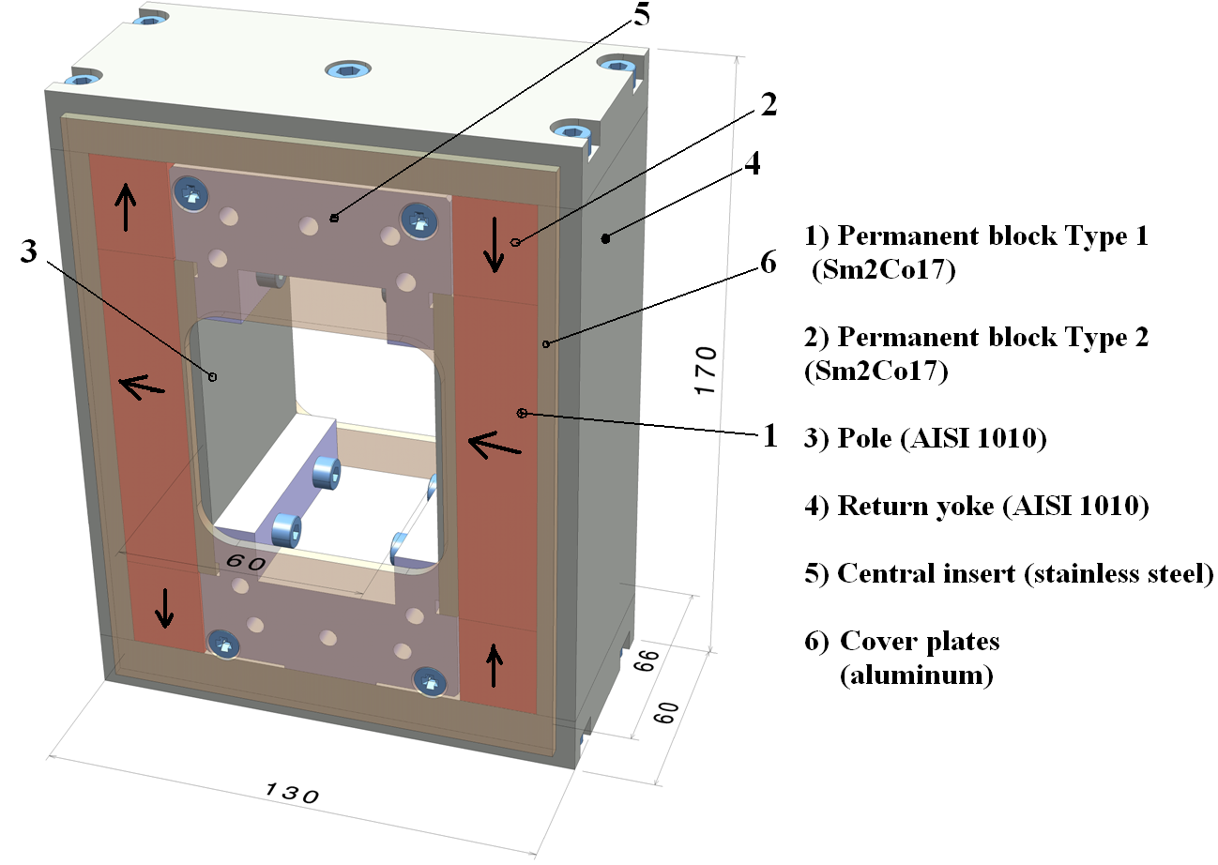
Mechanical structure

Slide 51
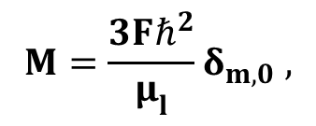
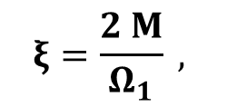
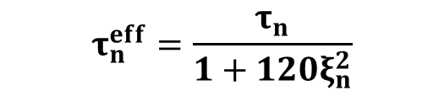

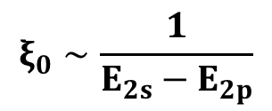
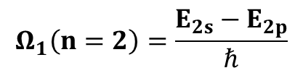
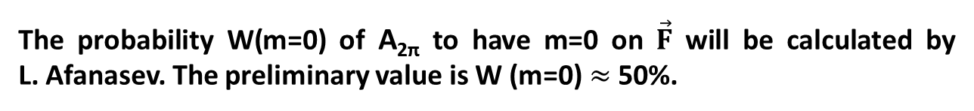

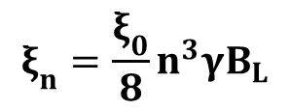
The lifetime of A_{2π} in electric field
L. Nemenov, V. Ovsiannikov (P. L. 2oo1)
mmmmmmmmmmm
F – strength of electric field in A_{2π} c.m.s.
$${F=βγB}_{L},$$
B_{L} in lab. syst.
→ m must be 0
$$Ω_{1}\left(n=2\right)=\frac{E_{2s}−E_{2p}}{ℏ}$$
$$ξ_{0}∼\frac{1}{E_{2s}−E_{2p}}$$
$$ξ_{n}=\frac{ξ_{0}}{8}n^{3}γB_{L}$$
$$ξ\left(2s−2p\right)=ξ_{0}γB_{L}$$
CONCLUSION: the lifetimes for long-lived states can be calculated using only one parameter → E_{2s}-E_{2p}.
The probability W(m=0) of A_{2π} to have m=0 on $\vec{F}$ will be calculated by L. Afanasev. The preliminary value is W (m=0)$≈$ 50%.

Slide 52
Period L of resonators for γ=16
Transition 2S-2P 3S-3P 4S-4P 5S-5P
L, μ 40 125 320 525

