Slide 1
π⁺π⁻ and πK Hadronic Atoms
Data Taking and Processing
DIRAC Run 2012
ISAB, 12 November 2012

Slide 2
Introduction
DIRAC 2012 Run:
    Data taking for observation of metastable π⁺π⁻ states
Magnetic field stability monitoring for DIRAC 2012 run
Events preselection and ntuple production for the 2008-2011 experimental data
Preshower amplitude signal correction of the 2008-2011 data
MC simulations of the π and K meson inclusive production at SPS energies
Publications, presentations and outreach
DIRAC – perspectives 2013-2014
Contents

Slide 3
Introduction

Slide 4
DIRAC Experiment
Test some previsions of the CHPT as the nonperturbative QCD theory
Problem 1:
DIRAC experimental setup
design and construction
Problem 2:
Observation of
π⁺π⁻ and πK atoms
Problem 3:
Lifetime measurement of
π⁺π⁻ and πK atoms
Problem 4:
Determination of the
π⁺π⁻ and πK scattering lengths
DIRAC spectrometer
B. Adeva, …, M. Pentia et al.
NIM A515 (2003) 467-496
Preshower detector
M. Pentia et al.
NIM A603 (2009) 309-318
Determination of ππ scattering lengths from measurement of π⁺π⁻ atom lifetime.
B. Adeva, …, M. Pentia et al..
Phys.Lett. B704 (2011) 24-29
Detection of π⁺π atoms with the DIRAC spectrometer at CERN.
B. Adeva, …, M. Pentia et al.
J.Phys. G30 (2004) 1929-1946
First measurement of the π⁺π⁻ atom lifetime.
B. Adeva, …, M. Pentia et al.
Phys.Lett. B619 (2005) 50-60
π⁺π⁻
DIRAC II setup
to be processed and published
Preshower for DIRAC II setup
to be processed and published
Detection of
π⁺π⁻ metastable atom
to be processed and published
Lifetime measurement of
π⁺π⁻ metastable atom
to be processed and published
Lamb shift determination in
π⁺π⁻ atoms
to be processed and published
Next steps
Evidence for πK atoms with DIRAC.
B. Adeva, …, M. Pentia et al.
Phys.Lett. B674 (2009) 11-16
Lifetime measurement of
π⁺π⁻ and πK atom
PS data to be processed
to be done at SPS
Determination of π⁺π⁻ and πK scattering length
PS data to be processed
to be done at SPS
πK
Next steps
Determination of
K⁺K⁻ scattering length
to be done at SPS
New DIRAC setup
to design and construct
Detection of
K⁺K⁻ atom
to be done at SPS
Lifetime measurement of
K⁺K⁻ atom
to be done at SPS
K⁺K⁻
M. Pentia IFIN-HH

Slide 5
2. DIRAC 2012 Run:
Data taking for observation
of metastable π⁺π⁻ states

Slide 6
Method for observing metastable A_{2π} with breakup Pt foil
M. Pentia
Be target 100 μm
Pt foil 2 μm
π⁺
Ionization
Atomic pairs
π⁻
Excitation 1s, 2s →2p, 3p, 4p, …
2p, 3p, 4p, …
A_{2π} atom production
p
24 GeV/c
M. Pentia IFIN-HH

Slide 7
Background of π⁺π⁻ pairs
M. Pentia
Be target 100 μm
A_{2π}
π⁺
p
Atomic pairs
(n_{A})
24 GeV/c
(N_{A})
π⁻
Production point
π⁺
Coulomb
pairs
p
(N_{C})
π⁻
24 GeV/c
Δ,ρ,ω,…
π⁺
π⁺
Non-
Coulomb
pairs
p
24 GeV/c
π⁻
η, η’,…
π⁺
Production point
π⁰
p
π⁺
Accidental
pairs
24 GeV/c
p
π⁻
M. Pentia IFIN-HH

Slide 8
Method for background reduction with magnetic field
Be target
100 μm
Magnetic Field
Pt foil
2 μm
M. Pentia
π⁺
Magnetic Field
Atomic, Coulomb Non- -Coulomb and accidental pairs
24 GeV/c
p
Δ,ρ,ω,η,η’…
π⁻
Production point
π⁺
Excitation
Ionization
24 GeV/c
1s, 2s →2p, 3p, 4p, …
π⁺
p
Atomic pairs
π⁻
Production point
M. Pentia IFIN-HH

Slide 9
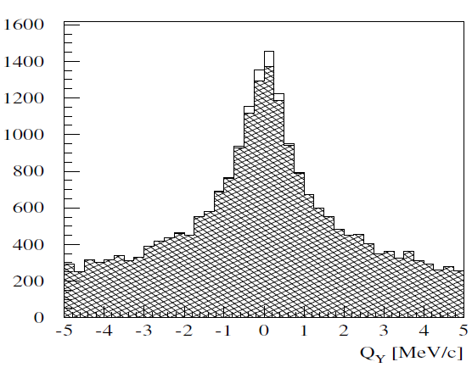
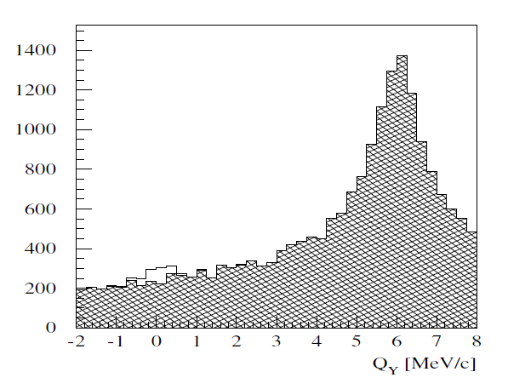
Simulation of metastable A_{2π} observation
Without magnet
With magnet after Be target
Simulated distribution of π⁺π⁻ pairs over Q_{y} with cut: |Q_{x}| < 1 Mev/c, |Q_{l}| < 1 Mev/c.
Atomic pairs from metastable atoms (light area) above background (hatched area)
produced in Beryllium target.
M. Pentia IFIN-HH

Slide 10
3. Magnetic field stability monitoring for DIRAC 2012 run

Slide 11
Q_{y} distribution for e⁺e⁻ pair
D. Dumitriu
M. Pentia IFIN-HH

Slide 12
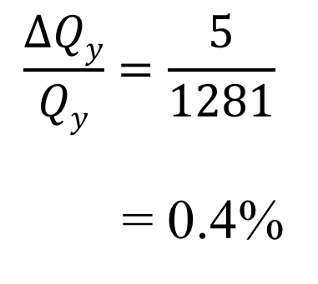
Time variation of Q_{y} mean values for e⁺e⁻ pair
D. Dumitriu
Sm₂Co₁₇
2012 DIRAC run weeks
1 2 3 4 5 6 7 8 9 10 11 12 13 14 15 16 17 18

Slide 13
4. Events preselection and ntuple
production for 2008-2011
experimental data

Slide 14
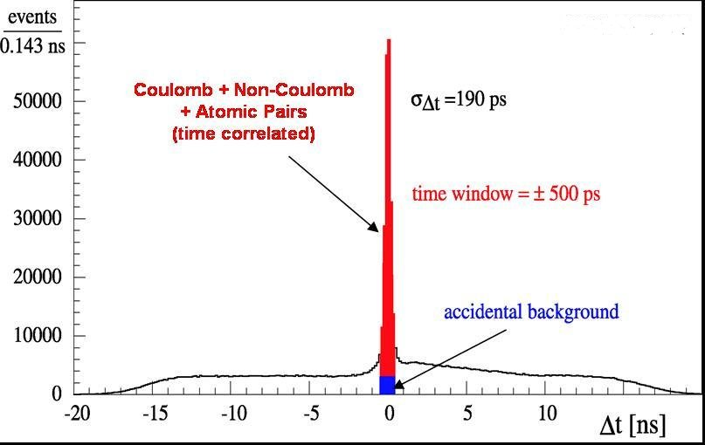
π⁺π⁻ pairs production and interaction processes in the target
M. Pentia
Target Ni 98 μm
π⁺
Target – two functions:
A_{2π} production
A_{2π} ionization
p
A_{2π}
Atomic pairs
(n_{A})
24 GeV/c
(N_{A})
π⁻
Production point
π⁺
Coulomb
pairs
p
(N_{C})
π⁻
24 GeV/c
Δ,ρ,ω,…
π⁺
π⁺
Non-
Coulomb
pairs
p
24 GeV/c
π⁻
η, η’,…
π⁺
Production point
π⁰
p
π⁺
Accidental
pairs
Coincidence events measured with DIRAC detector.
24 GeV/c
p
π⁻
M. Pentia IFIN-HH

Slide 15
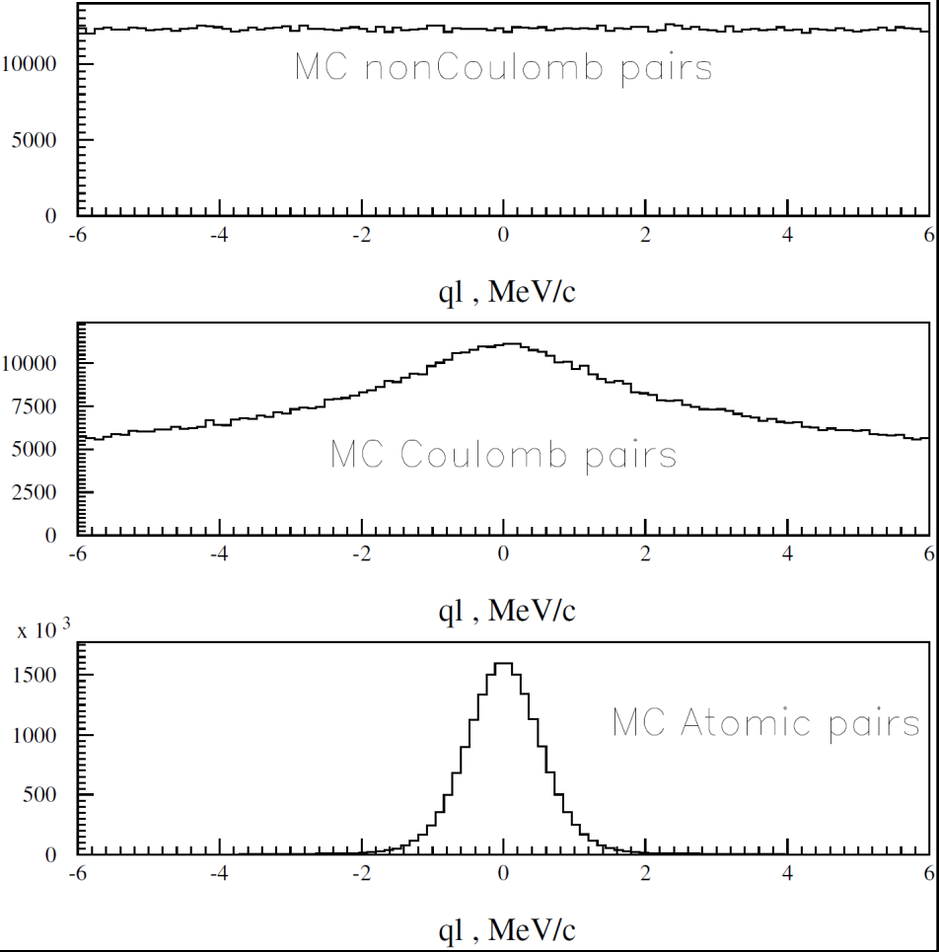
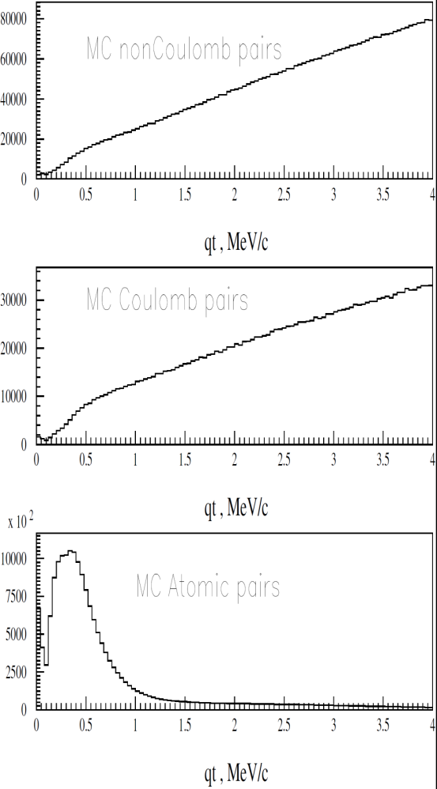
Simulation of Q_{L} and Q_{T} distributions of detecting π⁺π ⁻ pairs
V. Yazkov
M. Pentia IFIN-HH

Slide 16
Q_{L} and Q_{T} distribution for π⁺π⁻ pairs
The 2008, 2009, 2010 and 2011 experimental data were preselected and ntuples were prepared.
They are used for events / background separation to detect and measure the π⁺π⁻ atom lifetime.
M. Pentia IFIN-HH

Slide 17
Q_{L} distribution for K⁺π⁻ pairs
17
M. Pentia IFIN-HH

Slide 18
Q_{L} distribution for π⁺K⁻ pairs
18
M. Pentia IFIN-HH

Slide 19
5. Preshower amplitude signal
correction of the 2008-2011 data

Slide 20
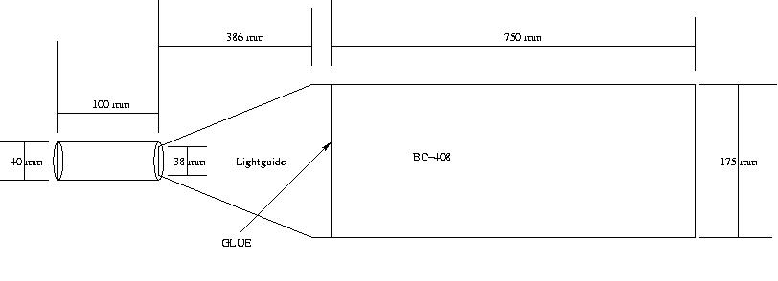
Coordinate dependence of the signal amplitude
M. Pentia
M. Pentia IFIN-HH

Slide 21
x- and y- dependence corrections
M. Pentia
M. Pentia IFIN-HH

Slide 22
x- and y- corrected amplitudes
M. Pentia
To correct the dispersion in the 40 slab amplification values, and to obtain the same amplitude peak position (~100) for all slabs, the amplitude values must be multiplied by the factor
M. Pentia IFIN-HH

Slide 23
6. MC simulations of the π and K meson
inclusive production at SPS energies

Slide 24
π⁺π⁻ and πK atom production at PS and SPS at CERN
 | Yield ratio
π⁺π⁻ atoms | 17
π⁺K⁻ atoms | 35
K⁺π⁻ atoms | 27
The ratio of π⁺π⁻, π⁺K⁻ and K⁺π⁻ atom yields at the proton momenta 450 GeV/c and angle 4◦ to the yields at the proton momenta 24 GeV/c and angle 5.7◦.
M. Pentia IFIN-HH

Slide 25
Simulation of π⁺ and π – production cross section
M. Gugiu
M. Pentia IFIN-HH

Slide 26
Simulation of K⁺ and K– production cross section
M. Gugiu
26
M. Pentia IFIN-HH

Slide 27
7. Publications, presentations and outreach
Simulation of K⁺ and K– production cross section
M. Gugiu

Slide 28
2012 DIRAC papers
M.Pentia, J.Smolik, V.Yazkov, “Amplitude alignment for preshower detector”, DIRAC Note 2012-07, October 21, 2012, http://dirac.web.cern.ch/DIRAC/note/note1207.pdf
A. Benelli (DIRAC Collaboration), ”DIRAC Experiment at CERN”,
Proc. 12th International Workshop on Meson Production, Properties and Interaction (MESON 2012), 31 May - 5 June 2012, Krakow [Poland], http://dirac.web.cern.ch/DIRAC/meson2012.pdf
“DIRAC observes dimeson atoms and measures their lifetime”, CERN COURIER, Feb 23, 2012, http://cerncourier.com/cws/article/cern/48623
“Search for long-lived states of π⁺π⁻ atoms”, Addendum to the DIRAC Proposal, CERN-SPSC-2012-SPSC-P-284 Add. 6, January 5, 2012, http://cdsweb.cern.ch/record/1410681/files/SPSC-P-284-ADD-6.pdf
M. Pentia IFIN-HH

Slide 29
8. DIRAC – perspectives 2013-2014

Slide 30
DIRAC Experiment
Test some previsions of the CHPT as the nonperturbative QCD theory
Problem 1:
DIRAC experimental setup
design and construction
Problem 2:
Observation of
π⁺π⁻ and πK atoms
Problem 3:
Lifetime measurement of
π⁺π⁻ and πK atoms
Problem 4:
Determination of the
π⁺π⁻ and πK scattering lengths
DIRAC spectrometer
B. Adeva, …, M. Pentia et al.
NIM A515 (2003) 467-496
Preshower detector
M. Pentia et al.
NIM A603 (2009) 309-318
Determination of ππ scattering lengths from measurement of π⁺π⁻ atom lifetime.
B. Adeva, …, M. Pentia et al..
Phys.Lett. B704 (2011) 24-29
Detection of π⁺π atoms with the DIRAC spectrometer at CERN.
B. Adeva, …, M. Pentia et al.
J.Phys. G30 (2004) 1929-1946
First measurement of the π⁺π⁻ atom lifetime.
B. Adeva, …, M. Pentia et al.
Phys.Lett. B619 (2005) 50-60
π⁺π⁻
To be processed and published existing PS data
DIRAC II setup
Preshower for DIRAC II setup
Observation of
π⁺π⁻ metastable atom
Lifetime measurement of
π⁺π⁻ metastable atom
Lamb shift determination in
π⁺π⁻ atoms
Evidence for πK atoms with DIRAC.
B. Adeva, …, M. Pentia et al.
Phys.Lett. B674 (2009) 11-16
Next steps
Lifetime measurement of
π⁺π⁻ and πK atom
to be done also at SPS
Determination of π⁺π⁻ and
πK scattering length
to be done also at SPS
πK
Next steps
Determination of
K⁺K⁻ scattering length
to be done at SPS
New DIRAC setup
to design and construct
Detection of
K⁺K⁻ atom
to be done at SPS
Lifetime measurement of
K⁺K⁻ atom
to be done at SPS
K⁺K⁻
M. Pentia IFIN-HH

Slide 31
Analysis of π⁺π⁻ and πK experimental data
Based on enormous existing experimental data, in the next two years they will be analyzed and processed as follows:
Run 2008, 2009, 2010 and 2011 data analysis with e⁺e⁻ background subtraction with PSh information.
Run 2008, 2009, 2010 and 2011 data analysis, taking into account non-pointlike π- and K-mesons production.
Run 2012 data analysis for metastable π⁺π⁻ hadronic atom detection.
Determination of π⁺π⁻ and πK hadronic atom lifetime based on existing data.
Determination of metastable π⁺π⁻ atom lifetime.
Determination of the π⁺π⁻ and πK scattering lenghts.
31
M. Pentia IFIN-HH

Slide 32
Study of πK hadronic atoms at SPS
DIRAC demonstrated for the first time, the existence of the πK hadronic atom^{*)}.
Next, we will try to study the properties and to measure the lifetime of the πK hadronic atom with greater precision and to evaluate the πK scattering lengths to test the Chiral Perturbation Theory predictions with three quarks.
The DIRAC Collaboration will send a new proposal to the CERN Scientific Council.
^{*)} B.Adeva,... G.Caragheorgheopol,… C.Ciocarlan, S.Constantinescu,... M.Duma, D.Dumitriu,... M.Gugiu,… M.Pentia, et al. [DIRAC Collaboration]
"Evidence for πK-atoms with DIRAC", Physics Letters B 674 (2009) 11.
32
M. Pentia IFIN-HH

Slide 33
Thank you
Simulation of K⁺ and K– production cross section
M. Gugiu

Slide 34
Additional slides
Simulation of K⁺ and K– production cross section
M. Gugiu

Slide 35
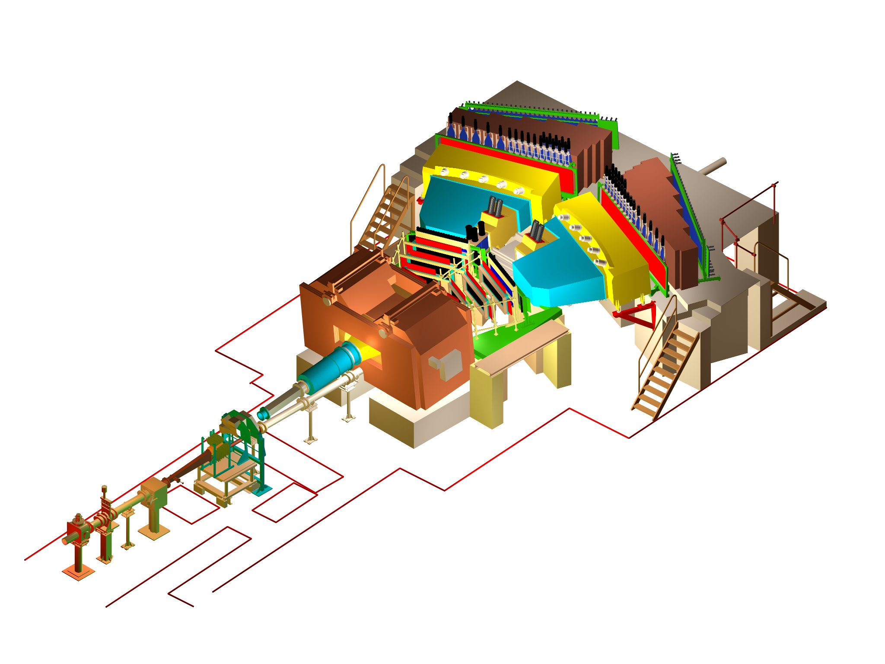
DIRAC upgraded Experimental setup
35
M. Pentia IFIN-HH
Notes:
35

Slide 36
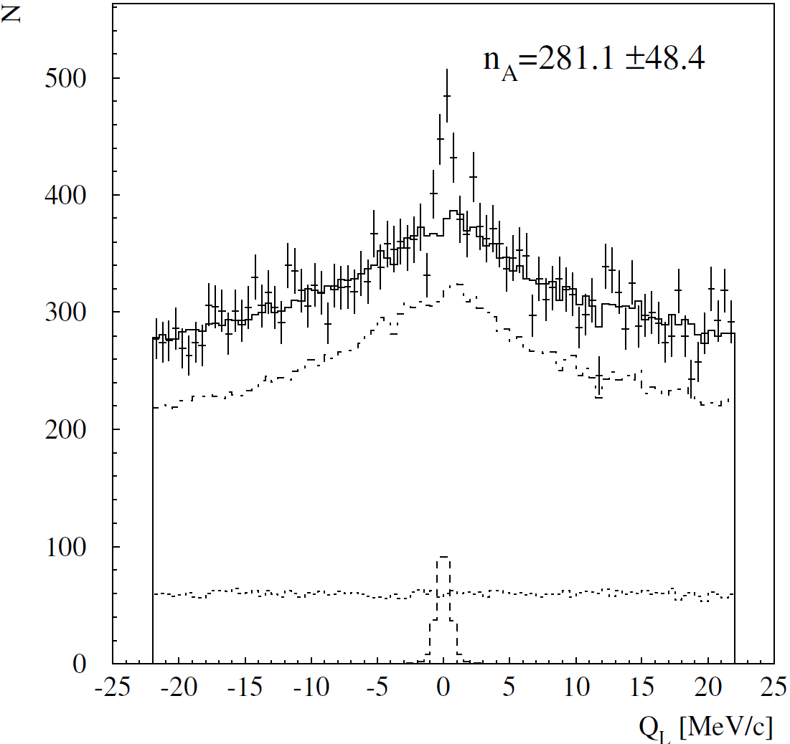
Metastable A_{2π} observation
V. Yazkov
Distribution of π⁺π⁻ pairs over Q_{L}, with the cut Q_{T} < 1 MeV/c. “Experimental” data (points with error bars) are fitted by a sum of “atomic pairs” from metastable states, “Coulomb pairs” and “non-Coulomb pairs”.
The background sum is shown by the solid line.
Coulomb pairs
atomic pairs from metastable states
non-Coulomb pairs
M. Pentia IFIN-HH

Slide 37
DIRAC Experiment
Conclusions:
Hadronic atoms lifetime measurement (order 10⁻¹⁵ sec), uses the relationship between the π⁺π⁻⁻ scattering lengths: a₀ (isospin 0) and a₂ (isospin 2), in the form 1/τ ~ |a₀-a₂|², and between the πK scattering lengths: a_{1/2} (isospin 1/2) and a_{3/2} (isospin 3/2), in the form 1/τ ~ |a_{1/2}-a_{3/2}|².
Measurement of the energy shift (ΔE_{nl}) between ns and np levels. For pure Coulomb field these two levels (with the same n-principal quantum number) are the same, but for hadronic atoms they are shifted mainly due to the strong interaction between components. The energy shift will be established by measuring the lifetime of the first excited states (metastable) of the hadronic atoms π⁺π⁻⁻ and πK. The connection with the scattering lengths a₀ and a₂ is expressed in the form ΔE^{str} ~ 2a₀ + a₂, and for a_{1/2} and a_{3/2} in the form ΔE^{str} ~ 2a_{1/2} + a_{3/2}.
These independent measurements will provide separate values for the scattering lengths a₀ and a₂, respective a_{1/2} and a_{3/2} and will be an evaluation of the theoretical predictions. In ChPT a₀ and a₂ are directly related to the quark mass generation and as such, they measure the degree of the chiral symmetry breaking. It is therefore necessary the knowledge of the parameter that describes the "order" in the quark system, specifying the symmetry breaking degree – quark condensate. Using the scattering lengths a_{1/2} and a_{3/2} we can determine this parameter, and so we can find the size of quark condensate and also the ratio strange/non-strange quark mass.
So our results will be a crucial verification of the theoretical nonperturbative QCD predictions.
37
M. Pentia IFIN-HH

Slide 38
Momentum dependence of the pion and electron amplitude
M. Pentia
M. Pentia IFIN-HH

Slide 39
Momentum dependence of the pion and electron amplitude
M. Pentia
M. Pentia IFIN-HH

Slide 40
Momentum dependence of the pion and electron amplitude
M. Pentia
M. Pentia IFIN-HH

Slide 41
Momentum dependence of the pion and electron amplitude
M. Pentia
M. Pentia IFIN-HH

Slide 42
Momentum dependence of the pion and electron amplitude
M. Pentia
M. Pentia IFIN-HH

Slide 43
Momentum dependence of the pion and electron amplitude
M. Pentia
M. Pentia IFIN-HH

Slide 44
High momenta pion separation
M. Pentia
M. Pentia IFIN-HH

Slide 45
High momenta pion separation
M. Pentia
M. Pentia IFIN-HH

Slide 46
High momenta pion separation
M. Pentia
M. Pentia IFIN-HH

Slide 47
High momenta pion separation
M. Pentia
M. Pentia IFIN-HH

Slide 48
High momenta pion separation
M. Pentia
M. Pentia IFIN-HH

