Slide 1
Experimental check of precise
predictions of QCD using
π⁺K⁻ , K⁺π⁻ and π⁺π⁻ atoms
L. Nemenov (JINR) on behalf of the DIRAC Collaboration
Physics Beyond Colliders meeting- CERN, 1-2 March 2017

Slide 2
QCD Lagrangian and its prediction
The QCD Lagrangians use the SU(3)_{L}*SU(3)_{R} and SU(2)_{L}*SU(2)_{R} chiral symmetry breaking.
L(u,d,s) = L(3) = L_{sym}(3)+ L_{sym.br.}(3)
L_{sym.br.} is proportional to m_{q}
L(u,d) = L(2) = L_{sym}(2) + L_{sym.br.}(2)
QCD provides cross sections with 1% precision
Perturbation theory is working at high momentum transfer Q.
Unitarity condition.
At large Q, contribution of L_{sym.br.} to the cross section is proportional to 1/Q⁴. Therefore these experiments checked only the L_{sym} prediction precision.
To check the total L(3) Lagrangian predictions, we must study the
low momentum transfer Q processes.
Tools: Lattice calculations and Chiral Perturbation Theory (ChPT)
Lattice----- L(3), L(2) ChPT------Effective Lagrangians.
2/27/2017

Slide 3
Measurement of the πK scattering length
The S-wave πK scattering lengths a_{1/2} and a_{3/2} in the chiral symmetry world are zero. Therefore the scattering length values a_{1/2} and a_{3/2} are very sensitive to the L_{sym.br.}(3).
For Lattice QCD the πK interaction at threshold is a relatively simple process. It gives πK scattering length values with an average precision of 5%.
This precision will be improved in the near future.
There is only one experimental data: DIRAC collaboration observed 349±62 πK atomic pairs (Phys.Rev.Lett. 2016) and measured |a_{1/2}-a_{3/2}| with an average precision of 34% (Conference in Chicago, 2016).
2/27/2017

Slide 4
Measurement of the πK scattering length
The DIRAC collaboration proposes:
to measure πK scattering lengths with precision better than 5% and
to check with this accuracy the Lattice calculation of the total QCD Lagrangian L(3).
The measurement should be performed with the 450 GeV/c SPS CERN proton beam.
2/27/2017

Slide 5
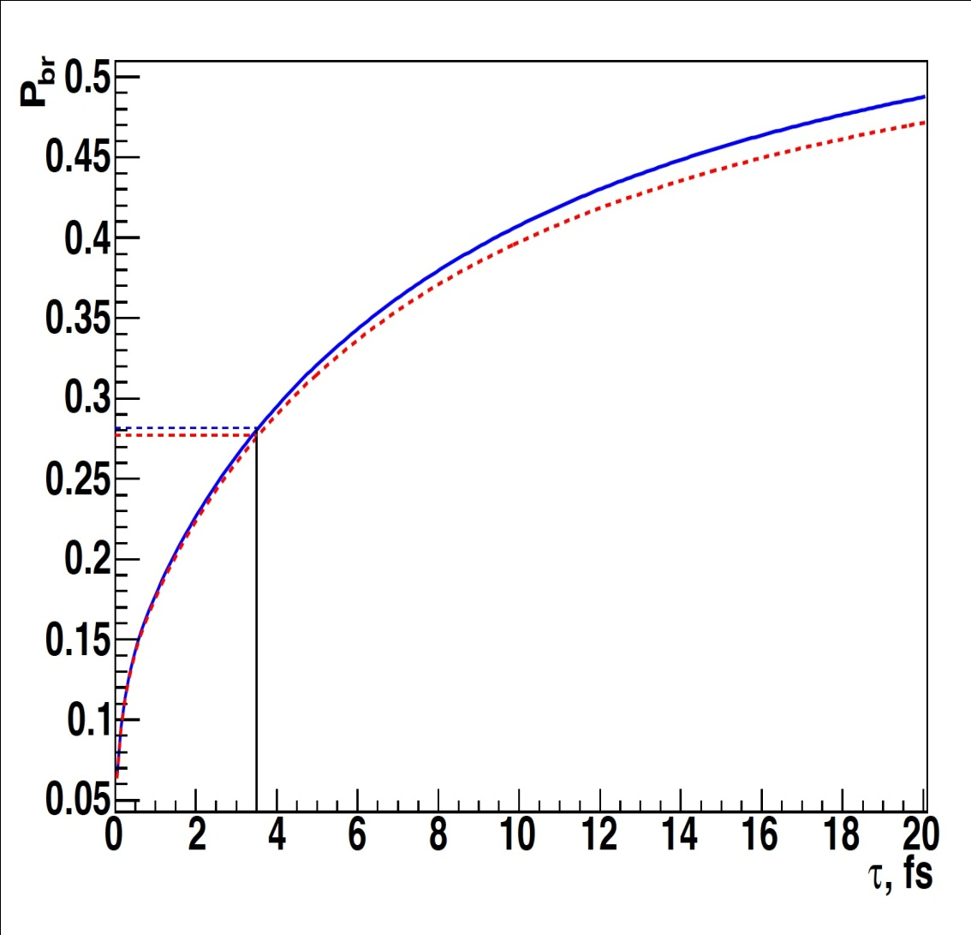
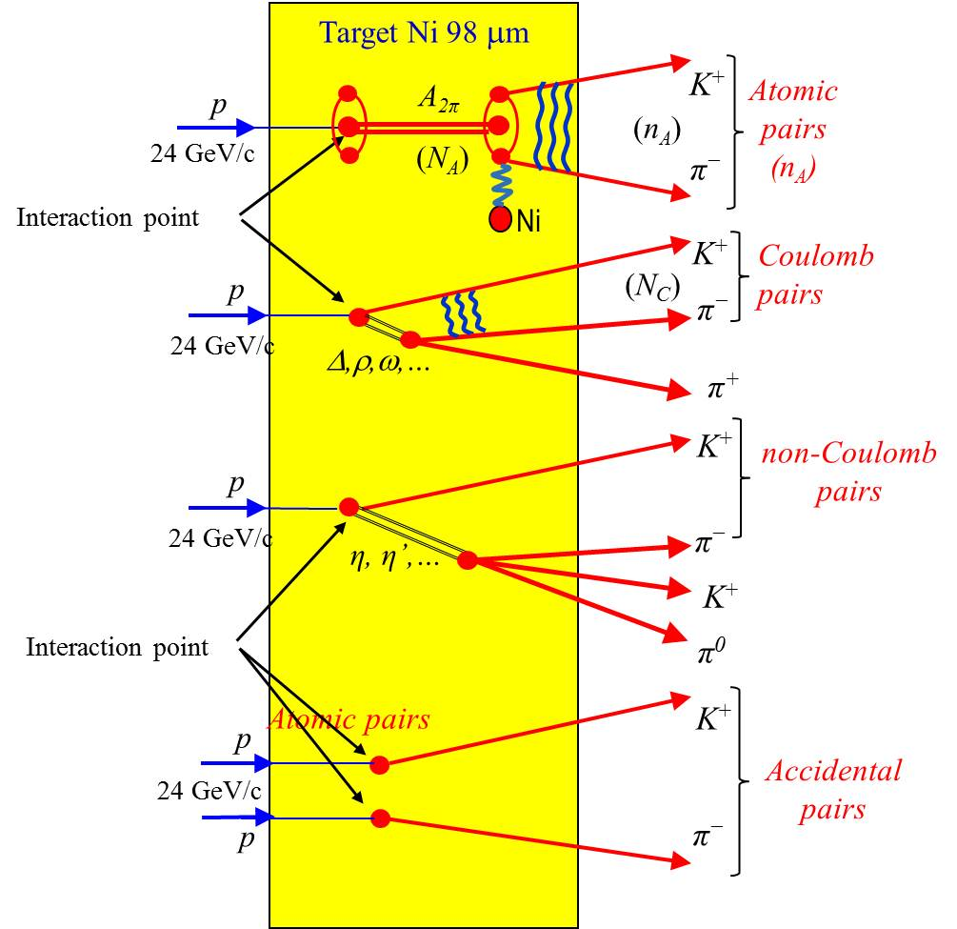
The πK atom lifetime and πK scattering length
$\frac{1}{τ}$ = R |a_{1/2}-a_{3/2}|²
τ_{th} =(3.5±0.4)×10⁻¹⁵ s. The evaluation error from this relation for |a_{1/2}-a_{3/2}| is 1%
2/27/2017

Slide 6
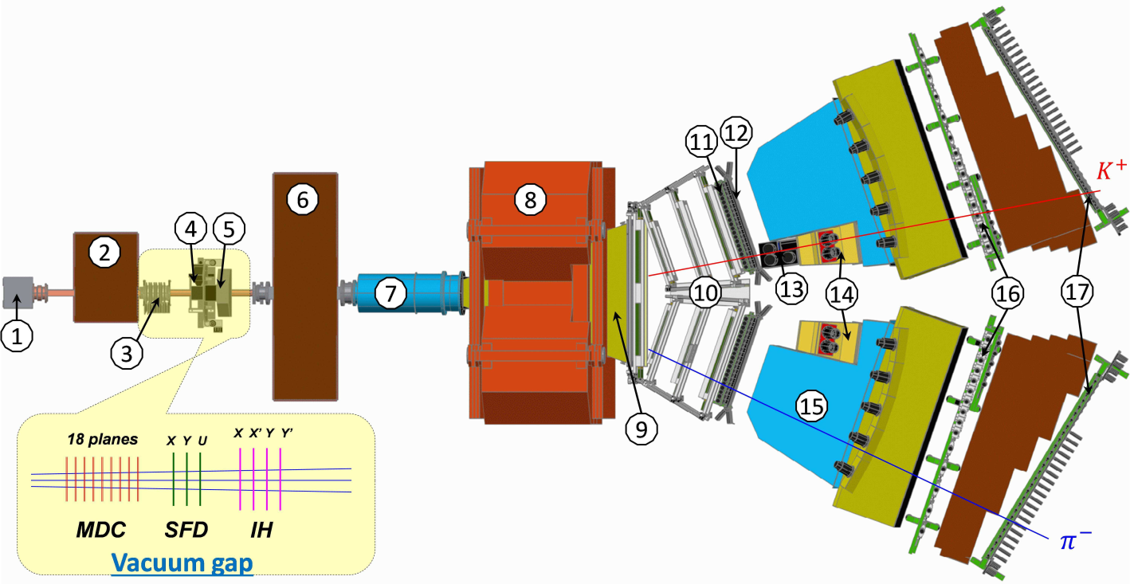
DIRAC setup, experimental and theoretical data
Experiment | Detected atomic pairs (n_{A}) | τ (10⁻¹⁵ sec) | a⁻ = $\frac{1}{3}$(a_{1/2}-a_{3/2}) | Average error
DIRAC | 349±61(stat)±9(syst) =349±62(tot) (5.6σ) | ${5.5}_{−2.8}^{+5.0}$ | ${0.072}_{−0.020}^{+0.031}$ | 34%
Theory | P.Buttiker et al., Eur.Phys.J. (2004) | K.Sasaki et al., Phys.Rev. (2014) | Z.Fu, Phys.Rev. (2013) | S.R.Beame et al. Phys.Rev (2008) | C.Lang et al.,Phys.Rev. (2012) | J.Bijnens et al., J. High Energy Phys. (2004)
a⁻ | 0.090±0.005 | 0.081 | 0.077 | 0.077 | 0.10 | 0.089
Method | Roy-Steiner equations | Lattice calculations | Lattice calculations | Lattice calculations | Lattice calculations | ChPT, two loops
2/27/2017

Slide 7
Dimeson atom production at proton momentum 450 GeV/c
The dimeson atom production in p-nucleus interaction can be enlarged by more than an order of magnitude if the incident proton momentum is increased from 24 to 450 GeV/c.
With the SPS operation conditions at 450 GeV/c (θ_{lab} = 4°) the yield, i.e. the number of produced dimeson atoms A_{2π} , A_{π}⁺_{K}⁻ and A_{π}⁻_{K}⁺ per time unit, will be 12±2, 53±11 and 24±5 times higher than in the previous DIRAC experiment (O.Gorchakov, L.Nemenov
J. Phys. G: Nucl. Part., 2016).
This significant increase in the A_{π}⁺_{K}⁻ and A_{π}⁻_{K}⁺ production allows
to measure with a new DIRAC setup in a comparable running time, |a_{1/2}-a_{3/2}| with a precision better than 5% and
to check with the same accuracy predictions of the total L(3) QCD Lagrangian based on the chiral SU(3)_{L}*SU(3)_{R} symmetry breaking
2/27/2017

Slide 8
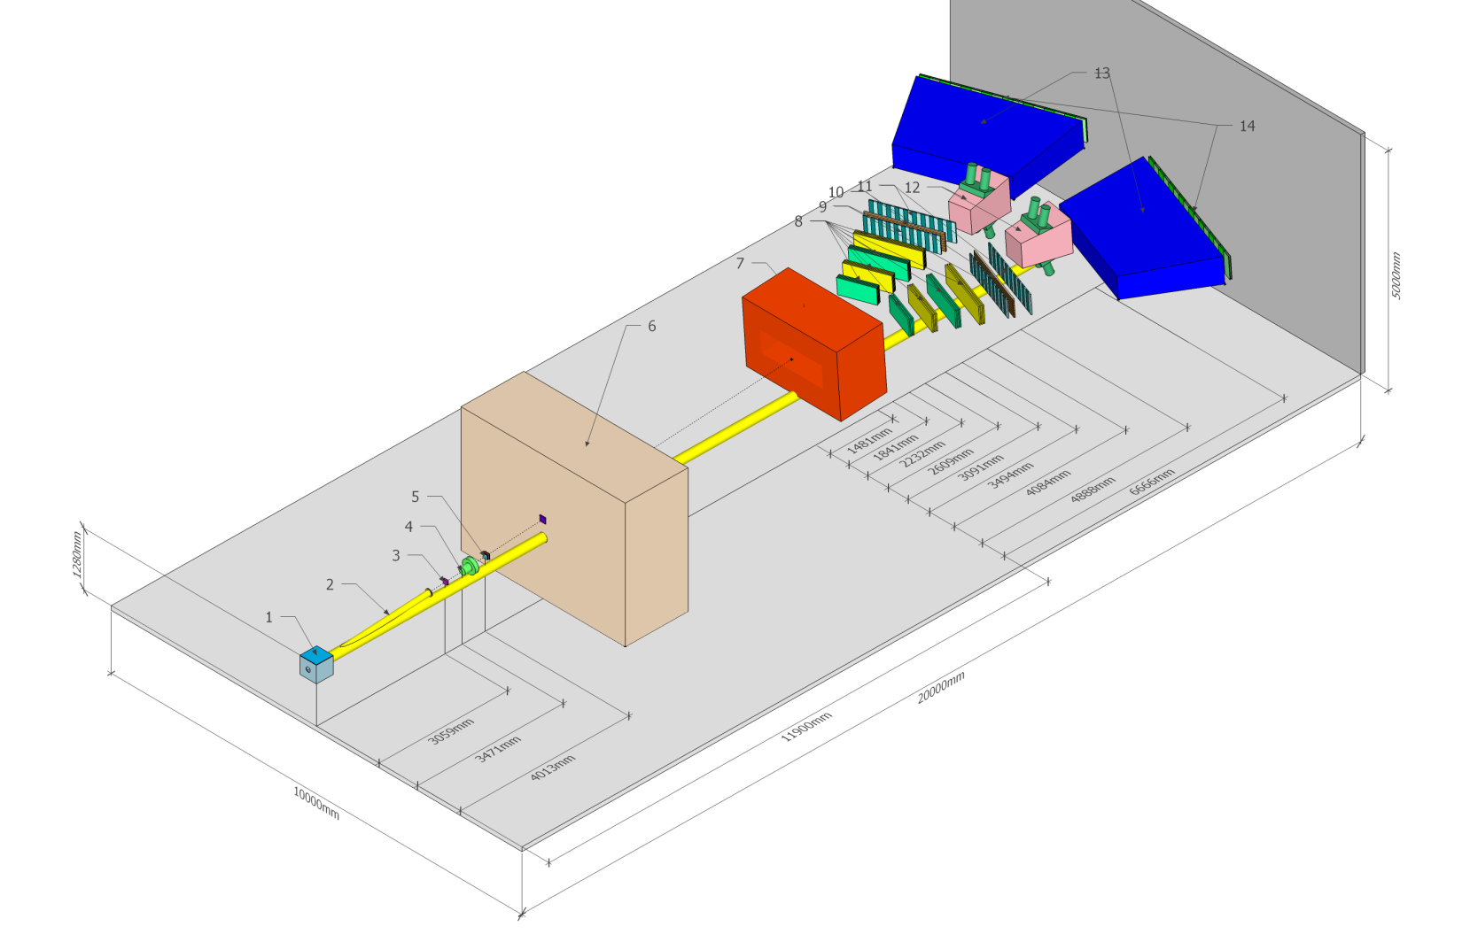
The possible scheme of the setup and detectors
2/27/2017

Slide 9
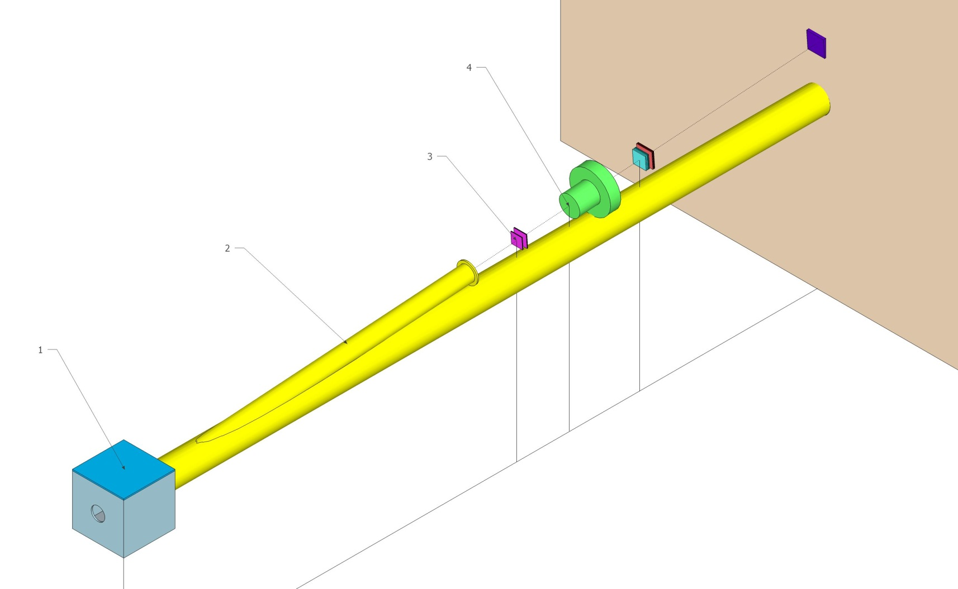
The possible scheme of the detectors before the magnet
2/27/2017

Slide 10
SPS beam time for πK scattering length measurement
The data at p_{p} = 24GeV/c and 450Gev/c were simulated, processed and analysed (V.Yazkov, DIRAC note, 2016 05).
Experimental conditions on SPS with Ni target
Thin Ni target, nuclear efficiency ~ 6x10⁻⁴.
The proton beam can be used for other experiments.
Proton beam intensity: 3x10¹¹ protons/s
(DIRAC worked at 2.7x10¹¹ protons/s)
Number of spills: 4.5x10⁵ with spill duration 4.5 s
Data taking: 3000 spills per 24 hours.
Running time: 5 months
The expected number of πK atomic pairs: n_{A}=13000
(In the DIRAC experiment was n_{A}=349±62)
The statistical precision in these conditions for πK scattering length will be: ~5%
The expected systematic error will be at the level of 2%
The expected number of π⁺π⁻ atomic pairs n_{A}=400000
The statistical precision of the π⁺π⁻ scattering length will be: 0.7%
The expected systematic error will be at the level of 2%
2/27/2017

Slide 11
L(2) and Chiral Lagrangian predictions check with short-lived π⁺π⁻ atoms
The QCD Lagrangian L(2) and Chiral Lagrangian describe processes with u and d quarks, using SU(2)_{L}*SU(2)_{R} chiral symmetry breaking.
From the ChPT prediction for a₀ and a₂, the π⁺π⁻ atom lifetime in the ground state, given by 1/τ = R|a₀-a₂|², is τ_{th}=(2.9±0.1)*10⁻¹⁵ s.
The evaluation error for |a₀-a₂| from this relation is 0.6%.
These Lagrangians predict the S-wave π⁺π⁻ scattering lengths a₀ and a₂.
2/27/2017

Slide 12
L(2) and Chiral Lagrangian predictions check with short-lived π⁺π⁻ atoms
ChPT | a₀ and a₂ a₀-a₂ | 2.3% precision 1.5% precision | Colangelo et al. Nucl.Phys.(2001)
Lattice calculations | a₀ a₂ | 4-10% precision ~1% precision | K.Sasaki et al., Phys.Rev. 2014, Z.Fu, Phys.Rev.(2013), C.Lang et al.,Phys.Rev.(2012), Feng et al., Phys. Lett.(2010), T.Yagy at al., arXiv:1108.2970, S.Beame et al. Phys.Rev(2008)
Experimental values | a₀-a₂ | ~ 4% precision | J.R.Bateley at al., Eur. Phys. J. (2009), J.R.Bateley at al., Eur. Phys. (2010), Adeva et al., Phys. Lett. (2011)
 | a₀ a₂ | ~ 6% precision ~22% precision | J.R.Bateley at al., Eur. Phys. J. (2009), J.R.Bateley at al., Eur. Phys. (2010)
on SPS | a₀-a₂ | ~2% precision | DIRAC estimation
2/27/2017

Slide 13
QCD and Chiral Lagrangian predictions check with long-lived π⁺π⁻ atoms
The DIRAC collaboration (Adeva et al., Phys.Lett.(2015) observed 436±61 pion pairs from the long-lived
(τ ≥ 1×10⁻¹¹ sec) π⁺π⁻ atom breakup (ionisation).
The study of these excited atoms allows to measure the Lamb shift depending on another ππ scattering length combination: 2a₀+a₂.
The theoretical restrictions are less than 10⁻³.
The SPS proton beam and the new experimental arrangements makes this measurements possible.
2/27/2017

Slide 14
Thank you
2/27/2017

Slide 15
Additional slides
Simulation of K⁺ and K– production cross section
M. Gugiu

Slide 16
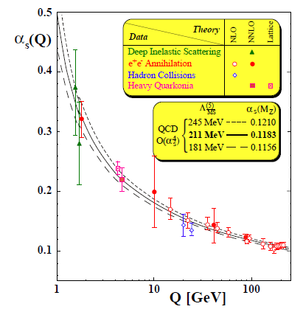
DIRAC search for strong interaction dynamics - Quark confinement
S. Bethke, J.Phys.G26:R27, 2000
α_{S} large – small Q²
“quark confinement”
perturbative QCD not suitable.
Lattice QCD solve field equations
on a space-time lattice by MC.
α_{S} small – large Q²
“asymptotic freedom”
and perturbative QCD
π⁺
π⁺
π⁰
π⁺
u
d
u
d
u
d
u
u
u
d
Small Δx distance;
quark degrees
of freedom
Energy fed
into the system
The released energy gets
out a quark-antiquark pair
from the Vacuum
Large Δx distance;
pion degrees of freedom
string breaks generate qq
pair to reduce field energy
“quark confinement”
DIRAC
“asymptotic freedom”
2/27/2017
Mircea Pentia IFIN-HH Bucharest

Slide 17
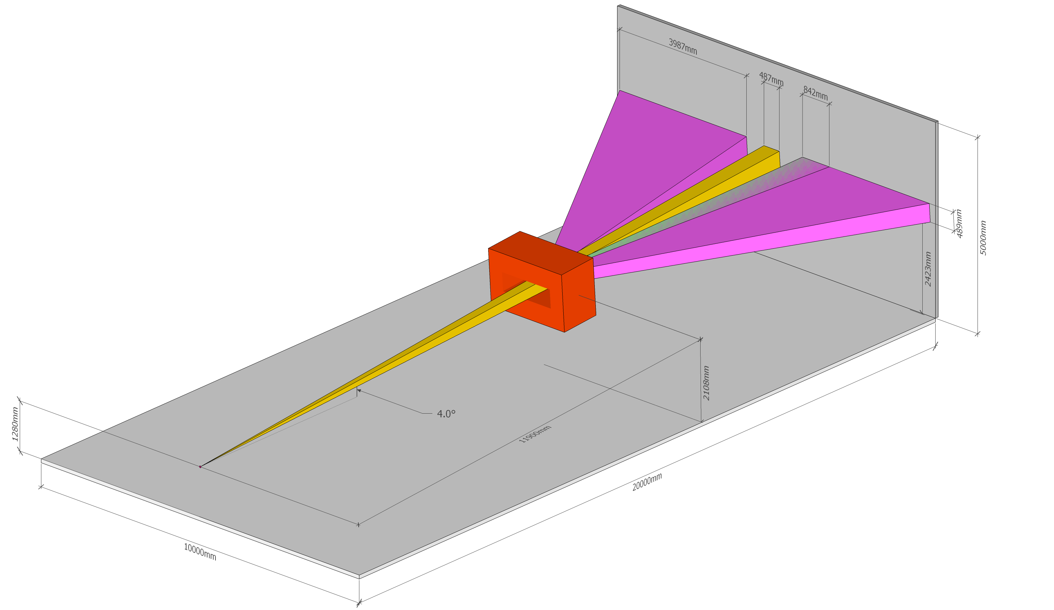
The possible scheme of the setup and detectors
2/27/2017

Slide 18
Detectors and dimensions (mm)
Name | Distance to the target | X-size | Y-size | Z-size | Other
Target | 0 | 50 | 50 | 0.1
First Upstream Tracker (Silicon) | 3059 | 86 | 86 |  | 4 planes 2 if pixel
RICH | 3471 | 94 | 94
Second Upstream Tracker (Scintillating Fiber) | 4013 | 100 | 100
Third Upstream Tracker (Ionization Hodoscope) | 4053 | 120 | 120
First Downstream Tracker | 13381 | 746 | 370
Second Downstream Tracker | 13711 | 946 | 380
Third Downstream Tracker | 14132 | 1133 | 390
Forth Downstream Tracker | 14509 | 1326 | 400
First Vertical Hodoscope | 14991 | 1471 | 400
Horizontal Hodoscope | 15594 | 1545 | 400
Second Vertical Hodoscope | 15984
Preshower | 18566
The Wall | 20000
2/27/2017

