Slide 1
Experimental check of precise
predictions of QCD using
π⁺K⁻ , K⁺π⁻ and π⁺π⁻ atoms
L. Nemenov (JINR, DIRAC collaboration)
CERN, june 2018

Slide 2








DIRAC Collaboration
CERN
Geneva, Switzerland
Tokyo Metropolitan University
Tokyo, Japan
Czech Technical University
Prague, Czech Republic
IFIN-HH
Bucharest, Romania
Institute of Physics ASCR
Prague, Czech Republic
JINR
Dubna, Russia
Nuclear Physics Institute ASCR
Rez, Czech Republic
SINP of Moscow State University
Moscow, Russia
INFN-Laboratori Nazionali di Frascati
Frascati, Italy
IHEP
Protvino, Russia
University of Messina
Messina, Italy
Santiago de Compostela University
Santiago de Compostela, Spain
KEK
Tsukuba, Japan
Bern University
Bern, Switzerland
Kyoto University
Kyoto, Japan
Kyoto Sangyo University
Kyoto, Japan
Zurich University
Zurich, Switzerland

Slide 3
Contents
1. Experimental check of QCD using π⁺K⁻
π⁻ K ⁺ and π⁺π⁻ atoms at PS CERN.
2. Long-lived π⁺π⁻ atom lifetime first measurement
and possibility to check of QCD measuring the atom Lamb shift.
Observation of K ⁺K ⁻ Coulomb pairs and K ⁺K ⁻ atoms production investigation.
4. The new physical method to investigate the particle production in the coordinate space.
5. K ⁺π⁻ , K ⁻ π⁺, π⁺π⁻ and K ⁺K ⁻ atom production at SPS CERN and check of QCD.
4. K ⁺π⁻ , K ⁻ π⁺, π⁺π⁻ and K ⁺K ⁻ atom production at SPS CERN and check of QCD.
5. The new physical method to investigate the particle production in the coordinate space.
6/25/18

Slide 4

QCD Lagrangian and its prediction
The QCD Lagrangians use the SU(3)_{L}*SU(3)_{R} and SU(2)_{L}*SU(2)_{R} chiral symmetry breaking.
L(u,d,s) = L(3) = L_{sym}(3)+ L_{sym.br.}(3)
L_{sym.br.} is proportional to m_{q}
L(u,d) = L(2) = L_{sym}(2) + L_{sym.br.}(2)
QCD provides cross sections with 1% precision
Perturbation theory is working at high momentum transfer Q.
Unitarity condition.
At large Q, contribution of L_{sym.br.} to the cross section is proportional to 1/Q⁴. Therefore these experiments checked only the L_{sym} prediction precision.
  To check the total L(3) Lagrangian predictions, we must study the
  low momentum transfer Q processes.
Tools: Lattice calculations and Chiral Perturbation Theory (ChPT)
Lattice----- L(3), L(2) ChPT------Effective Lagrangians.
6/25/18

Slide 5
Measurement of the πK scattering length
The S-wave πK scattering lengths a_{1/2} and a_{3/2} in the chiral symmetry world are zero. Therefore the scattering length values a_{1/2} and a_{3/2} are very sensitive to the L_{sym.br.}(3).
For Lattice QCD the πK interaction at threshold is a relatively simple process. It gives πK scattering length values with an average precision of 5%.
This precision will be improved in the near future.
There is only one experimental data: DIRAC collaboration observed 349±62 πK atomic pairs (Phys.Rev.Lett. 2016) and measured |a_{1/2}-a_{3/2}| with an average precision of 34% (Phys.Rev.D 2017).
6/25/18

Slide 6


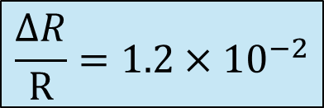
π⁺π– atom lifetime
π⁺π– atom (pionium) is a hydrogen-like atom consisting of π⁺ and π– mesons:
E_{B} = -1.86 keV, r_{B} = 387 fm, p_{B} ≈ 0.5 MeV/c
π⁺
π⁰
The π⁺π⁻ atom lifetime is dominated by the decay into π⁰ π⁰ mesons:
π⁻
π⁰
$$\frac{ΔR}{R}=1.2×{10}^{−2}$$
$$τ_{1s}=(2.9±0.1)×{10}^{−15}s$$
$$τ_{2p}=1.17×{10}^{−11}s$$
a₀ and a₂ are the ππ S-wave scattering lengths for isospin I=0 and I=2.
≠ 0 for l = 0
A_{2π}(1s, 2s,…, ns)
π⁰π⁰
= 0 for l ≠ 0
γ
π⁰π⁰
A_{2π}(np)
A_{2π}(1s, 2s,…(n-1)s)
The np state lifetime depends on the transition np 1s, 2s,…, (n-1)s probability.
This probability is about 3 orders of magnitude less than for ns π⁰π⁰.

Slide 7
Method of A_{2π} observation and measurement
Target Ni 98 μm
A_{2π}
π⁺
p
(n_{A})
Atomic pairs
24 GeV/c
(N_{A})
π⁻
Interaction point
Ni
π⁺
p
(N_{C})
π⁻
Coulomb pairs
24 GeV/c
Δ,ρ,ω,…
π⁺
π⁺
p
Non-Coulomb pairs
24 GeV/c
π⁻
η, η’,…
π⁺
Interaction point
π⁰
p
π⁺
24 GeV/c
Accidental pairs
p
π⁻
6/25/18

Slide 8
Coulomb pairs and atoms
For charged pairs from short-lived sources and with small relative momenta Q , Coulomb final state interaction has to be taken into account.
This interaction increases the production yield of the free pairs with Q decreasing and creates atoms.
π⁺π⁻, Κ⁺π⁻, Κ⁻π⁺,
Κ⁺Κ⁻, π⁺μ⁻, π⁻μ⁺
(π⁺π⁻), (Κ⁺π⁻), (Κ⁻π⁺),
(Κ⁺Κ⁻), (π⁺μ⁻), (π⁻μ⁺)
Coulomb pair
Atom
There is a precise ratio between the number of produced Coulomb pairs (N_{C}) with small Q and the number of atoms (N_{A}) produced simultaneously with Coulomb pairs:
6/25/18

Slide 9
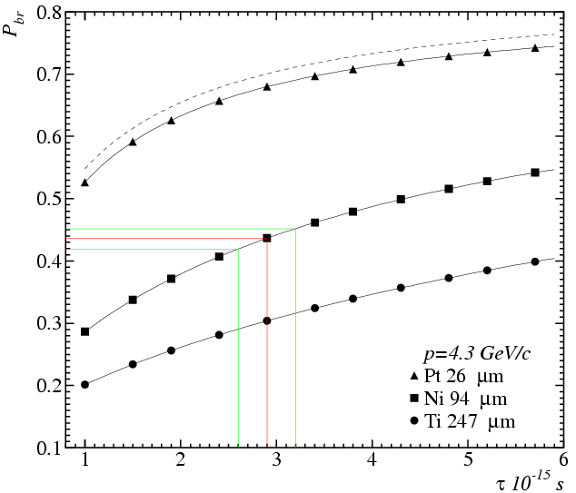
Break-up probability
Solution of the transport equations provides one-to-one dependence of the measured break-up probability (P_{br}) on pionium lifetime τ
Cross section calculation precision 0.6%
All targets have the same thickness in radiation lengths 6.7*10⁻³ X₀
There is an optimal target material for a given lifetime

Slide 10
Κ⁺π⁻ and Κ⁻π⁺ atoms lifetime
Kπ-atom (A_{Kπ}) is a hydrogen-like atom consisting of K⁺ and π⁻ mesons:
E_{B}= -2.9 keV r_{B} = 248 fm p_{B} ≈ 0.8 MeV
The Kπ-atom lifetime (ground state 1S), τ=1/Γ is dominated by the annihilation process into K⁰π⁰:
K⁺
π⁰
K⁰
π⁻
**
(**) J. Schweizer (2004)
From Roy-Steiner equations:
If

Slide 11
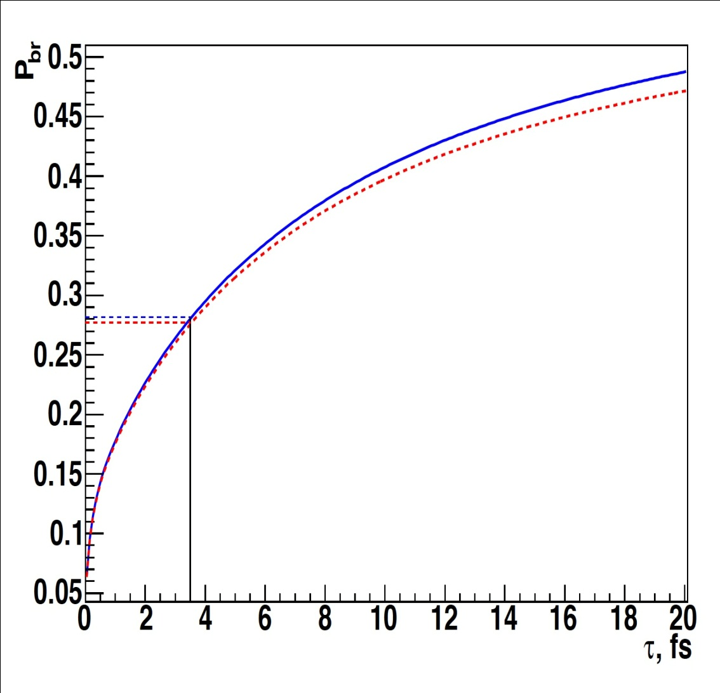
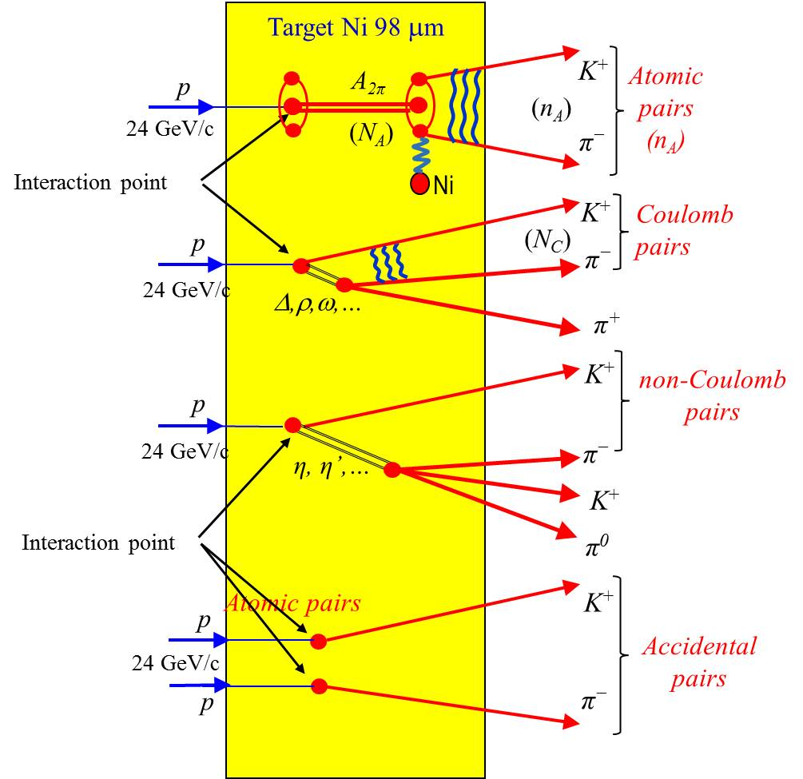
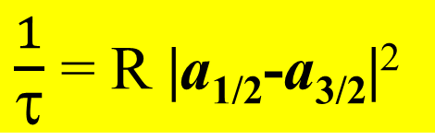
The πK atom lifetime and πK scattering length
$\frac{1}{τ}$ = R |a_{1/2}-a_{3/2}|²
τ_{th} =(3.5±0.4)×10⁻¹⁵ s. The evaluation error from this relation for |a_{1/2}-a_{3/2}| is 1%
6/25/18

Slide 12
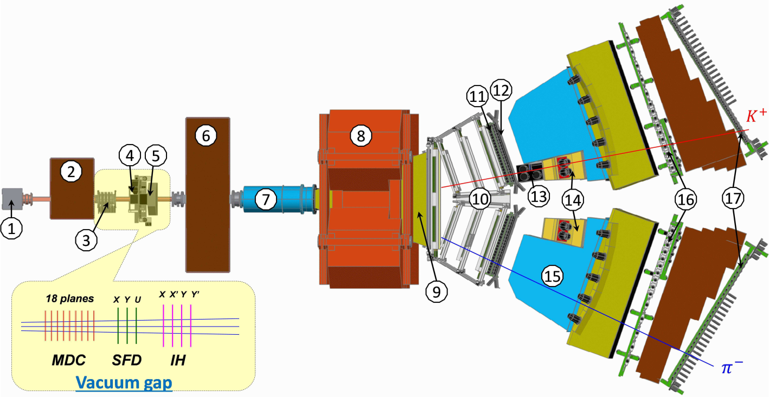
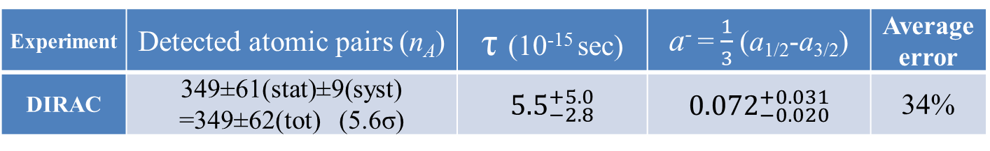
DIRAC setup, experimental and theoretical data
27 September to 19 November.
27 September to 19 November.
Experiment | Detected atomic pairs (n_{A}) | τ (10⁻¹⁵ sec) | a⁻ = $\frac{1}{3}$(a_{1/2}-a_{3/2}) | Average error
DIRAC | 349±61(stat)±9(syst) =349±62(tot) (5.6σ) | ${5.5}_{−2.8}^{+5.0}$ | ${0.072}_{−0.020}^{+0.031}$ | 34%
Theory | P.Buttiker et al., Eur.Phys.J. (2004) | K.Sasaki et al., Phys.Rev. (2014) | Z.Fu, Phys.Rev. (2013) | S.R.Beame et al. Phys.Rev (2008) | C.Lang et al.,Phys.Rev. (2012) | J.Bijnens et al., J. High Energy Phys. (2004)
a⁻ | 0.090±0.005 | 0.081 | 0.077 | 0.077 | 0.10 | 0.089
Method | Roy-Steiner equations | Lattice calculations | Lattice calculations | Lattice calculations | Lattice calculations | ChPT, two loops
6/25/18

Slide 13
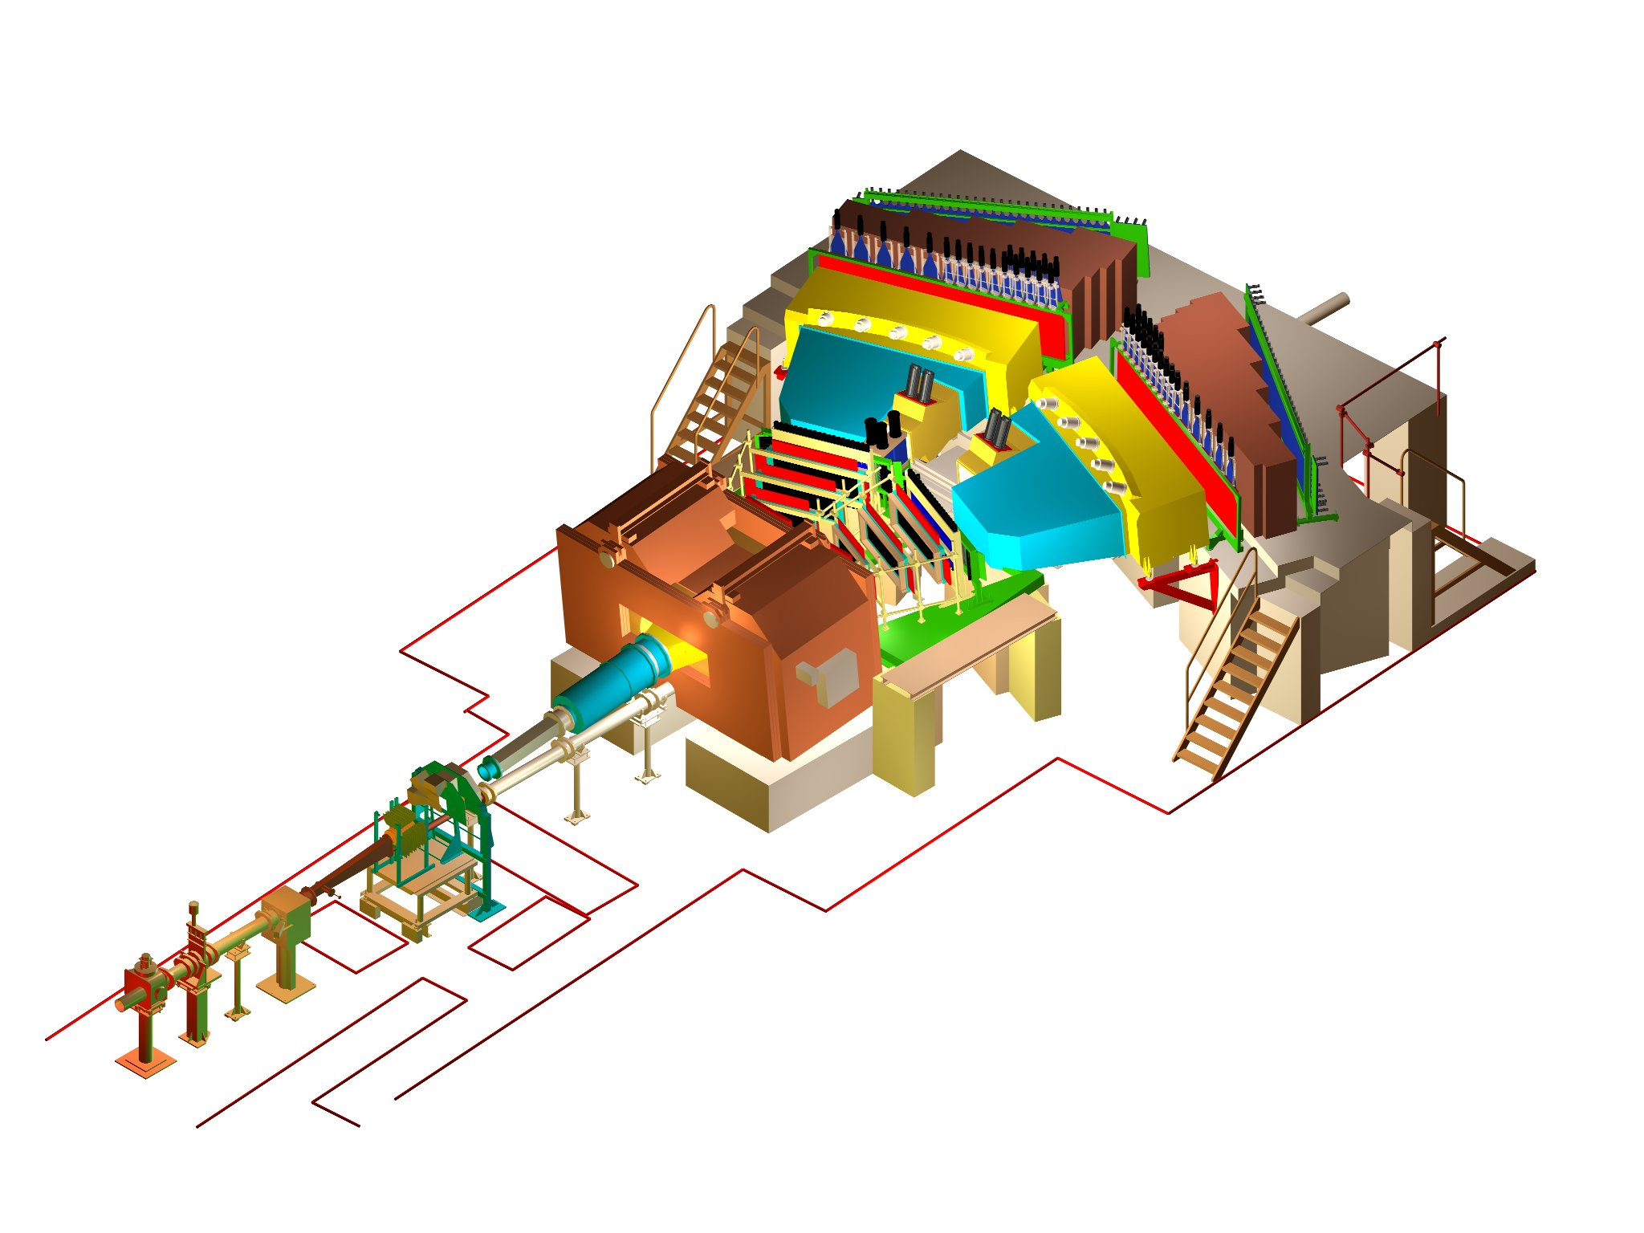
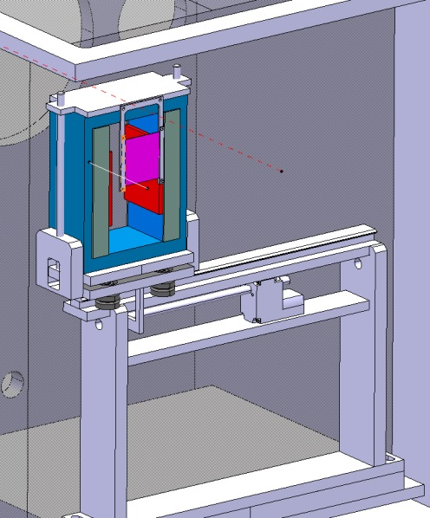
DIRAC upgraded Experimental setup
BLUE … magnet yoke
GREY … magnet poles
RED … magnet shimming
PURPLE … Pt foil
σ_{QX} = σ_{QY} = 0.5 MeV/c
σ_{QL} = 0.5 MeV/c (ππ)
σ_{QL} = 0.9 MeV/c (πΚ)
6/25/18
Notes:
13

Slide 14
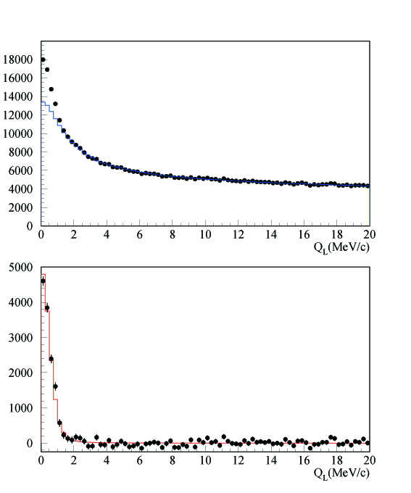
DIRAC results with GEM/MSGC
Q_{L} distribution
←All events
←After background
subtraction

Slide 15
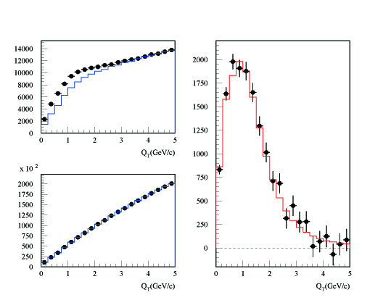
DIRAC results with GEM/MSGC
Q_{T} distribution
←After background
subtraction for Q_{L}<2MeV/c
Q_{L}<2 MeV/c
Q_{L}>2 MeV/c

Slide 16
Experimental results
K→3π:
2009 NA48/2 (EPJ C64, 589)
plus additional 3.4% theory uncertainty
Ke4:
2010 NA48/2 (EPJ C70, 635)
π⁺π⁻ atom:
2011 DIRAC (PLB 704, 24)
6/25/18
Notes:
16

Slide 17
πK atom observation
All data Platinum and Nickel targets
K⁺π⁻ and K⁻π⁺ atoms , Q_{L} distribution for Q_{T} < 4 MeV/c χ² /ndf = 41/37
In absense of “atomic pairs” χ 2 /ndf = 73/38

Slide 18
DIRAC setup, experimental and theoretical data
Experiment | Detected atomic pairs (n_{A}) | τ (10⁻¹⁵ sec) | a⁻ = $\frac{1}{3}$(a_{1/2}-a_{3/2}) | Average error
DIRAC | 349±61(stat)±9(syst) =349±62(tot) (5.6σ) | ${5.5}_{−2.8}^{+5.0}$ | ${0.072}_{−0.020}^{+0.031}$ | 34%
Theory | P.Buttiker et al., Eur.Phys.J. (2004) | K.Sasaki et al., Phys.Rev. (2014) | Z.Fu, Phys.Rev. (2013) | S.R.Beame et al. Phys.Rev (2008) | C.Lang et al.,Phys.Rev. (2012) | J.Bijnens et al., J. High Energy Phys. (2004)
a⁻ | 0.090±0.005 | 0.081 | 0.077 | 0.077 | 0.10 | 0.089
Method | Roy-Steiner equations | Lattice calculations | Lattice calculations | Lattice calculations | Lattice calculations | ChPT, two loops
6/25/18

Slide 19
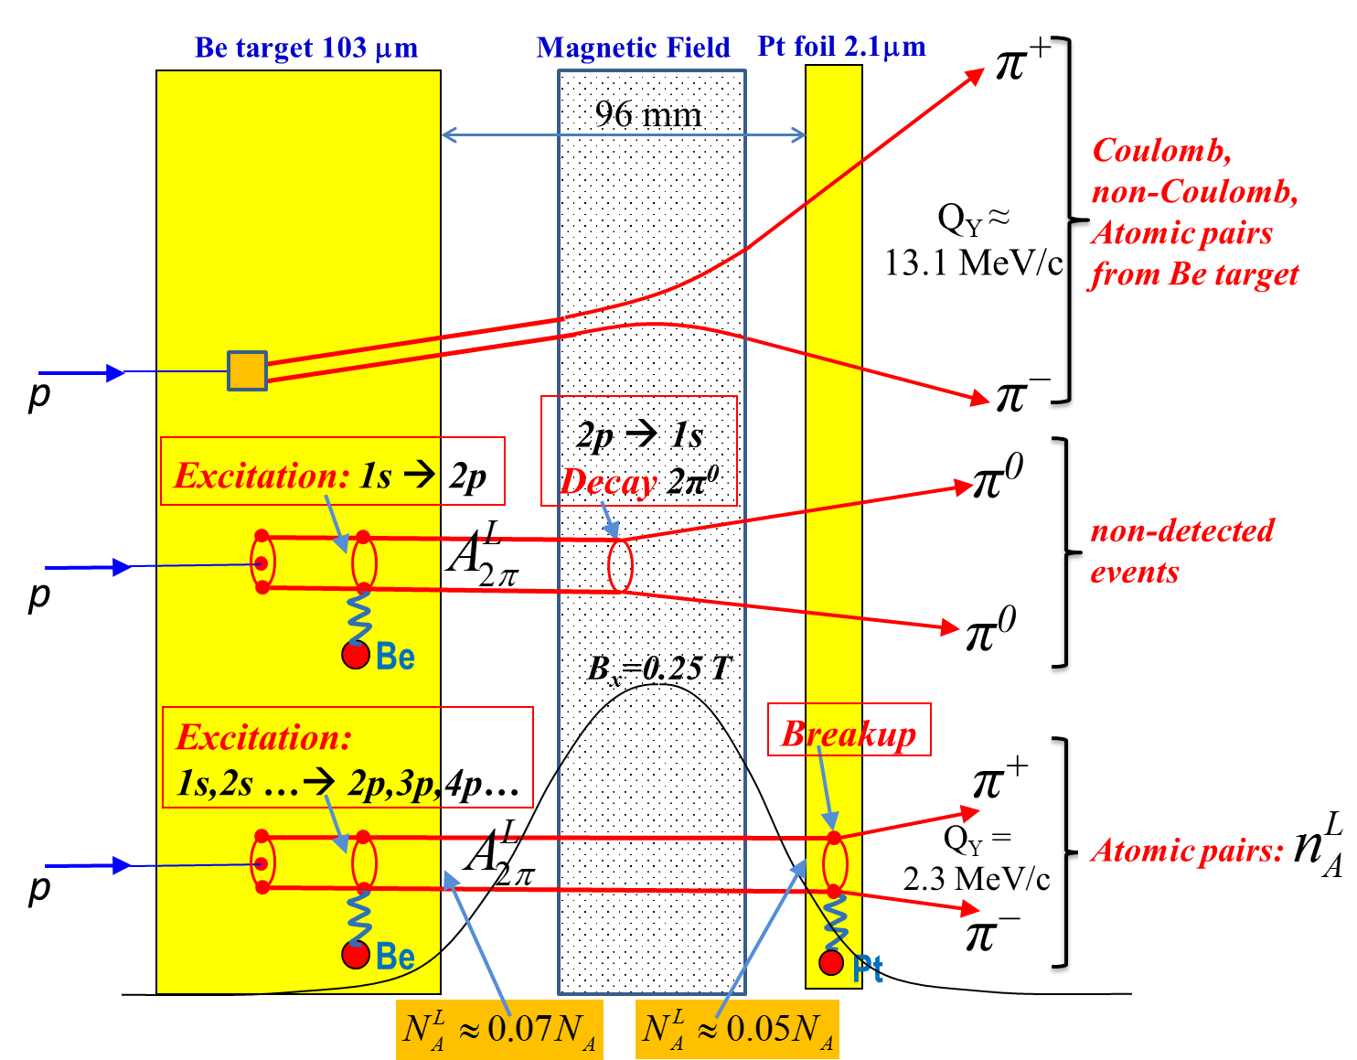
The π⁺π⁻ atoms production in Be target
Fig. 1 Method to observe long-lived A^{L}_{2π} by means of a breakup foil (Pt). The most of the produced π⁺π⁻ atoms decay (~70%) or are ionized (~6%) in the Be target. The excited (long lived) atoms (~24%) are investigated here.
6/25/18

Slide 20
π⁺π⁻ atom lifetime and decay lengths
n | τ_{2π} (10⁻¹¹sec) |  | Decay length A_{2π} in L.S. (cm) for γ=16
 |  |  | (λ_{ns}=c ∙ γ ∙ τ_{nl})
 | s (l=0) | p (l=1) | s (l=0) | p (l=1)
 | τ_{ns}=τ_{1s}∙ n³
1 | 2.9 ∙10⁻⁴ | - | 1.39∙10⁻³ | -
2 | 2.32∙10⁻³ | 1.17 | 1.11∙10⁻² | 5.6
3 | 7.83∙10⁻³ | 3.94 | 3.76∙10⁻² | 19
4 | 1.86∙10⁻² | 9.05 | 8.91∙10⁻² | 43
5 | 3.63∙10⁻² | 17.5 | 1.74∙10⁻¹ | 84
6 | 6.26∙10⁻² | 29.9 | 3.01∙10⁻¹ | 144
7 | 9.95∙10⁻² | 46.8 | 4.77∙10⁻¹ | 225
8 | 1.48∙10⁻¹ | 69.3 | 7.13∙10⁻¹ | 333
6/25/18

Slide 21
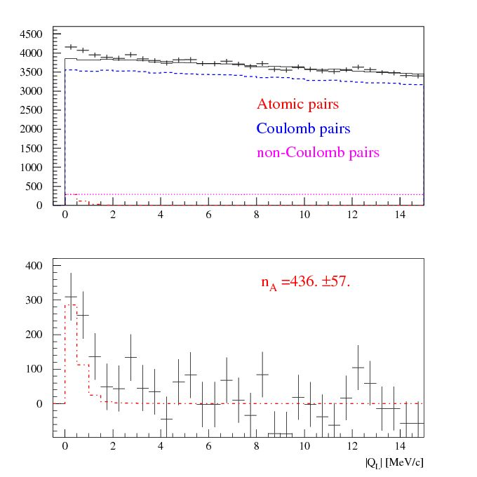
Experimental |Q_{L}| distributions of π⁺π– pairs
|Q_{L}| distribution of π⁺π– pairs
for Q_{T} <2.0 MeV/c
a) The experimental distribution (points with statistical error) and the simulated background (solid line).
b) The experimental distribution after background subtraction (points with statistical error) and the simulated distribution of atomic pairs (dot-dashed line).
The fit procedure has been applied to the 2-dimensional (|Q_{L}|, Q_{T} ) distribution.
a)
b)
6/25/18

Slide 22
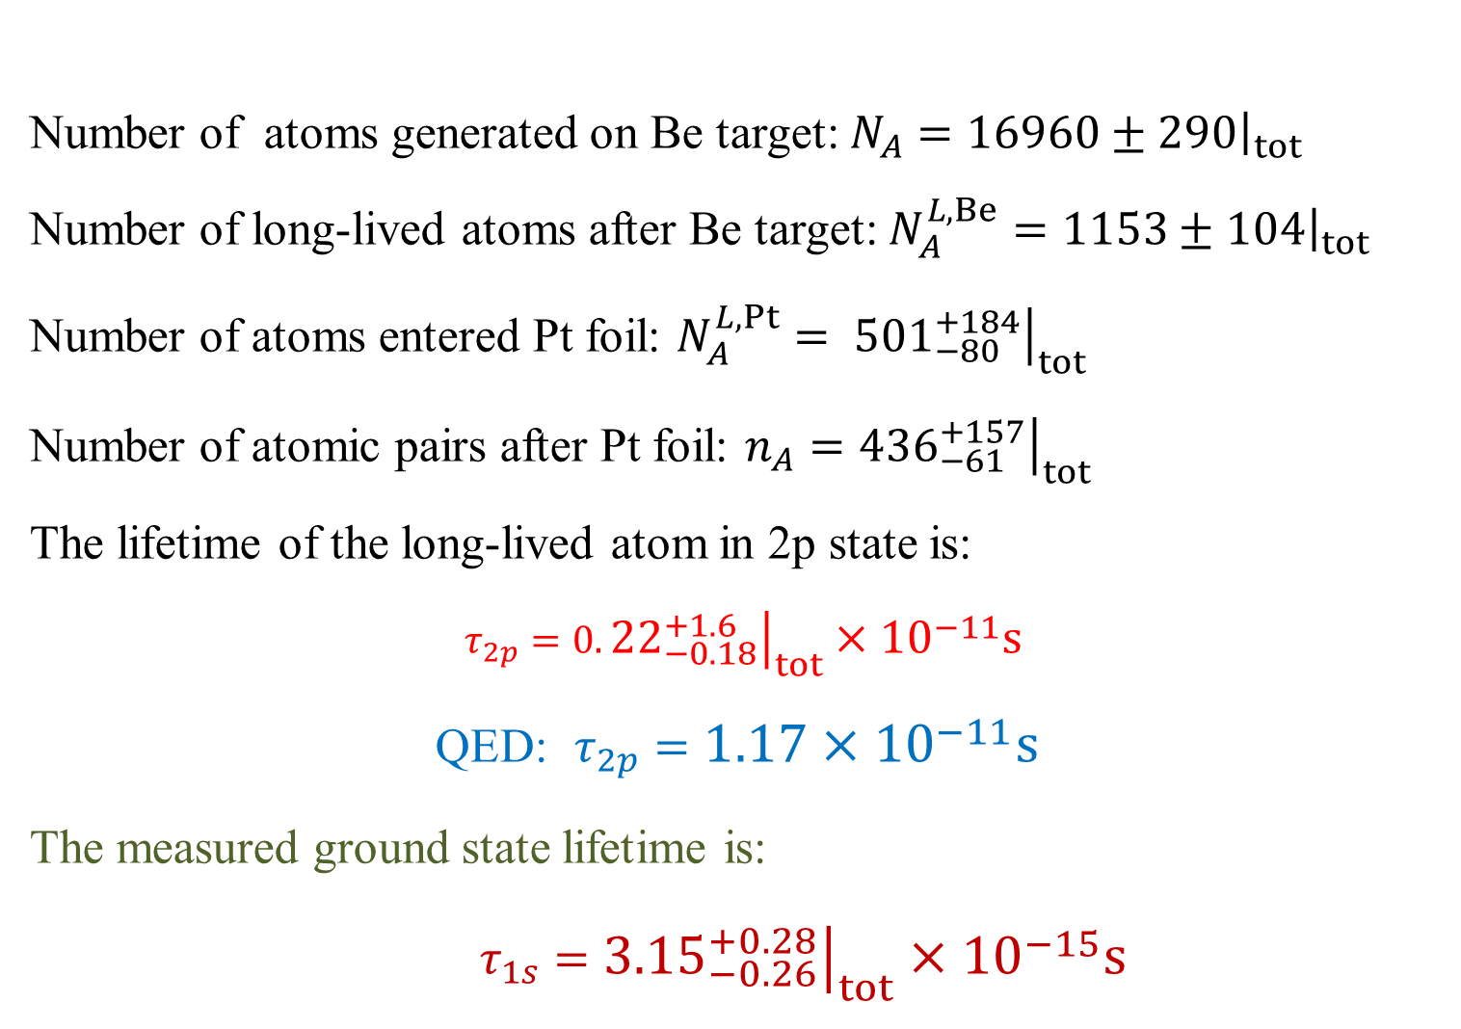
Lifetime of long-lived π⁺π⁻ atoms
Number of atoms generated on Be target: $N_{A}={\left.16960±290\right|}_{tot}$
Number of long-lived atoms after Be target: $N_{A}^{L,Be}={\left.1153±104\right|}_{tot}$
Number of atoms entered Pt foil: $N_{A}^{L,Pt}= {\left.{501}_{−80}^{+184}\right|}_{tot}$
Number of atomic pairs after Pt foil: $n_{A}={\left.{436}_{−61}^{+157}\right|}_{tot}$
The lifetime of the long-lived atom in 2p state is:
$τ_{2p}=0.{\left.{22}_{−0.18}^{+1.6}\right|}_{tot}×{10}^{−11}s$
QED: $τ_{2p}=1.17×{10}^{−11}s$
The measured ground state lifetime is:
$τ_{1s}={\left.{3.15}_{−0.26}^{+0.28}\right|}_{tot}×{10}^{−15}s$
6/25/18

Slide 23
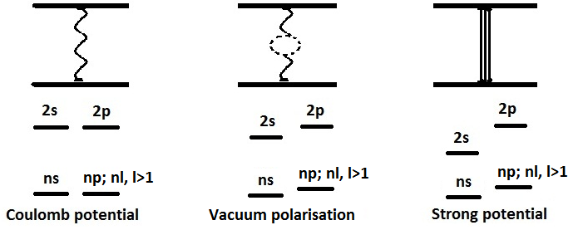
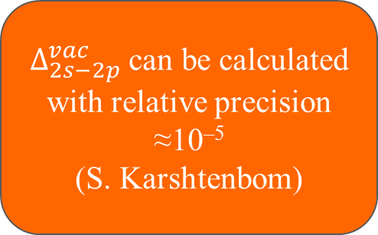
Energy splitting measurement
A_{2π} Energy Levels
$Δ_{2s−2p}^{vac}$ can be calculated with relative precision ≈10^{–5}
(S. Karshtenbom)
For Coulomb potential,
E depends only on n
higher order QED
Notation:
J. Schweizer
[PL B (2004)]
G.V.Efimov et al.
Sov.J.Nucl.Phys. (1986)
CONCLUSION: one parameter (2a₀+a₂) allows to calculate all values

Slide 24
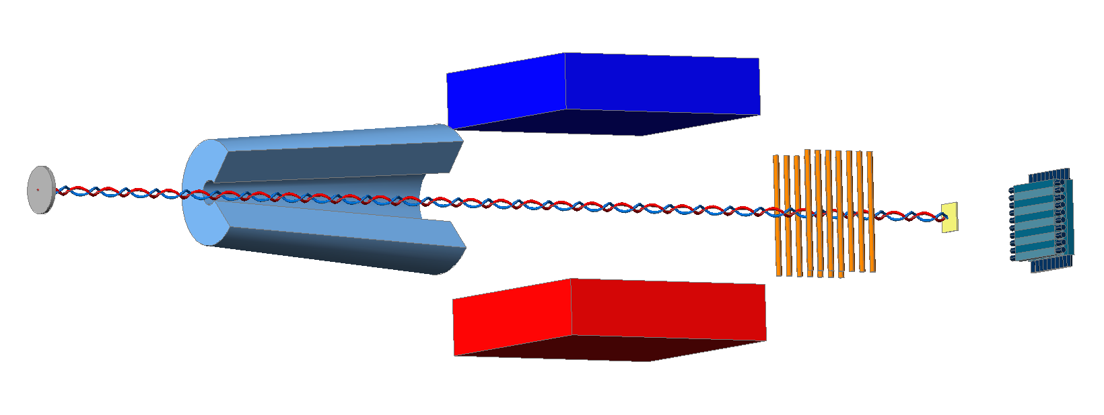
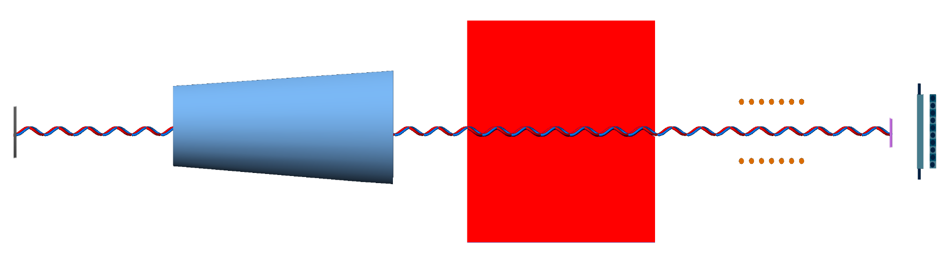
DIRAC future Experimental setup
Forward Detectors
Collimator
Pt foil
Resonators
proton beam
Secondaries
6/25/18

Slide 25
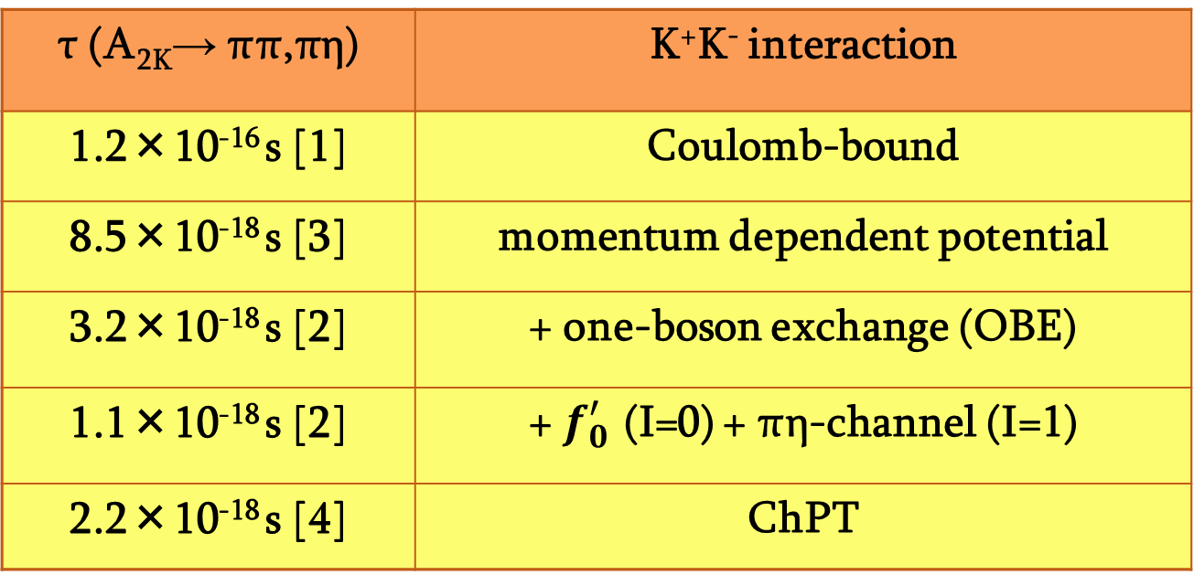
K⁺K– atom and its lifetime
The A_{2Κ} lifetime is strongly reduced by strong interaction (OBE, scalar meson f₀ and a₀) as compared to the annihilation of a purely Coulomb-bound system (K⁺K⁻).
τ (A_{2K}→ ππ,πη) | K⁺K⁻ interaction
1.2×10⁻¹⁶ s [1] | Coulomb-bound
8.5×10⁻¹⁸ s [3] | momentum dependent potential
3.2×10⁻¹⁸ s [2] | + one-boson exchange (OBE)
1.1×10⁻¹⁸ s [2] | + $f_{0}^{′}$ (I=0) + πη-channel (I=1)
2.2×10⁻¹⁸ s [4] | ChPT
K⁺K⁻ interaction
complexity
References:
[1] S. Wycech, A.M. Green, Nucl. Phys. A562 (1993), 446;
[2] S. Krewald, R. Lemmer, F.P. Sasson, Phys. Rev. D69 (2004), 016003;
[3] Y-J Zhang, H-C Chiang, P-N Shen, B-S Zou, PRD74 (2006) 014013;
[4] S.P. Klevansky, R.H. Lemmer, PLB702 (2011) 235.
6/25/18

Slide 26
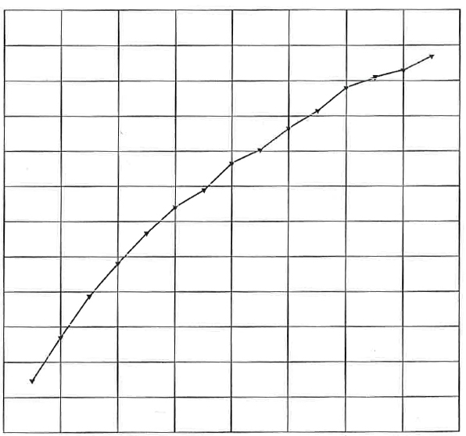
Κ⁺Κ⁻ atoms ionization probability
28 μm Pt
x 10⁻²
3.9
3.5
3.1
2.7
2.3
1.9
1.5
Ionization Probability
0 1 2 3 4
Life time τ in 10^{–18} s
Κ⁺Κ⁻ atoms Lorentz factor is γ = 18
Notes:
26

Slide 27
Coulomb pairs and atoms
For charged pairs from short-lived sources and with small relative momenta Q , Coulomb final state interaction has to be taken into account.
This interaction increases the production yield of the free pairs with Q decreasing and creates atoms.
Κ⁺Κ⁻
Coulomb pair
Atom
There is a precise ratio between the number of produced Coulomb pairs (N_{C}) with small Q and the number of atoms (N_{A}) produced simultaneously with Coulomb pairs:
6/25/18

Slide 28
The experimental distributions of K+K- pairs on the longitudinal component QL of Q, the relative momentum Q in the c.m.s. of pair, for the 3 values of the transfer momentum QT:
0 < QT < 2MeV/c, 2< QT < 4MeV/c,
4< QT < 6MeV/c.
These distributions were obtained after subtraction from the experimental distributions of K+K- and pi+pi- pairs the background of pi-pi pairs. The part of the K+K- pairs in the initial distributions was 70%. In the each interval of QT the yield of pairs is increasing with the decreasing of Ql. This effect is caused by the Coulomb interaction between K+ and K- in the final state. To prove that this effect cannot be explained without Coulomb interaction of K+K- pairs the K+K- distributions were fitted by simulated distribution of K+K- pairs(red color) and the distribution of experimental pi+pi- pairs processed as K+K-(blue color). It is obvious that
experimental distributions cannot be described without K+K- interaction in the final state.

Slide 29
30%
50%
70%

Slide 30
30%
50%
70%

Slide 31
30%
50%
70%

Slide 32



















































$$u$$
$$u$$
$$K^{+}$$
$$\overline{s}$$
$$K^{+}$$
$$s$$
$$\overline{s}$$
$$K^{−}$$
$$s$$
$$ϕ$$
$$\overline{u}$$
$$\overline{s}$$
$$u$$
$$s$$
$$u$$
$$s$$
$$d$$
$$d$$
$$p$$
$$K^{−}$$
$$p$$
$$\overline{u}$$
$$u$$
$$u$$
$$Λ(1520)$$
$$u$$
$$π^{0}$$
$$d$$
$$π^{−}$$
$$\overline{u}$$
$$\overline{u}$$
$$u$$
$$K^{∗+}$$
$$u$$
$$d$$
$$K^{∗0}$$
$$u$$
$$K^{+}$$
$$K^{+}$$
$$\overline{s}$$
$$\overline{s}$$
$$\overline{s}$$
$$\overline{s}$$
$$s$$
$$s$$
$$K^{−}$$
$$K^{−}$$
$$\overline{u}$$
$$\overline{u}$$
$$u$$
$$u$$

Slide 33
Measurement of the πK and ππ scattering length on SPS CERN
The number of produced A_{2π} , A_{π}⁺_{K}⁻ and A_{π}⁻_{K}⁺ per time unit at SPS CERN at p_{p} = 450Gev/c, will be 12±2, 53±11 and 24±5 times higher than in the DIRAC experiment [J.Phys. G: Nucl. Phys. 43 (2016)]
For the setup with the same parameters as in the DIRAC experiment and running time 5 months the expected statistical (sysematic) precision for πK scattering length |a_{1/2}-a_{3/2}| is ~5% (2%). (The DIRAC error is 34%). It allows to check with the same accuracy predictions of the total L(3) QCD Lagrangian based on the chiral SU(3)_{L}*SU(3)_{R} symmetry breaking.
Simultaneously the expected number of π⁺π⁻ atomic pairs n_{A}=400000 . The statistical (systematic) precision of the π⁺π⁻ scattering length
|a₀-a₂| will be: 0.7% (2%).
6/25/18

Slide 34
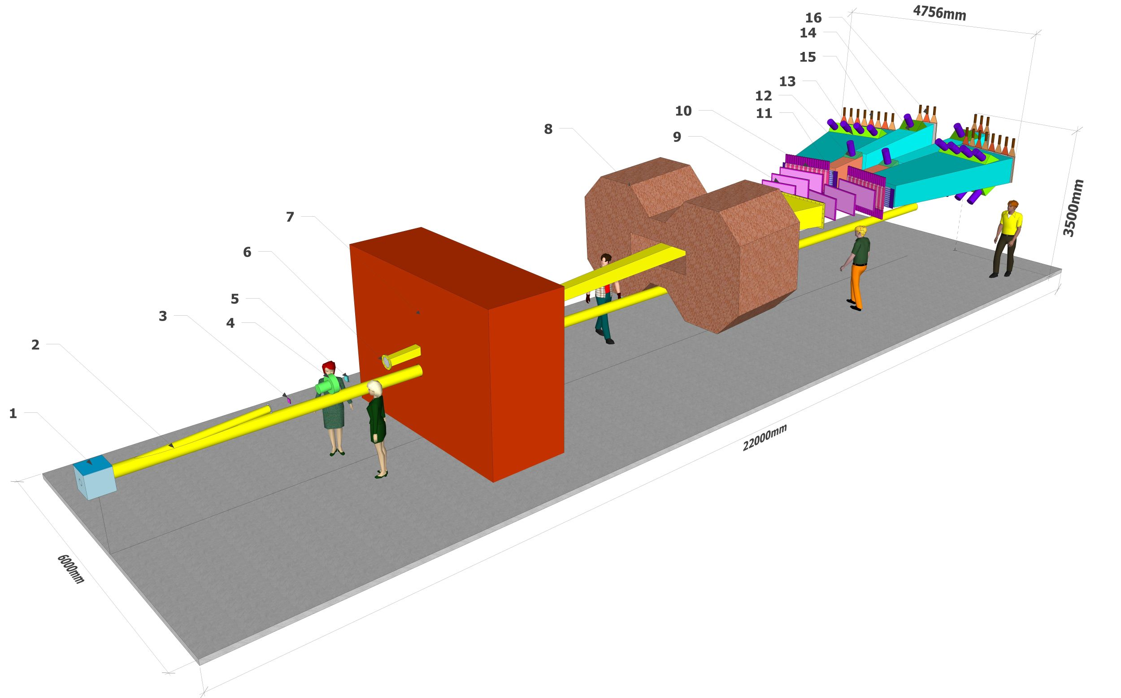
DIRAC++ (Setup Isometric view)
6/25/18

Slide 35
L(3) ,L(2) and Chiral Lagrangian predictions check with Kπ and π⁺π⁻ atoms
The Lattice calculations: for the πK scattering lengths a_{1/2} and a_{3/2} the precision is~ 5% and will be improved in the near future. The experimental precision for a_{1/2} - a_{3/2} from the πK atom lifetime measurement is 34%. For the proton beam intensity 3x10¹¹ protons/s, 3000 spills per day and running time 5 months the expected accuracy will be 5%. At the same running time the ππ scattering lengths a₀ , a₂ measurement will be improved.
Lattice calculations ChPT | a₀ a₂ a₀ and a₂ a₀-a₂ | 4-10% precision ~1% precision 2.3% precision 1.5% precision | K.Sasaki et al., Phys.Rev. 2014, Z.Fu, Phys.Rev.(2013), C.Lang et al.,Phys.Rev.(2012), Feng et al., Phys. Lett.(2010), T.Yagy at al., arXiv:1108.2970, S.Beame et al. Phys.Rev(2008) Colangelo et al. Nucl.Phys.(2001)
Experimental values | a₀-a₂ | ~ 4% precision | J.R.Bateley at al., Eur. Phys. J. (2009), K decay, cusp-effect. Adeva et al., Phys. Lett. (2011) ππ atom lifetime measurement
 | a₀ a₂ | ~ 6% precision ~22% precision | J.R.Bateley at al., Eur. Phys. J. (2009), Ke4 decay J.R.Bateley at al., Eur. Phys. (2010) Ke4 decay
Expected Experimental values on SPS | a₀-a₂ 2a₀ +a₂ | 0.7% (~2%) Statistical(systematic) Errors Will de estimated | DIRAC-NOTE-2016-05
6/25/18

Slide 36
Thank you
6/25/18

Slide 37
The π⁺π⁻ atomic states distribution at the exit of Be target on quantum numbers (n l m)
n | l | m | P_{m} |  | P_{l} | P_{max} (P_{min}) | P_{l >0} (%)
 |  |  | (%) |  | (%)
1 | 0 | 0 |  | 11.11 | 11.11
2 | 0 | 0 |  | 3.570 | 3.57
 | 1 | -1 ; 1 | 2 x | 1.231 | 2.46 | 2.46 (2.46)
3 | 0 | 0 |  | 0.674 | 0.67
 | 1 | -1 ; 1 | 2 x | 0.425 | 0.85 | 1.54 (1.51)
 | 2 | -2 ; 2 | 2 x | 0.278 | 0.69
 |  | 0 |  | 0.138
4 | 0 | 0 |  | 0.189 | 0.19
 | 1 | -1 ; 1 | 2 x | 0.144 | 0.29 | 0.91 (0.81)
 | 2 | -2 ; 2 | 2 x | 0.121 | 0.31
 |  | 0 |  | 0.070
 | 3 | -3 ; 3 | 2 x | 0.102 | 0.31
 |  | -1 ; 1 | 2 x | 0.051
5 | 0 | 0 |  | 0.077 | 0.08
 | 1 | -1 ; 1 | 2 x | 0.065 | 0.13 | 0.67 (0.46)
 | 2 | -2 ; 2 | 2 x | 0.060 | 0.16
 |  | 0 |  | 0.041
 | 3 | -3 ; 3 | 2 x | 0.056 | 0.18
 |  | -1 ; 1 | 2 x | 0.035
 | 4 | -4 ; 4 | 2 x | 0.052 | 0.20
 |  | -2 ; 2 | 2 x | 0.031
 |  | 0 |  | 0.028
6 | 0 | 0 |  | 0.044 | 0.04
 | 1 | -1 ; 1 | 2 x | 0.039 | 0.08 | 0.64 (0.27)
 | 2 | -2 ; 2 | 2 x | 0.038 | 0.11
 |  | 0 |  | 0.030
 | 3 | -3 ; 3 | 2 x | 0.037 | 0.13
 |  | -1 ; 1 | 2 x | 0.028
 | 4 | -4 ; 4 | 2 x | 0.036 | 0.15
 |  | -2 ; 2 | 2 x | 0.027
 |  | 0 |  | 0.025
 | 5 | -5 ; 5 | 2 x | 0.036 | 0.17
 |  | -3 ; 3 | 2 x | 0.026
 |  | -1 ; 1 | 2 x | 0.024
n | l | m | P_{m} |  | P_{l} | P_{max} (P_{min}) | P_{l >0} (%)
 |  |  | (%) |  | (%)
7 | 0 | 0 |  | 0.032 | 0.03
 | 1 | -1 ; 1 | 2 x | 0.030 | 0.06 | 0.73 (0.16)
 | 2 | -2 ; 2 | 2 x | 0.030 | 0.09
 |  | 0 |  | 0.026
 | 3 | -3 ; 3 | 2 x | 0.030 | 0.11
 |  | -1 ; 1 | 2 x | 0.026
 | 4 | -4 ; 4 | 2 x | 0.030 | 0.13
 |  | -2 ; 2 | 2 x | 0.025
 |  | 0 |  | 0.025
 | 5 | -5 ; 5 | 2 x | 0.030 | 0.16
 |  | -3 ; 3 | 2 x | 0.025
 |  | -1 ; 1 | 2 x | 0.024
 | 6 | -6 ; 6 | 2 x | 0.030 | 0.18
 |  | -4 ; 4 | 2 x | 0.025
 |  | -2 ; 2 | 2 x | 0.024
 |  | 0 |  | 0.024
8 | 0 | 0 |  | 0.028 | 0.03
 | 1 | -1 ; 1 | 2 x | 0.027 | 0.05 | 0.92 (0.08)
 | 2 | -2 ; 2 | 2 x | 0.027 | 0.08
 |  | 0 |  | 0.026
 | 3 | -3 ; 3 | 2 x | 0.027 | 0.11
 |  | -1 ; 1 | 2 x | 0.026
 | 4 | -4 ; 4 | 2 x | 0.027 | 0.13
 |  | -2 ; 2 | 2 x | 0.025
 |  | 0 |  | 0.025
 | 5 | -5 ; 5 | 2 x | 0.027 | 0.16
 |  | -3 ; 3 | 2 x | 0.026
 |  | -1 ; 1 | 2 x | 0.025
 | 6 | -6 ; 6 | 2 x | 0.027 | 0.18
 |  | -4 ; 4 | 2 x | 0.026
 |  | -2 ; 2 | 2 x | 0.025
 |  | 0 |  | 0.025
 | 7 | -7 ; 7 | 2 x | 0.028 | 0.21
 |  | -5 ; 5 | 2 x | 0.026
 |  | -3 ; 3 | 2 x | 0.026
 |  | -1 ; 1 | 2 x | 0.025
Population of the π⁺π⁻ atomic levels at the Be target exit as a function of quantum numbers
n, l, m.
The last column shows the overall population of the atomic levels for long-lived
(l > 0) atoms

Slide 38
Resonant enhancement of the annihilation rate of A_{2π}
L.Nemenov, V.Ovsiannikov, E.Tchaplyguine, Nucl. Phys. (2002)
l₀
In Lab. System:
In CM System:
at resonance:
γ_{A}
6/25/18
γ_{res}

Slide 39
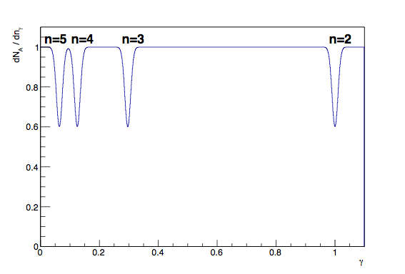
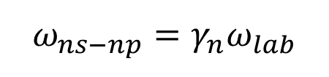
Energy splitting measurement
In a periodic electric field, there will be oscillations between ns and np states, if the external field frequency will coincide with ns - np frequency.
$$ω_{ns−np}={γ_{n}ω}_{lab}$$
No theoretical input!
6/25/18

Slide 40
QCD and Chiral Lagrangian predictions check with long-lived π⁺π⁻ atoms
The DIRAC collaboration Phys.Lett.(2015) observed 436±61 pion pairs from the long-lived (τ ≥ 1×10⁻¹¹ sec) π⁺π⁻ atom breakup in Pt foil(Phys.Lett.(2015).
The short-lived atoms lifetime measurement allowed to evaluate ππ scattering length combination a₀ - a_{2.}
The study of the long-lived atoms will allow to measure the Lamb shift depending on another ππ scattering length combination: 2a₀+a₂ and to evaluate the a₀, a₂ separately.
6/25/18

Slide 41
Proton-antiproton pair analysis
In 2018, DIRAC will perform a search for proton-antiproton Coulomb pairs and thus proton- antiproton atoms with the same strategy as in the K⁺K⁻ case.
6/25/18

Slide 42
Coulomb correlations
Coulomb correlations as a possible new physical method to investigate the particles production in the coordinate space.
The shape of Coulomb correlation curve for K⁺K– and proton-antiproton pairs is expected to be much sensitive to the size of particle production region compared to the case of π⁺π– pairs. Thus, detailed study of this shape could open a possibility to evaluate the size of production region for such pairs. The investigation is planned for 2018.
6/25/18

Slide 43
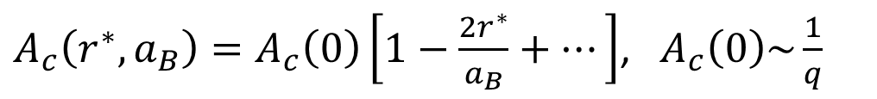
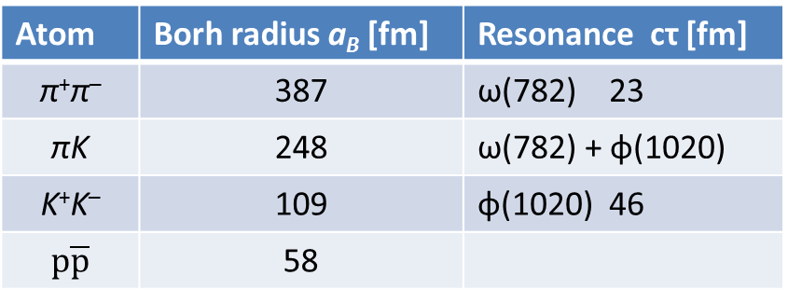
Coulomb correlations
Atom | Borh radius a_{B} [fm] | Resonance cτ [fm]
π⁺π– | 387 | ω(782) 23
πK | 248 | ω(782) + φ(1020)
K⁺K– | 109 | φ(1020) 46
$$p\overline{p}$$ | 58
 | Z | A | Nublear radius [fm]
Be | 04 | 9.012 | 2.56
Ni | 28 | 58.69 | 4.78
Pt | 78 | 195.08 | 7.13
Coulomb correlation with account of size of pair production region $r^{∗}$
$A_{c}\left(r^{∗},a_{B}\right)=A_{c}\left(0\right)\left[1−\frac{2r^{∗}}{a_{B}}+…\right]$, ${ A}_{c}\left(0\right)\sim \frac{1}{q}$
Point-like Coulomb correlation
6/25/18

Slide 44
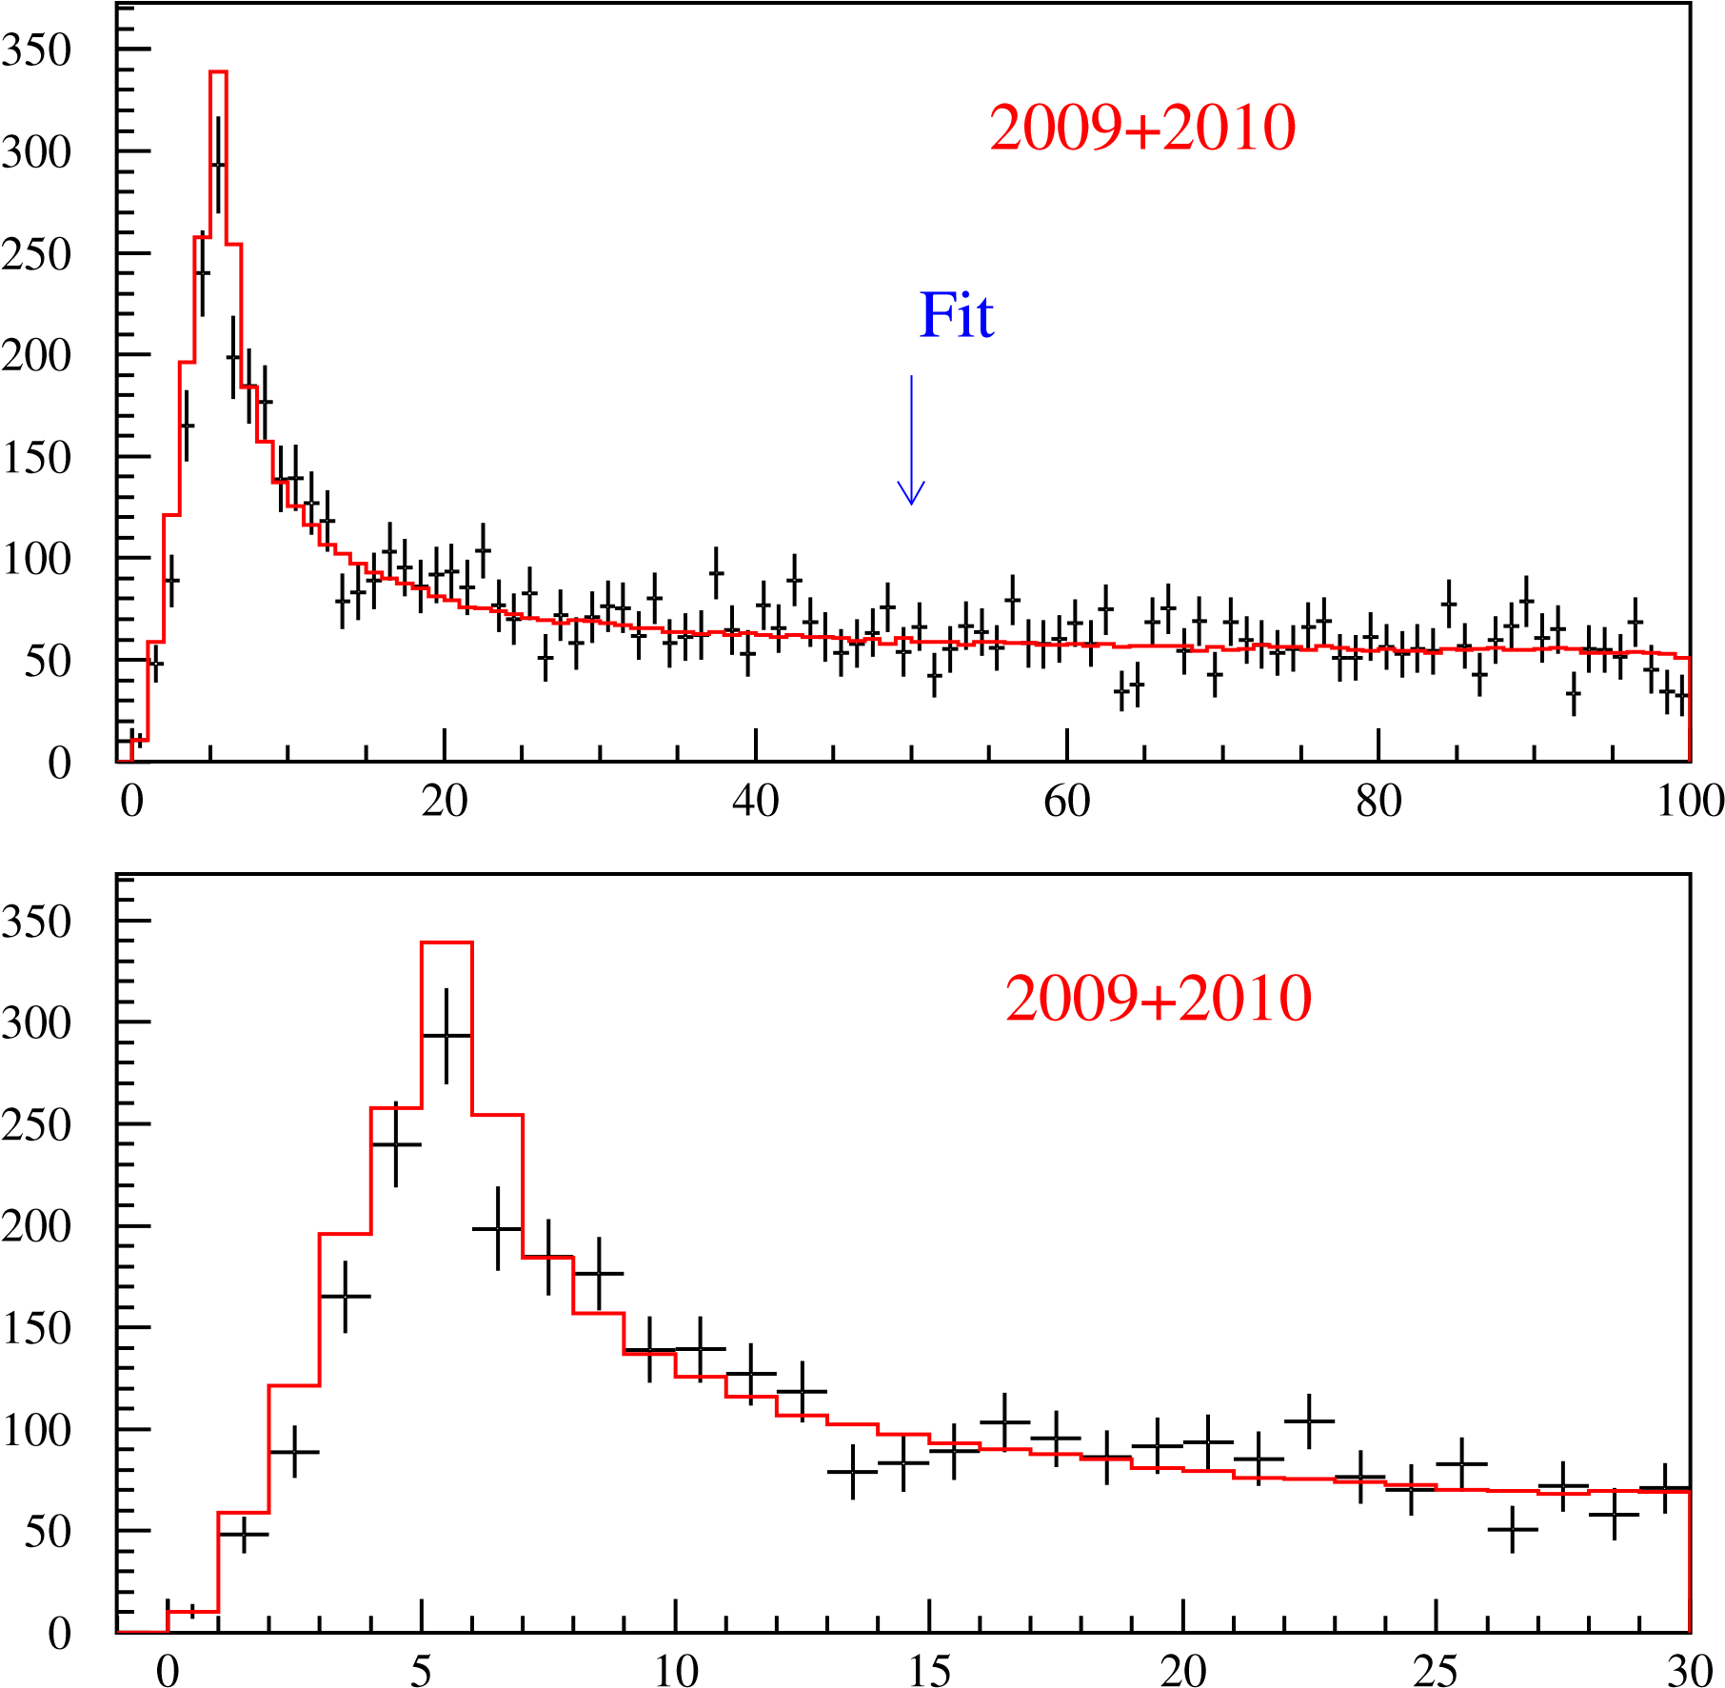
K⁺K⁻ pair analysis
N
N
Q [MeV/c]
6/25/18

Slide 45
K⁺K⁻ pair analysis
K⁺K⁻ Coulomb pairs ratio
R
R
R
6/25/18
Q[MeV/c]

Slide 46
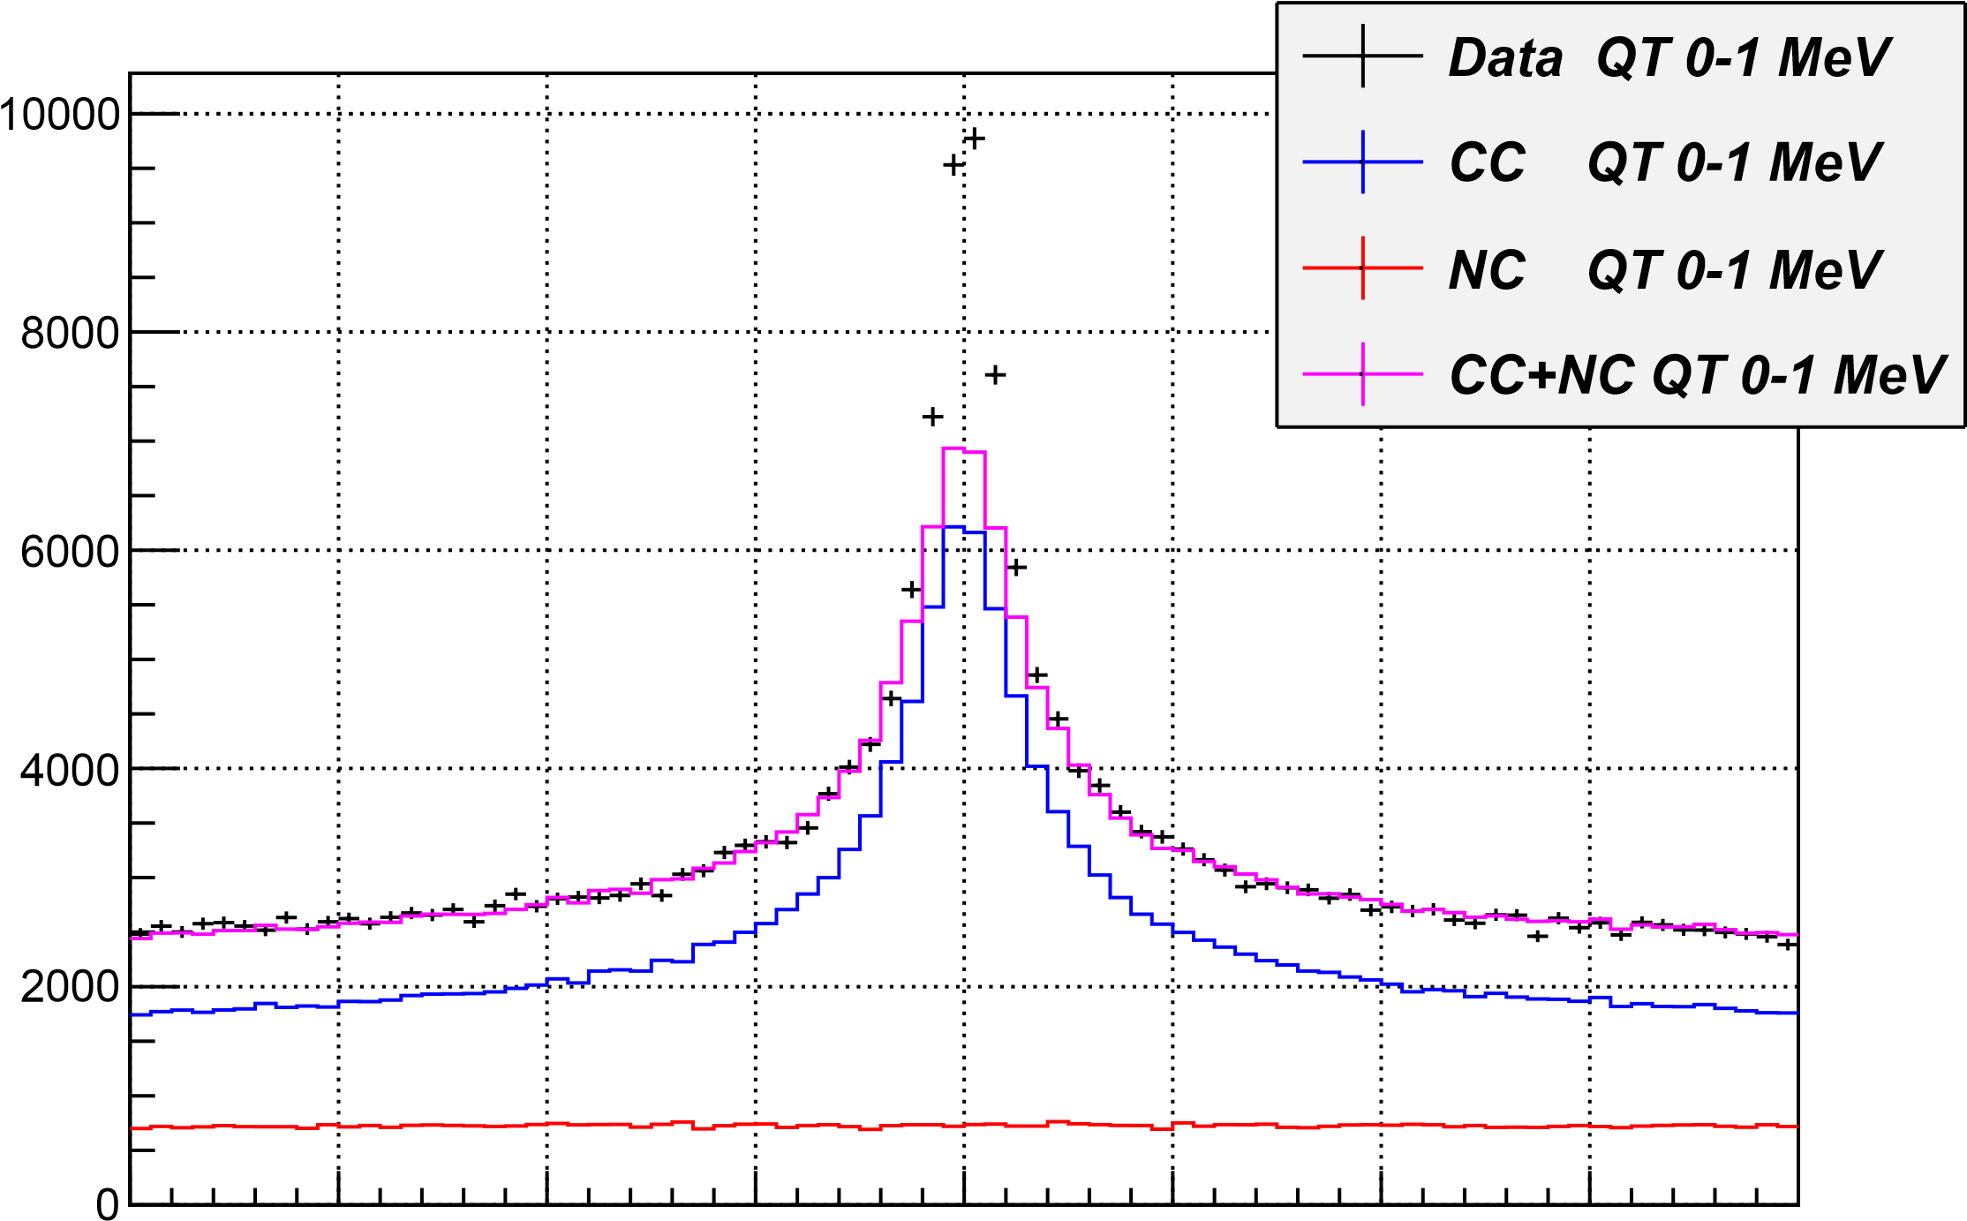
-20 -15 -10 -5 0 5 10 15 20
Q_{l} for Q_{T} between 0-1 MeV (accidentals subtracted) MeV/c

Slide 47
The π⁺π⁻ atomic states distribution at the exit of Be target on quantum numbers (n l m)
Table: Relative population P_{n}(Be) and P_{n}(Pt) as a function of principal quantum number n
n | 2 | 3 | 4 | 5 | ≥2
P_{n}(Be) x 10² | 2.46 ± Ο(10⁻³) | 1.53 ± 0.01 | 0.86 ± 0.03 | 0.56 ± 0.06 | 6.8 ± 0.3
P_{n}(Pt) x 10² | 0.46 ± Ο(10⁻⁴) | 1.09 ± Ο(10⁻³) | 0.77 ± 0.03 | 0.54 ± 0.06 | 4.3 ± 0.3

Slide 48
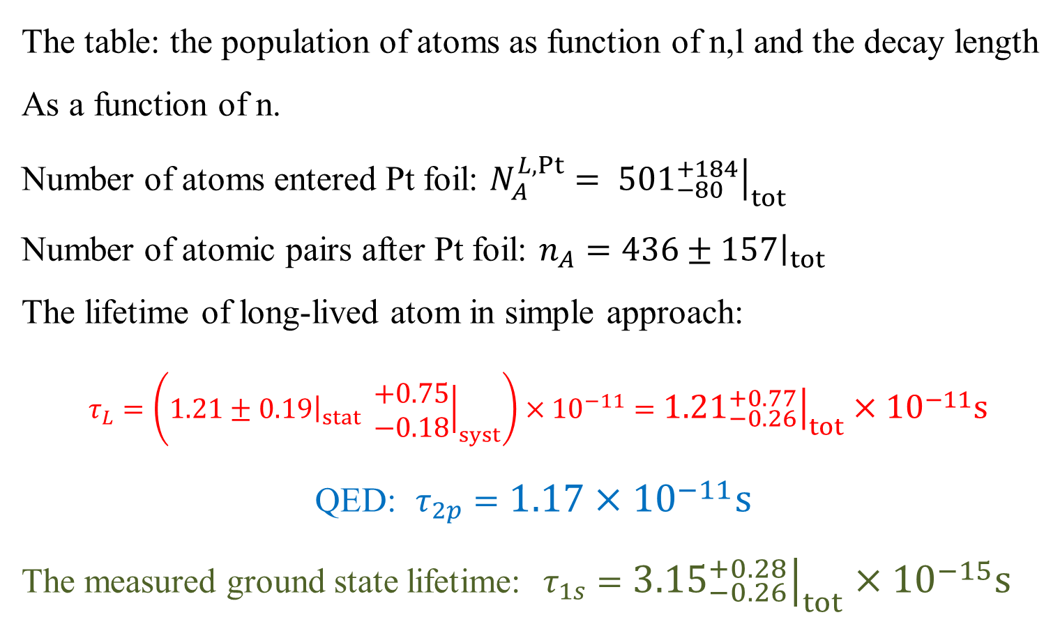
Lifetime of long-lived π⁺π⁻ atoms
The table: the population of atoms as function of n,l and the decay length
As a function of n.
Number of atoms entered Pt foil: $N_{A}^{L,Pt}= {\left.{501}_{−80}^{+184}\right|}_{tot}$
Number of atomic pairs after Pt foil: $n_{A}={\left.436±157\right|}_{tot}$
The lifetime of long-lived atom in simple approach:
$τ_{L}=\left(1.21±{\left.0.19\right|}_{stat} {\left.\begin{matrix}+0.75 \\ −0.18\end{matrix}\right|}_{syst}\right)×{10}^{−11}={\left.{1.21}_{−0.26}^{+0.77}\right|}_{tot}×{10}^{−11}s$
QED: $τ_{2p}=1.17×{10}^{−11}s$
The measured ground state lifetime: $τ_{1s}={\left.{3.15}_{−0.26}^{+0.28}\right|}_{tot}×{10}^{−15}s$
6/25/18

Slide 49
The πK atom lifetime and πK scattering length
$\frac{1}{τ}$ = R |a_{1/2}-a_{3/2}|²
τ_{th} =(3.5±0.4)×10⁻¹⁵ s. The evaluation error from this relation for |a_{1/2}-a_{3/2}| is 1%
6/25/18

Slide 50
I. Long-lived states of π⁺π⁻ atoms
Fig. 8. |Q_{L}| experimental distribution after subtraction of background obtained with 3 parameter fit (black points with statistical error) and after subtraction of background obtained with 2 parameter fit (blue dashed line), comparing to the simulated distribution of atomic pairs (red dotted-dashed line).
The fit procedures have been applied to the 1-dimensional |Q_{L}| distribution.
The atomic pairs number in the region |Q_{L}| < 2, Q_{T} < 4 MeV/c obtained with 3 parameter fit is n_{A}^{L} = 435±03 and with 2 parameter fit is n_{A}^{L} = 579±64.
6/25/18

Slide 51



























1
$$u$$
$$u$$
$$K^{+}$$
$$K^{+}$$
$$\overline{s}$$
$$\overline{s}$$
$$s$$
$$ϕ$$
$$s$$
$$ϕ$$
$$\overline{s}$$
$$\overline{s}$$
$$s$$
$$s$$
$$K^{−}$$
$${\overline{K}}^{0}$$
$$\overline{u}$$
$$\overline{u}$$
$$u$$
$$K^{0}$$
$$\overline{s}$$
$$s$$
$$ϕ$$
$$\overline{s}$$
$$s$$
$$K^{−}$$
$$\overline{u}$$

Slide 52




1a
$$g$$
$$ϕ$$
$$g$$
$$g$$

Slide 53

















2
$$u$$
$$K^{+}$$
$$s$$
$$\overline{s}$$
$$K^{−}$$
$$\overline{u}$$
$$u$$
$$s$$
$$u$$
$$p$$
$$d$$
$$d$$
$$p$$
$$u$$
$$u$$
$$Λ(1520)$$
$$g$$

Slide 54


























3
$$u$$
$$d$$
$$π^{0}$$
$$π^{−}$$
$$\overline{u}$$
$$\overline{u}$$
$$u$$
$$K^{∗+}$$
$$u$$
$$d$$
$$K^{∗0}$$
$$u$$
$$K^{+}$$
$$K^{+}$$
$$\overline{s}$$
$$\overline{s}$$
$$\overline{s}$$
$$\overline{s}$$
$$s$$
$$s$$
$$K^{−}$$
$$K^{−}$$
$$\overline{u}$$
$$\overline{u}$$
$$u$$
$$u$$

Slide 55
K⁺K⁻ pair analysis
K⁺K⁻ Coulomb pairs signal
N
2009 + 2010
Distribution of K⁺K⁻ pairs in the RUN 2009 + 2010 over the full pair momentum in laboratory system.
6/25/18
P[MeV/c]

Slide 56
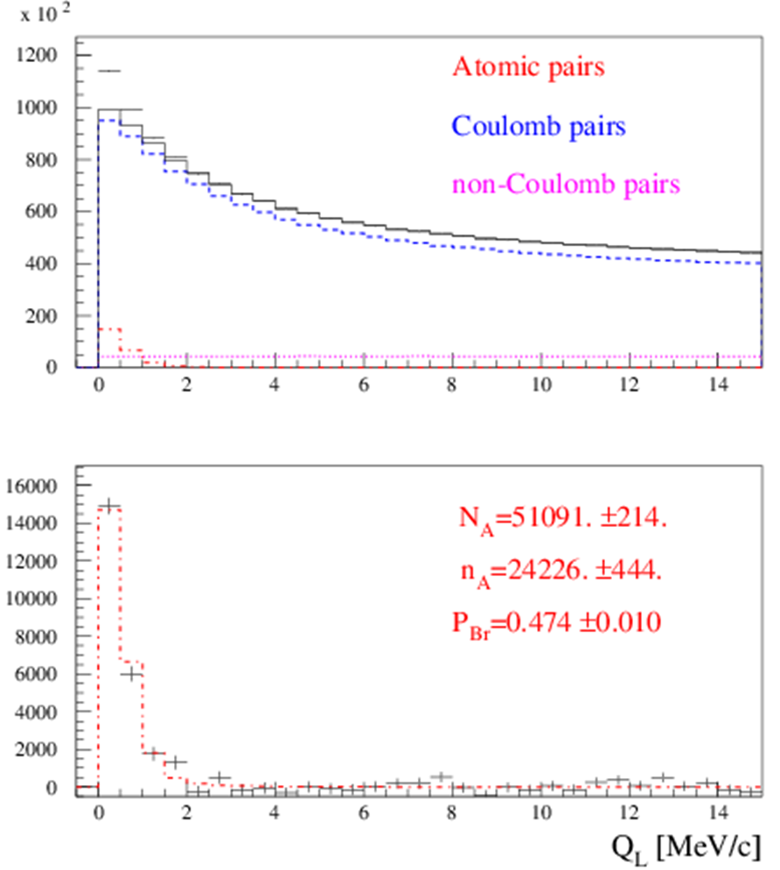
III. The short-lived π⁺π⁻ atom lifetime measurement
Preliminary results on the short-lived atom lifetime measurement based on all available 2008-2010 data are presented in Fig. 1 and 2.
Fig.1. Distribution over |Q_{L}| for events, selected with criterion
Q_{T} < 4 MeV/c. Fractions of atomic, Coulomb and non-Coulomb pairs were obtained by fitting the distri-bution over (|Q_{L}|,Q_{T}) with criteria: |Q_{L}|<15 MeV/c, Q_{T} < 4 MeV/c.
N_{A}, n_{A} and P_{br}. are the number of produced atoms, detected atomic pairs and probability of the atoms breaking in the target respectively.
6/25/18

Slide 57
III. The short-lived π⁺π⁻ atom lifetime measurement
Preliminary results on the short-lived atom lifetime measurement based on all available 2008-2010 data are presented in Fig. 1 and 2.
Fig.1. Distribution over |Q_{L}| for events, selected with criterion
Q_{T} < 4 MeV/c. Fractions of atomic, Coulomb and non-Coulomb pairs were obtained by fitting the distri-bution over (|Q_{L}|,Q_{T}) with criteria: |Q_{L}|<15 MeV/c, Q_{T} < 4 MeV/c.
N_{A}, n_{A} and P_{br}. are the number of produced atoms, detected atomic pairs and probability of the atoms breaking in the target respectively.
6/25/18

Slide 58
III. The short-lived π⁺π⁻ atom lifetime measurement
1. The average probability of π⁺π⁻ atom breakup for the Ni targets of 98 µm thickness (RUN 2008) and 109 µm (RUNS 2009-2010) was evaluated as P_{br}= 0.474 ± 0.01. It is in agreement with the value P_{br}= 0.46 ± 0.013 obtained for the 98 µm target and published in 2011.
In the final data analysis, the new measurements of multiple scattering will be included. The dedicated paper will be ready before June of 2018.
2. The current value of systematical error in the π⁺π⁻ atom lifetime measurement is equal to the statistical uncertainty. The main part of the systematical error arises due to an uncertainty in the multiple scattering in the Ni target.
To reduce this error, we did an experimental study of the multiple scattering in the targets: Be: 100 and 2000 μm; Ti: 250 μm ; Ni: 50, 109 and 150 μm and Pt: 2 and 30 μm.
For Be (2000 μm), Ni (109 μm) the difference between theoretical and experimental r.m.s. is 0.4% and 0.8% accordingly. The r.m.s. values were calculated in the interval of ±2σ.
The achieved precision of multiple scattering investigation is better by one order of magnitude than in the previous experiments.
6/25/18

Slide 59
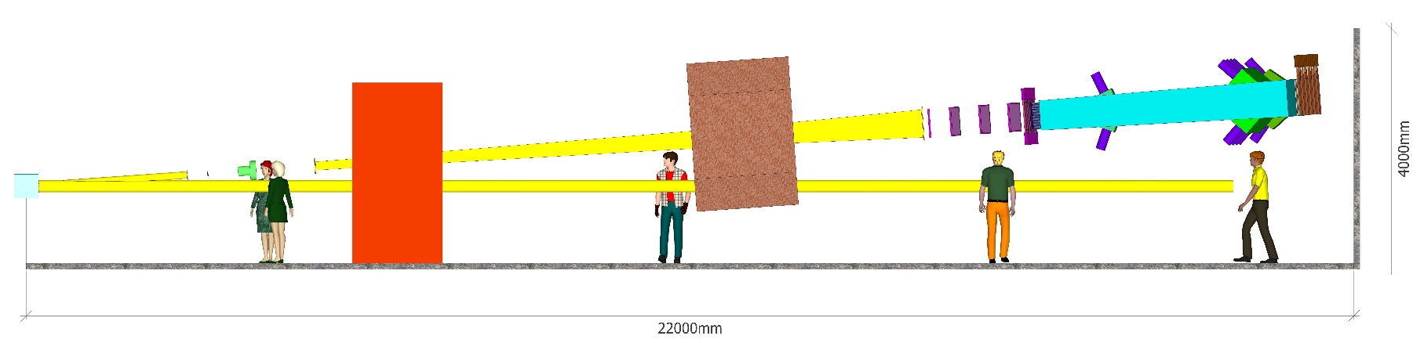
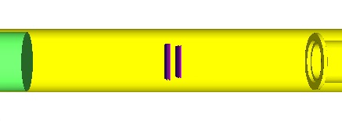
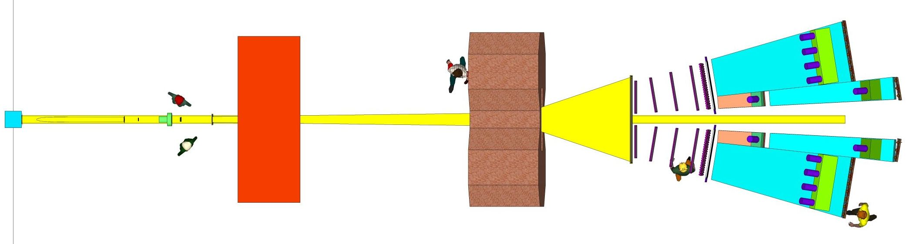
DIRAC++ Setup (top view)
π⁺
K⁺
K –
π–
6/25/18

Slide 60
DIRAC++ (Detectors)
Setup element (number planes) | Aperture (cm) | Occupancy (s⁻¹ · cm⁻²) | X₀ % | Resolution
 |  |  |  | Coordinate (µm) | Time (ns)
1. Target Station (*) 2. Vacuum system (*) 3. Vertex detector (2 ÷ 4 planes) | 7.6 × 7.6 | (5 ÷ 20) · 10⁵ | 0.7 ÷ 1.5 | 50 | 0.2
4. RICH? | 9.0 × 9.0 | (4 ÷ 16) · 10⁵ | < 5 |  | < 1
5. SFD (3 planes) (*) | 10. × 10. | (3 ÷ 12) · 10⁵ | 2.7 | 60 | 0.3
6. Vacuum system (*) 7. Iron shielding wall (*) 8. Spectrometer magnet (*) | 155 × 50
9. Downstream Tracker (2 × 8) | 75 ÷ 110×44 | (1 ÷ 10) · 10⁴ | 4 ÷ 8 | < 80
10. Vertical Hodoscope (2 × 1 ÷ 2) (*) | 112 × 44 | (1 ÷ 8) · 10⁴ |  |  | < 0.7
11. Horizontal Hodoscope (2) (*) | 115 × 44 | (1 ÷ 8) · 10⁴ |  |  | < 0.5
12. Heavy Gas Cherenkov detector (2) (*) | 30 × 49 | (1 ÷ 8) · 10⁴ |  |  | < 1.0
13. Nitrogen Cherenkov detector (2) | 90 × 50 | (1 ÷ 10) · 10³ |  |  | < 1.0
14. Nitrogen Cherenkov detector (2) | 37 × 53 | (1 ÷ 8) · 10⁴ |  |  | < 1.0
15. PreShower detector (2) | 148 × 60 | (1 ÷ 8) · 10³ |  |  | < 1.0
16. PreShower detector (2) | 56 × 60 | (5 ÷ 40) · 10³ |  |  | < 1.0
--. Ionisation Hodoscope (4 planes) | 10. × 10. | (4 ÷ 16) · 10⁵ | 3
* - Existing parts of the Setup
? - Micro-Pattern Gas Detectors (MPGD)
6/25/18

Slide 61
SPS beam time for πK scattering length measurement
The data at p_{p} = 24GeV/c and 450Gev/c were simulated, processed and analysed (V.Yazkov, DIRAC note, 2016 05).
Experimental conditions on SPS with Ni target
Thin Ni target, nuclear efficiency ~ 6x10⁻⁴.
The proton beam can be used for other experiments.
Proton beam intensity: 3x10¹¹ protons/s
(DIRAC worked at 2.7x10¹¹ protons/s)
Number of spills: 4.5x10⁵ with spill duration 4.5 s
Data taking: 3000 spills per 24 hours.
Running time: 5 months
The expected number of πK atomic pairs: n_{A}=13000
(In the DIRAC experiment was n_{A}=349±62)
The statistical precision in these conditions for πK scattering length will be: ~5%
The expected systematic error will be at the level of 2%
The expected number of π⁺π⁻ atomic pairs n_{A}=400000
The statistical precision of the π⁺π⁻ scattering length will be: 0.7%
The expected systematic error will be at the level of 2%
6/25/18

Slide 62
L(2) and Chiral Lagrangian predictions check with short-lived π⁺π⁻ atoms
The QCD Lagrangian L(2) and Chiral Lagrangian describe processes with u and d quarks, using SU(2)_{L}*SU(2)_{R} chiral symmetry breaking.
From the ChPT prediction for a₀ and a₂, the π⁺π⁻ atom lifetime in the ground state, given by 1/τ = R|a₀-a₂|², is τ_{th}=(2.9±0.1)*10⁻¹⁵ s.
The evaluation error for |a₀-a₂| from this relation is 0.6%.
These Lagrangians predict the S-wave π⁺π⁻ scattering lengths a₀ and a₂.
6/25/18

Slide 63
Experimental check of precise
predictions of QCD using
π⁺K⁻ , K⁺π⁻ and π⁺π⁻ atoms
L. Nemenov (JINR)
CERN, June 2018

