Slide 1
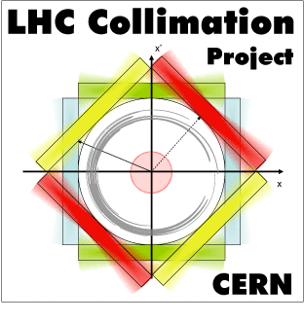
Energy deposition simulations for crystals MDs
FLUKA study: E. Skordis, A. Lechner, F. Cerutti
based on Sixtrack input: D. Mirarchi, S. Redaelli

Slide 2
Introduction
Right of IP7
Dispersion Suppressor
Cell 13
Beam 1
Cell 8
Cell 9
Cell 10
Cell 11
Cell 12
Cell 14
MQ7
MQ8
MQ9
MQ10
MQ11
MQ12
MQ14
MQ13
TCLA.AR7
Connection Cryostat
3 scenarios at 7 TeV:
Reference normal collimation
Crystal collimation in channeling state
Crystal collimation in amorphous state
3 cases of loss rate considered:
1 bunch 10¹⁰p, 0.02h beam lifetime ≈ 1.39 10⁸ p/s
1 bunch 10¹⁰p, 0.2h beam lifetime ≈ 1.39 10⁷ p/s
1 nominal bunch 1.15*10¹¹p, 1h beam lifetime ≈ 3.19 10⁷ p/s
Best case scenario
for getting BLM signal above threshold
Coil energy deposition results normalised to this case

Slide 3
Simulation set-up
Right of IP7
Dispersion Suppressor
Cell 13
Beam 1
Cell 8
Cell 9
Cell 10
Cell 11
Cell 12
Cell 14
MQ7
MQ8
MQ9
MQ10
MQ11
MQ12
MQ14
MQ13
TCLA.AR7
Connection Cryostat
Usual “1+2 step” simulation
Get SixTrack distributions of proton inelastic interactions in the collimators
Starting from cleaned¹ Sixtrack distributions, loaded in all the IR7 collimators (crystal included) of the FLUKA geometry, generate the distribution of particles impacting the TCLA and DS aperture (high cutoff simulation to get enough statistics)
Use the above distribution to simulate the energy deposition in the Magnet Coils and the BLM signals per inelastic interaction in the collimators
¹ Single turn reinteractions of diffracted protons are discarded
Roughly 0.5 per mil protons interacting in the primary collimator reach the DS

Slide 4
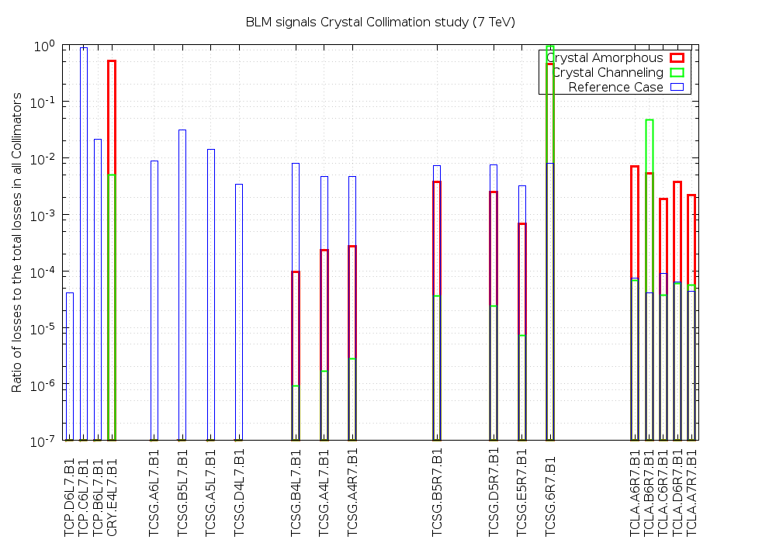
Loss distributions (cleaned Sixtrack input for FLUKA)
IR7 LSS

Slide 5
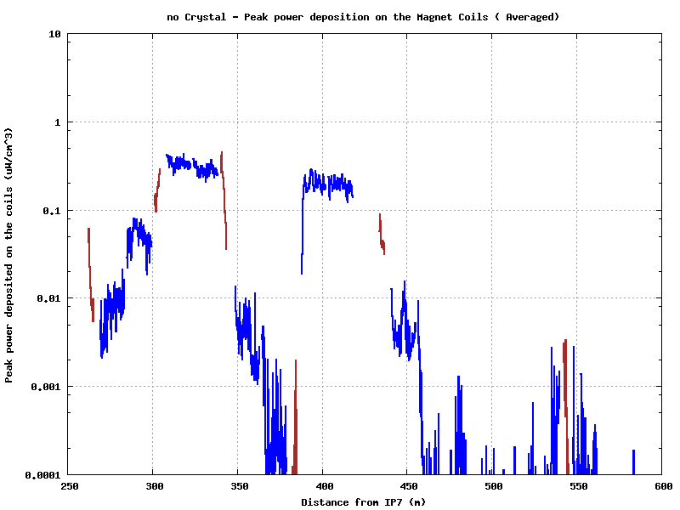
Reference Scenario
Cell 9
Cell 11
Cell 8
Cryostat
Cell 10
Cell 12
MQ9
MQ11
MQ13
MQ8
MQ10
Cell 13
MQ7
Cell 14
MQ12
Beam 1
MQ14

Slide 6
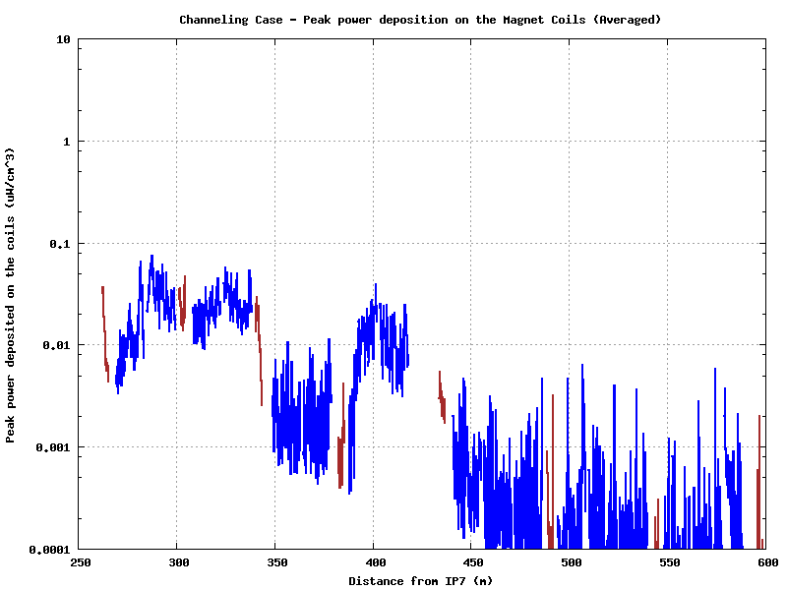
Crystal Channeling
Cell 9
Cell 8
Cell 11
Cell 10
Cryostat
MQ12
MQ13
Cell 12
Cell 13
Cell 14
MQ8
MQ14
MQ7
MQ9
Beam 1
MQ11
MQ10

Slide 7
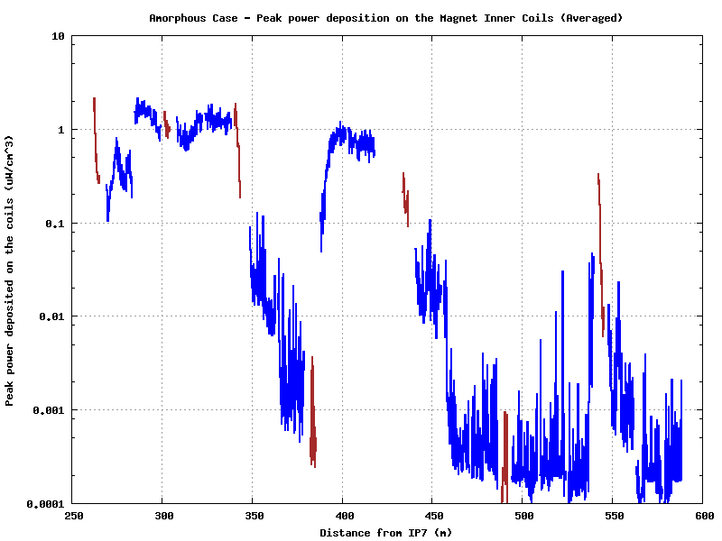
Crystal Amorphous
Cell 8
Cell 9
Cell 11
Cryostat
Cell 10
MQ13
Cell 12
Cell 13
Cell 14
MQ7
MQ8
MQ9
MQ11
MQ12
MQ14
Beam 1
MQ10

Slide 8
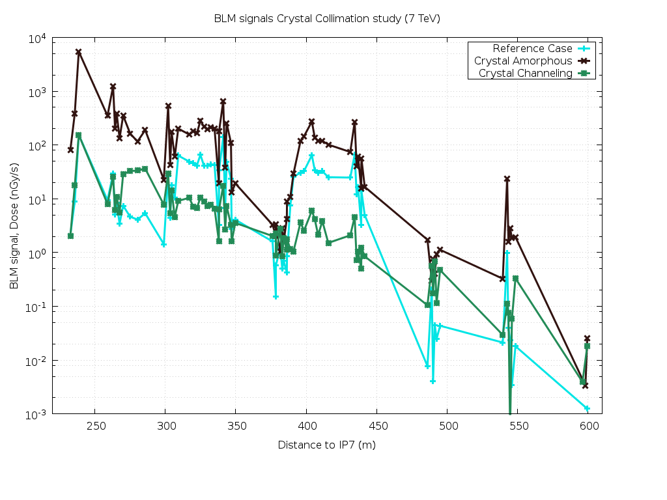
Case 1 - BLM pattern comparison
1 bunch 10¹⁰p, 0.02h beam lifetime 1.39 10⁸ p/s
Cell 11
Cell 8
Cell 9
Cryostat
BLM detection threshold
Cell 10
Cell 12
Cell 13
maximum BLM sensitivity increase
MQ7
MQ8
MQ9
Cell 14
TCLA.AR7
MQ11
MQ14
Beam 1
MQ10
MQ12
MQ13

Slide 9
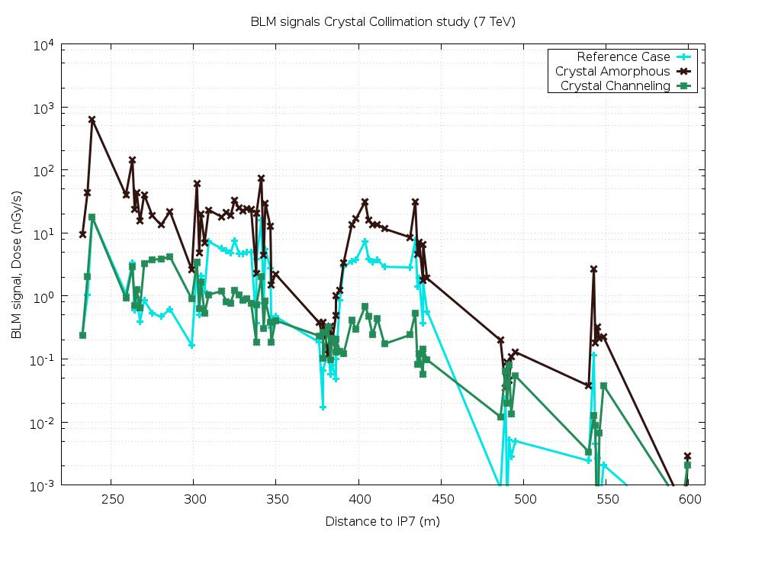
Case 2 - BLM signal comparison
1 bunch 10¹⁰p, 0.2h beam lifetime 1.39 10⁷ p/s
Cell 11
Cell 8
Cell 9
Cryostat
BLM detection threshold
Cell 10
Cell 12
Cell 13
maximum BLM sensitivity increase
MQ7
MQ8
MQ9
Cell 14
TCLA.AR7
MQ11
MQ14
Beam 1
MQ10
MQ12
MQ13

Slide 10
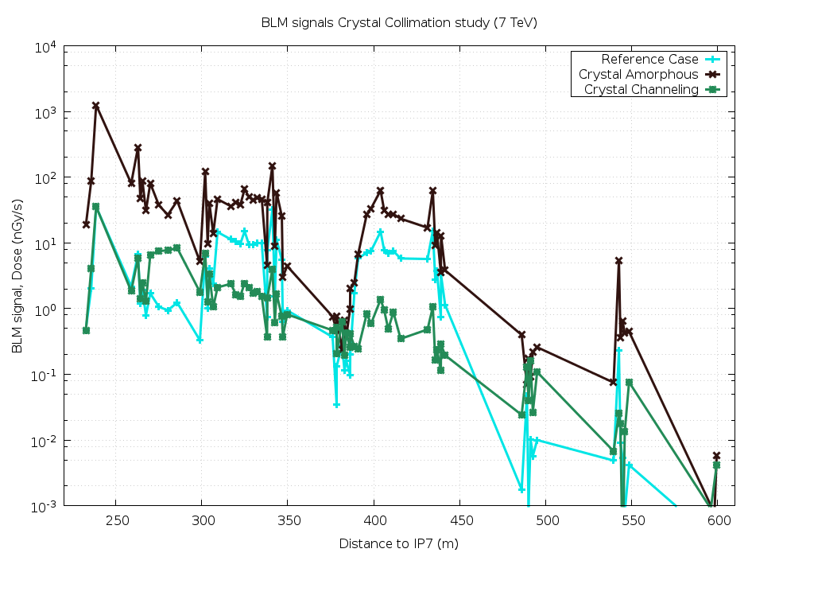
Case 3 - BLM signal comparison
1 nominal bunch 1.15*10¹¹p, 1h beam lifetime 3.19 10⁷ p/s
Cell 11
Cell 8
Cell 9
Cryostat
BLM detection threshold
Cell 10
Cell 12
Cell 13
maximum BLM sensitivity increase
MQ7
MQ8
MQ9
Cell 14
TCLA.AR7
MQ11
MQ14
Beam 1
MQ10
MQ12
MQ13

Slide 11
Conclusions
Crystal collimation is very effective while in channeling mode, lowering the energy deposition in the magnet coils by a factor of 10 with respect to regular collimation.
However in amorphous state the energy deposited in the coils is increased by a factor of 5 with respect to regular collimation (by a factor of 50 with respect to channeling mode)
The considered MD loss rates are expected to produce BLM signals in the DS which are below the detection threshold
Assuming the latter to be pushed down by 1 order of magnitude, the different operation scenarios could be disentangled with a 10⁸ p/s loss rate

