Slide 1
Short overview of experimental program with TBTS
Wilfrid Farabolini and Roger Ruber
for the
TBTS Team

Slide 2
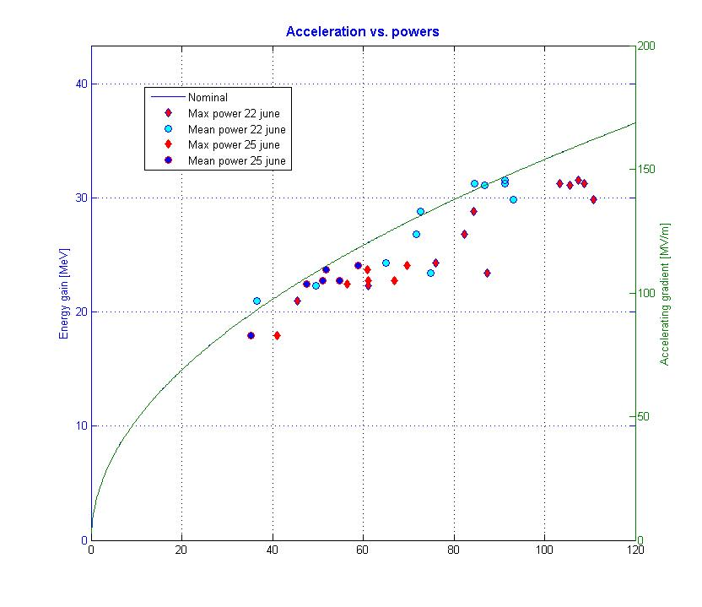
Acceleration vs. RF power
Acceleration vs. power is close to nominal
Power to be better processed (not peak nor mean but averaged during a filling time before a short probe beam pulse
Still some uncertainties about the RF coupler calibration and reliability (damaged ?)

Slide 3
RF power measurements using water temperatures differences and flow
Water cooling circuit
Raw temperature data from PT100
Better accuracy with a higher repetition rate
Results from a finite differences model
Comparison between calorimetric method and RF couplers: ratio 0.79

Slide 4
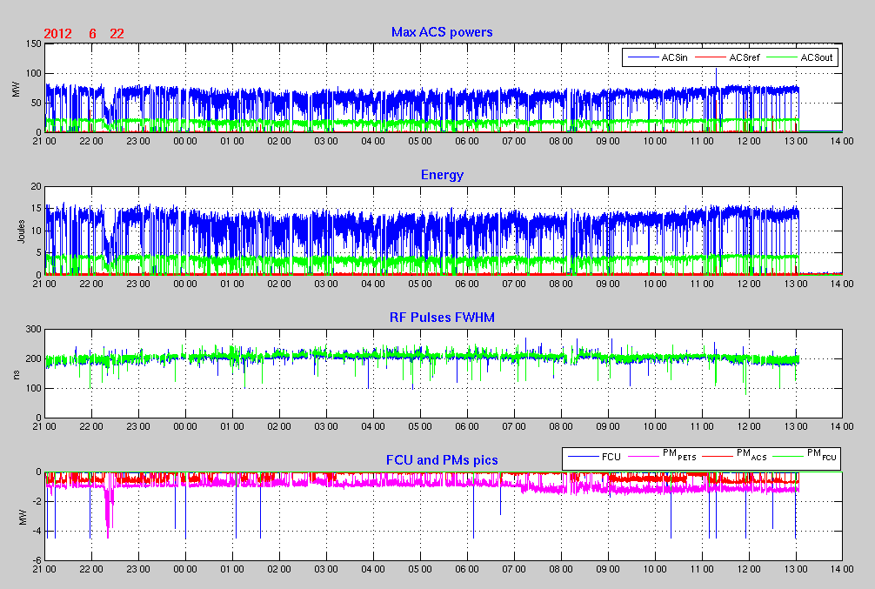
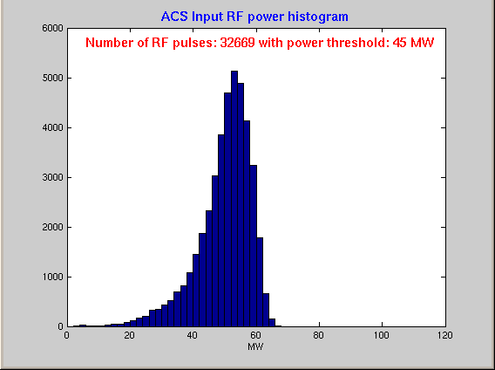
RF power monitoring
PETS and ACS RF couplers data during 16 hours
Histogram of ACS power input

Slide 5
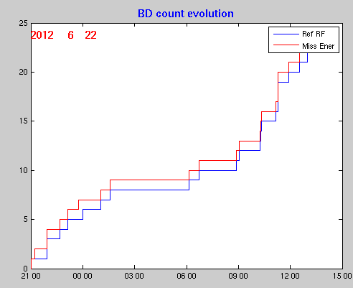
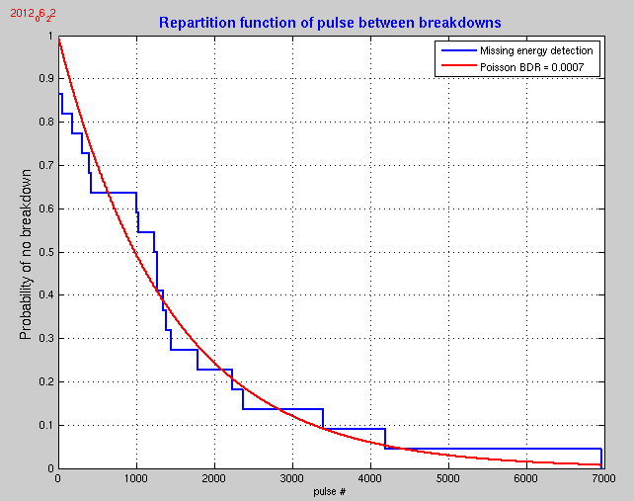
BD statistics
BDs evolution with time
Time between breakdown distribution compared to Poisson law for BDR = 7E-04
Quite period without clusters (moderate RF power: 55 MW)

Slide 6
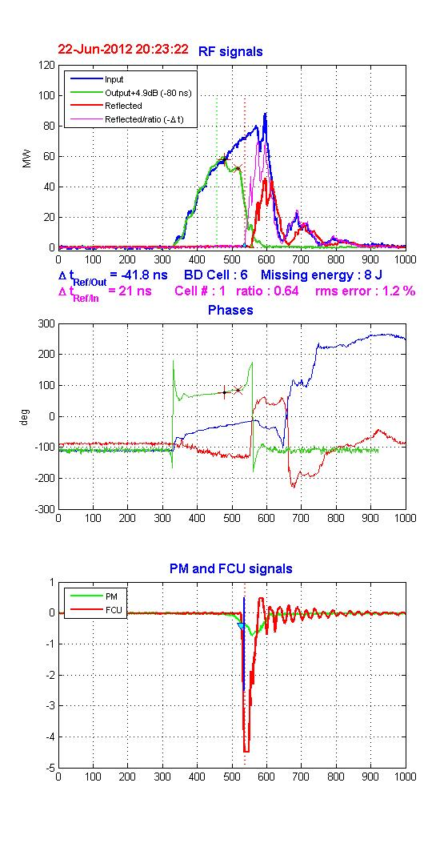
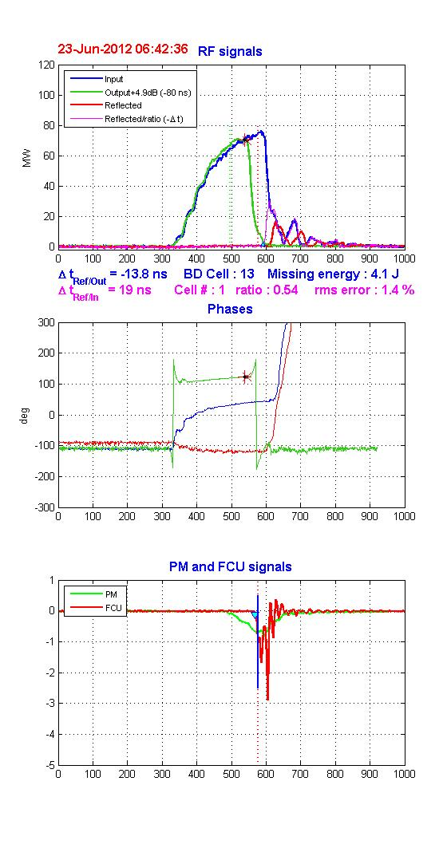
BDs signals analysis
3 different records from the same batch (night of the 22nd June)
Many information to be derived: consistency between BD from RF coupler and FCU edge , phase stability of RF output, phase drift of RF reflected, 2 staged BDs often visible on RF output, correlation RF input / RF reflected after BD, RF input perturbations induced by RF reflected…

Slide 7
BDs location within ACS
Reflected rising edge
Transmitted falling edge
Reflected rising edge
Transmitted falling edge
FCU edge
Input falling edge
Reflected falling edge
1st method (transmission): looking at BD position when BD strikes
2nd and 3rd methods (combining previous signals with FCU):
4th method (echo): looking at BD position when RF pulse stops
Cell positions around cell 6 seem more affected, clustered BDs are close in position, first 3 methods give consistent results, method 4 seems to show a BD drift toward the structure input...

Slide 8
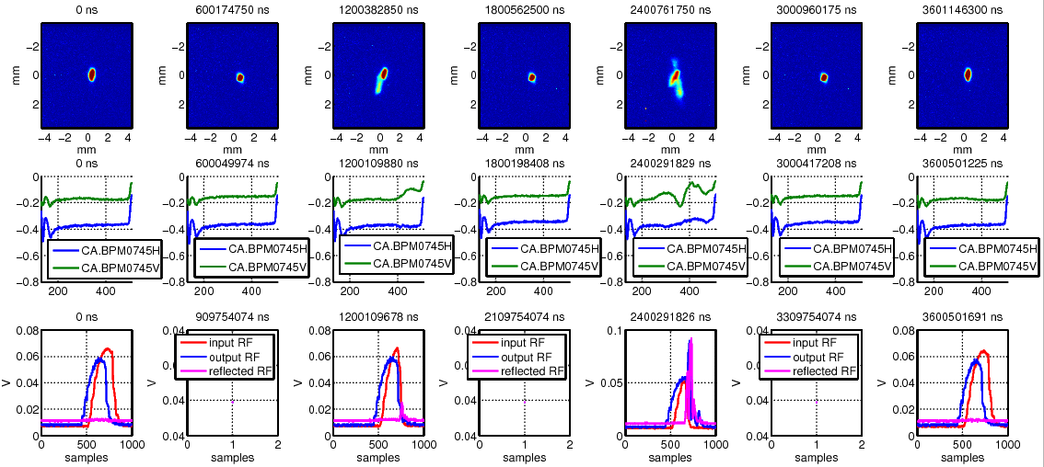
BD beam kicks (Andrea Palaia)
Successive shots around 2 BDs events
Statistical analysis on going (isotropic distribution ?, relation with BDs location and missing energy)

Slide 9
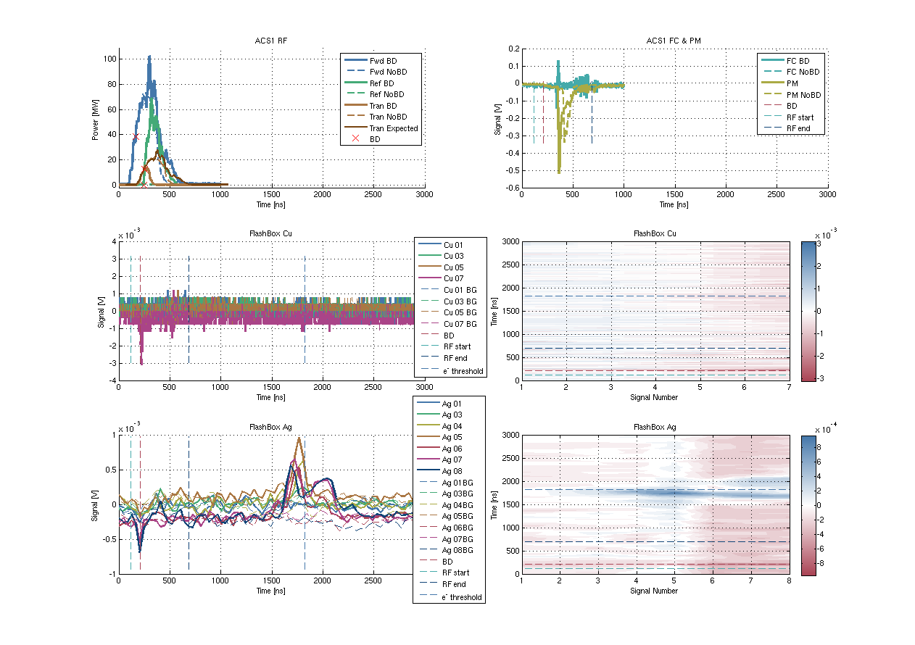
Flash Box results (Alexey Dubrovskiy)
V≈1.7m/1480ns=0.38%c
V≈0.125m/80ns=0.5%c
1480 ns
From the magnet: m/e = 2.1-4.5×10³ m_{e}/e⁺:
H₂¹, Cu²⁶⁻²⁹ etc

