Slide 1
Experimental check of precise
predictions of QCD using
π⁺K⁻, K⁺π⁻ and π⁺π⁻ atoms
L. Nemenov (JINR, DIRAC Collaboration)

Slide 2








DIRAC Collaboration
CERN
Geneva, Switzerland
Tokyo Metropolitan University
Tokyo, Japan
Czech Technical University
Prague, Czech Republic
IFIN-HH
Bucharest, Romania
Institute of Physics ASCR
Prague, Czech Republic
JINR
Dubna, Russia
Nuclear Physics Institute ASCR
Rez, Czech Republic
SINP of Moscow State University
Moscow, Russia
INFN-Laboratori Nazionali di Frascati
Frascati, Italy
IHEP
Protvino, Russia
University of Messina
Messina, Italy
Santiago de Compostela University
Santiago de Compostela, Spain
KEK
Tsukuba, Japan
Bern University
Bern, Switzerland
Kyoto University
Kyoto, Japan
Kyoto Sangyo University
Kyoto, Japan
Zurich University
Zurich, Switzerland
Notes:
<number>

Slide 3
Contents
1. Experimental check of QCD .
2. Investigation of short-lived π⁺π⁻ atoms.
3. Observation and investigation of π⁻ K ⁺ and π⁺K⁻ atoms.
4. Observation and investigation of long-lived π⁺π⁻ atoms
and possibility to measure the atom Lamb shift.
5. Investigation of K ⁺K ⁻ and proton-antiproton pairs in the region near two mass and K ⁺K ⁻ and proton-antiproton atoms production.
6. The Coulomb pairs as the tool to investigate the particle production in the coordinate space and the experimental setups calibration.
7. K ⁺π⁻ , K ⁻ π⁺, π⁺π⁻ and K ⁺K ⁻ atom production at SPS CERN and check of QCD.
8. The new physical method to investigate the particle production in the coordinate space.
02/22/2023
<number>

Slide 4
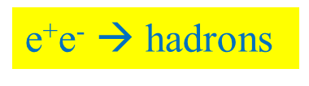
QCD Lagrangian and its prediction
The QCD Lagrangians use the SU(3)_{L}*SU(3)_{R} and SU(2)_{L}*SU(2)_{R} chiral symmetry breaking.
L(u,d,s) = L(3) = L_{sym}(3)+ L_{sym.br.}(3)
L_{sym.br.} is proportional to m_{q}
L(u,d) = L(2) = L_{sym}(2) + L_{sym.br.}(2)
QCD provides cross sections with 1% precision
Perturbation theory is working at high momentum transfer Q.
Unitarity condition.
At large Q, contribution of L_{sym.br.} to the cross section is proportional to 1/Q⁴. Therefore these experiments checked only the L_{sym} prediction precision.
To check the total L(3) Lagrangian predictions, we must study the
low momentum transfer Q processes.
Tools: Lattice calculations and Chiral Perturbation Theory (ChPT)
Lattice----- L(3), L(2) ChPT------Effective Lagrangians.
02/22/2023
<number>

Slide 5
Measurement of the πK scattering length
The S-wave πK scattering lengths a_{1/2} and a_{3/2} in the chiral symmetry world are zero. Therefore the scattering length values a_{1/2} and a_{3/2} are very sensitive to the L_{sym.br.}(3).
For Lattice QCD the πK interaction at threshold is a relatively simple process. It gives πK scattering length values with an average precision of 5%.
This precision will be improved in the near future.
There is only one experimental data: DIRAC collaboration observed 349±62 πK atomic pairs (Phys.Rev.Lett. 2016) and measured
|a_{1/2}-a_{3/2}| with an average precision of 34% (Phys.Rev.D 2017).
02/22/2023
<number>

Slide 6
π⁺π⁻ atom lifetime
π⁺π– atom (pionium) is a hydrogen-like atom consisting of π⁺ and π– mesons:
E_{B} = -1.86 keV, r_{B} = 387 fm, p_{B} ≈ 0.5 MeV/c
π⁺
π⁰
The π⁺π⁻ atom lifetime is dominated by the decay into π⁰ π⁰ mesons:
π⁻
π⁰
$\frac{ΔR}{R}=1.2×{10}^{−2}$
$τ_{1s}=\left(2.9±0.1\right)×{10}^{−15}s$
$τ_{2p}=1.17×{10}^{−11}s$
a₀ and a₂ are the ππ S-wave scattering lengths for isospin I=0 and I=2.
≠ 0 for l = 0
A_{2π}(1s, 2s,…, ns)
π⁰π⁰
= 0 for l ≠ 0
γ
π⁰π⁰
A_{2π}(np)
A_{2π}(1s, 2s,…(n-1)s)
The np state lifetime depends on the transition np 1s, 2s,…, (n-1)s probability.
This probability is about 3 orders of magnitude less than for ns π⁰π⁰.

Slide 7
Method of A_{2π} observation and measurement
Target Ni 98 μm
A_{2π}
π⁺
p
(n_{A})
Atomic pairs
24 GeV/c
(N_{A})
π⁻
Interaction point
Ni
π⁺
p
(N_{C})
π⁻
Coulomb pairs
24 GeV/c
Δ,ρ,ω,…
π⁺
π⁺
p
Non-Coulomb pairs
24 GeV/c
π⁻
η, η’,…
π⁺
Interaction point
π⁰
p
π⁺
24 GeV/c
Accidental pairs
p
π⁻
02/22/2023
<number>

Slide 8
Coulomb pairs and atoms
For charged pairs from short-lived sources and with small relative momenta Q , Coulomb final state interaction has to be taken into account.
This interaction increases the production yield of the free pairs with Q decreasing and creates atoms.
π⁺π⁻, Κ⁺π⁻, Κ⁻π⁺,
Κ⁺Κ⁻, π⁺μ⁻, π⁻μ⁺
(π⁺π⁻), (Κ⁺π⁻), (Κ⁻π⁺),
(Κ⁺Κ⁻), (π⁺μ⁻), (π⁻μ⁺)
Coulomb pair
Atom
There is a precise ratio between the number of produced Coulomb pairs (N_{C}) with small Q and the number of atoms (N_{A}) produced simultaneously with Coulomb pairs:
02/22/2023
<number>

Slide 9
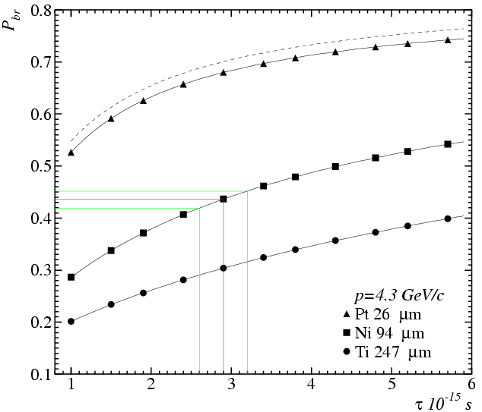
Break-up probability
Solution of the transport equations provides one-to-one dependence of the measured break-up probability (P_{br}) on pionium lifetime τ
Cross section calculation precision 0.6%
All targets have the same thickness in radiation lengths 6.7*10⁻³ X₀
There is an optimal target material for a given lifetime

Slide 10
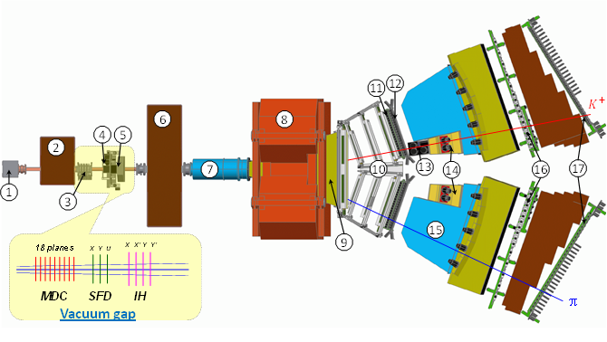
DIRAC upgraded Experimental setup
1 Target station ; 2 First shielding; 3 Micro Drift Chambers; 4 Scintillating Fiber Detector; 5 Ionization Hodoscope; 6 Second Shielding; 7 Vacuum Tube; 8 Spectrometer Magnet; 9 Vacuum Chamber; 10 Drift Chambers; 11 Vertical Hodoscope; 12 Horizontal Hodoscope; 13 Aerogel Čerenkov; 14 Heavy Gas Čerenkov; 15 Nitrogen Čerenkov; 16 Preshower; 17 Muon Detector
02/22/2023
<number>

Slide 11
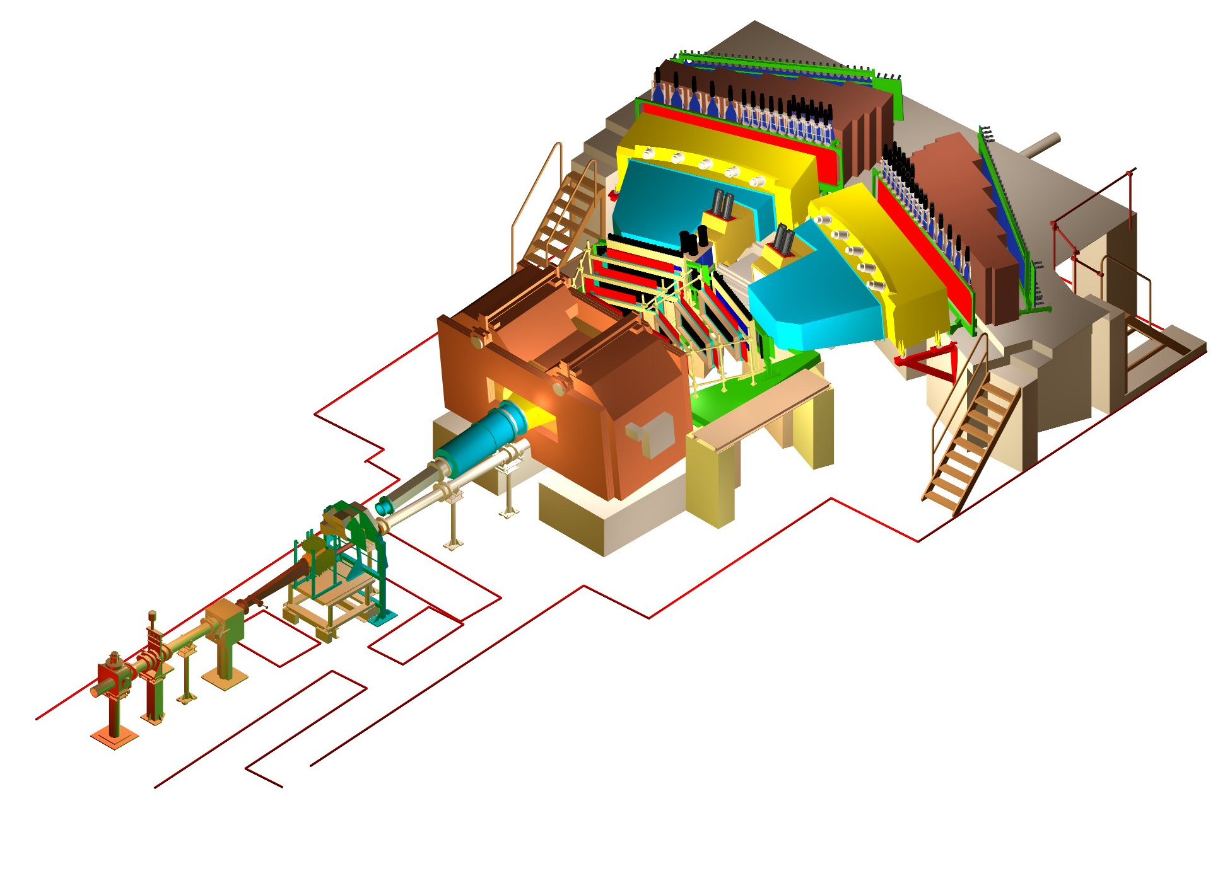
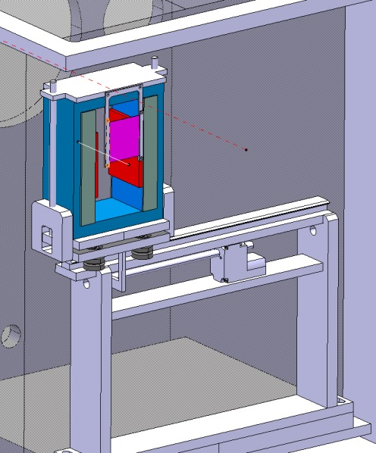
DIRAC upgraded Experimental setup
BLUE … magnet yoke
GREY … magnet poles
RED … magnet shimming
PURPLE … Pt foil
σ_{QX} = σ_{QY} = 0.5 MeV/c
σ_{QL} = 0.5 MeV/c (ππ)
σ_{QL} = 0.9 MeV/c (πΚ)
02/22/2023
<number>
Notes:
<number>

Slide 12
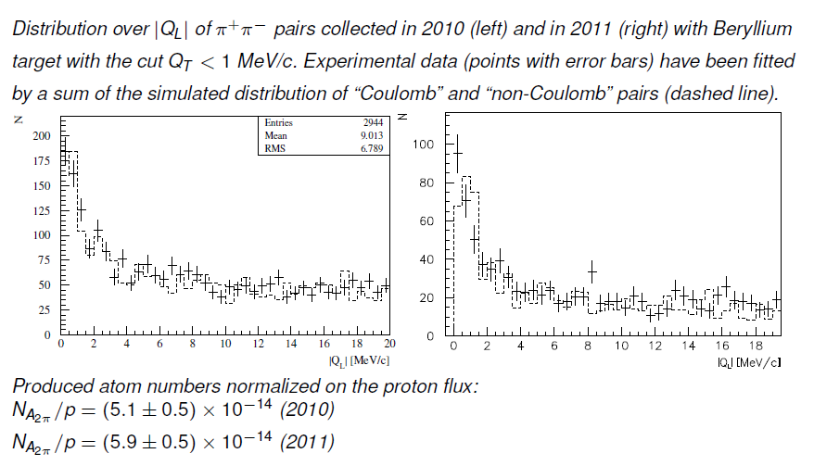
Measurement of A_{2π} production rate in p-Be interactions
Q
Q_{T}
Q
π⁺
π⁺
P_{∑,LS}
π⁻
Q_{L}
π⁻
02/22/2023
<number>

Slide 13
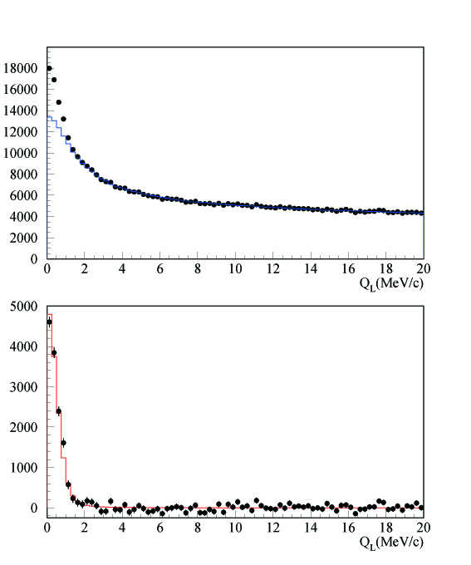
DIRAC results with GEM/MSGC
Q_{L} distribution
←All events
←After background
subtraction
<number>
Notes:
<number>

Slide 14
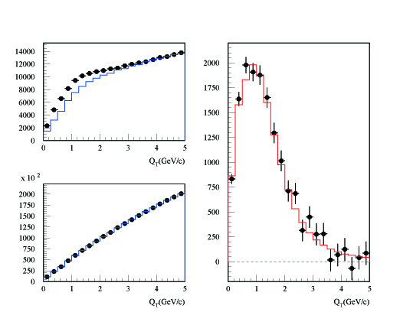
DIRAC results with GEM/MSGC
Q_{T} distribution
←After background
subtraction for Q_{L}<2MeV/c
Q_{L}<2 MeV/c
Q_{L}>2 MeV/c
<number>
Notes:
<number>

Slide 15
Experimental results
K→3π:
2009 NA48/2 (EPJ C64, 589)
plus additional 3.4% theory uncertainty
Ke4:
2010 NA48/2 (EPJ C70, 635)
π⁺π⁻ atom:
2011 DIRAC (PLB 704, 24)
02/22/2023
<number>
Notes:
<number>

Slide 16
K⁺π⁻ and K⁻π⁺ atoms lifetime
Kπ-atom (A_{Kπ}) is a hydrogen-like atom consisting of K⁺ and π⁻ mesons:
E_{B}= -2.9 keV r_{B} = 248 fm p_{B} ≈ 0.8 MeV
The Kπ-atom lifetime (ground state 1S), τ=1/Γ is dominated by the annihilation process into K⁰π⁰:
K⁺
π⁰
K⁰
π⁻
**
(**) J. Schweizer (2004)
From Roy-Steiner equations:
If

Slide 17
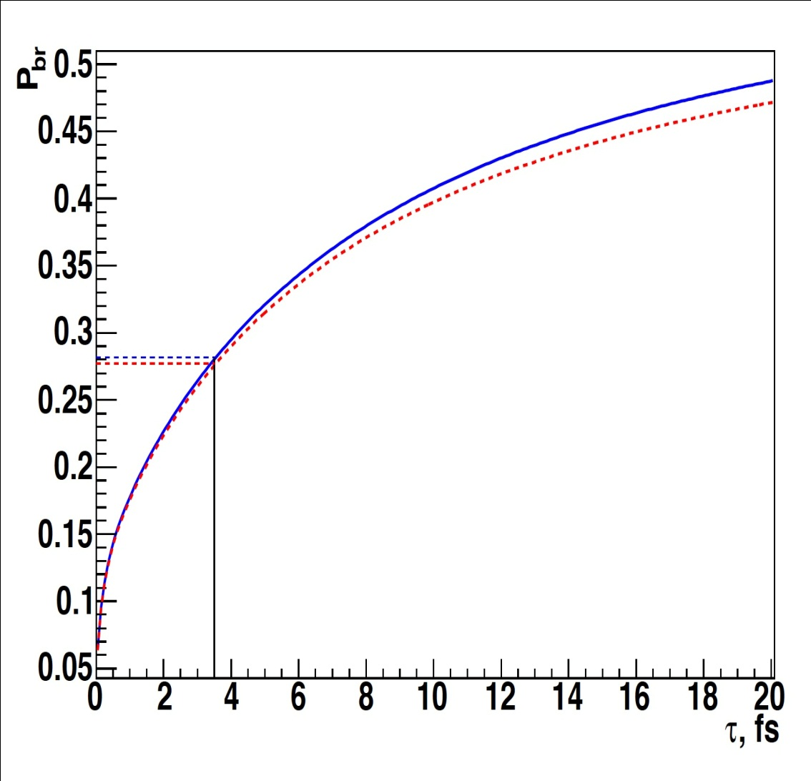
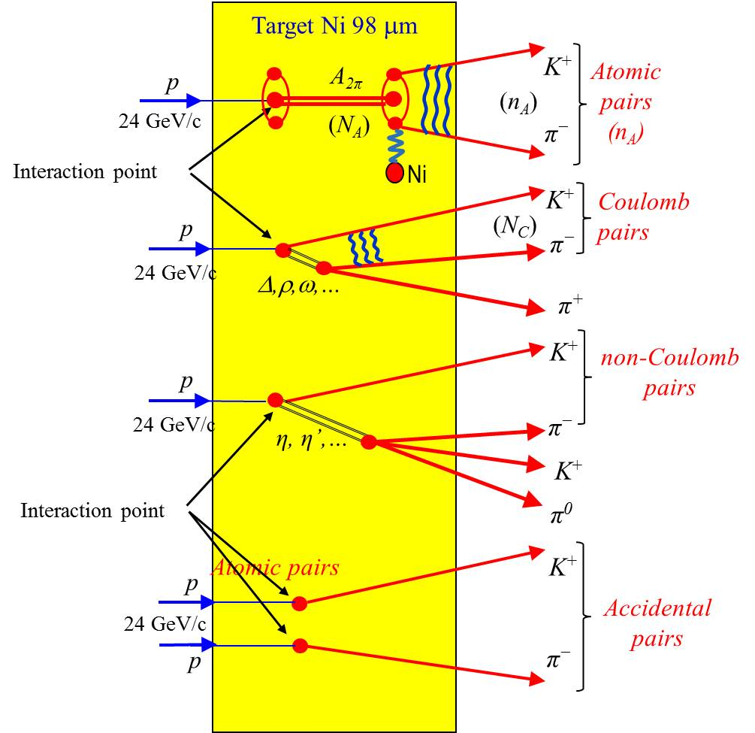
The πK atom lifetime and πK scattering length
= R |a_{1/2}-a_{3/2}|²
τ_{th} =(3.5±0.4)×10⁻¹⁵ s. The evaluation error from this relation for |a_{1/2}-a_{3/2}| is 1%
02/22/2023
<number>

Slide 18
πK atom observation
All data Platinum and Nickel targets
K⁺π⁻ and K⁻π⁺ atoms , Q_{L} distribution for Q_{T} < 4 MeV/c χ² /ndf = 41/37
In absense of “atomic pairs” χ 2 /ndf = 73/38
Notes:
<number>

Slide 19
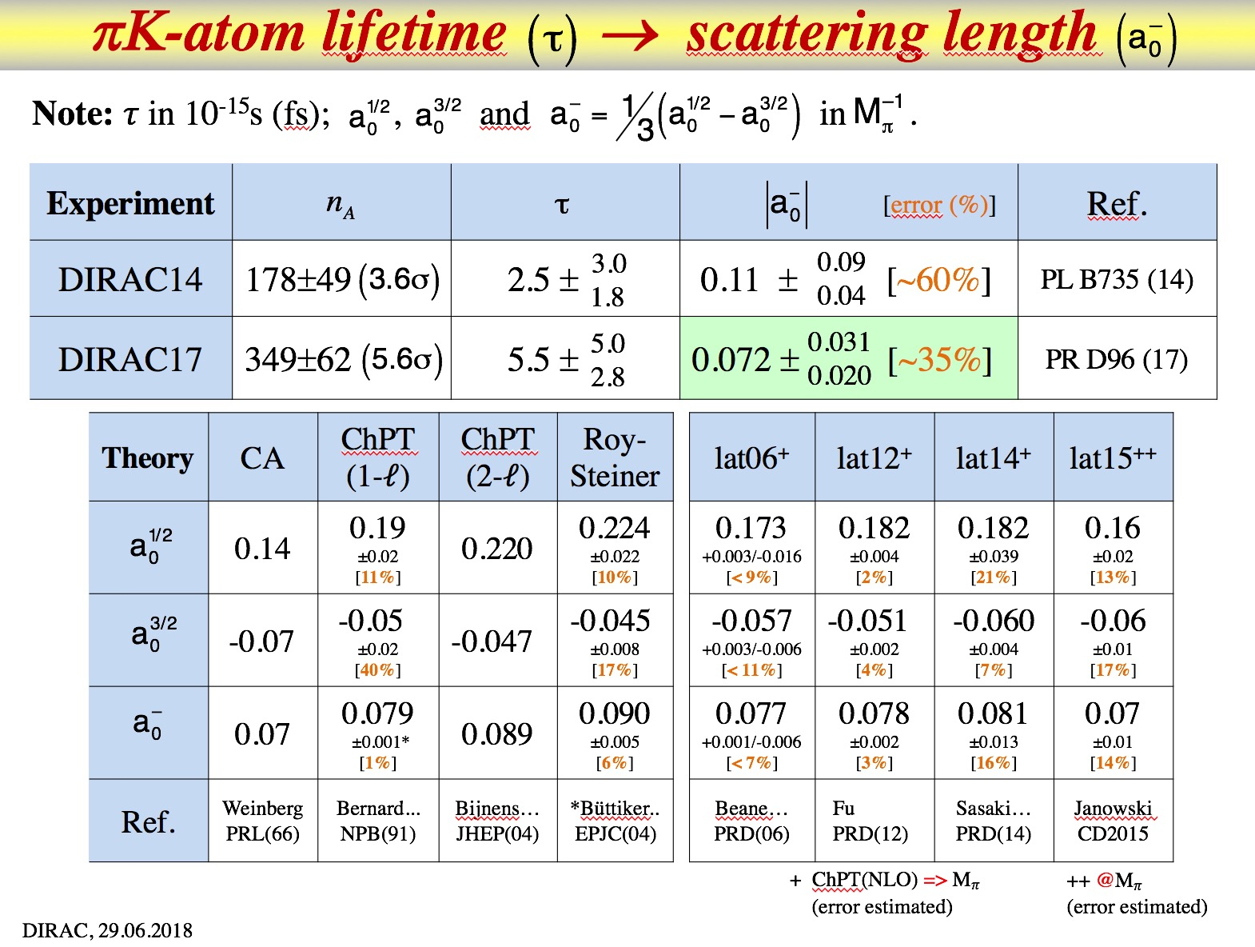
πK-atom lifetime (τ) → scattering length ( )
2/22/23
L. Nemenov
<number>

Slide 20
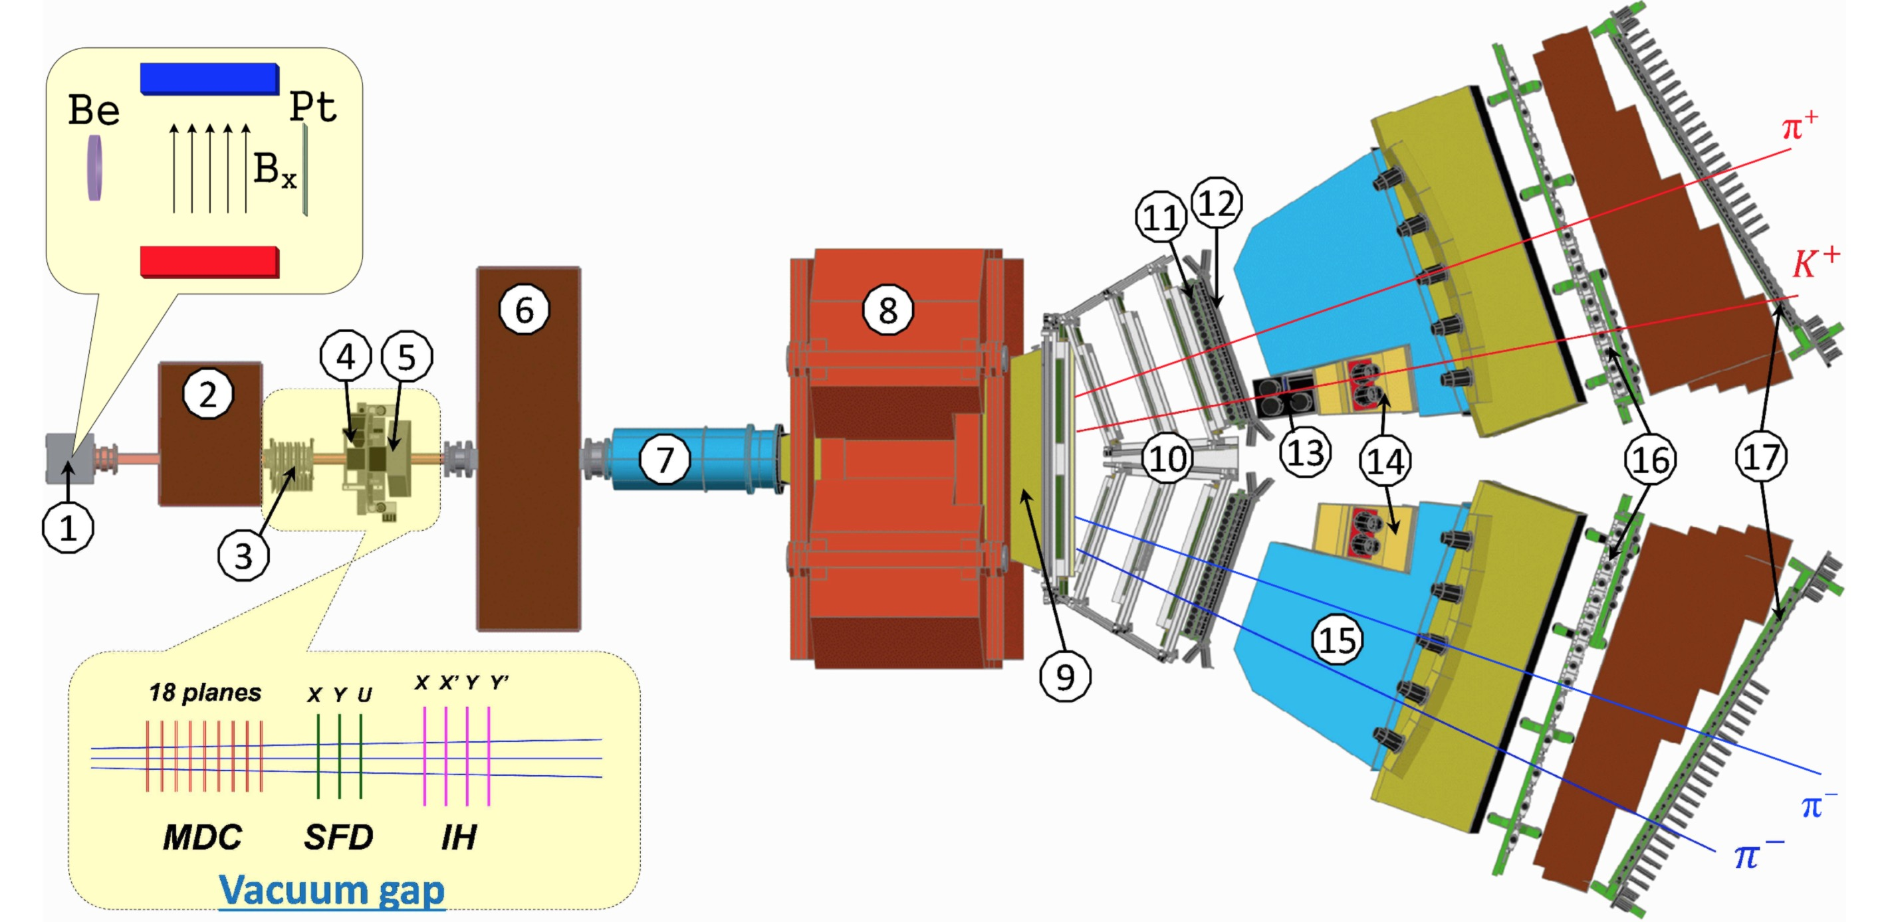
DIRAC setup, experimental and theoretical data
Fig. 2. General view of the DIRAC setup:
1 -- target station with insertion, showing the Be target, magnetic field and Pt breakup foil; 2 -- first shielding;
3 -- microdrift chambers (MDC); 4 -- scintillating fiber detector (SFD); 5 -- ionisation hodoscope (IH);
6 -- second shielding; 7 -- vacuum tube; 8 -- spectrometer magnet; 9 -- vacuum chamber; 10 -- drift chambers (DC);
11 -- vertical hodoscope (VH); 12 -- horizontal hodoscope (HH); 13 -- aerogel Cherenkov; 14 -- heavy gas Cherenkov;
15 -- nitrogen Cherenkov; 16 -- preshower (PSh); 17 -- muon detector.
(The plotted symmetric and asymmetric events are a π⁺π⁻ and K⁺π⁻ pair, respectively.)
02/22/2023
<number>

Slide 21
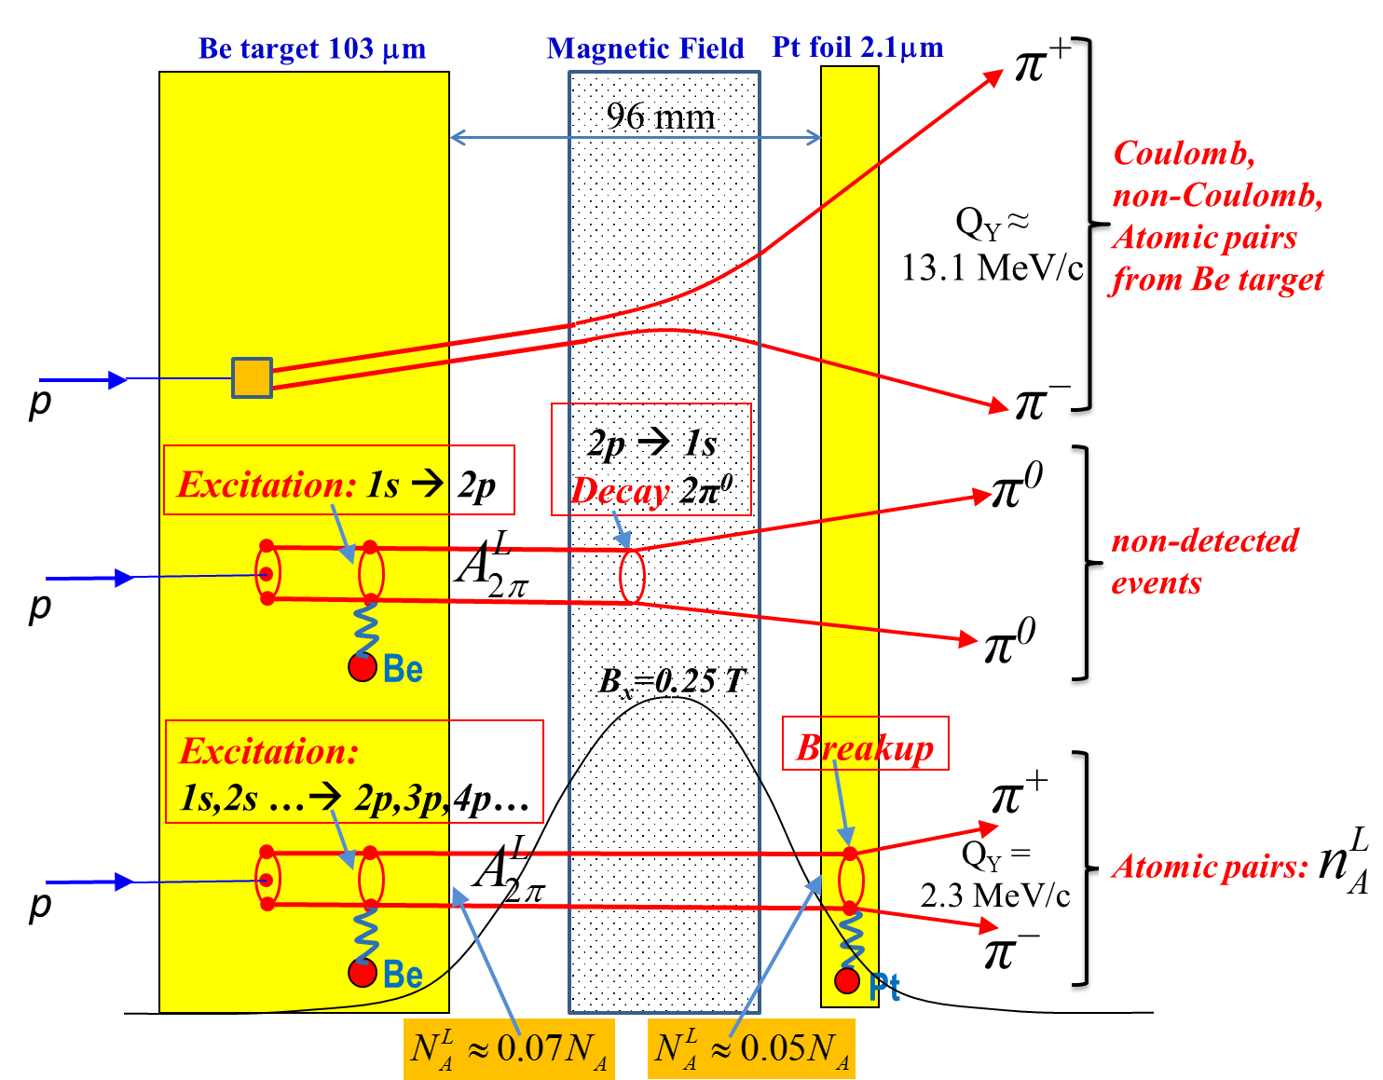
The π⁺π⁻ atoms production in Be target
Fig. 1 Method to observe long-lived A^{L}_{2π} by means of a breakup foil (Pt). The most of the produced π⁺π⁻ atoms decay (~70%) or are ionized (~6%) in the Be target. The excited (long lived) atoms (~24%) are investigated here.
02/22/2023
<number>

Slide 22
y-beam position (run 2012)
Pt foil edge position
7.5 mm from the beam axis
Proton beam position when the IH slabs single counts increase on factor 2 due to the halo beam interaction with the Pt foil
(no Be target).
Y
02/22/2023
<number>

Slide 23
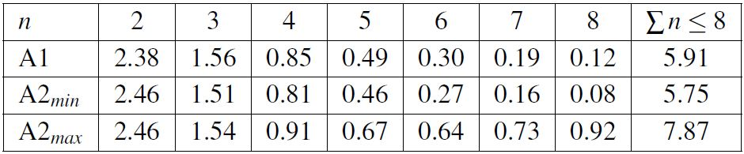
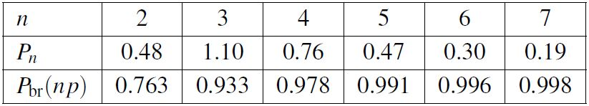
DIRAC Collaboration
Table 2: Summed populations of long-lived atomic states versus n given in % of the total number of produced A_{2π} in the Be target. The values are calculated in approach 1 (A1) and minimum/maximum values in approach 2 (A2_{min}/A2_{max}).
Table 3: P_{n} (in %) is the population of long-lived atomic states versus n (summed over l and m) at the entry in the Pt foil. P_{br}(np) is the breakup probability of the A_{2π} np states in the 2.1μm thick Pt foil. The values are calculated in approach 1 for the average atom momentum 4.44 GeV/c and the ground state lifetime τ = 3.15∙10⁻¹⁵ s.
08/12/2022
<number>
Notes:
<number>

Slide 24
π⁺π⁻ atom lifetime and decay lengths
n | τ_{2π} (10⁻¹¹sec) |  | Decay length A_{2π} in L.S. (cm) for γ=16
 |  |  | (λ_{ns}=c ∙ γ ∙ τ_{nl})
 | s (l=0) | p (l=1) | s (l=0) | p (l=1)
 | τ_{ns}=τ_{1s}∙ n³
1 | 2.9 ∙10⁻⁴ | - | 1.39∙10⁻³ | -
2 | 2.32∙10⁻³ | 1.17 | 1.11∙10⁻² | 5.6
3 | 7.83∙10⁻³ | 3.94 | 3.76∙10⁻² | 19
4 | 1.86∙10⁻² | 9.05 | 8.91∙10⁻² | 43
5 | 3.63∙10⁻² | 17.5 | 1.74∙10⁻¹ | 84
6 | 6.26∙10⁻² | 29.9 | 3.01∙10⁻¹ | 144
7 | 9.95∙10⁻² | 46.8 | 4.77∙10⁻¹ | 225
8 | 1.48∙10⁻¹ | 69.3 | 7.13∙10⁻¹ | 333

Slide 25
Experimental |Q_{L}| and Q_{T} distributions of π⁺π⁻ pairs
Fig. 6. |Q_{L}| distribution of π⁺π⁻ pairs for Q_{T} < 2.0 MeV/c
Fig.7. Q_{T} distribution of π⁺π⁻ pairs for |Q_{L}|< 2 MeV/c
a) Experimental distribution (points with statistical error) and the simulated background (solid line).
b) Experimental distribution after background subtraction (points with statistical error) and the simulated distribution of atomic pairs (dotted-dashed line). The fit procedure has been applied to the 2-dimensional (|Q_{L}|,Q_{T}) distribution.
02/22/2023
<number>

Slide 26
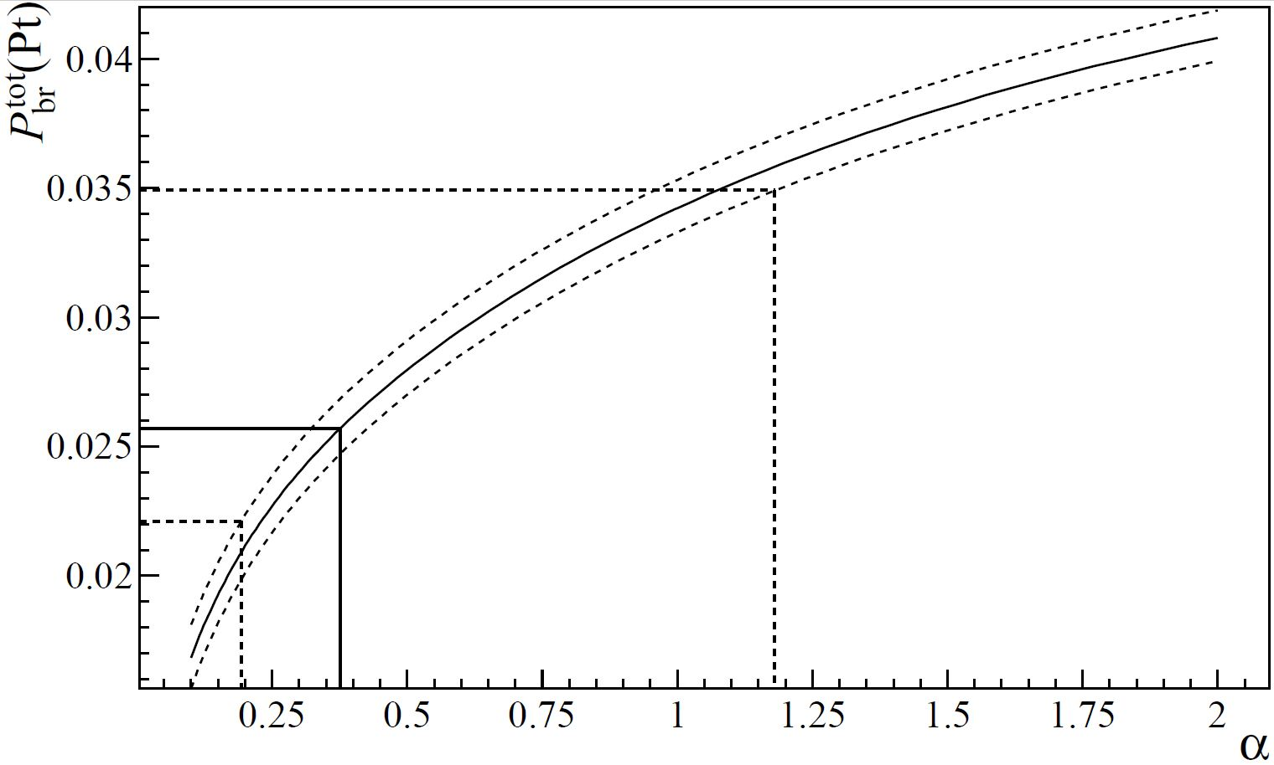


Breakup probability
Probability calculated as a function of α . The horizontal lines correspond to the measured value together with the total errors. The value α = 1, which corresponds to pure QED calculations, is within the error band of the measurement.
08/12/2022
<number>

Slide 27
Lifetime of long-lived π⁺π⁻ atoms
Number of atoms generated on Be target:
Number of long-lived atoms after Be target:
Number of atoms entered Pt foil:
Number of atomic pairs after Pt foil:
The lifetime of the long-lived atom in 2p state is:
QED:
The measured ground state lifetime is: One-third of the long-lived atoms have a lab decay length of 40 – 140cm. It opens the possibility to measure the Lamb shift and ππ scattering lengths. The experimental results were presented as section report at Rochester 2018, submitted as CERN preprint and will be submitted for publication
02/22/2023
<number>

Slide 28
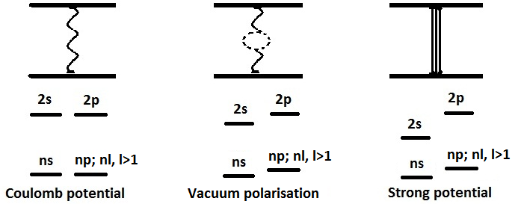
Energy splitting measurement
A_{2π} Energy Levels
can be calculated with relative precision ≈10^{–5}
(S. Karshtenbom)
For Coulomb potential,
E depends only on n
higher order QED
Notation:
J. Schweizer
[PL B (2004)]
G.V.Efimov et al.
Sov.J.Nucl.Phys. (1986)
CONCLUSION: one parameter (2a₀+a₂) allows to calculate all values
02/22/2023
<number>

Slide 29
K⁺K⁻ Coulomb pairs and K⁺K⁻ atoms
For charged pairs from short-lived sources and with small relative momenta Q , Coulomb final state interaction has to be taken into account.
This interaction increases the production yield of the free pairs with Q decreasing and creates atoms.
Κ⁺Κ⁻
Coulomb pair
Atom
There is a precise ratio between the number of produced Coulomb pairs (N_{C}) with small Q and the number of atoms (N_{A}) produced simultaneously with Coulomb pairs:
02/22/2023
<number>

Slide 30
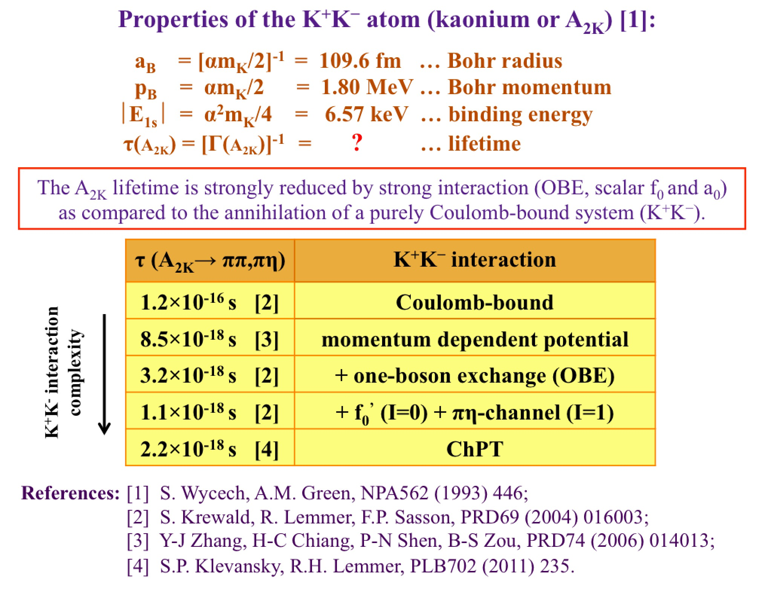
K⁺K⁻ atom and its lifetime
08/12/2022
<number>

Slide 31
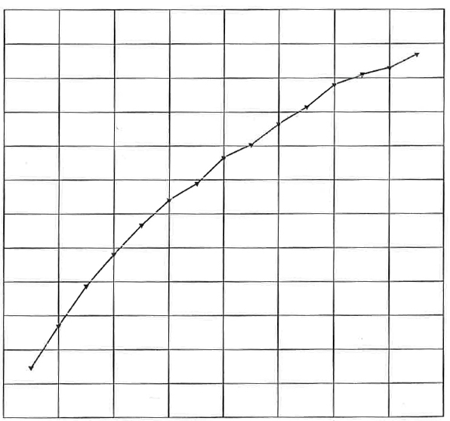
K⁺K⁻ atom ionization probability
28 μm Pt
x 10⁻²
3.9
3.5
3.1
2.7
2.3
1.9
1.5
Ionization Probability
0 1 2 3 4
Life time τ in 10^{–18} s
Κ⁺Κ⁻ atoms Lorentz factor is γ = 18
Notes:
<number>
<number>

Slide 32

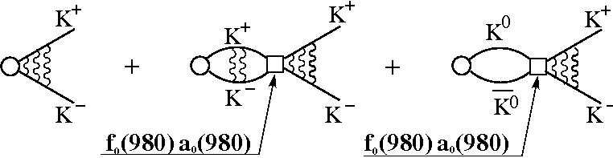
Schematic description of K⁺K⁻ production processes
a) | b)
The schematic description of K⁺K⁻ production processes.
The black point presents the pair point-like production; the wavy lines describe the Coulomb interaction in the final state.
The circle and square present the pair non point-like production and strong interaction in the final state respectively.
10/3/2022
<number>

Slide 33
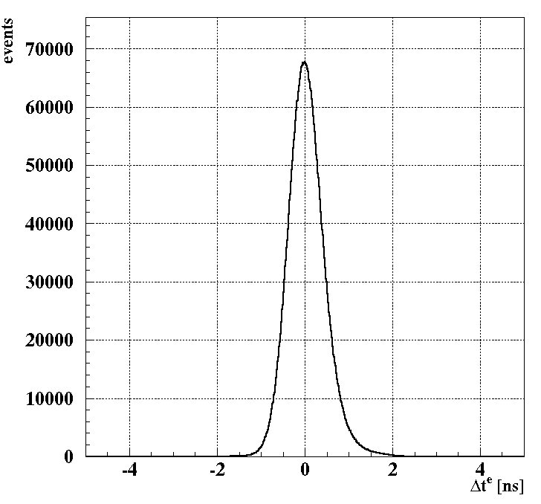
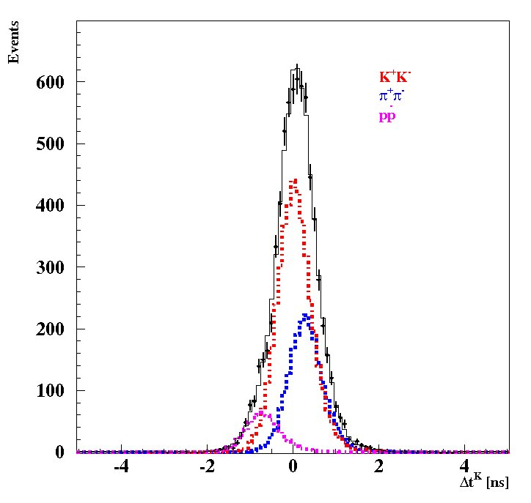
K⁺K⁻ production and detection with DIRAC
Δt^{e} distribution of electron-positron pairs.
Δt^{K} distribution of K⁺K⁻, π⁺π⁻ and p-anti p pairs with momentum of about 3.5GeV/c. The peak at zero corresponds to K⁺K⁻, the peak on the right to π⁺π⁻ and the small peak on the left to p-anti p pairs.
10/3/2022
<number>

Slide 34
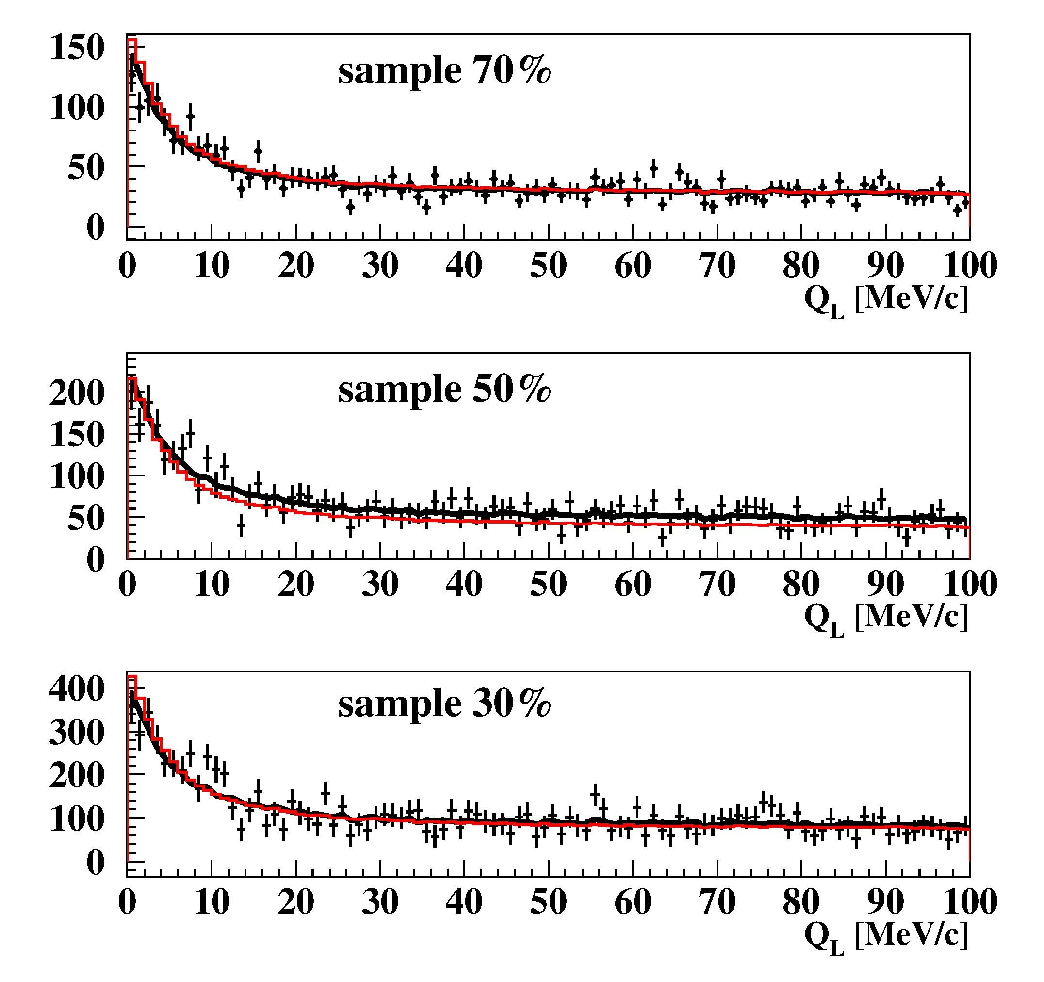
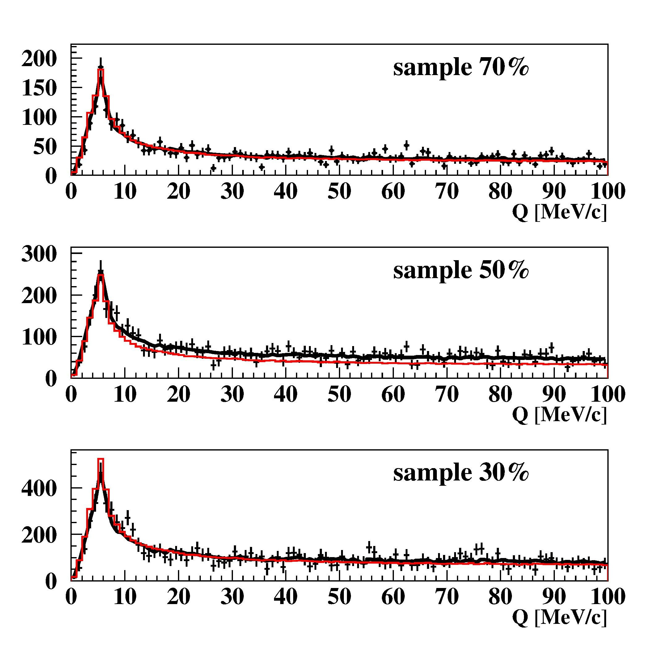
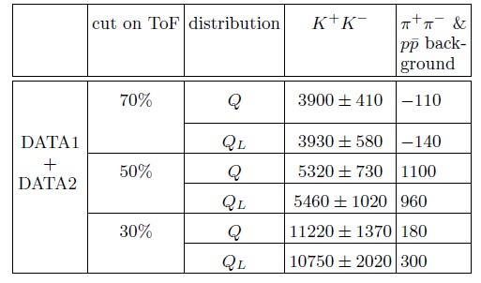
K⁺K⁻ production and detection with DIRAC
The experimental spectra of Q_{L} and Q are fitted by simulated K⁺K⁻ (point-like, Coulomb FSI) and residual π⁺π⁻ and p-anti-p background distributions. The red curve is the K⁺K⁻ distribution, the black one is the sum of K⁺K⁻ and residual background distributions.
10/3/2022
<number>

Slide 35
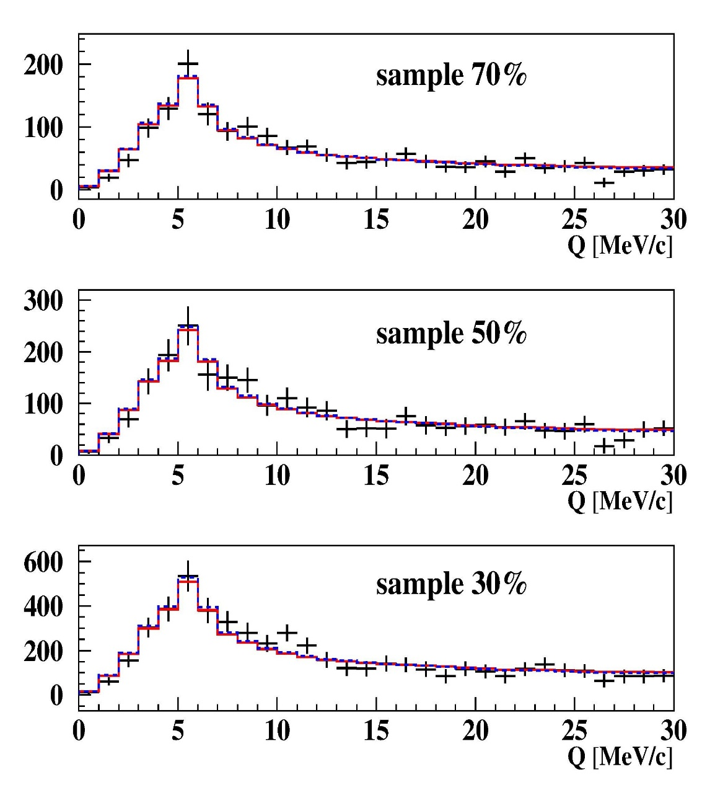
K⁺K⁻ production and detection with DIRAC
Q distributions in the interval0−30MeV/c of K⁺K⁻ (ALICE parametrization) of the subsamples 30%, 50% and 70% for the DATA1 and DATA2 after residual background subtraction. The red and the blue fitting curves were evaluated from the analysis of experimental distributions with residual background in Coulomb and Martin parametrizations respectively. It is seen that in this interval of Q the difference between these curves is absent and they describe ”pure” experimental K⁺K⁻ distributions well.
The K⁺K⁻ pair numbers, including residual background pairs, are 3790 (70%), 6420 (50%) and 11030 (30%).
10/3/2022
<number>

Slide 36
Measurement of the πK and π⁺π⁻ scattering length on SPS CERN
The number of produced A_{2π} , A_{π}⁺_{K}⁻ and A_{π}⁻_{K}⁺ per time unit at SPS CERN at p_{p} = 450Gev/c, will be 12±2, 53±11 and 24±5 times higher than in the DIRAC experiment [J.Phys. G: Nucl. Phys. 43 (2016)]
For the setup with the same parameters as in the DIRAC experiment and running time 5 months the expected statistical (sysematic) precision for πK scattering length |a_{1/2}-a_{3/2}| is ~5% (2%). (The DIRAC error is 34%). It allows to check with the same accuracy predictions of the total L(3) QCD Lagrangian based on the chiral SU(3)_{L}*SU(3)_{R} symmetry breaking.
Simultaneously the expected number of π⁺π⁻ atomic pairs n_{A}=400000 . The statistical (systematic) precision of the π⁺π⁻ scattering length
|a₀-a₂| will be: 0.7% (2%).
02/22/2023
<number>

Slide 37
L(3) ,L(2) and Chiral Lagrangian predictions check with Kπ and π⁺π⁻ atom
The Lattice calculations: for the πK scattering lengths a_{1/2} and a_{3/2} the precision is~ 5% and will be improved in the near future. The experimental precision for a_{1/2} - a_{3/2} from the πK atom lifetime measurement is 34%. For the proton beam intensity 3x10¹¹ protons/s, 3000 spills per day and running time 5 months the expected accuracy will be 5%. At the same running time the ππ scattering lengths a₀ , a₂ measurement will be improved.
Lattice calculations ChPT | a₀ a₂ a₀ and a₂ a₀-a₂ | 4-10% precision ~1% precision 2.3% precision 1.5% precision | K.Sasaki et al., Phys.Rev. 2014, Z.Fu, Phys.Rev.(2013), C.Lang et al.,Phys.Rev.(2012), Feng et al., Phys. Lett.(2010), T.Yagy at al., arXiv:1108.2970, S.Beame et al. Phys.Rev(2008) Colangelo et al. Nucl.Phys.(2001)
Experimental values | a₀-a₂ | ~ 4% precision | J.R.Bateley at al., Eur. Phys. J. (2009), K decay, cusp-effect. Adeva et al., Phys. Lett. (2011) ππ atom lifetime measurement
 | a₀ a₂ | ~ 6% precision ~22% precision | J.R.Bateley at al., Eur. Phys. J. (2009), Ke4 decay J.R.Bateley at al., Eur. Phys. (2010) Ke4 decay
Expected Experimental values on SPS | a₀-a₂ 2a₀ +a₂ | 0.7% (~2%) Statistical(systematic) Errors Will de estimated | DIRAC-NOTE-2016-05

Slide 38
The yield of π⁺π⁻, π⁺K⁻ and K⁺π⁻ atoms
θ_{lab} | 5.7° |  | 4° | 2° | 0°
E_{p} | 24 GeV/c |  | 450 GeV/c | 450 GeV/c | 450 GeV
The yield of π⁺π⁻ atoms
W_{A} | 1.25·10⁻⁹ | 1.9·10⁻⁸ |  | 3.5·10⁻⁸ | 4.5·10⁻⁸
W_{A}^{N} | 1 | 15 (9.7±1.5) |  | 28 (17.5±2.8) | 36 (22.7±3.6)
(W_{A}/W_{ch})^{N} | 1 | 2.4 (1.55±0.20) |  | 1.2 (0.77±0.13) | 0.27 (0.17±0.03)
The yield of π⁺K⁻ atoms
W_{A} | 1.3·10⁻¹¹ | 8.8·10⁻¹⁰ |  | 1.7·10⁻⁹ | 2.0·10⁻⁹
W_{A}^{N} | 1 | 67 (45 ± 8) |  | 131 (87 ± 15) | 154 (104 ± 18)
(W_{A}/W_{ch})^{N} | 1 | 10.6 (7.0±1.0) |  | 5.8 (3.9±0.7) | 1.2 (0.79±0.13)
The yield of K⁺π⁻ atoms
W_{A} | 3.1·10⁻¹¹ | 9.7·10⁻¹⁰ |  | 2.1·10⁻⁹ | 2.7·10⁻⁹
W_{A}^{N} | 1 | 31 (18.6±4.1) |  | 68 (41±9) | 87 (52±11)
(W_{A}/W_{ch})^{N} | 1. | 4.9 (2.9±0.6) |  | 3.0 (1.9±0.4) | 0.66 (0.40±0.09)
SPS duty cycle add factor 5 relative to PS
02/22/2023

Slide 39
Q_{l} for different Q_{T} intervals (accidental subtracted)
FWHM =3.25 MeV/c
FWHM =3.5 MeV/c
FWHM =4.8 MeV/c
FWHM =10.5 MeV/c

Slide 40
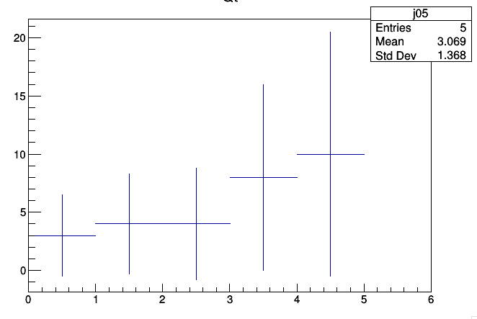

Slide 41
Thank you
02/22/2023
<number>

Slide 42
πK scattering
What new will be known if πK scattering length will be measured?
The measurement of the s-wave πK scattering lengths would test our understanding of the chiral SU(3)_{L} × SU(3)_{R} symmetry breaking of QCD (u, d and s quarks), while the measurement of ππ scattering lengths checks only the SU(2)_{L} × SU(2)_{R} symmetry breaking (u, d quarks).
This is the principal difference between ππ and πK scattering!
02/22/2023
<number>
Notes:
<number>

Slide 43
QCD and Chiral Lagrangian predictions check with long-lived π⁺π⁻ atoms
The DIRAC collaboration Phys.Lett.(2015) observed 436±61 pion pairs from the long-lived (τ ≥ 1×10⁻¹¹ sec) π⁺π⁻ atom breakup in Pt foil(Phys.Lett.(2015).
The short-lived atoms lifetime measurement allowed to evaluate ππ scattering length combination a₀ - a_{2.}
The study of the long-lived atoms will allow to measure the Lamb shift depending on another ππ scattering length combination: 2a₀+a₂ and to evaluate the a₀, a₂ separately.
02/22/2023
<number>

Slide 44
Lifetime of long-lived π⁺π⁻ atoms
The table: the population of atoms as function of n,l and the decay length
As a function of n.
Number of atoms entered Pt foil:
Number of atomic pairs after Pt foil:
The lifetime of long-lived atom in simple approach:
QED:
The measured ground state lifetime:
02/22/2023
<number>

Slide 45
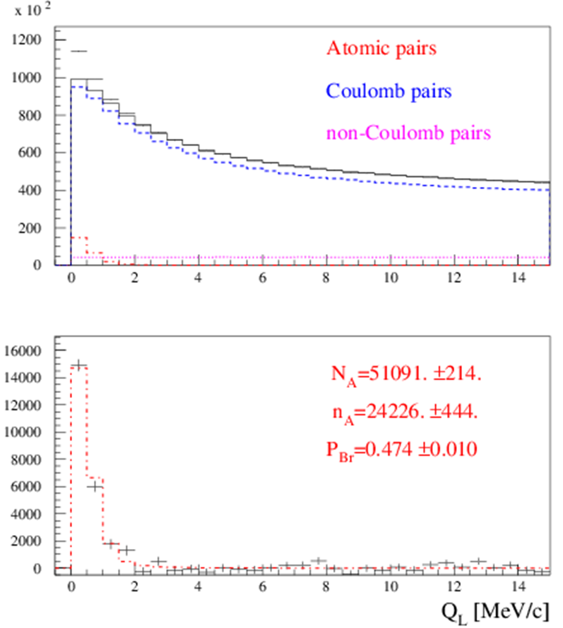
III. The short-lived π⁺π⁻ atom lifetime measurement
Preliminary results on the short-lived atom lifetime measurement based on all available 2008-2010 data are presented in Fig. 1 and 2.
Fig.1. Distribution over |Q_{L}| for events, selected with criterion
Q_{T} < 4 MeV/c. Fractions of atomic, Coulomb and non-Coulomb pairs were obtained by fitting the distri-bution over (|Q_{L}|,Q_{T}) with criteria: |Q_{L}|<15 MeV/c, Q_{T} < 4 MeV/c.
N_{A}, n_{A} and P_{br}. are the number of produced atoms, detected atomic pairs and probability of the atoms breaking in the target respectively.
02/22/2023
<number>

Slide 46
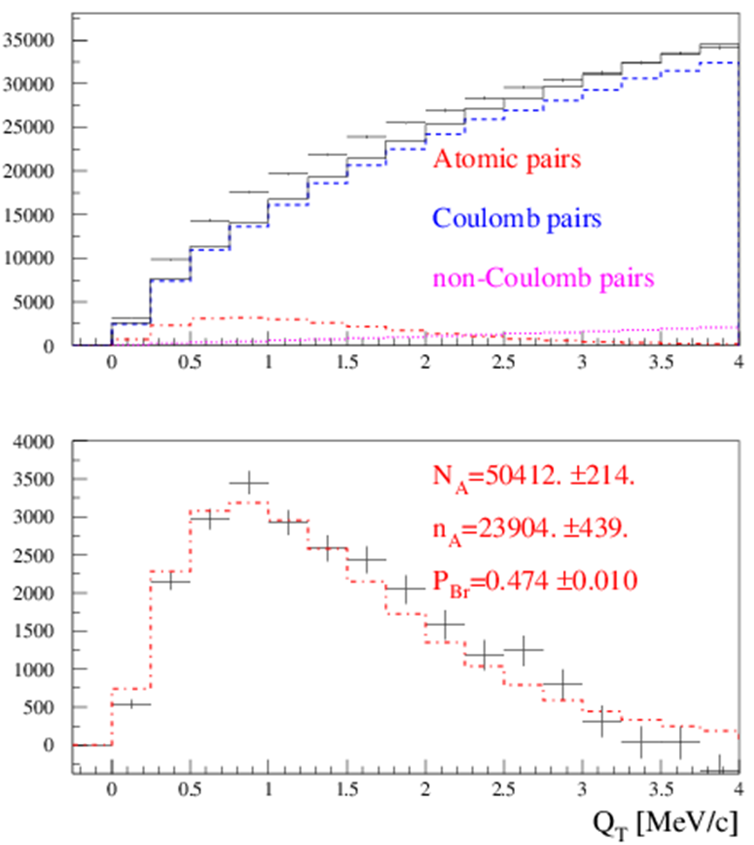
III. The short-lived π⁺π⁻ atom lifetime measurement
Preliminary results on the short-lived atom lifetime measurement based on all available 2008-2010 data are presented in Fig. 1 and 2.
Fig.2. Distribution over Q_{T} of events, selected with criterion |Q_{L}| < 2 MeV/c. Fractions of atomic, Coulomb and non-Coulomb pairs were obtained by fitting the distri-bution over (|Q_{L}|,Q_{T}) with criteria: |Q_{L}|<15 MeV/c, Q_{T} < 4 MeV/c. N_{A}, n_{A} and P_{br}. are the number of produced atoms, detected atomic pairs and probability of the atoms breaking in the target respectively.
02/22/2023
<number>

Slide 47
III. The short-lived π⁺π⁻ atom lifetime measurement
1. The average probability of π⁺π⁻ atom breakup for the Ni targets of 98 µm thickness (RUN 2008) and 109 µm (RUNS 2009-2010) was evaluated as P_{br}= 0.474 ± 0.01. It is in agreement with the value P_{br}= 0.46 ± 0.013 obtained for the 98 µm target and published in 2011.
In the final data analysis, the new measurements of multiple scattering will be included. The dedicated paper will be ready before June of 2018.
2. The current value of systematical error in the π⁺π⁻ atom lifetime measurement is equal to the statistical uncertainty. The main part of the systematical error arises due to an uncertainty in the multiple scattering in the Ni target.
To reduce this error, we did an experimental study of the multiple scattering in the targets: Be: 100 and 2000 μm; Ti: 250 μm ; Ni: 50, 109 and 150 μm and Pt: 2 and 30 μm.
For Be (2000 μm), Ni (109 μm) the difference between theoretical and experimental r.m.s. is 0.4% and 0.8% accordingly. The r.m.s. values were calculated in the interval of ±2σ.
The achieved precision of multiple scattering investigation is better by one order of magnitude than in the previous experiments.
02/22/2023
<number>

Slide 48
QCD and Chiral Lagrangian predictions check with long-lived π+π- atoms
The DIRAC collaboration Phys.Lett.(2015) observed 436±61 pion pairs from the long-lived (τ ≥ 1×10⁻¹¹ sec) π⁺π⁻ atom breakup in Pt foil(Phys.Lett.(2015).
The short-lived atoms lifetime measurement allowed to evaluate ππ scattering length combination a₀ - a_{2.}
The study of the long-lived atoms will allow to measure the Lamb shift depending on another ππ scattering length combination: 2a₀+a₂ and to evaluate the a₀, a₂ separately.
At present time:
a₀ precision is 6% (experiment), 4-10%(Lattice), 2.3%(ChPT)
a₂ precision is 22% (experiment), 1% (Lattice), 2.3% (ChPT)
a₀ - a_{2.} precision is 4% (experiment), 1.5%(ChPT)
2/22/23
L. Nemenov
<number>

Slide 49
SPS beam time for πK scattering length measurement
The data at p_{p} = 24GeV/c and 450Gev/c were simulated, processed and analysed (V.Yazkov, DIRAC note, 2016 05).
Experimental conditions on SPS with Ni target
Thin Ni target, nuclear efficiency ~ 6x10⁻⁴.
The proton beam can be used for other experiments.
Proton beam intensity: 3x10¹¹ protons/s
(DIRAC worked at 2.7x10¹¹ protons/s)
Number of spills: 4.5x10⁵ with spill duration 4.5 s
Data taking: 3000 spills per 24 hours.
Running time: 5 months
The expected number of πK atomic pairs: n_{A}=13000
(In the DIRAC experiment was n_{A}=349±62)
The statistical precision in these conditions for πK scattering length will be: ~5%
The expected systematic error will be at the level of 2%
The expected number of π⁺π⁻ atomic pairs n_{A}=400000
The statistical precision of the π⁺π⁻ scattering length will be: 0.7%
The expected systematic error will be at the level of 2%
02/22/2023
<number>

