Slide 1
Status Report of the
DIRAC Experiment - PS 212
L. Nemenov (JINR)
SPSC – 20 October 2015

Slide 2








DIRAC Collaboration
CERN
Geneva, Switzerland
Tokyo Metropolitan University
Tokyo, Japan
Czech Technical University
Prague, Czech Republic
IFIN-HH
Bucharest, Romania
Institute of Physics ASCR
Prague, Czech Republic
JINR
Dubna, Russia
Nuclear Physics Institute ASCR
Rez, Czech Republic
SINP of Moscow State University
Moscow, Russia
INFN-Laboratori Nazionali di Frascati
Frascati, Italy
IHEP
Protvino, Russia
University of Messina
Messina, Italy
Santiago de Compostela University
Santiago de Compostela, Spain
KEK
Tsukuba, Japan
Bern University
Bern, Switzerland
Kyoto University
Kyoto, Japan
Kyoto Sangyo University
Kyoto, Japan
Zurich University
Zurich, Switzerland

Slide 3
Contents
Theoretical motivation
Long-lived π⁺π⁻ atom analysis
π⁺K⁻ and π⁻ K ⁺ atom analysis
Short-lived π⁺π⁻ atom analysis
K ⁺K ⁻ pair analysis and K ⁺K ⁻ atom
K ⁺π⁻ , K ⁻ π⁺, π⁺π⁻ , K ⁺K ⁻ atom production analysis at pp=24GeV/c and pp=450GeV/c
Letter of Intent
Further works
26.10.15

Slide 4
Theoretical motivation
ElectroWeak L_{EW}
Standard Model
strong:
L_{QCD}
SU(2)_{L}×U(1)
local gauge theory
SU(3)_{c}
Strong interaction: L_{QCD} = L_{sym} + L_{sym-break} (m_{q} ≠ 0)
(chiral symmetry)
HIGH energy
(small distance)
Q>>
Q<<
LOW energy
(large distance)
perturbative QCD:
L_{QCD} (q,g)
Interaction → „weak“ (asympt. freedom)
Method: expansion in coupling
Checks only L_{sym} !
non-perturbative QCD:
L_{eff} (GB: π,K,η); L_{lattice} (q,g)
Interaction → „strong“ (confinement) Methods: 1) Chiral Perturbation Theory
2) Lattice Gauge Theory
Checks L_{sym} as well as L_{sym-break} !
spontaneously
broken symmetry
quark-
condensate
26.10.15

Slide 5
Theoretical motivation
ππ scattering length
In ChPT the effective Lagrangian, which describes the ππ interaction, is an expansion in terms:
(tree) (1-loop) (2-loop)
G. Colangelo, J. Gasser and H. Leutwyler, Nucl. Phys. B603 (2001) 125, using ChPT (2-loop) & Roy equations:
These results precision depends on the low-energy constants (LEC) l₃ and l₄:
Lattice gauge calculations from 2006 provided values for these l₃ and l₄ which
allows to improve the scattering length precision.
Lattice calculation are giving also the scattering length values.
26.10.15

Slide 6
Method of A_{2π} observation and measurement
Target Ni 98 μm
A_{2π}
π⁺
p
(n_{A})
Atomic pairs
24 GeV/c
(N_{A})
π⁻
Interaction point
Ni
π⁺
p
(N_{C})
π⁻
Coulomb pairs
24 GeV/c
Δ,ρ,ω,…
π⁺
π⁺
p
Non-Coulomb pairs
24 GeV/c
π⁻
η, η’,…
π⁺
Q – relative momentum in π⁺π– c.m.s.
Q_{L}, Q_{T}
Interaction point
π⁰
p
π⁺
24 GeV/c
Accidental pairs
p
π⁻
26.10.15

Slide 7
Coulomb pairs and atoms
For charged pairs from short-lived sources and with small relative momenta Q , Coulomb final state interaction has to be taken into account.
This interaction increases the production yield of the free pairs with Q decreasing and creates atoms.
π⁺π⁻, Κ⁺π⁻, Κ⁻π⁺,
Κ⁺Κ⁻, π⁺μ⁻, π⁻μ⁺
(π⁺π⁻), (Κ⁺π⁻), (Κ⁻π⁺),
(Κ⁺Κ⁻), (π⁺μ⁻), (π⁻μ⁺)
Coulomb pair
Atom
There is a precise ratio between the number of produced Coulomb pairs (N_{C}) with small Q and the number of atoms (N_{A}) produced simultaneously with Coulomb pairs:
26.10.15

Slide 8


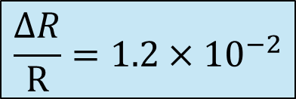
π⁺π– atom lifetime
π⁺π– atom (pionium) is a hydrogen-like atom consisting of π⁺ and π– mesons:
E_{B} = -1.86 keV, r_{B} = 387 fm, p_{B} ≈ 0.5 MeV/c
π⁺
π⁰
The π⁺π⁻ atom lifetime is dominated by the decay into π⁰ π⁰ mesons:
π⁻
π⁰
$$\frac{ΔR}{R}=1.2×{10}^{−2}$$
$$τ_{1s}=(2.9±0.1)×{10}^{−15}s$$
$$τ_{2p}=1.17×{10}^{−11}s$$
a₀ and a₂ are the ππ S-wave scattering lengths for isospin I=0 and I=2.
≠ 0 for l = 0
A_{2π}(1s, 2s,…, ns)
π⁰π⁰
= 0 for l ≠ 0
γ
π⁰π⁰
A_{2π}(np)
A_{2π}(1s, 2s,…(n-1)s)
The np state lifetime depends on the transition np 1s, 2s,…, (n-1)s probability.
This probability is about 3 orders of magnitude less than for ns π⁰π⁰.

Slide 9
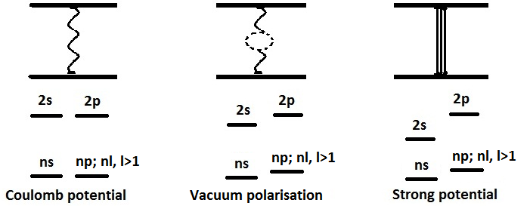
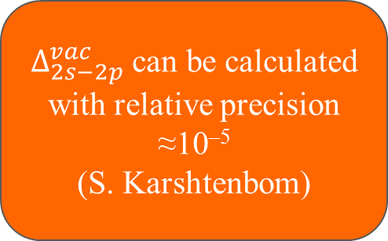
Energy splitting measurement
A_{2π} Energy Levels
$Δ_{2s−2p}^{vac}$ can be calculated with relative precision ≈10^{–5}
(S. Karshtenbom)
For Coulomb potential,
E depends only on n
higher order QED
Notation:
J. Schweizer
[PL B (2004)]
G.V.Efimov et al.
Sov.J.Nucl.Phys. (1986)
CONCLUSION: one parameter (2a₀+a₂) allows to calculate all values

Slide 10
Long-lived π⁺π– atoms
Paper “First observation of long-lived π⁺π⁻ atoms” accepted for publication in Physics Letters B.
The number of atomic pairs from long-lived π⁺π⁻ atoms breakup in the Pt foil is:
n_{A}=436±57|_{stat}±23|_{syst}=436±61|_{tot} (7.1 σ).
The preliminary value of the long-lived π⁺π⁻ atom lifetime will be presented in April 2016.
In 2016, we will study the possibility to evaluate a lower limit for the Lamb shift of π⁺π⁻ atom based on the existing data.
In 2016 we intend to process the 2011 data.
26.10.15

Slide 11
Method for observing long-lived π⁺π⁻ atom with breakup Pt foil
Be target103 μm
MagneticField
Pt foil 2.1 μm
96 mm
Magnetic Field
π⁺
Atomic, Coulomb, non-Coulomb and accidental pairs
Coulomb pairs → N_{A}
24 GeV/c
Q_{Y} =
12.9MeV/c
p
Δ,ρ,ω,η,η’…
π⁻
Interaction point
B_{X}=0.25T
Excitation
π⁺
Breakup
24 GeV/c
1s, 2s,…→2p, 3p, 4p, …
π⁺
p
Long-lived states
Q_{Y}=
2.3MeV/c
Atomic pairs
Be
Pt
π⁻
Interaction point
N_{A}*=(6.8 ±0.6)∙10⁻²N_{A}
N_{A}*=(4.3 ±0.6)∙10⁻²
N_{A}=17043±410 n_{A}^{L} = 436±61
τ_{1s}=(2.9 ± 0.1)∙10⁻¹⁵s
τ_{2p}=1.2∙10⁻¹¹s
n | 2 | 3 | 4 | 5 | ≥ 2
ε_{n}(Be)×10² | 2.48 ± O(10⁻³) | 1.54 ± 0.01 | 0.86 ± 0.03 | 0.56 ± 0.06 | 6.8 ± 0.6
ε_{n}(Pt)×10² | 0.52 ± O(10⁻⁴) | 1.10 ± O(10⁻³) | 0.78 ± 0.03 | 0.54 ± 0.06 | 4.3 ± 0.6
P_{br} | 0.72 ± 0.03 | 0.89 ± 0.03 | 0.94 ± 0.02 | 0.96 ± 0.02 | 0.97 ± 0.02
26.10.15
11

Slide 12
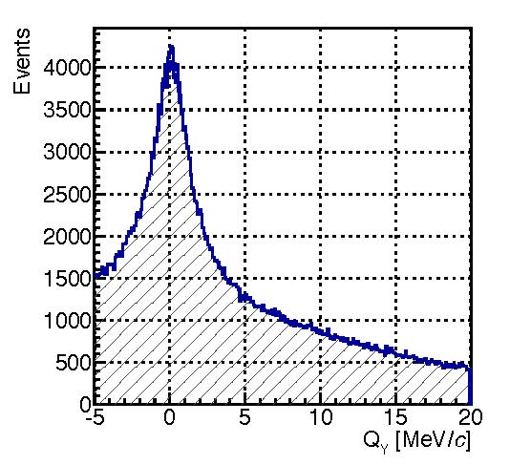
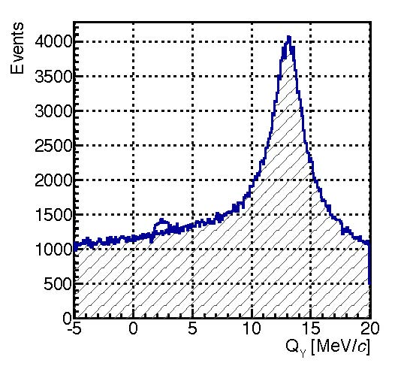
The background reduction with magnetic field for long-lived A_{2π} observation
V. Yazkov
Q_{y} distribution of “atomic pairs” (signal) above the background of π⁺π– Coulomb pairs
produced in Beryllium target, without (left) and with (right) magnet used in 2012 run.
Selected events with the cut:
Expected signal (atomic pairs) from broken up long-lived π⁺π– atoms
Simulation without magnet
Simulation with magnet
26.10.15

Slide 13
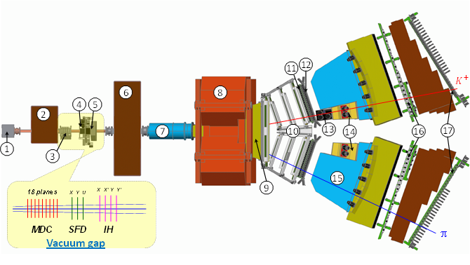
DIRAC upgraded Experimental setup
1 Target station ; 2 First shielding; 3 Micro Drift Chambers; 4 Scintillating Fiber Detector; 5 Ionization Hodoscope; 6 Second Shielding; 7 Vacuum Tube; 8 Spectrometer Magnet; 9 Vacuum Chamber; 10 Drift Chambers; 11 Vertical Hodoscope; 12 Horizontal Hodoscope; 13 Aerogel Čerenkov; 14 Heavy Gas Čerenkov; 15 Nitrogen Čerenkov; 16 Preshower; 17 Muon Detector
26.10.15

Slide 14
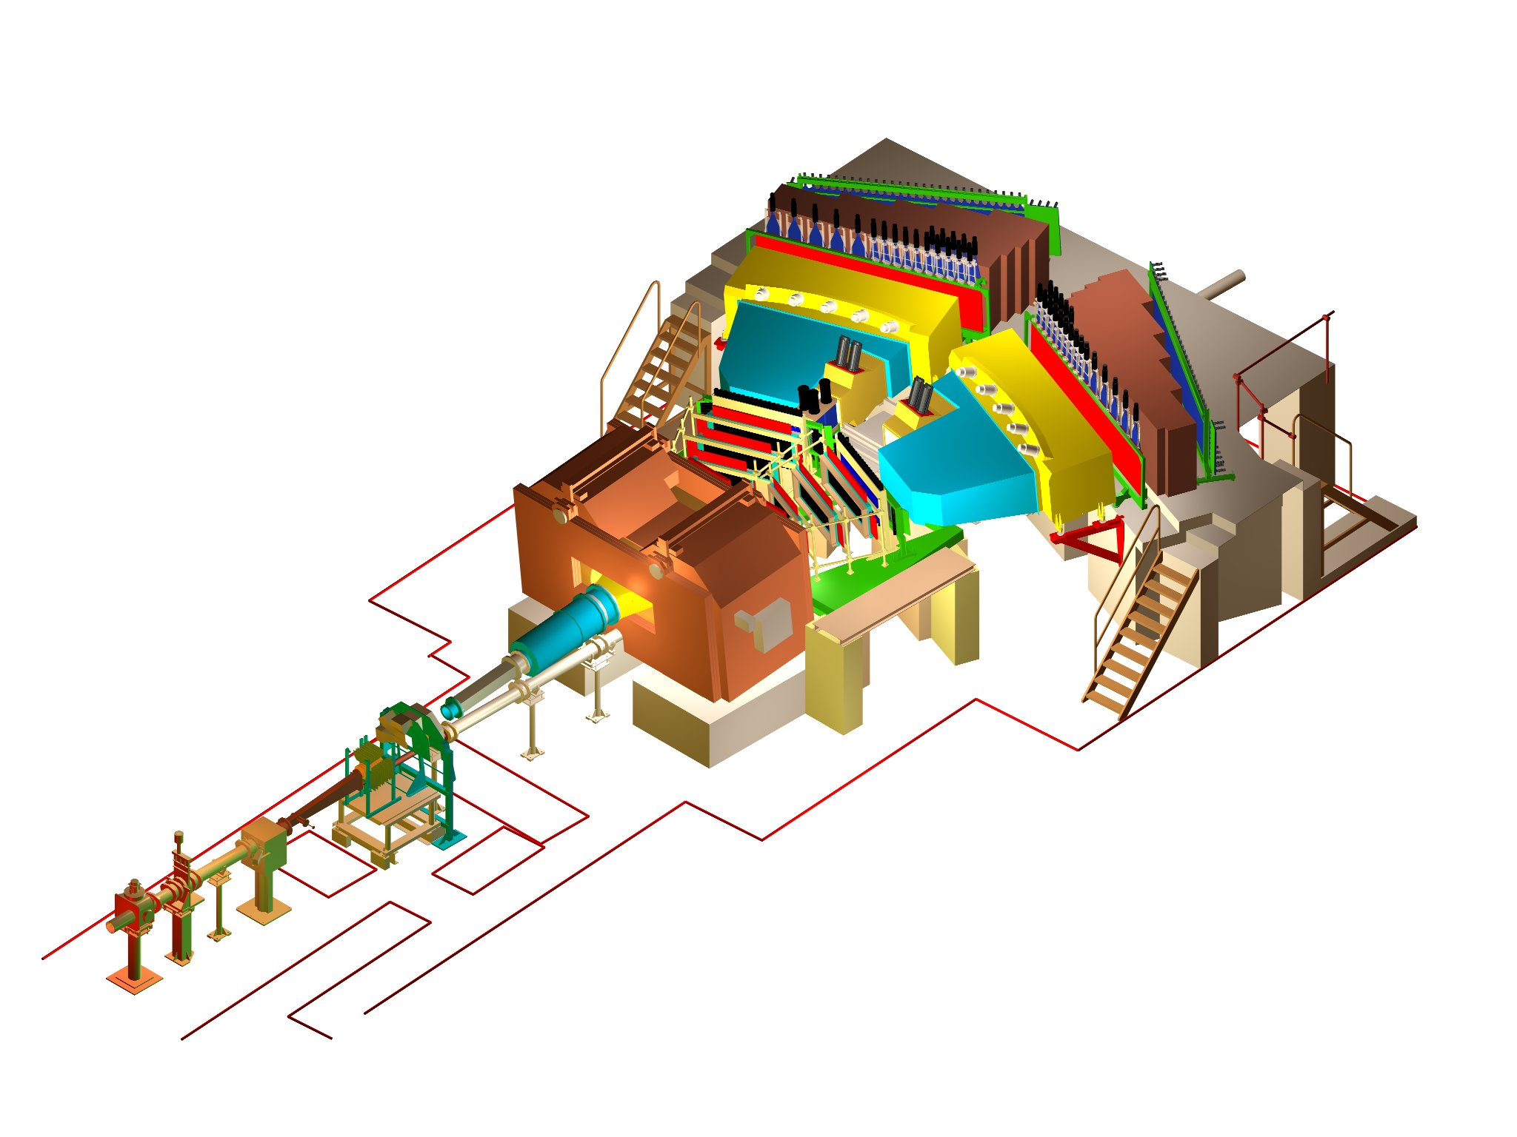
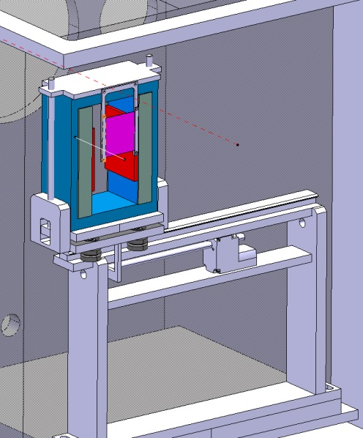
DIRAC upgraded Experimental setup
BLUE … magnet yoke
GREY … magnet poles
RED … magnet shimming
PURPLE … Pt foil
σ_{QX} = σ_{QY} = 0.5 MeV/c
σ_{QL} = 0.5 MeV/c (ππ)
σ_{QL} = 0.9 MeV/c (πΚ)
26.10.15
Notes:
14

Slide 15
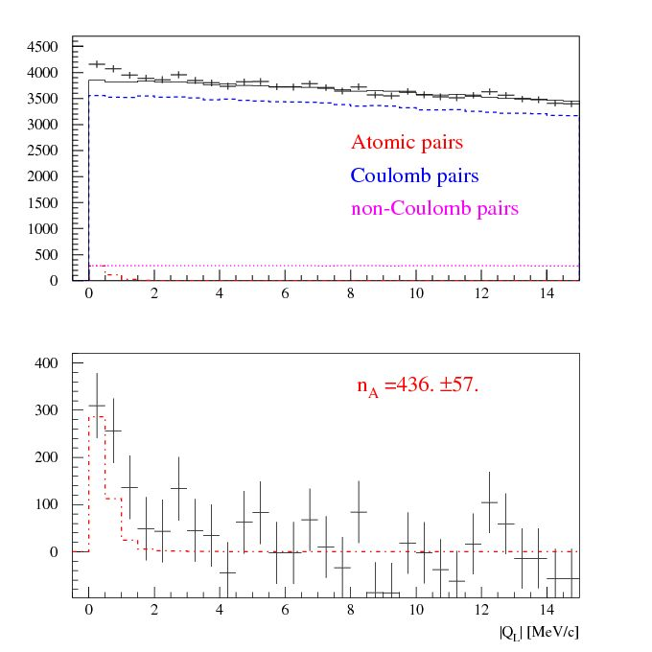
Experimental |Q_{L}| distributions of π⁺π– pairs
|Q_{L}| distribution of π⁺π– pairs
for Q_{T} <2.0 MeV/c
a) The experimental distribution (points with statistical error) and the simulated background (solid line).
b) The experimental distribution after background subtraction (points with statistical error) and the simulated distribution of atomic pairs (dot-dashed line).
The fit procedure has been applied to the 2-dimensional (|Q_{L}|, Q_{T} ) distribution.
a)
b)
26.10.15

Slide 16
πK scattering
What new will be known if πK scattering length will be measured?
The measurement of the s-wave πK scattering lengths would test our understanding of the chiral SU(3)_{L} × SU(3)_{R} symmetry breaking of QCD (u, d and s quarks), while the measurement of ππ scattering lengths checks only the SU(2)_{L} × SU(2)_{R} symmetry breaking (u, d quarks).
This is the principal difference between ππ and πK scattering!
26.10.15

Slide 17
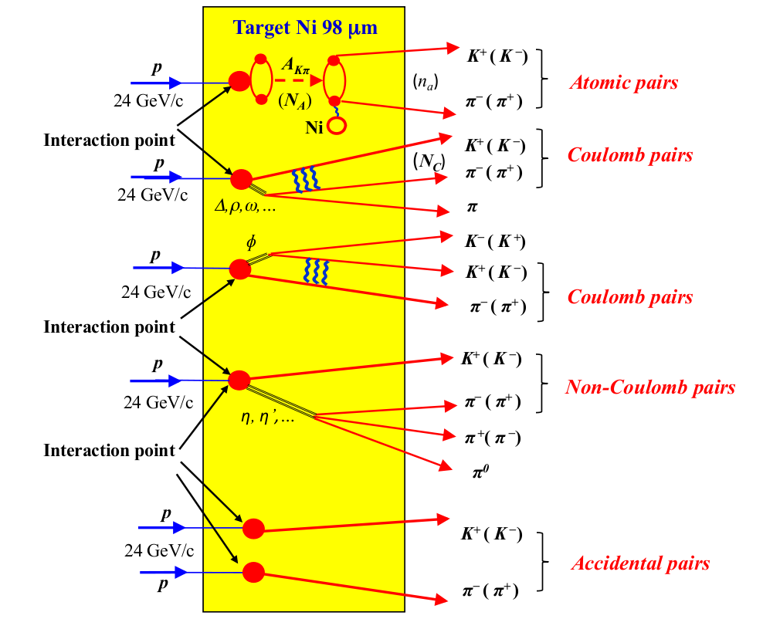
Method of Kπ atom observation and investigation
Q – relative momentum in π⁺π– c.m.s.
Q_{L}, Q_{T}
26.10.15

Slide 18
π⁺K – and π–K ⁺ atoms
Published paper: Physics Letters B 735 (2014) 288
“First πK atom lifetime and πK scattering length measurements”
In this paper, characteristic πK pairs from πK atom breakup in the Ni target have been observed, as many as
178±49 (3.6σ) πK atomic pairs as well as
653±42 produced πK atoms
Based on these results, the first measurement of the πK atom lifetime has been deduced
and the first measurement of the S-wave isospin-odd πK scattering length
The result was obtained using 2/3 of the existing statistics with low and medium background in the scintillation fiber detector.
26.10.15

Slide 19
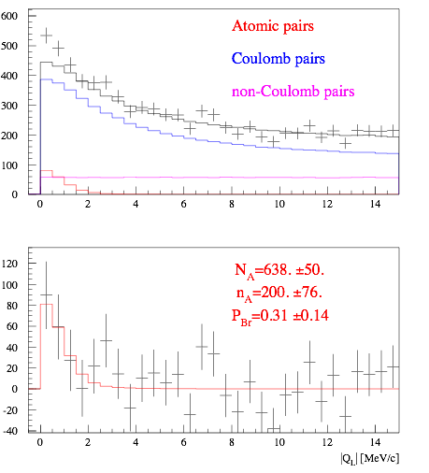
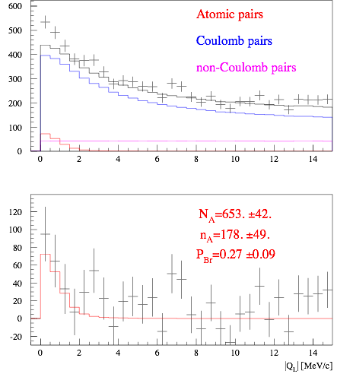
π⁺K – and π–K ⁺ - run 2008-2010
Run 2008-2010, statistics with low and medium background (2/3 of all statistics).
|Q_{L}| distribution
analysis on |Q_{L}| for Q_{T} < 4 MeV/c
|Q_{L}| distribution
analysis on |Q_{L}| and Q_{T} for Q_{T} < 4 MeV/c
26.10.15

Slide 20
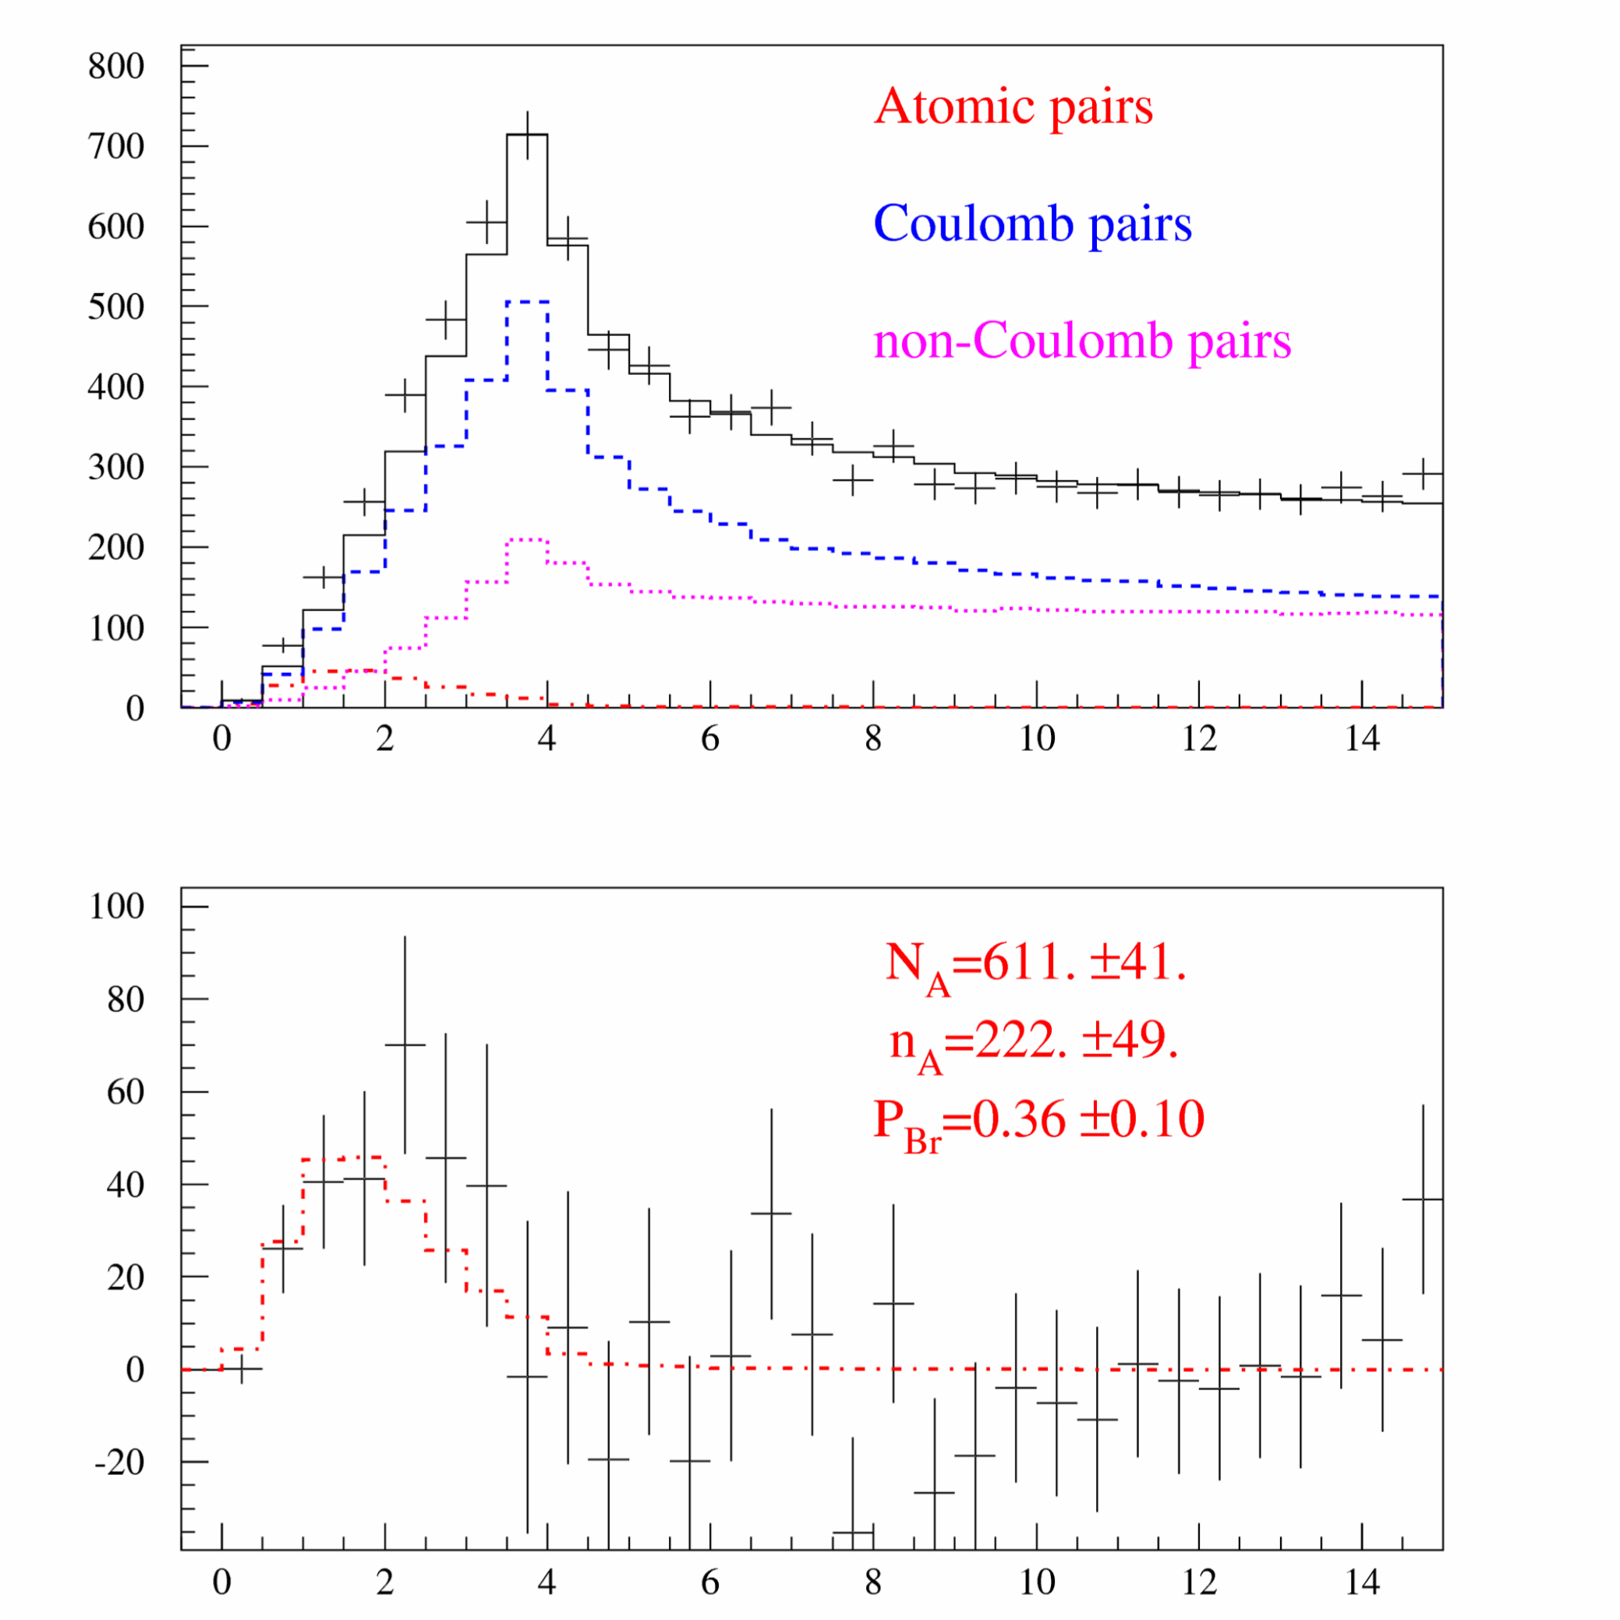
Experimental Q distributions of K⁺π – pairs
The Q distribution of the K⁺π– pairs collected with Platinum target in 2007 and Nickel target in 2008, 2009, 2010.
26.10.15

Slide 21
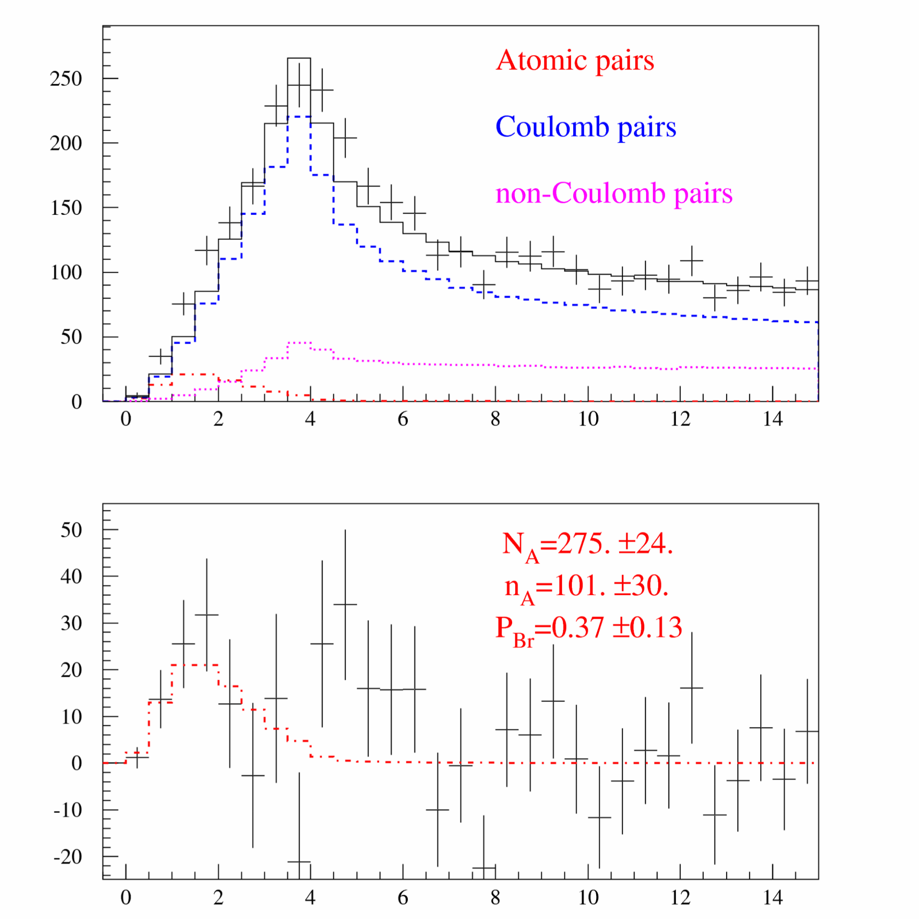
Experimental Q distributions of π⁺K – pairs
The Q distribution of the π⁺K– pairs collected with Platinum target in 2007 and Nickel target in 2008, 2009, 2010.
26.10.15

Slide 22
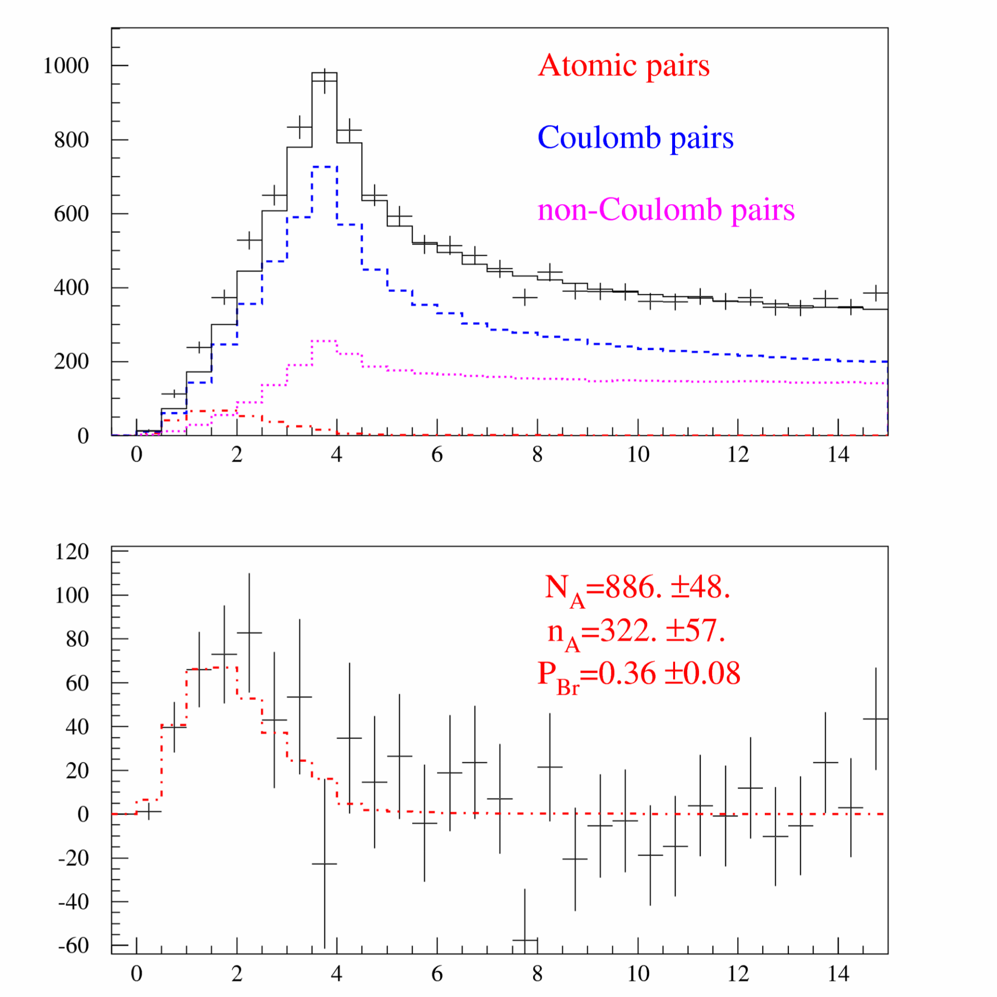
Experimental Q distributions of K⁺π – and π⁺K – pairs
The Q distribution of the K⁺π⁻ and π⁺K⁻ pairs(2/3 of existing statistic) collected with Platinum target in 2007 and Nickel target in 2008, 2009, 2010.
26.10.15

Slide 23
Experimental number of atomic K⁺π –, π⁺K – pairs
Number of “atomic pairs” (n_{A}) with statistical error and ratio signal-to-error (r_{A}) for πK atoms collected with Nickel target in 2008, 2009 and 2010. Selection criteria: |Q_{L}| < 20 MeV/c, Q_{T} < 4 MeV/c.
Variable | n_{A} ^{K+π-} (r_{A}) | n_{A}^{π+K-} (r_{A}) | n_{A}^{πK} (r_{A})
Q | 175. ± 46. (3.8) | 85. ± 29. (3.0) | 260. ± 54. (4.8)
|Q_{L}| | 93. ± 70. (1.3) | 53. ± 42. (1.3) | 146. ± 82. (1.8)
|Q_{L}|,Q_{T} | 158. ± 44. (3.6) | 72. ± 28. (2.6) | 230. ± 53. (4.4)
Number of “atomic pairs” (n_{A}) with statistical error and ratio signal-to-error (r_{A}) for πK atoms collected with Platinum target in 2007. Selection criteria: |Q_{L}| < 20 MeV/c, Q_{T} < 4 MeV/c.
Variable | n_{A} ^{K+π-} (r_{A}) | n_{A}^{π+K-} (r_{A}) | n_{A}^{πK} (r_{A})
Q | 46. ± 17. (2.8) | 16. ± 10. (1.5) | 62. ± 19. (3.2)
|Q_{L}| | 55. ± 25. (2.2) | 16. ± 14. (1.1) | 71. ± 29. (2.5)
|Q_{L}|,Q_{T} | 55. ± 16. (3.5) | 10. ± 10. (1.0) | 65. ± 18. (3.5)
Number of “atomic pairs” (n_{A}) with statistical error and ratio signal-to-error (r_{A}) for πK atoms collected with Platinum and Nickel target in 2007, 2008, 2009 and 2010. Selection criteria:|Q_{L}| < 20 MeV/c, Q_{T} <4 MeV/c
Variable | n_{A} ^{K+π-} (r_{A}) | n_{A}^{π+K-}(r_{A})) | n_{A}^{πK}(r_{A})
Q | 222. ± 48. (4.6) | 101. ± 30. (3.3) | 322. ± 57. (5.6)
|Q_{L}| | 148. ± 75. (2.0) | 69. ± 45. (1.5) | 216. ± 87. (2.5)
|Q_{L}|,Q_{T} | 213. ± 47. (4.5) | 82. ± 30. (2.7) | 295. ± 56. (5.3)
26.10.15

Slide 24
π⁺K – and π–K⁺ atoms Data Process improvement
The procedure of matching the downstream tracks with SFD hits will be modified accounting a dependence of the expected hits region on particle momenta. The main aim of this procedure is to improve the quality of the statistics with the low and medium background and to process the part of the statistics with high background (1/3 of the total data).
The preliminary results on K⁺π⁻ and K⁻π⁺ atoms investigation using all the data available from 2007, 2008, 2009 and 2010 runs and with the improved analysis will be ready in April 2016.
26.10.15

Slide 25
π⁺π – atom analysis
1. At present time the π⁺π⁻ pairs are using as calibration process for the πK pairs analysis. Preliminary results on the π⁺π⁻ atom lifetime measurement based on all available data will be ready at the end of 2016.
2. The current systematical error in the π⁺π⁻ atom lifetime measurement is equal to statistical uncertainty. The main part of systematical error arise due to the multiple scattering in the Ni target. To reduce this error we continue experimental study of the multiple scattering of our targets: Ni: 50, 109 and 150 microns; Be: 100 and 2000 microns; Pt: 2 and 30 microns and Ti: 250 microns.
26.10.15

Slide 26
Multiple scattering evaluation
The Ratio RMS(exp)/RMS(Mol) evaluated for intervals
∓1 RMS(Mol), ∓2 RMS(Mol), ∓3 RMS(Mol)
SCATTERER | RMS(Mol) | ∓1 RMS (Mol) | ∓2 RMS (Mol) | ∓3 RMS (Mol)
Ni-50 | 0.7913E-03 | 1.01217 | 0.95509 | 0.99187
Ni-100 | 0.1118E-02 | 0.98192 | 0.96447 | 0.95943
Ni-150 | 0.1369E-02 | 0.97556 | 0.96181 | 0.95436
Ti-250 | 0.1113E-02 | 1.00850 | 0.98617 | 0.99082
Ni-109 | 0.1167E-02 | 0.99661 | 0.97571 | 0.95421
Pt-30 | 0.1361E-02 | 0.98962 | 0.95817 | 0.94733
Be-2mm | 0.9705E-03 | 1.00103 | 0.94648 | 0.93091
Ni-109 Drift Chamber
Resolution
Ni-109 Scatter
Ni-109 Reconstructed
Distribution
Ni-109 Multiple
Scattering Simulation
26.10.15

Slide 27
K⁺K– Coulomb pairs and K⁺K– atoms
For charged pairs from short-lived sources and with small relative momenta Q , Coulomb final state interaction has to be taken into account.
Κ⁺Κ⁻
(Κ⁺Κ⁻)
Coulomb pairs
Atoms
There is a precise ratio between the number of produced Coulomb pairs (N_{C}) with small Q and the number of atoms (N_{A}) produced simultaneously with Coulomb pairs:
From K⁺K⁻ pairs analysis the Coulomb pair distribution on Q will be obtained, allowing to extract the total number of produced K⁺K⁻ atoms.
26.10.15

Slide 28
K⁺K– atom and its lifetime
The A_{2π} lifetime is strongly reduced by strong interaction (OBE, scalar meson f₀ and a₀) as compared to the annihilation of a purely Coulomb-bound system (K⁺K⁻).
τ (A_{2K}→ ππ,πη) | K⁺K⁻ interaction
1.2×10⁻¹⁶ s [1] | Coulomb-bound
8.5×10⁻¹⁸ s [3] | momentum dependent potential
3.2×10⁻¹⁸ s [2] | + one-boson exchange (OBE)
1.1×10⁻¹⁸ s [2] | + f₀’ (I=0) + πη-channel (I=1)
2.2×10⁻¹⁸ s [4] | ChPT
K⁺K⁻ interaction
complexity
References:
[1] S. Wycech, A.M. Green, Nucl. Phys. A562 (1993), 446;
[2] S. Krewald, R. Lemmer, F.P. Sasson, Phys. Rev. D69 (2004), 016003;
[3] Y-J Zhang, H-C Chiang, P-N Shen, B-S Zou, PRD74 (2006) 014013;
[4] S.P. Klevansky, R.H. Lemmer, PLB702 (2011) 235.
26.10.15

Slide 29
K⁺K– pair analysis and K⁺K– atoms
A search for K⁺K⁻ Coulomb pairs in the 1/3 of 2010 data will be performed. The number of K⁺K⁻ atoms, which are produced together with these Coulomb pairs, will be extracted.
In the first part of the work we will analyse about
7000 K⁺K⁻ pairs with total lab momenta 2.8 to 6.0 GeV/c, corresponding to 1/3 of the statistics.
If a signal is observed, Coulomb pairs will also be searched for in the higher momentum range from 6.0 to 9.6 GeV/c (about 2400 pairs).
The total statistics of K⁺K⁻ pairs produced on Ni and Pt targets is about 100000.
26.10.15

Slide 30
K⁺π⁻, K⁻π⁺, π⁺π⁻ and K⁺K⁻ atom production in p-nucleus
interaction at proton momentum 24 GeV/c and 450 GeV/c
DIRAC note (September 2015) presented simulation of the inclusive production of K⁺, K⁻, π⁺ and π⁻ in p-nucleus interaction at 24 GeV/c and 450 GeV/c. The simulated results compared with dedicated experimental data.
The yields of K⁺π⁻, K⁻π⁺ and π⁺π⁻ atoms in p-nucleus interaction at proton momenta 24 GeV/c and 450 GeV/c are calculated. Minimum values of this yields evaluated with the errors obtained from the experiments.
26.10.15

Slide 31
π⁺π⁻ and πK atom production
26.10.15

Slide 32
The yield of π⁺π⁻,π⁺K⁻ and K⁺π⁻ atoms
θ_{lab} | 5.7° |  | 4° | 2° | 0°
E_{p} | 24 GeV/c |  | 450 GeV/c | 450 GeV/c | 450 GeV
The yield of π⁺π⁻ atoms
W_{A} | 1.25·10⁻⁹ | 1.9·10⁻⁸ |  | 3.5·10⁻⁸ | 4.5·10⁻⁸
W_{A}^{N} | 1 | 15 (9.7±1.5) |  | 28 (17.5±2.8) | 36 (22.7±3.6)
(W_{A}/W_{ch})^{N} | 1 | 2.4 (1.55±0.20) |  | 1.2 (0.77±0.13) | 0.27 (0.17±0.03)
The yield of π⁺K⁻ atoms
W_{A} | 1.3·10⁻¹¹ | 8.8·10⁻¹⁰ |  | 1.7·10⁻⁹ | 2.0·10⁻⁹
W_{A}^{N} | 1 | 67 (45 ± 8) |  | 131 (87 ± 15) | 154 (104 ± 18)
(W_{A}/W_{ch})^{N} | 1 | 10.6 (7.0±1.0) |  | 5.8 (3.9±0.7) | 1.2 (0.79±0.13)
The yield of K⁺π⁻ atoms
W_{A} | 3.1·10⁻¹¹ | 9.7·10⁻¹⁰ |  | 2.1·10⁻⁹ | 2.7·10⁻⁹
W_{A}^{N} | 1 | 31 (18.6±4.1) |  | 68 (41±9) | 87 (52±11)
(W_{A}/W_{ch})^{N} | 1. | 4.9 (2.9±0.6) |  | 3.0 (1.9±0.4) | 0.66 (0.40±0.09)
SPS duty cycle add factor 5 relative to PS
26.10.15

Slide 33
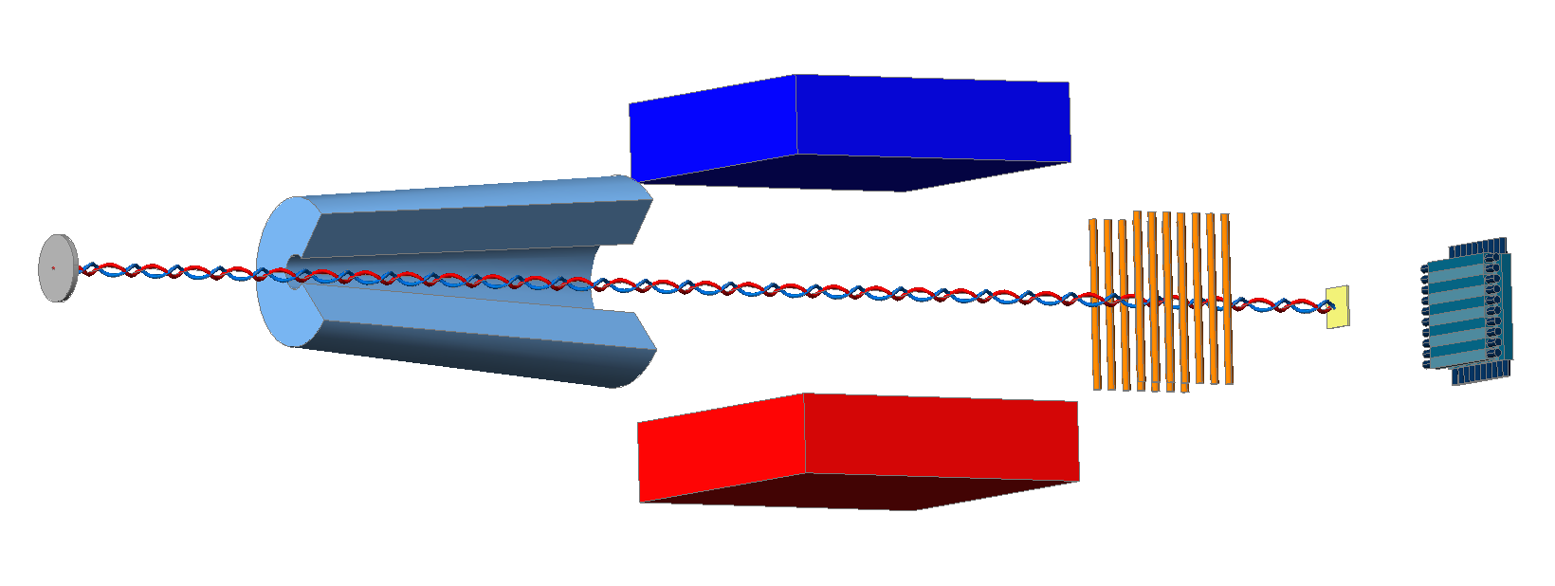
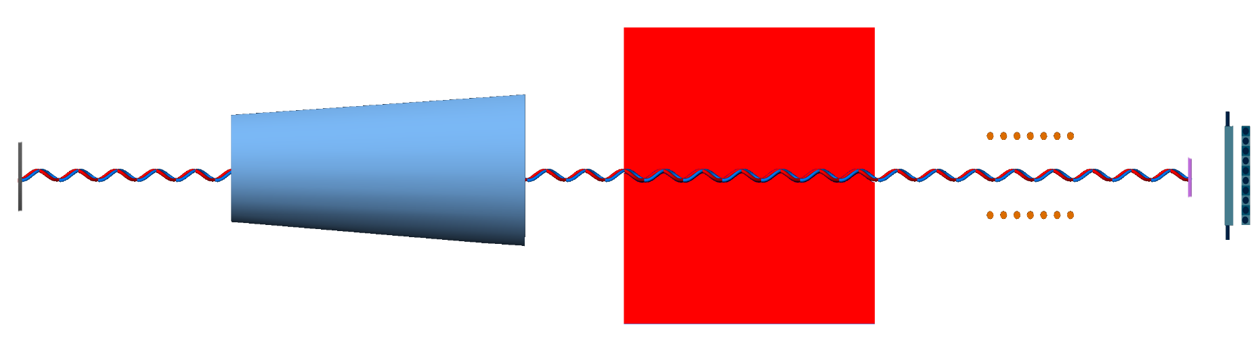
DIRAC future Experimental setup
Forward Detectors
Collimator
Pt foil
Resonators
proton beam
Secondaries
26.10.15

Slide 34

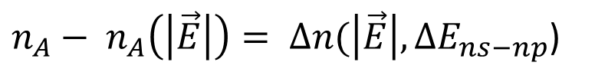






Energy splitting measurement
In the static electric field there will be Stark mixing between the ns and the np wave functions.
$τ_{np} ⇒ τ_{np}^{eff}(\left|\vec{E}\right|, ∆E_{ns−np})< τ_{np}$
$$\vec{E}$$
= 0
$$n_{A}$$
$$\vec{E}$$
$$n_{A}(\vec{E})$$
$$⇒$$
$$τ_{np}$$
$$τ_{np}^{eff}$$
Be
Pt
Be
Pt
$n_{A}− n_{A}\left(\left|\vec{E}\right|\right)= ∆n(\left|\vec{E}\right|,∆E_{ns−np}$)
Only relative abundances of different atomic quantum states are taken from theory.
26.10.15

Slide 35
Resonant enhancement of the annihilation rate of A_{2π}
L.Nemenov, V.Ovsiannikov, E.Tchaplyguine, Nucl. Phys. (2002)
l₀
In Lab. System:
In CM System:
at resonance:
γ_{A}
26.10.15
γ_{res}

Slide 36
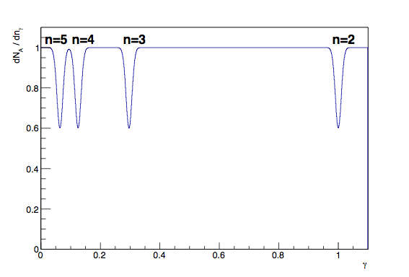
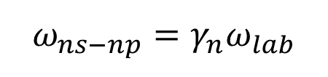
Energy splitting measurement
In a periodic electric field, there will be oscillations between ns and np states, if the external field frequency will coincide with ns - np frequency.
$$ω_{ns−np}={γ_{n}ω}_{lab}$$
No theoretical input!
26.10.15

Slide 37
Letter of Intent
Preparation of a Letter of Intent about the investigation of π⁺π⁻, π⁺K⁻, K⁺π⁻ and K⁺K⁻ atoms at SPS energy
before November 2016
26.10.15

Slide 38
Instrumental publication
The paper “Updated DIRAC spectrometer at CERN PS for the investigation of ππ and Kπ atoms” has been submitted to NIM
Measurement of K⁺π⁻, K⁻π⁺ and π⁺π⁻ atoms production cross sections in proton interaction with Be, Ni and Pt nuclei based on 2007-2012 experimental data, will be done in 2017.
Dedicated measurements of the proton flux and the dead time of electronics and of DAQ were done for these purposes. Estimation of systematic biases in our cross sections can be done basing on extrapolation of single particle production cross sections available for 32 GeV/c protons.
π⁺µ⁻ and π⁻µ⁺ pair analysis
The 2010 experimental data has been searched for π⁺µ⁻ and π⁻µ⁺ Coulomb pairs with the aim of extracting the number of πµ atoms produced simultaneously with the Coulomb pairs. An upper limit on the atom production will be calculated and published as DIRAC note before the end of 2017.
26.10.15

Slide 39
Thank you
26.10.15

Slide 40
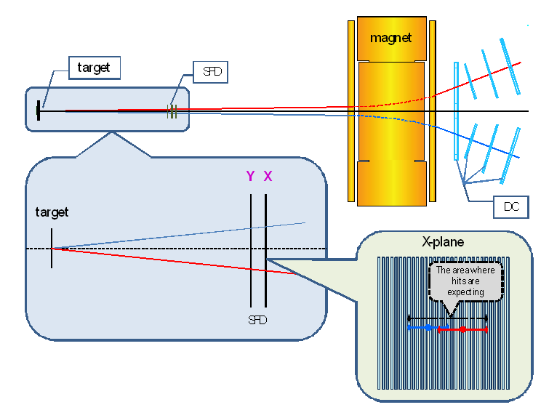
Hit regions in SFD
26.10.15

Slide 41
Theoretical motivation
Lattice calculations of l₃, l₄
2006: l₃, l₄ … first lattice calculations
2012: 10 collaborations: 3 in USA, 5 in Europe and 2 in Japan
J. Gasser, H. Leutwyler: model calculation (1985)
l₃=2.9±2.4, l₄ =4.3 ±0.9
Lattice calculations of these constants have been done in 20 works.
Best result (BMW): l₃=2.6±0.5st ±0.4sys, l₄ =3.8 ±0.4st ±0.2sys
Therefore, the theoretical pion-pion scattering length precision can be improved.
The best experimental results on the scattering length have a precision not better than 4%.
26.10.15

Slide 42
Experimental |Q_{L}| distributions of π⁺π⁻ pairs
Analysis of data collected in 2012 for different Q_{T} cuts. The detected numbers n_{A}^{L} of atomic pairs and the corresponding total numbers n_{A}^{L,tot} (via selection efficiency) are presented together with the background contribution (Coulomb, non-Coulomb and accidental pairs) and the fit quality χ² / n (n - degrees of freedom). Errors are only statistical.
Q_{T} cut (MeV/c) | n_{A}^{L} | n_{A}^{L,tot} | Background | χ² / n
Fit over Q_{L}, Q_{T}
2.0 | 436±57 | 488±64 | 16790 | 138/140
Fit over Q_{L}
0.5 | 152±29 | 467±88 | 971 | 29/27
1.0 | 349±53 | 489±75 | 3692 | 19/27
1.5 | 386±78 | 454±91 | 9302 | 22/27
2.0 | 442±105 | 495±117 | 16774 | 22/27
26.10.15

Slide 43
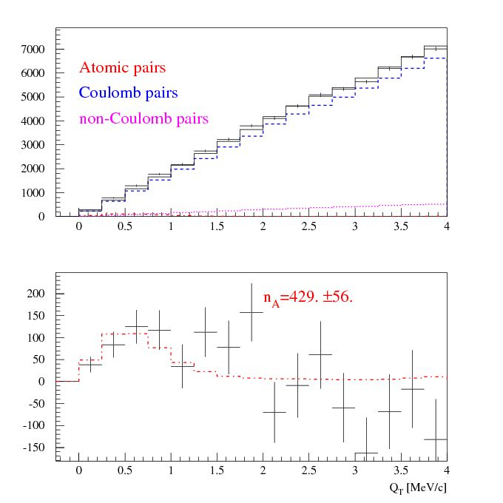
Experimental Q_{T} distributions of π⁺π⁻ pairs
Q_{T} distribution of π⁺π⁻ pairs
for |Q_{L}| < 2 MeV/c
a) The experimental distribution (points with statistical error) and the simulated background (solid line).
b) The experimental distribution after background subtraction (points with statistical error) and the simulated distribution of atomic pairs (dot-dashed line).
The fit procedure has been applied to the 2-dimensional (|Q_{L}|, Q_{T} ) distribution.
a)
b)
26.10.15

Slide 44
Magnet impact on Q_{y} distribution for e⁺e⁻ pairs
Real data
Be
Pt
Magnetic Field
e⁺
12.9 MeV/c
Q_{Y}=
12.9MeV/c
Q_{y}(GeV/c)
e⁻
12.9 Mev/c
e⁺
2.3 MeV/c
Q_{Y}=
2.3MeV/c
e⁻
Q_{y}(GeV/c)
Peak at Q_{y}=2.3MeV/c evaluated after subtraction of the mirrored left side part.
26.10.15
44

Slide 45
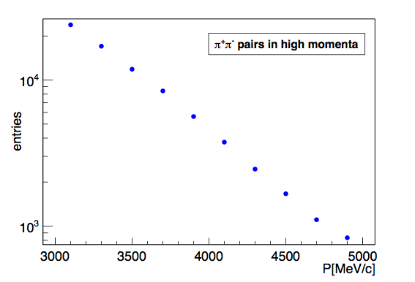
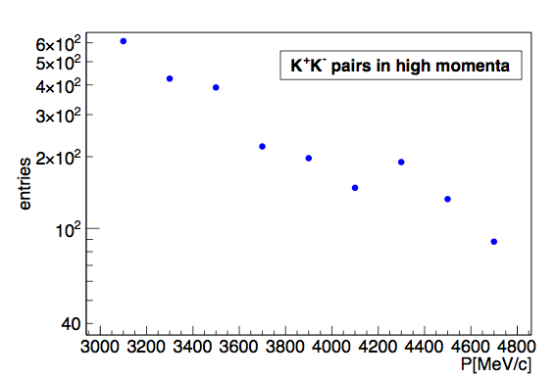
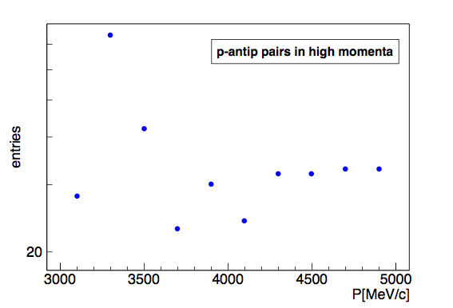
The π⁺π⁻, K⁺K⁻ and p-p pair numbers
26.10.15

Slide 46
π⁺μ⁻ and π⁻μ⁺ pair analysis
Analogously, the 2010 data will be investigated with respect to π⁺μ⁻ and π⁻μ⁺ Coulomb pairs, to extract the number of πμ atoms, produced together with these Coulomb pairs. The analysis will be finished in January 2015.
In presence of a signal, the 2011 and 2012 data will be processed in order to improve statistics.
26.10.15

Slide 47
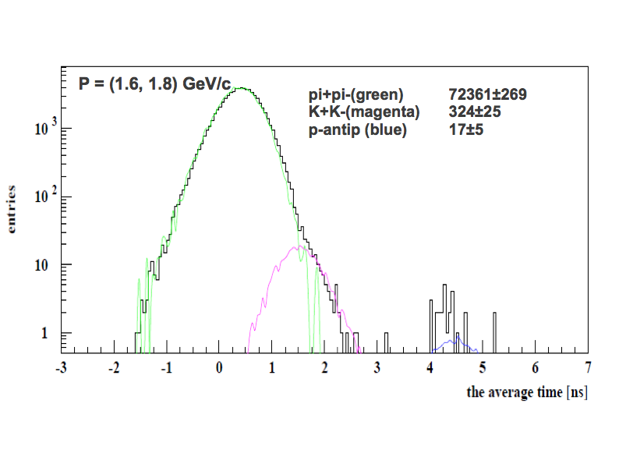
Search of K⁺K⁻ and p-p pair with TOF (low momentum)
the average TOF (ns)
26.10.15

Slide 48
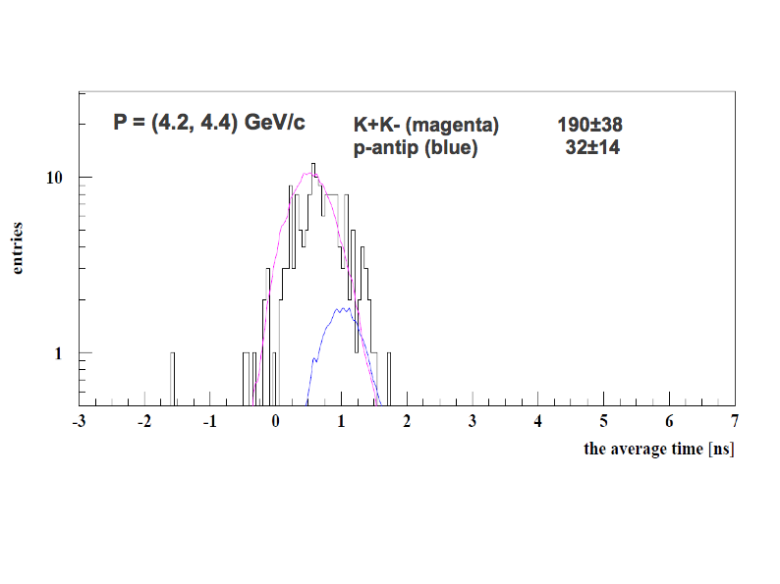
Search of K⁺K– and p-p pair with TOF (high momentum)
the average TOF (ns)
26.10.15

Slide 49
Proton – antiproton pair analysis
DIRAC will perform a search for proton−antiproton Coulomb pairs, thus proton−antiproton atoms, with the same strategy as in the K⁺K⁻ case (see previous section).
The search for proton−antiproton Coulomb pairs in the lower momentum region will be finished before May 2016.
26.10.15

Slide 50
Additional slides
Simulation of K⁺ and K– production cross section
M. Gugiu

Slide 51
Physics motivation
π⁺π⁻ atom: lifetime & scattering length
... published by DIRAC, Physics Letters B 704 (2011), 24.
26.10.15
Notes:
51

Slide 52
Experimental results
K→3π:
2009 NA48/2 (EPJ C64, 589)
plus additional 3.4% theory uncertainty
Ke4:
2010 NA48/2 (EPJ C70, 635)
π⁺π⁻ atom:
2011 DIRAC (PLB 704, 24)
26.10.15
Notes:
52

Slide 53
Experimental results with additional theoretical constraints
K→3π:
2009 NA48/2 (EPJ C64, 589)
...with ChPT constraint between a₀ and a₂:
plus additional 2% theory uncertainty
Ke4:
2010 NA48/2 (EPJ C70, 635)
...with ChPT constraint between a₀ and a₂:
Ke4 & K→3π:
2010 NA48/2 (EPJ C70, 635)
Remark: the results didn’t include theory uncertainty
26.10.15
Notes:
53

Slide 54
π⁺π⁻ atom lifetime and decay lengths
n | τ_{2π} (10⁻¹¹sec) |  | Decay length A_{2π} in L.S. (cm) for γ=16
 |  |  | (λ_{ns}=c ∙ γ ∙ τ_{nl})
 | s (l=0) | p (l=1) | s (l=0) | p (l=1)
 | τ_{ns}=τ_{1s}∙ n³
1 | 2.9 ∙10⁻⁴ | - | 1.39∙10⁻³ | -
2 | 2.32∙10⁻³ | 1.17 | 1.11∙10⁻² | 5.6
3 | 7.83∙10⁻³ | 3.94 | 3.76∙10⁻² | 19
4 | 1.86∙10⁻² | 9.05 | 8.91∙10⁻² | 43
5 | 3.63∙10⁻² | 17.5 | 1.74∙10⁻¹ | 84
6 | 6.26∙10⁻² | 29.9 | 3.01∙10⁻¹ | 144
7 | 9.95∙10⁻² | 46.8 | 4.77∙10⁻¹ | 225
8 | 1.48∙10⁻¹ | 69.3 | 7.13∙10⁻¹ | 333
Breakup foil | Thick (μm) | 2p | 3p | 4p | 5p | 6p | 7p
Pt (Z=78) | 1.0 | 0.4147 | 0.6895 | 0.8553 | 0.9324 | 0.9667 | 0.9828
 | 1.5 | 0.6084 | 0.8526 | 0.9446 | 0.9765 | 0.9889 | 0.9944
 | 2.0 | 0.7422 | 0.9244 | 0.9743 | 0.9895 | 0.9951 | 0.9975
Platinum foils:
The breakup probability for np states and different thicknesses
(A_{2π} momentum P_{A}=4.5GeV /c and A_{2π} lifetime τ = 3.0·10⁻¹⁵s)
26.10.15

Slide 55

Lamb shift measurement with external magnetic field
See: L. Nemenov, V. Ovsiannikov, Physics Letters B 514 (2001) 247.
Impact on atomic beam by
external magnetic field B_{lab} and Lorentz factor γ
…. relative distance between
π⁺ and π⁻ in A_{2π} system
π⁻
…. laboratory magnetic field
π⁺
…electric field in A_{2π} system
26.10.15

Slide 56
Dependence of A_{2π} lifetime τ_{eff} for 2p-states of the electric field E strength
where:
B_{Lab} = 2 Tesla
26.10.15

Slide 57
y-beam position (run 2012)
Pt foil edge position
7.5 mm from the beam axis
Proton beam position when the IH slabs single counts increase on factor 2 due to the halo beam interaction with the Pt foil
(no Be target).
Y
26.10.15

Slide 58
Experimental conditions (run 2012)
Primary proton beam | 24 GeV/c
Beam intensity | (3.0 ÷3.3)·10¹¹ proton/spill
Spill duration | 450 ms
Secondary particles intensity (single count of one IH plane) | ≈7·10⁶ particle/spill
Be target
Target thickness | 103 μm
Radiation thickness | 2.93·10⁻⁴ X₀
Probability of inelastic proton interaction | 2.52·10⁻⁴
26.10.15

Slide 59
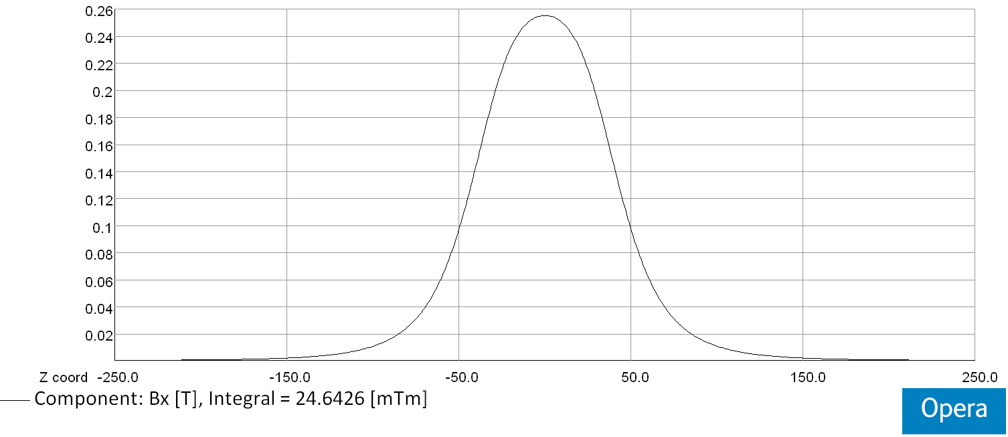
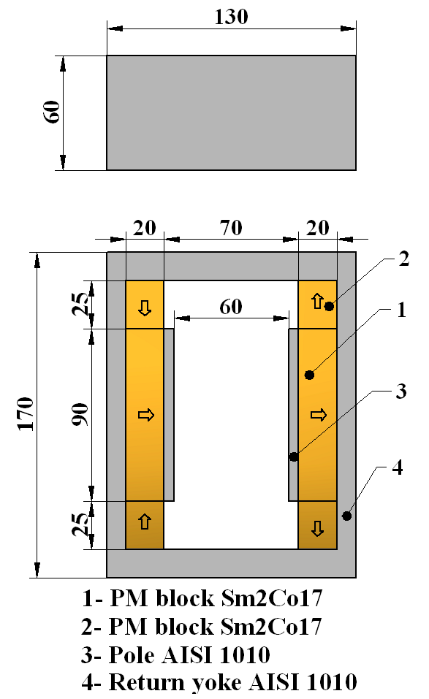
Magnet
Layout of the dipole magnet (arrows indicate the direction of magnetization)
Horizontal field distribution along z-axis at X=Y=0mm
∫Bx(0,0,z)dz = 24.6x10⁻³ [Tm]
26.10.15

Slide 60
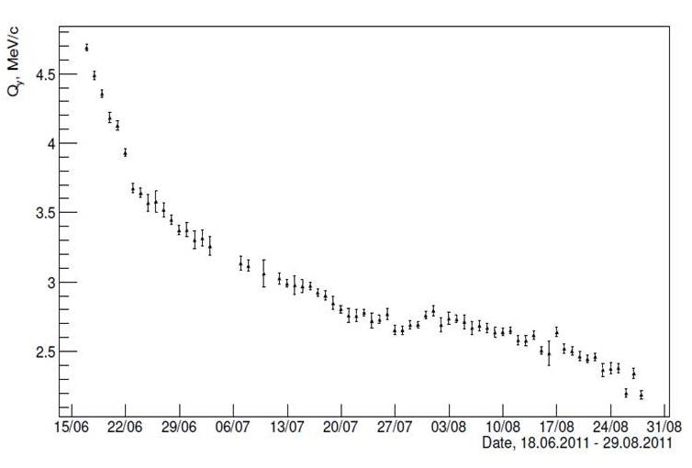
Degradation of old magnet
New magnet behavior
Old magnet (Nd-Fe-B), 2011
New magnet (Sm-Co), 2012
The position of the second peak in Q_{Y} distributions of e⁺e⁻ pairs versus dates.
26.10.15

Slide 61
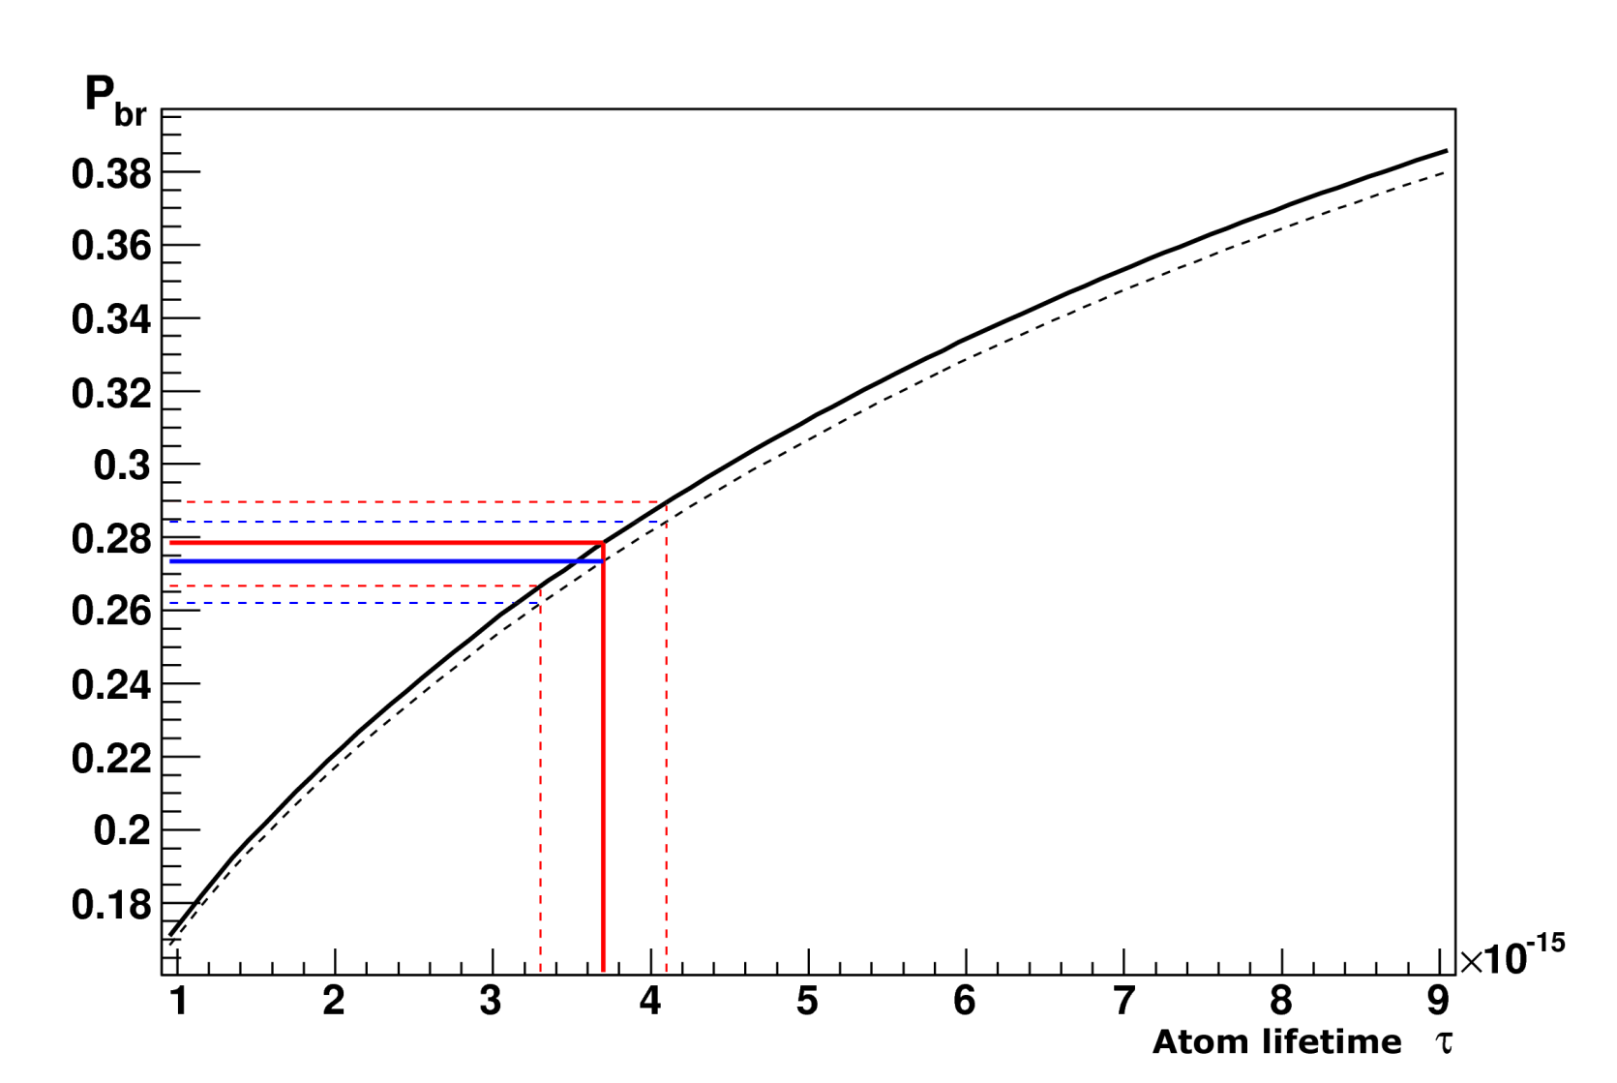
Break-up dependencies P_{br} from atom lifetime for K⁺π– and π⁺K– atom
P_{br} values corresponding to τ_{1S}^{th}
Atom | s, μm | P_{br} | P_{br}-σ | P_{br}+σ
A_{πΚ} | 98 | 0.274 | 0.263 | 0.285
A_{πΚ} | 108 | 0.278 | 0.267 | 0.290
A_{Κπ} | 98 | 0.269 | 0.258 | 0.280
A_{Κπ} | 108 | 0.273 | 0.262 | 0.284
Probability of break-up as a function of lifetime in the ground state for A_{πΚ} (solid line) and A_{Κπ} atoms (dashed line) in Ni target of thickness 108 μm.
Average momentum of A_{Κπ} and A_{πΚ} are 6.4 GeV/c and 6.5 GeV/c accordingly.
26.10.15

Slide 62
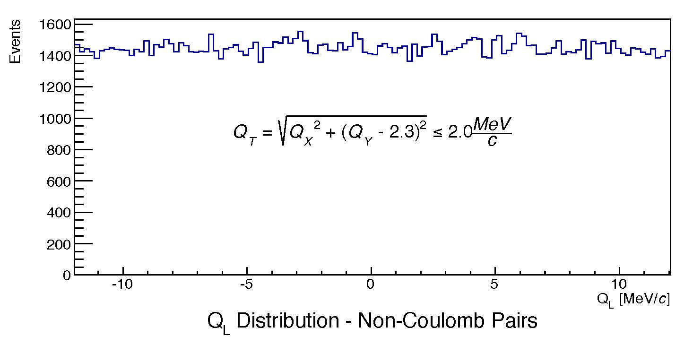
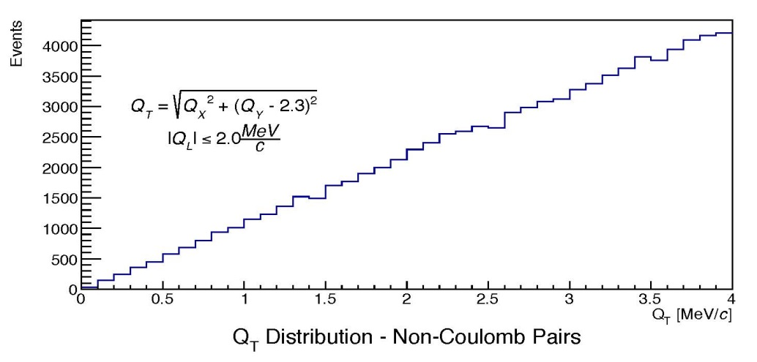
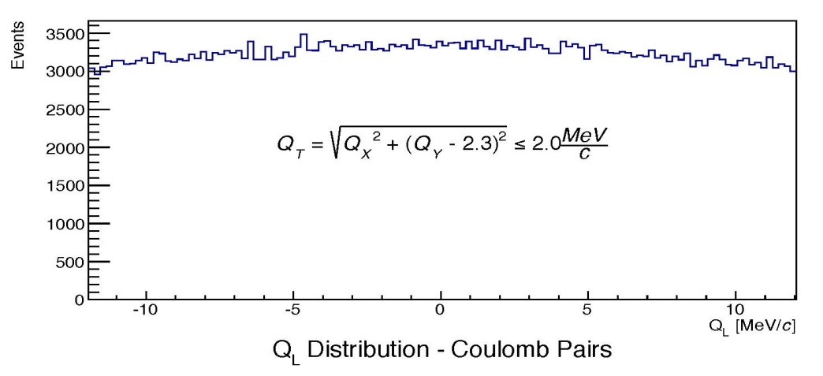
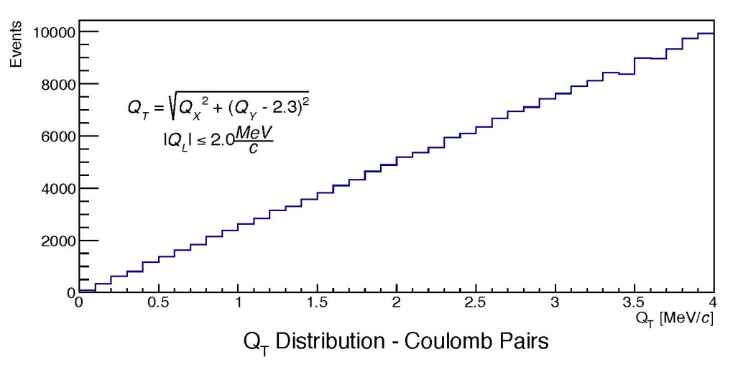
Simulation of π⁺π⁻ pairs for long-lived A_{2π} observation
Q_{L}
Atomic pairs
Q_{L}(MeV/c)
Atomic pairs
Q_{T}(MeV/c)
26.10.15

Slide 63
Long-lived π⁺π⁻ atoms
Experimental (real data) and simulated distributions over |Q_{L}|
for Q_{T}<0.5 MeV/c
~5.9σ
26.10.15

Slide 64
Long-lived π⁺π⁻ atoms
Experimental (real data) and simulated distributions over |Q_{L}|
for Q_{T}<1.0 MeV/c
~7.8σ
26.10.15

Slide 65
Long-lived π⁺π⁻ atoms
Experimental (real data) and simulated distributions over |Q_{L}|
for Q_{T}<1.5 MeV/c
~5.5σ
26.10.15

Slide 66
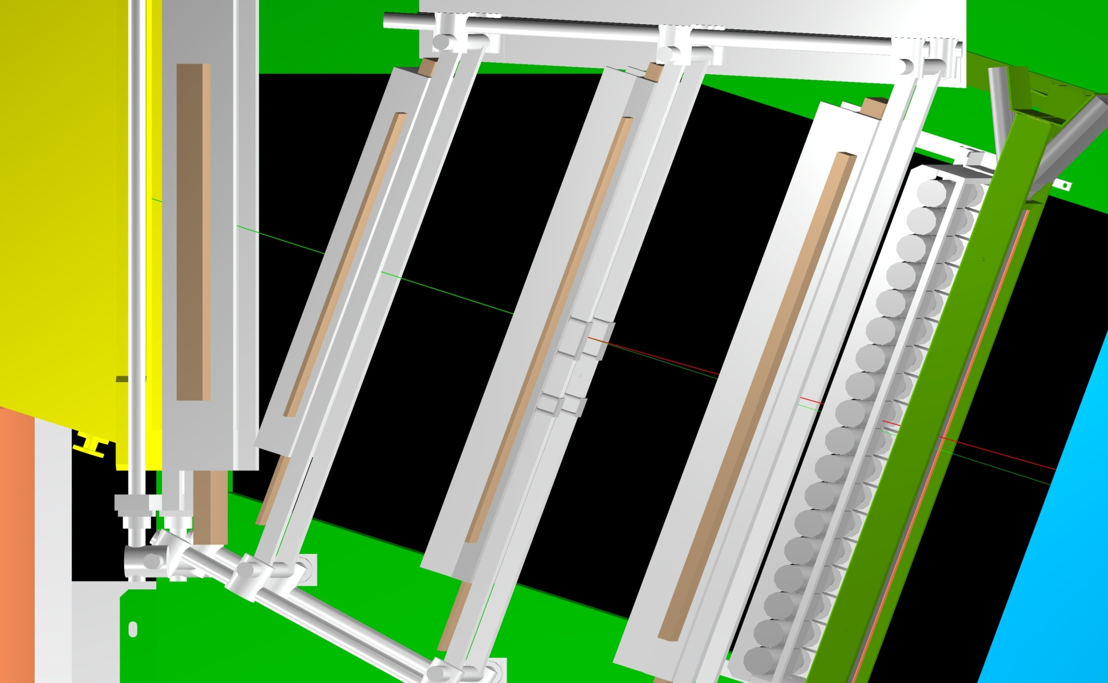
Multiple scattering measurement
26.10.15

Slide 67
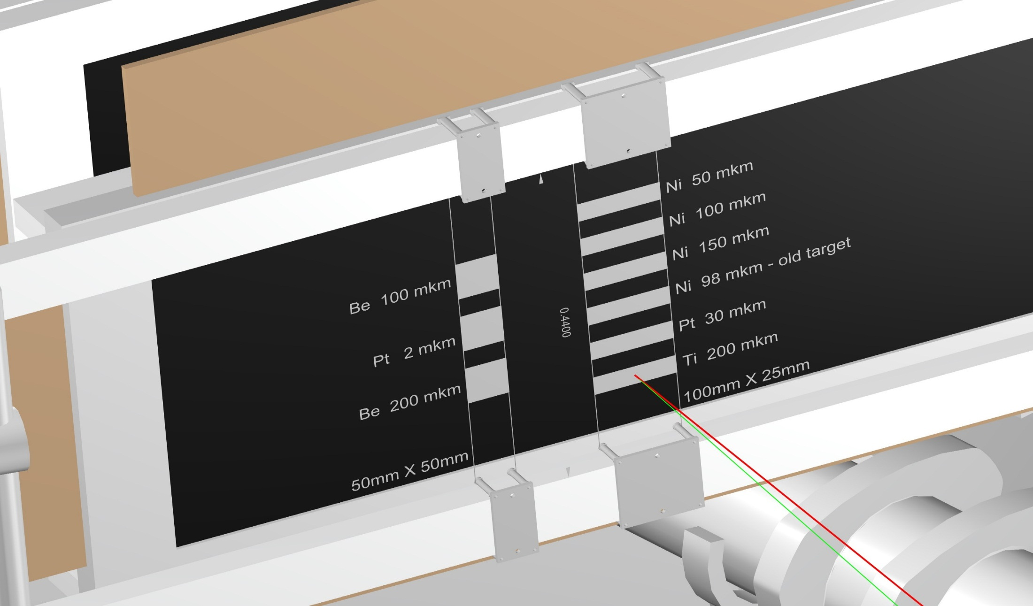
Multiple scattering measurement
26.10.15

Slide 68
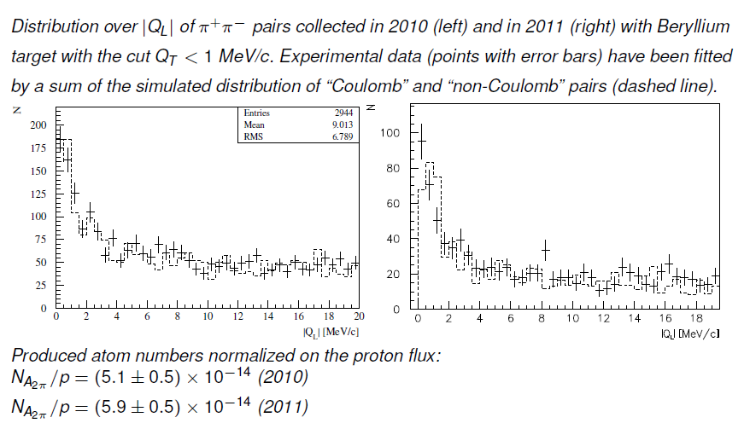
Measurement of A_{2π} production rate in p-Be interactions
Q
Q_{T}
Q
π⁺
π⁺
P_{∑,LS}
π⁻
Q_{L}
π⁻
26.10.15

Slide 69
DIRAC setup characteristics and experimental conditions
The angle of the secondary channel relative to proton beam | 5.7±1°
Solid angle | 1.2•10⁻³ sr
Dipole magnet | B_{max} = 1.65 T BL = 2.2 Tm
Spectrometer
Relative resolution on the particle momentum in L.S. |  | 3•10⁻³
Precision on Q-projections (experimental measurement) | σ_{QX} = σ_{QY} = 0.5 MeV/c | σ_{QL} = 0.5 MeV/c (ππ) σ_{QL} = 0.9 MeV/c (πΚ)
26.10.15

