Slide 1
DIRAC Report
SPSC – October 2020
L. Nemenov on behalf of the DIRAC Collaboration

Slide 2
K⁺K⁻ production and detection with DIRAC
The K⁺K⁻ production processes. a) point-like production and Coulomb interaction in the final state, b) point-like and non point-like pair generation with Coulomb and strong final state interaction.
Q distributions in the interval 0 - 30 MeV/c of K⁺K⁻ (ALICE approach) of the subsamples 30%, 50% and 70% for the RUNs 2009 and 2010 after residual background subtraction. The red and the blue fitting curves were evaluated from the analysis of experimental distributions with residual background in Coulomb and Martin approaches respectively. It is seen that in this interval of Q the difference between these curves is absent and they describe ”pure” experimental K⁺K⁻ distribution well.
These experimental distributions allow to evaluate number of K⁺K⁻ atoms generated simultaneously with the detected K⁺K⁻ pairs.

Slide 3
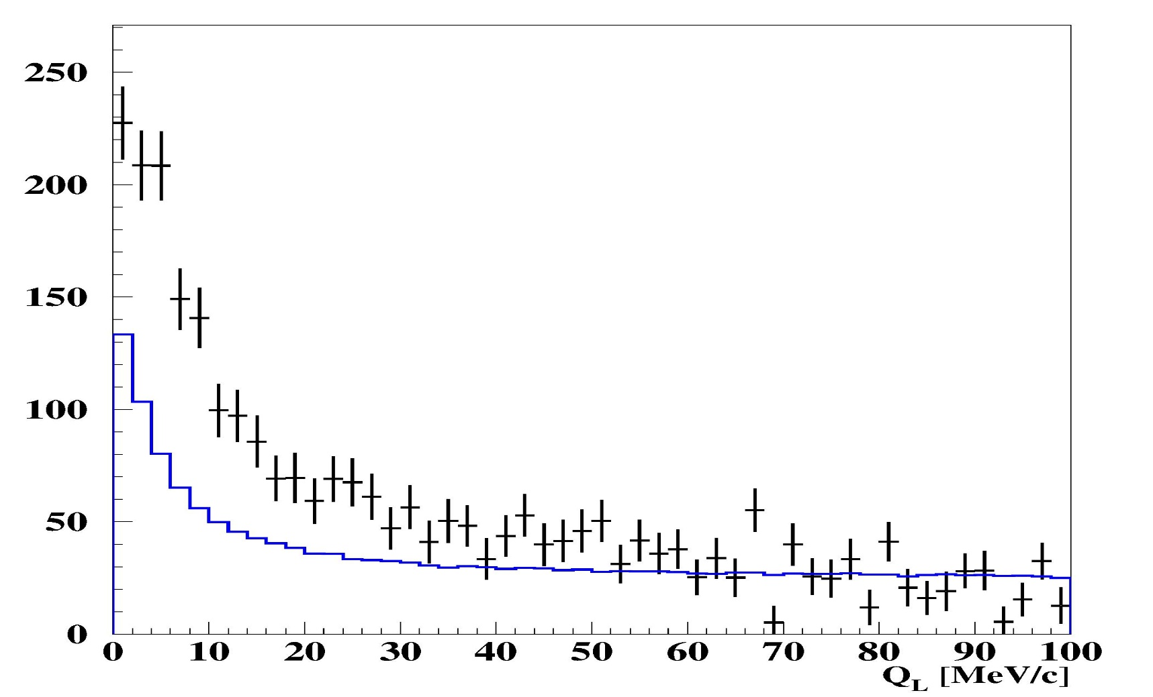
p -‾ p experimental Q_{L} distributions
The black experimental points show the Q_{L} distribution of the proton-antiproton pairs (preliminary data). The blue curve is the fit of experimental distribution in Q_{L} interval 50MeV/c -100MeV/c. The blue curve describes the same experimental distribution of K⁺K⁻ pairs. It is seen that for low Q_{L} values the Coulomb interaction in the final state for proton-antiproton pairs gives a significantly higher yield than for K⁺K⁻.

Slide 4
Thank you
10/16/20

