Slide 1
Last results of DIRAC experiment at CERN
Leonid AFANASYEV
JOINT INSTITUTE FOR NUCLEAR RESEARCH
on behalf of the DIRAC collaboration
NEW TRENDS IN HIGH-ENERGY PHYSICS
September 23 – 29, 2013
Alushta, Crimea, Ukraine

Slide 2








DIRAC collaboration
CERN
Geneva, Switzerland
Tokyo Metropolitan University
Tokyo, Japan
Czech Technical University
Prague, Czech Republic
IFIN-HH
Bucharest, Romania
Institute of Physics ASCR
Prague, Czech Republic
JINR
Dubna, Russia
Nuclear Physics Institute ASCR
Rez, Czech Republic
SINP of Moscow State University
Moscow, Russia
INFN-Laboratori Nazionali di Frascati
Frascati, Italy
IHEP
Protvino, Russia
University of Messina
Messina, Italy
Santiago de Compostela University
Santiago de Compostela, Spain
KEK
Tsukuba, Japan
Bern University
Bern, Switzerland
Kyoto University
Kyoto, Japan
Kyoto Sangyo University
Kyoto, Japan
Zurich University
Zurich, Switzerland

Slide 3
Contents
1. Hadronic atoms and low-energy QCD predictions.
2. Method of ππ and Kπ atom investigation.
3. DIRAC setup.
4. Status of π⁺π⁻ atom investigation.
5. Status of Κ⁺π⁻, Κ⁻π⁺ atom investigation.
6. Status of Κ⁺π⁻, Κ⁻π⁺ atom investigation.
7. Future of DIRAC at SPS CERN

Slide 4
1. Hadronic atoms and low energy QCD predictions

Slide 5
Pionium lifetime
Pionium (A_{2π}) is a hydrogen-like atom consisting of π⁺ and π⁻mesons:
E_{B}=-1.86 keV, r_{B}=387 fm, p_{B}≈0.5 MeV
The lifetime of π⁺π⁻ atoms is dominated by
the annihilation process into π⁰ π⁰:
π⁺
π⁰
π⁰
π⁻
Gasser et al. – 2001
a₀ and a₂ are the ππ S-wave scattering lengths for isospin I=0 and I=2.
If

Slide 6
K⁺π⁻ and K⁻π⁺ atoms lifetime
Kπ-atom (A_{Kπ}) is a hydrogen-like atom consisting of K⁺ and π⁻ mesons:
E_{B}= -2.9 keV r_{B} = 248 fm p_{B} ≈ 0.8 MeV
The Kπ-atom lifetime (ground state 1S), τ=1/Γ is dominated by the annihilation process into K⁰π⁰:
K⁺
π⁰
K⁰
π⁻
**
(**) J. Schweizer (2004)
From Roy-Steiner equations:
If

Slide 7
ππ scattering lengths
In ChPT the effective Lagrangian, which describes the ππ interaction, is an expansion in (even) terms:
(tree) (1-loop) (2-loop)
Colangelo et al. in 2001, using ChPT (2-loop) & Roy equations:
These results (precision) depend on the low-energy constants (LEC) l₃ and l₄:
Lattice gauge calculations from 2006 provided values for these l₃ and l₄.
Because l₃ and l₄ are sensitive to the quark condensate,
precision measurements of a₀, a₂ are a way
to study the structure of the QCD vacuum.

Slide 8
Lattice calculations of l₃ , l₄
• 2006: l₃, l₄ First lattice calculations
• 2012: 10 collaborations: 3 USA, 5 Europe, 2 Japan
• J. Gasser, H. Leutwyler: Model calculation (1985)
l₃=2.6±2.5, Δl₃/l₃ ≈1
• Lattice calculations in near future will obtain
Δl₃/l₃≈ 0.1 or Δl₃ ≈ 0.2-0.3
• To check the predicted values of l₃ the experimental
relative errors of ππ-scattering lengths and their
combinations must be at the level (0.2-0.3)%

Slide 9
ππ scattering
ChPT predicts s-wave scattering lengths:
The expansion of M_{π}² in powers of the quark masses starts with the linear term:
where
is the quark condensate, reflecting the property of QCD vacuum.
The estimates indicate values in the range 0 < l₃ < 5
Measurement of l₃ ⇒ improved the value of

Slide 10
πK scattering lengths
I. ChPT predicts s-wave scattering lengths:
V. Bernard, N. Kaiser,
U. Meissner. – 1991
A. Roessl. – 1999
J. Bijnens, P. Dhonte, P. Talavera. – April 2004
II. Roy-Steiner equations:
P.Büttiker et al. − 2004

Slide 11
πK scattering
What new will be known if πK scattering length will be measured?
The measurement of the s-wave πΚ scattering lengths would test our understanding of the chiral SU(3)_{L} × SU(3)_{R} symmetry breaking of QCD (u, d and s quarks), while the measurement of ππ scattering lengths checks only the SU(2)_{L} × SU(2)_{R} symmetry breaking (u, d quarks).
This is the principal difference between ππ and πΚ scattering!
Experimental data on the πΚ low-energy phases are absent

Slide 12
2. Method of π⁺π⁻ and Kπ atom
observation and investigation

Slide 13
Method of π⁺π⁻ atom observation and investigation
Target Ni 98 μm
A_{2π}
π⁺
p
(n_{A})
Atomic pairs
24 GeV/c
(N_{A})
π⁻
Interaction point
π⁺
p
(N_{C})
π⁻
Coulomb pairs
24 GeV/c
Δ,ρ,ω,…
π⁺
π⁺
p
Non-Coulomb pairs
24 GeV/c
π⁻
η, η’,…
π⁺
Interaction point
π⁰
p
Atomic pairs
π⁺
24 GeV/c
Accidental pairs
p
π⁻

Slide 14
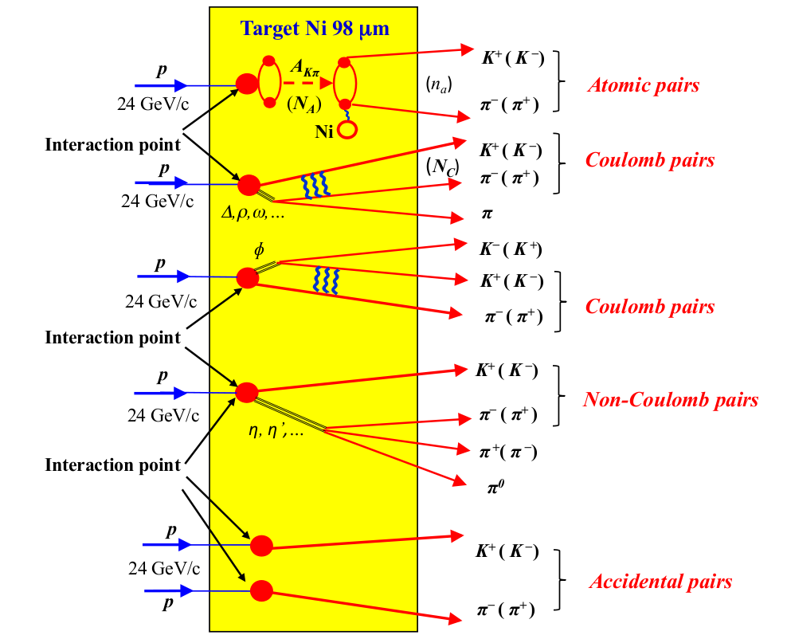
Method of Kπ atom observation and investigation

Slide 15
Coulomb pairs and atoms
For the charged pairs from the short-lived sources and small relative momentum Q there is strong Coulomb interaction in the final state.
This interaction increases the production yield of the free pairs with Q decreasing and creates atoms.
π⁺π⁻, Κ⁺π⁻, Κ⁻π⁺,
Κ⁺Κ⁻, π⁺μ⁻, π⁻μ⁺
(π⁺π⁻), (Κ⁺π⁻), (Κ⁻π⁺),
(Κ⁺Κ⁻), (π⁺μ⁻), (π⁻μ⁺)
Coulomb pairs
Atoms
There is precise ratio between the number of produced Coulomb pairs (N_{C}) with small Q and the number of atoms (N_{A}) produced simultaneously with these Coulomb pairs:

Slide 16
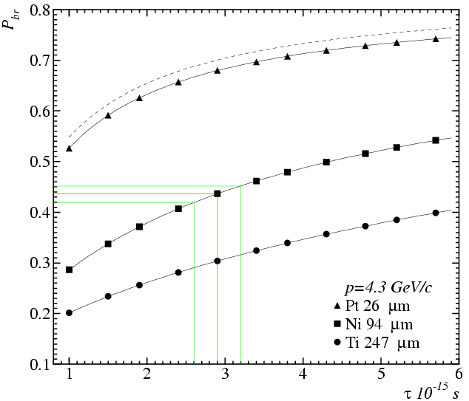
Break-up probability
Solution of the transport equations provides one-to-one dependence of the measured break-up probability (P_{br}) on pionium lifetime τ
Cross section calculation precision 0.6%
All targets have the same thickness in radiation lengths 6.7*10⁻³ X₀
There is an optimal target material for a given lifetime

Slide 17
3. DIRAC setup

Slide 18
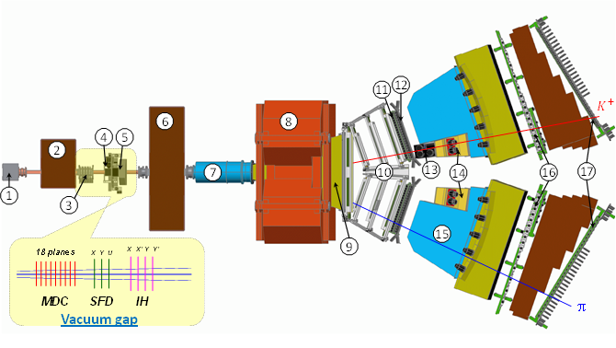
Experimental setup
1 Target station with Ni foil; 2 First shielding; 3 Micro Drift Chambers; 4 Scintillating Fiber Detector; 5 Ionization Hodoscope; 6 Second Shielding; 7 Vacuum Tube; 8 Spectrometer Magnet; 9 Vacuum Chamber; 10 Drift Chambers; 11 Vertical Hodoscope; 12 Horizontal Hodoscope; 13 Aerogel Čerenkov; 14 Heavy Gas Čerenkov; 15 Nitrogen Čerenkov; 16 Preshower; 17 Muon Detector

Slide 19
Experimental conditions
SFD
Coordinate precision | σ_{X} = 60 μm | σ_{Y} = 60 μm | σ_{W} = 120 μm
Time precision | σ^{t}_{X} = 380 ps | σ^{t}_{Y} = 512 ps | σ^{t}_{W} = 522 ps
DC
Coordinate precision | σ = 85 μm
VH
Time precision | σ = 100 ps
Spectrometer
Relative resolution on the particle momentum in L.S. |  |  | 3•10⁻³
Precision on Q-projections | σ_{QX} = σ_{QY} = 0.5 MeV/c | σ_{QL} = 0.5 MeV/c (ππ) σ_{QL} = 0.9 MeV/c (πΚ)
Trigger efficiency 98 % | for pairs with Q_{L} < 28 MeV/c Q_{X} < 6 MeV/c Q_{Y} < 4 MeV/c

Slide 20
Published results on π⁺π⁻ atom lifetime
and scattering length
DIRAC data | τ_{1s} (10⁻¹⁵ s) value stat syst theo* tot | |a₀-a₂| value stat syst theo* tot | Reference
2001 |  |  | PL B 619 (2005) 50
2001-03 |  |  | PL B 704 (2011) 24
* theoretical uncertainty included in systematic error
NA48 | K-decay | a₀-a₂ value stat syst theo tot | Reference
2009 | K_{3π} |  | EPJ C64 (2009) 589
2010 | K_{e4} & K_{3π} |  | EPJ C70 (2010) 635
Notes:
20

Slide 21
4. Status of π⁺π⁻ atom investigation

Slide 22
π⁺π⁻ atoms – run 2008-2010
Run 2008-2010, statistics with low and medium background (2/3 of all statistics).
Point-like production of all particles, the K⁺K⁻, pp admixture has not been take into account
|Q_{L}| distribution
analysis on |Q_{L}| for Q_{T} < 4 MeV/c
|Q_{L}| distribution
analysis on |Q_{L}| and Q_{T} for Q_{T} < 4 MeV/c
P_{br} (2001-2003) = 0.446±0.0093

Slide 23
π⁺π⁻ atoms – run 2008-2010
Q_{T} distribution
analysis on |Q_{L}|, Q_{T} for |Q_{L}| < 2 MeV/c
Q_{T} distribution
analysis on |Q_{L}|, Q_{T} for |Q_{L}| > 2 MeV/c

Slide 24
π⁺π⁻ pair analysis
 | 2008 | 2009 | 2010 | 2008-2010
N_{A}(Q_{L}) | 13141±129 | 19774±153 | 19474±155 | 52389±253
N_{A}(Q_{L}-Q_{T}) | 13245±114 | 20072±137 | 19732±138 | 53048±225
n_{A}(Q_{L}) | 6140±352 | 9769±419 | 9397±420 | 25306±690
n_{A}(Q_{L}-Q_{T}) | 5537±233 | 8384±284 | 8033±284 | 21954±465
P_{br}(Q_{L}) | 0.467±0.030 | 0.494±0.024 | 0.483±0.024 | 0.483±0.0148
P_{br}(Q_{L}-Q_{T}) | 0.418±0.020 | 0.418±0.016 | 0.407±0.016 | 0.414±0.010
P_{br}(2001-2003)=0.446±0.0093

Slide 25
π⁺π⁻ data
Statistics for measurement of |a₀-a₂| scattering length difference and expected precision
Year | n_{A} | δ_{stat}(%) | Δ_{syst}(%) | δ_{syst}(%)MS | δ_{tot}(%)
2001-2003 | 21000 | 3.1 | 3.0 | 2.5 | 4.3
2008-2010* | 25000 | 3.1 | 3.0 | 2.5 | 4.3
2001-2003 2008-2010 | 46000 | 2.2 | 3.0 2.1 | 2.5 1.25 | 3.7 3.0
* There is 1/3 of the data with a higher background whose implication will be investigated.

Slide 26
5.a. Status of K⁻π⁺ atom investigation

Slide 27
K⁻π⁺ atoms – run 2008-2010
Run 2008-2010, statistics with low and medium background (2/3 of all statistics). Point-like production for all particles.
|Q_{L}| distribution
analysis on |Q_{L}| for Q_{T} < 4 MeV/c
|Q_{L}| distribution
analysis on |Q_{L}| and Q_{T} for Q_{T} < 4 MeV/c

Slide 28
K⁻π⁺ pair analysis
 | 2008 | 2009 | 2010 | 2008-2010
N_{A}(Q_{L}) | 47±13 | 76±15 | 83±15 | 206±25
N_{A}(Q_{L}-Q_{T}) | 51±11 | 78±13 | 60±12 | 188±21
n_{A}(Q_{L}) | 35±21 | 28±24 | -4±22 | 60±39
n_{A}(Q_{L}-Q_{T}) | 21±13 | 26±16 | 35±16 | 82±26
P_{br}(Q_{L}) | 0.75±0.62 | 0.37±0.37 | -0.04±0.26
P_{br}(Q_{L}-Q_{T}) | 0.41±0.33 | 0.34±0.24 | 0.58±0.36

Slide 29
5.b. Status of K⁺π⁻ atom investigation

Slide 30
K⁺π⁻ atoms – run 2008-2010
Run 2008-2010, statistics with low and medium background (2/3 of all statistics). Point-like production for all particles.
|Q_{L}| distribution
analysis on |Q_{L}| for Q_{T} < 4 MeV/c
|Q_{L}| distribution
analysis on |Q_{L}| and Q_{T} for Q_{T} < 4 MeV/c

Slide 31
K⁺π⁻ pair analysis
 | 2008 | 2009 | 2010 | 2008-2010
N_{A}(Q_{L}) | 125±19 | 151±28 | 155±28 | 431±44
N_{A}(Q_{L}-Q_{T}) | 132±16 | 169±24 | 164±23 | 465±37
n_{A}(Q_{L}) | 25±30 | 54±42 | 61±41 | 140±66
n_{A}(Q_{L}-Q_{T}) | 14±19 | 33±26 | 49±26 | 96±41
P_{br}(Q_{L}) | 0.20±0.26 | 0.36±0.33 | 0.39±0.32
P_{br}(Q_{L}-Q_{T}) | 0.11±0.15 | 0.20±0.17 | 0.30±0.19

Slide 32
K⁻π⁺ and K⁺π⁻ pairs analysis
 | K⁻π⁺ pairs 2008-2010 | K⁺π⁻ pairs 2008-2010 | K⁻π⁺ and K⁺π⁻ pairs sum 2008-2010
N_{A}(Q_{L}) | 206±25 | 431±44 | 637±50
N_{A}(Q_{L}-Q_{T}) | 188±21 | 465±37 | 653±42
n_{A}(Q_{L}) | 60±39 | 140±66 | 200±76
n_{A}(Q_{L}-Q_{T}) | 82±26 | 96±41 | 178±49

Slide 33
The first measurements of Кπ atom lifetime and Кπ scattering lengths
Basing on 178±49 detected atomic pairs and 653±42 produced atoms
we get the first preliminary results.
The first measurements of Кπ atom lifetime!
The first measurements of Кπ scattering lengths!
Preliminary

Slide 34
6. Search for long-lived states of π+π− atoms

Slide 35
Search for long-lived states
of π+π− atoms
During 2011-2012 the data were collected for observation of the long-lived states of π⁺π⁻ atom. This observation opens the future possibility to measure the energy difference between ns and np states ΔE(ns-np) and the value of ππ scattering length combination |2a₀+a₂|.
Magnetic field
Foil of 2 µm Platinum
Q_{t}≈12 MeV/c for atomic pairs produced in the target
Target of 100 µm Berylium
Q_{t}≤1,5 MeV/c for atomic pairs from long-lived atoms
proton
proton
A_{2π} breakup point
long-live A_{2π}
100mm

Slide 36
Search for long-lived states
of π+π− atoms
Distribution of π ⁺π⁻ pairs over longitudinal component of relative momentum Q_{L} with polynomial-fitted background.
The peak at zero at the level of 5σ is expected to be originate form breakup of the long-lived π ⁺π⁻ atoms inside the Platinum foil of 2 µm placed at 100mm behind the primary target.
preliminary

Slide 37
7. Future of DIRAC at SPS CERN.

Slide 38
Experiment DIRAC at SPS CERN
In first half of 2013 DIRAC setup has been dismantled from the experimental hall of PS CERN. All detectors are stored for using in the future experiment.
DIRAC collaboration is planning to continue investigation of π–K⁺, π⁺K– and π⁺π– atoms at SPS accelerator at CERN. The correspondent gains in production rates of these atoms at SPS relative to PS (450 GeV vs. 24 GeV) are 18, 24 and 12. This allows to increase significantly the collected data and to check the precise prediction of Low-Energy QCD at a higher accuracy. Now the collaboration is planning to submit the Letter of Intend for study πK and π⁺π– atoms at SPS to SPSC CERN in the beginning of 2014.

Slide 39
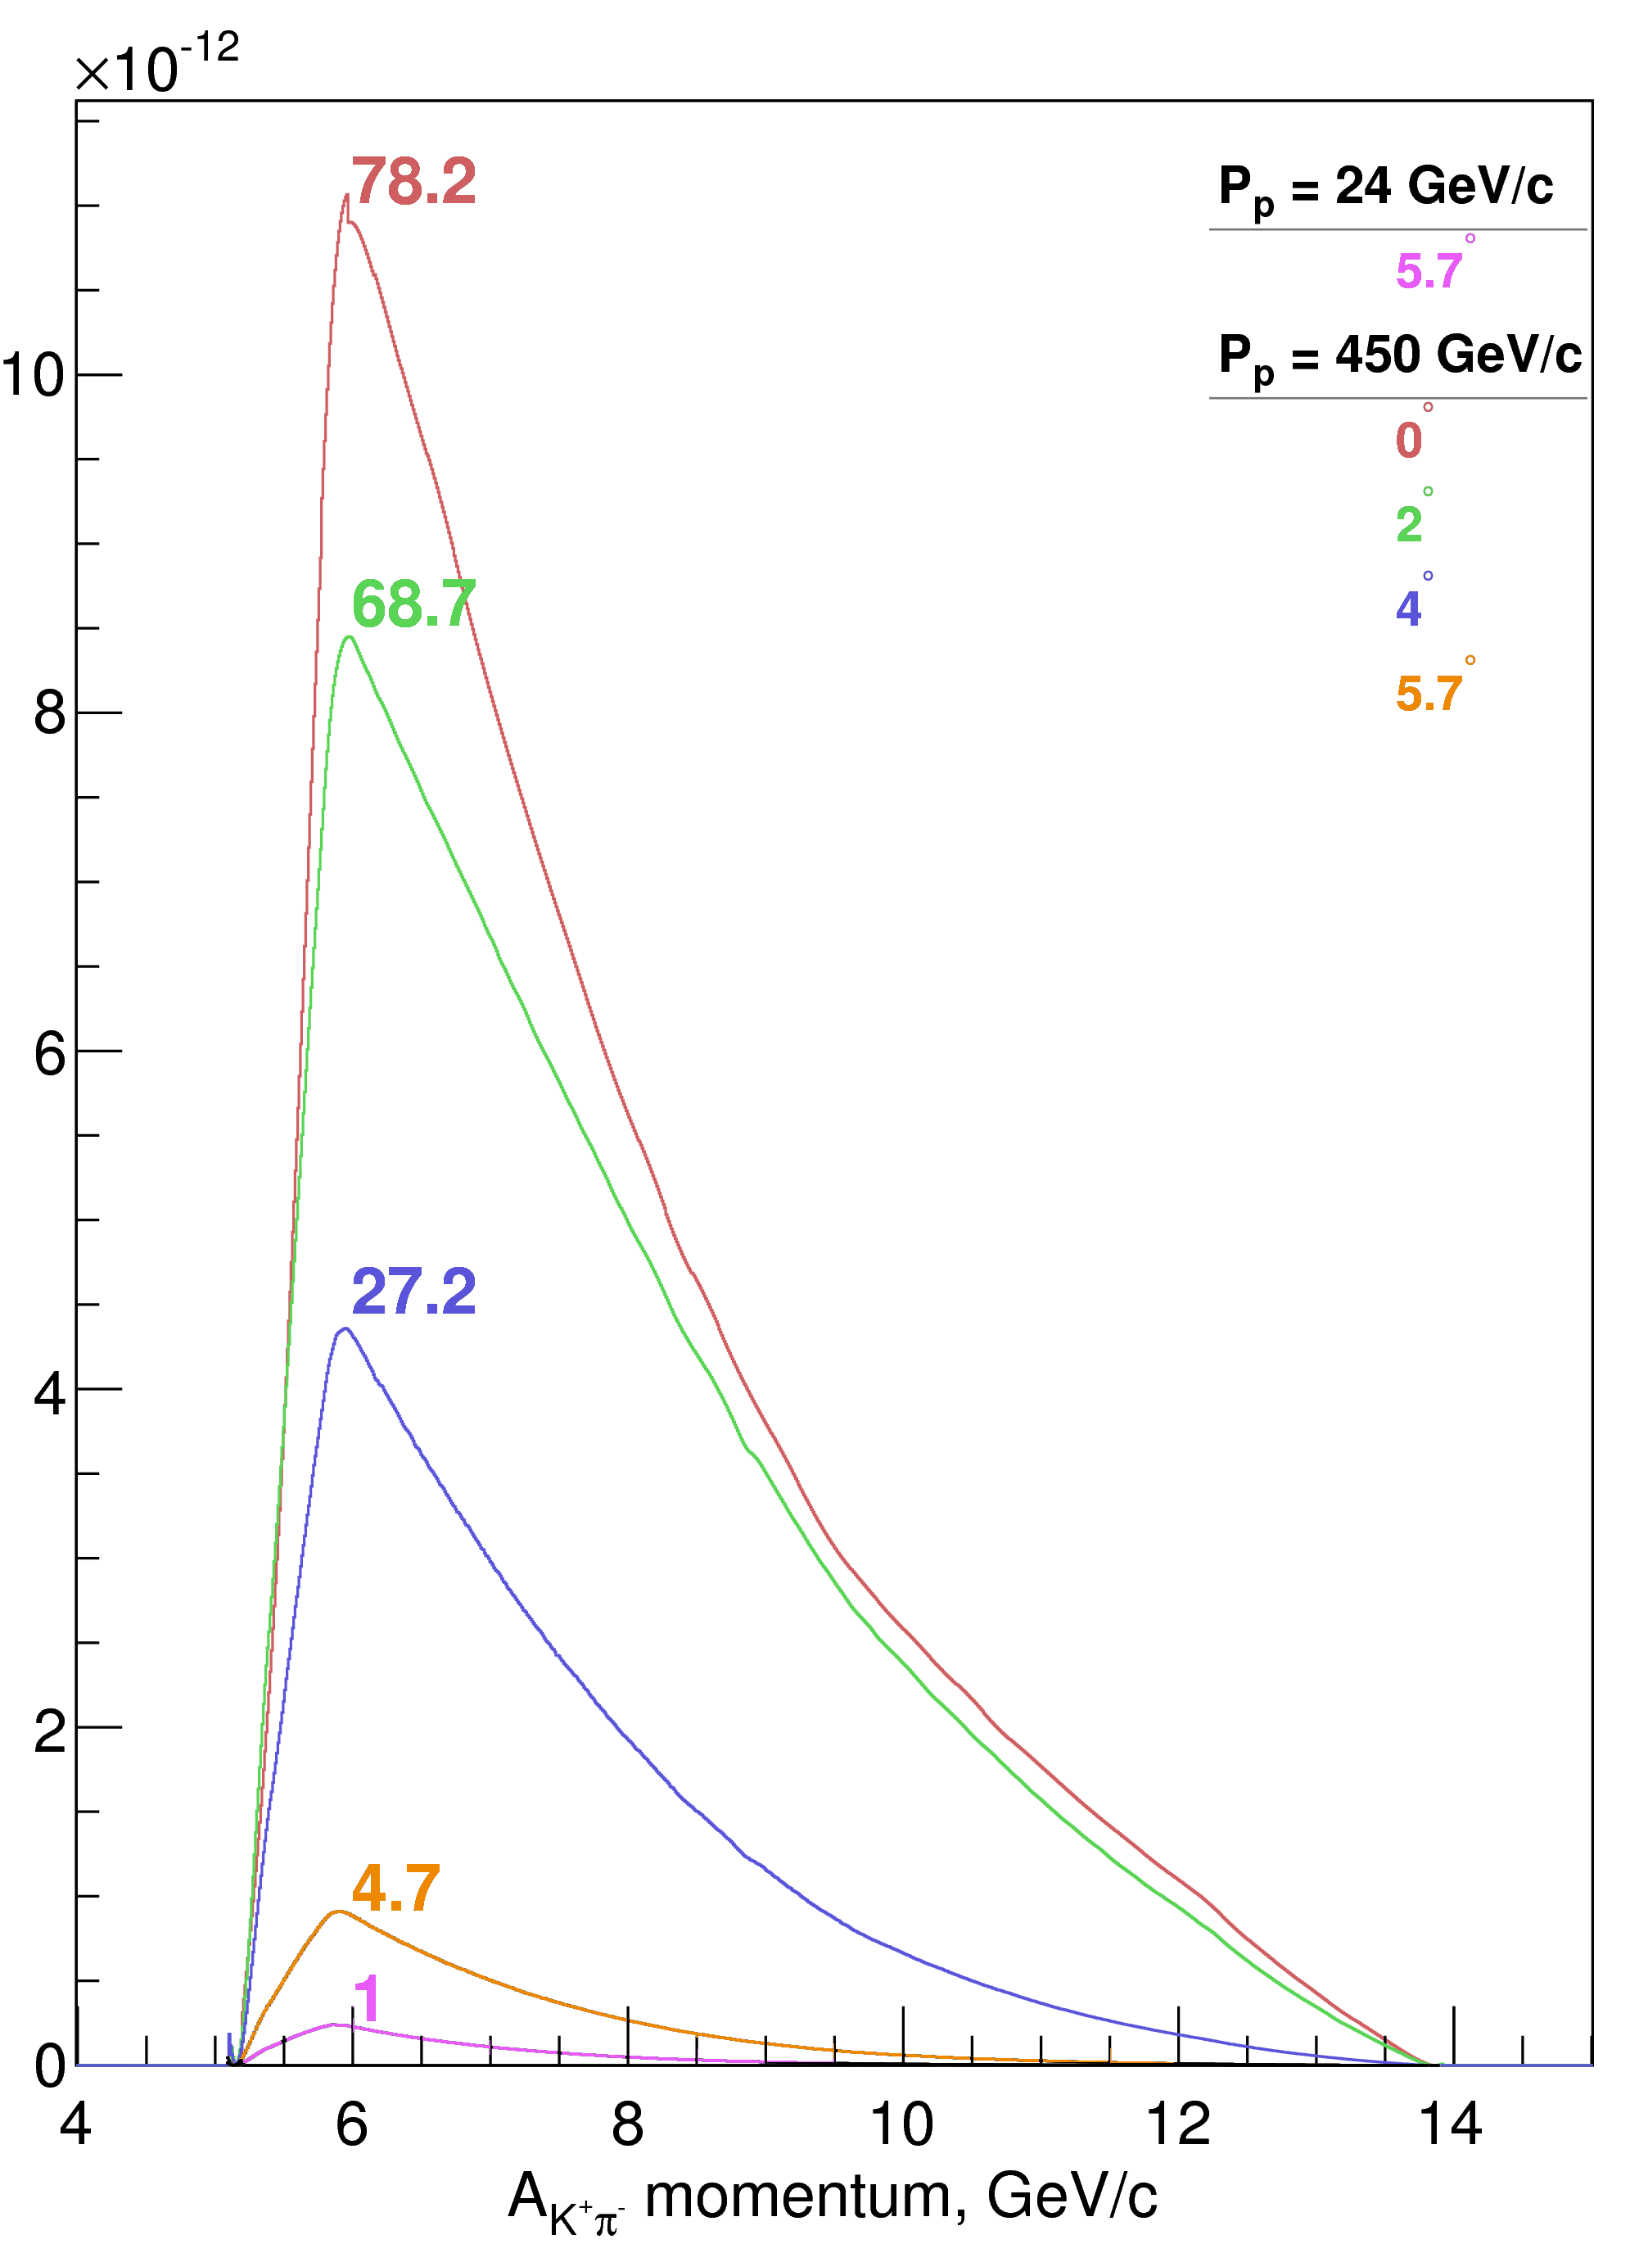
Yield of A_{Kπ} per one p-Ni interaction
Yield of A_{Kπ} dependence as a function of the atoms angle production and momentum in L. S. Bin = 9.6 MeV/c.

Slide 40
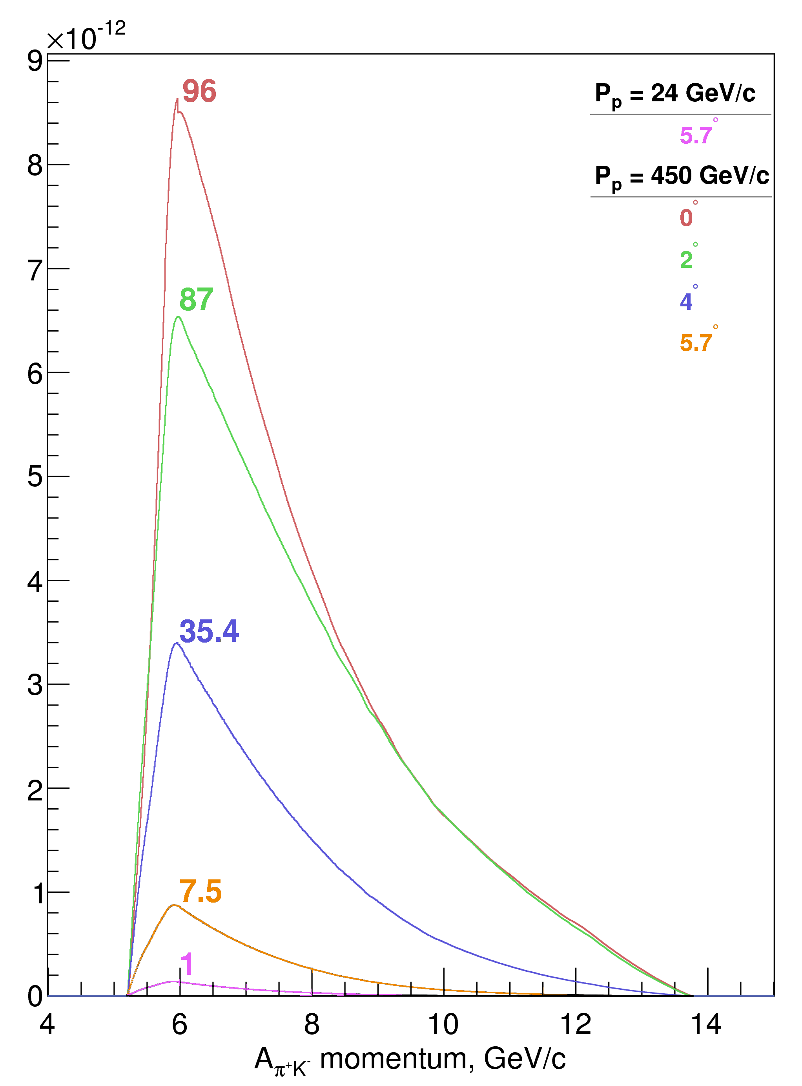
Yield of A_{πK} per one p-Ni interaction
Yield of A_{πΚ} dependence as a function of the atoms angle production and momentum in L. S. Bin = 9.6 MeV/c.

Slide 41
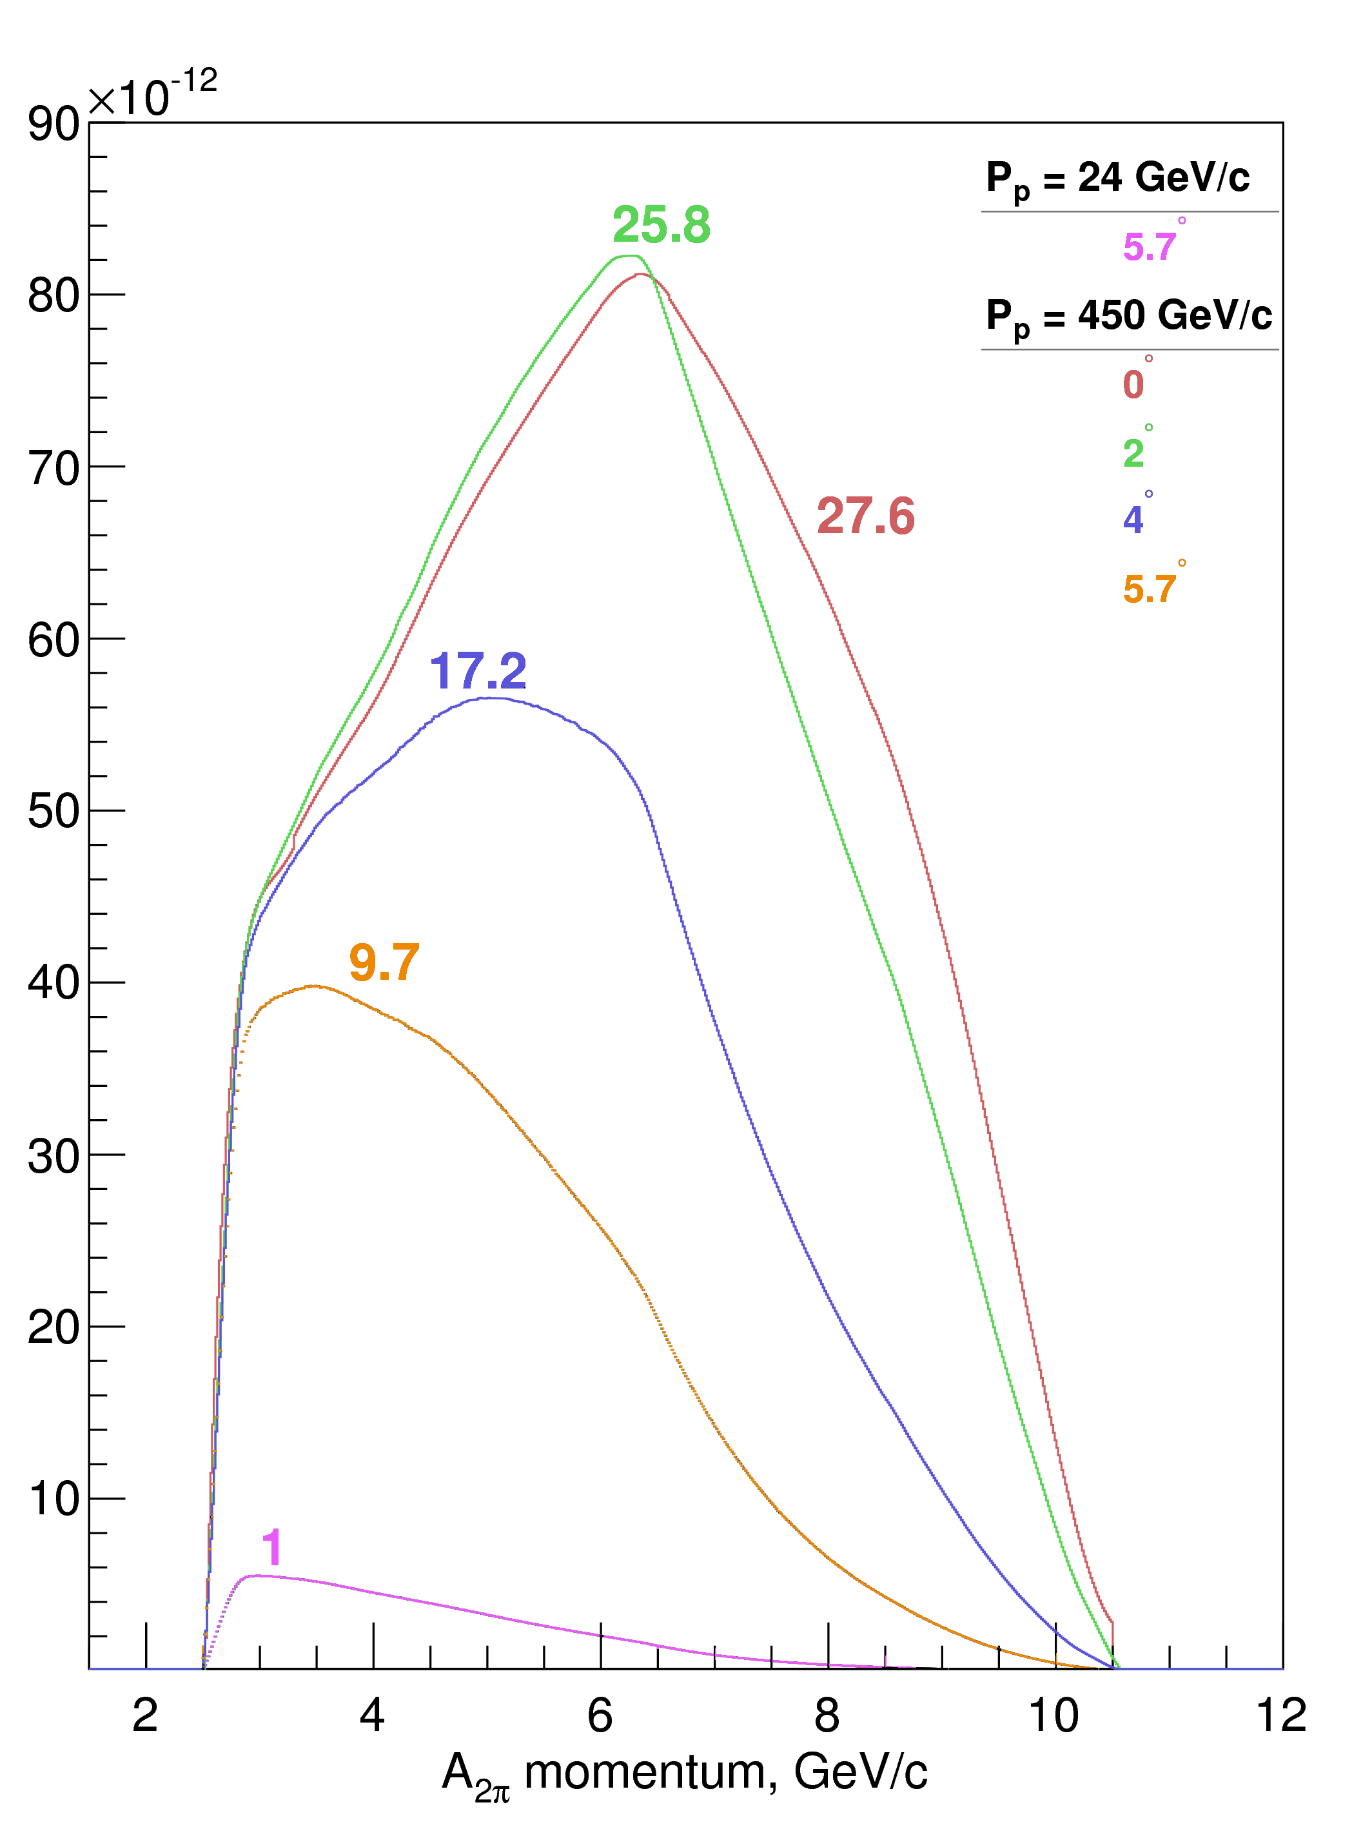
Yield of A_{2π} per one p-Ni interaction
Yield of A_{2π} dependence as a function of the atoms angle production and momentum in L. S. Bin = 15 MeV/c.

Slide 42
DIRAC prospects at SPS CERN
Yield of dimeson atoms per one p-Ni interaction, detectable by DIRAC upgrade setup
E_{p} | PS - 24 GeV |  |  | SPS - 450 GeV
Θ_{lab} | 5.7⁰ |  |  | 5.7⁰ |  |  | 4⁰ |  |  | 2⁰
Atoms | π⁺π⁻ | K⁻π⁺ | K⁺π⁻ | π⁺π⁻ | K⁻π⁺ | K⁺π⁻ | π⁺π⁻ | K⁻π⁺ | K⁺π⁻ | π⁺π⁻ | K⁻π⁺ | K⁺π⁻
W_{A} | 1.1E-9 | 2.6E-11 | 4.4E-11 | 1.0E-8 | 2.0E-10 | 2.1E-10 | 1.8E-8 | 9.3E-10 | 1.2E-9 | 2.7E-8 | 2.3E-9 | 3.0E-9
W_{A}^{N} | 1 | 1 | 1 | 9.7 | 7.5 | 4.7 | 17.2 | 35.4 | 27.2 | 25.8 | 86.9 | 68.7
W_{A}/W_{π} | 7.0E-8 | 1.7E-9 | 2.9E-9 | 2.3E-7 | 4.4E-9 | 4.7E-9 | 2.0E-7 | 1.0E-8 | 1.3E-8 | 8.3E-8 | 7.0E-9 | 9.2E-9
W_{A}^{N}/W_{π}^{N} | 1 | 1 | 1 | 3.3 | 2.6 | 1.6 | 2.9 | 6.0 | 4.6 | 1.2 | 4.0 | 3.2
 |  |  |  | A multiplier factor due to spill duration: ~ 4
Total gain |  |  |  | 13 | 10 | 6 | 12 | 24 | 18 | 5 | 16 | 13

Slide 43
Thank you
for your attention!

Slide 44
Supplementary slides

Slide 45
Experimental conditions (run 2008-2010)
Primary proton beam | 24 GeV/c
Beam intensity | (10.5÷12)·10¹⁰ proton/spill
Single count of one IH plane | (5÷6)·10⁶ particle/spill
Spill duration | 450 ms
Ni target
Purity | 99.98%
Target thickness (year) | 98±1 μm (2008) | 108 ±1 μm (2009-2010)
Radiation thickness | 6.7·10⁻³ X₀ | 7.4·10⁻³ X₀
Probability of inelastic proton interaction | 6.4·10⁻⁴ | 7.1·10⁻⁴

Slide 46
Experimental conditions
Secondary particles channel (relative to the proton beam) | 5.7°
Angular divergence in vertical and horizontal planes | ±1°
Solid angle | 1.2•10⁻³ sr
Dipole magnet | B_{max} = 1.65 T, BL = 2.2 Tm
Time resolution [ps]
 | VH | IH |  |  |  | SFD
plane | 1 | 1 | 2 | 3 | 4 | X | Y | W
2008 | 112 | 713 | 728 | 718 | 798 | 379 | 508 | 518
2010 | 113 | 907 | 987 | 997 | 1037 | 382 | 517 | 527

Slide 47
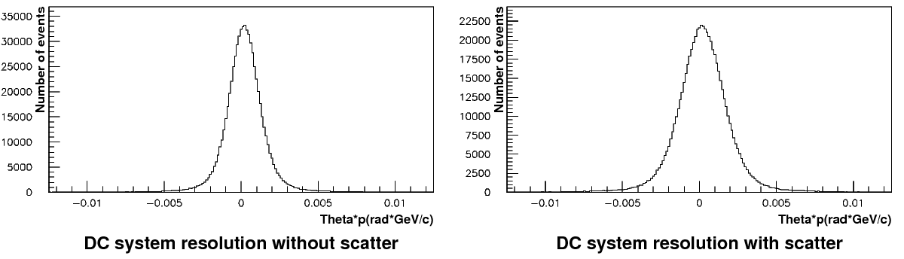
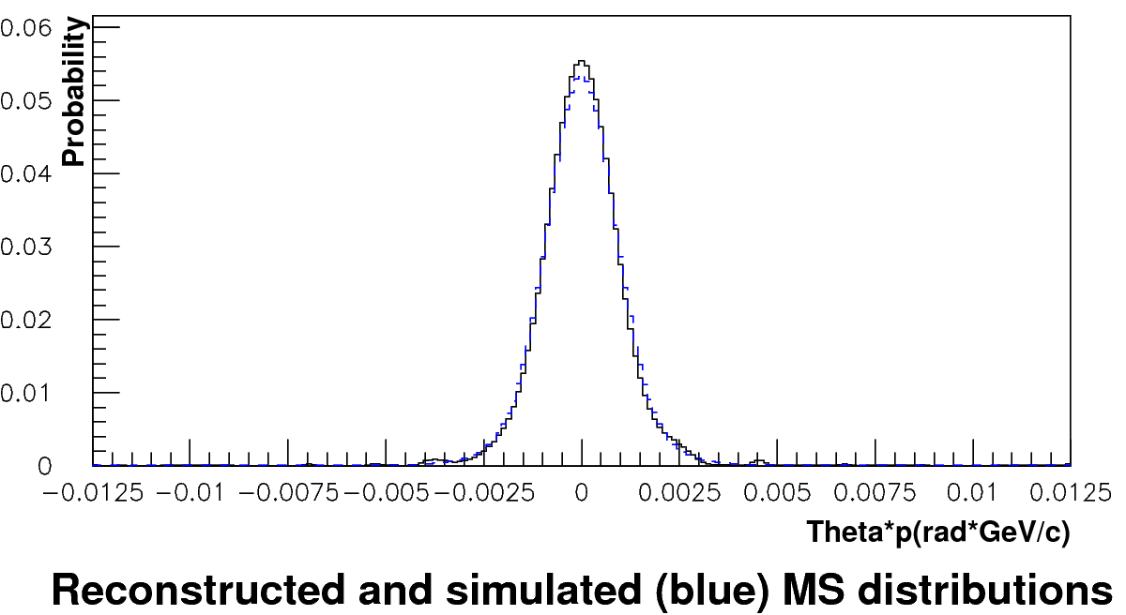
Analysis of multiple scattering in Ni (100 μm)
Run 2011. Analysis of multiple scattering in Ni (100 µm). Only events with one track in each projection were analyzed. δθ/θ ~ 0.7 %. After including in the analysis of all available events the statistics will be doubled and the expected value will be less than 0.5 %.

Slide 48
A_{2π} and A_{πΚ} production

Slide 49
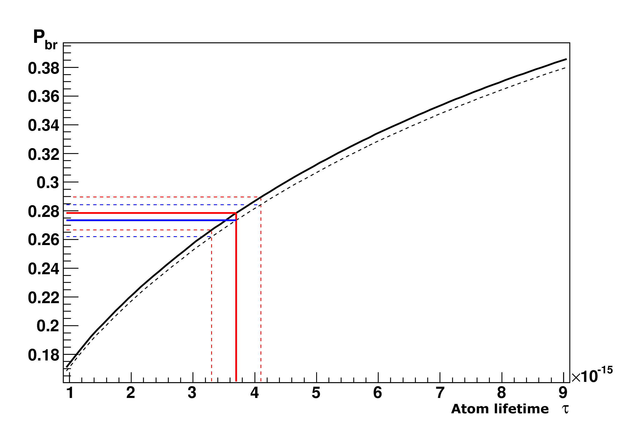
Break-up dependencies P_{br} of atom lifetime
for K⁺π⁻ atom (A_{kπ}) and K⁻π⁺ atom (A_{πK})
Probability of break-up as a function of lifetime in the ground state for A_{πΚ} (solid line) and A_{Κπ} atoms (dashed line) in Ni target of thickness 108 μm.
Average momentum of A_{Κπ} and A_{πΚ} are 6.4 GeV/c and 6.5 GeV/c accordingly.

Slide 50
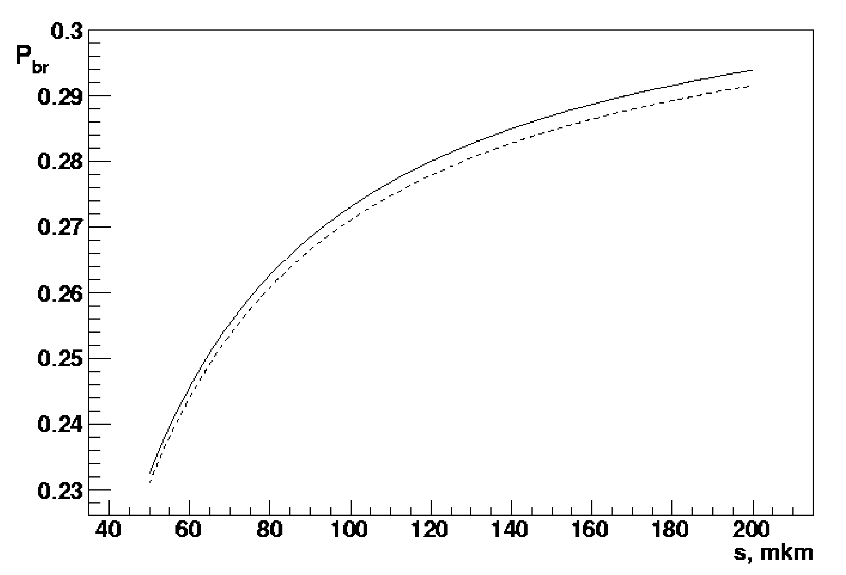
Break-up dependencies P_{br} from the target thickness for Κ⁺π⁻ atom (A_{Κπ}) and Κ⁻π⁺ atom (A_{πΚ})
Probability of break-up as a function of Ni target thickness for A_{πΚ} (solid line) and A_{Κπ} atoms (dashed line), τ_{1S} = 3.7•10⁻¹⁵ s.
Average momentum of A_{Κπ} and A_{πΚ} are 6.4 GeV/c and 6.5 GeV/c accordingly.

Slide 51
Q_{L} distribution Κ⁺π⁻ pairs

Slide 52
Q_{L} distribution π⁺ Κ⁻ pairs

Slide 53
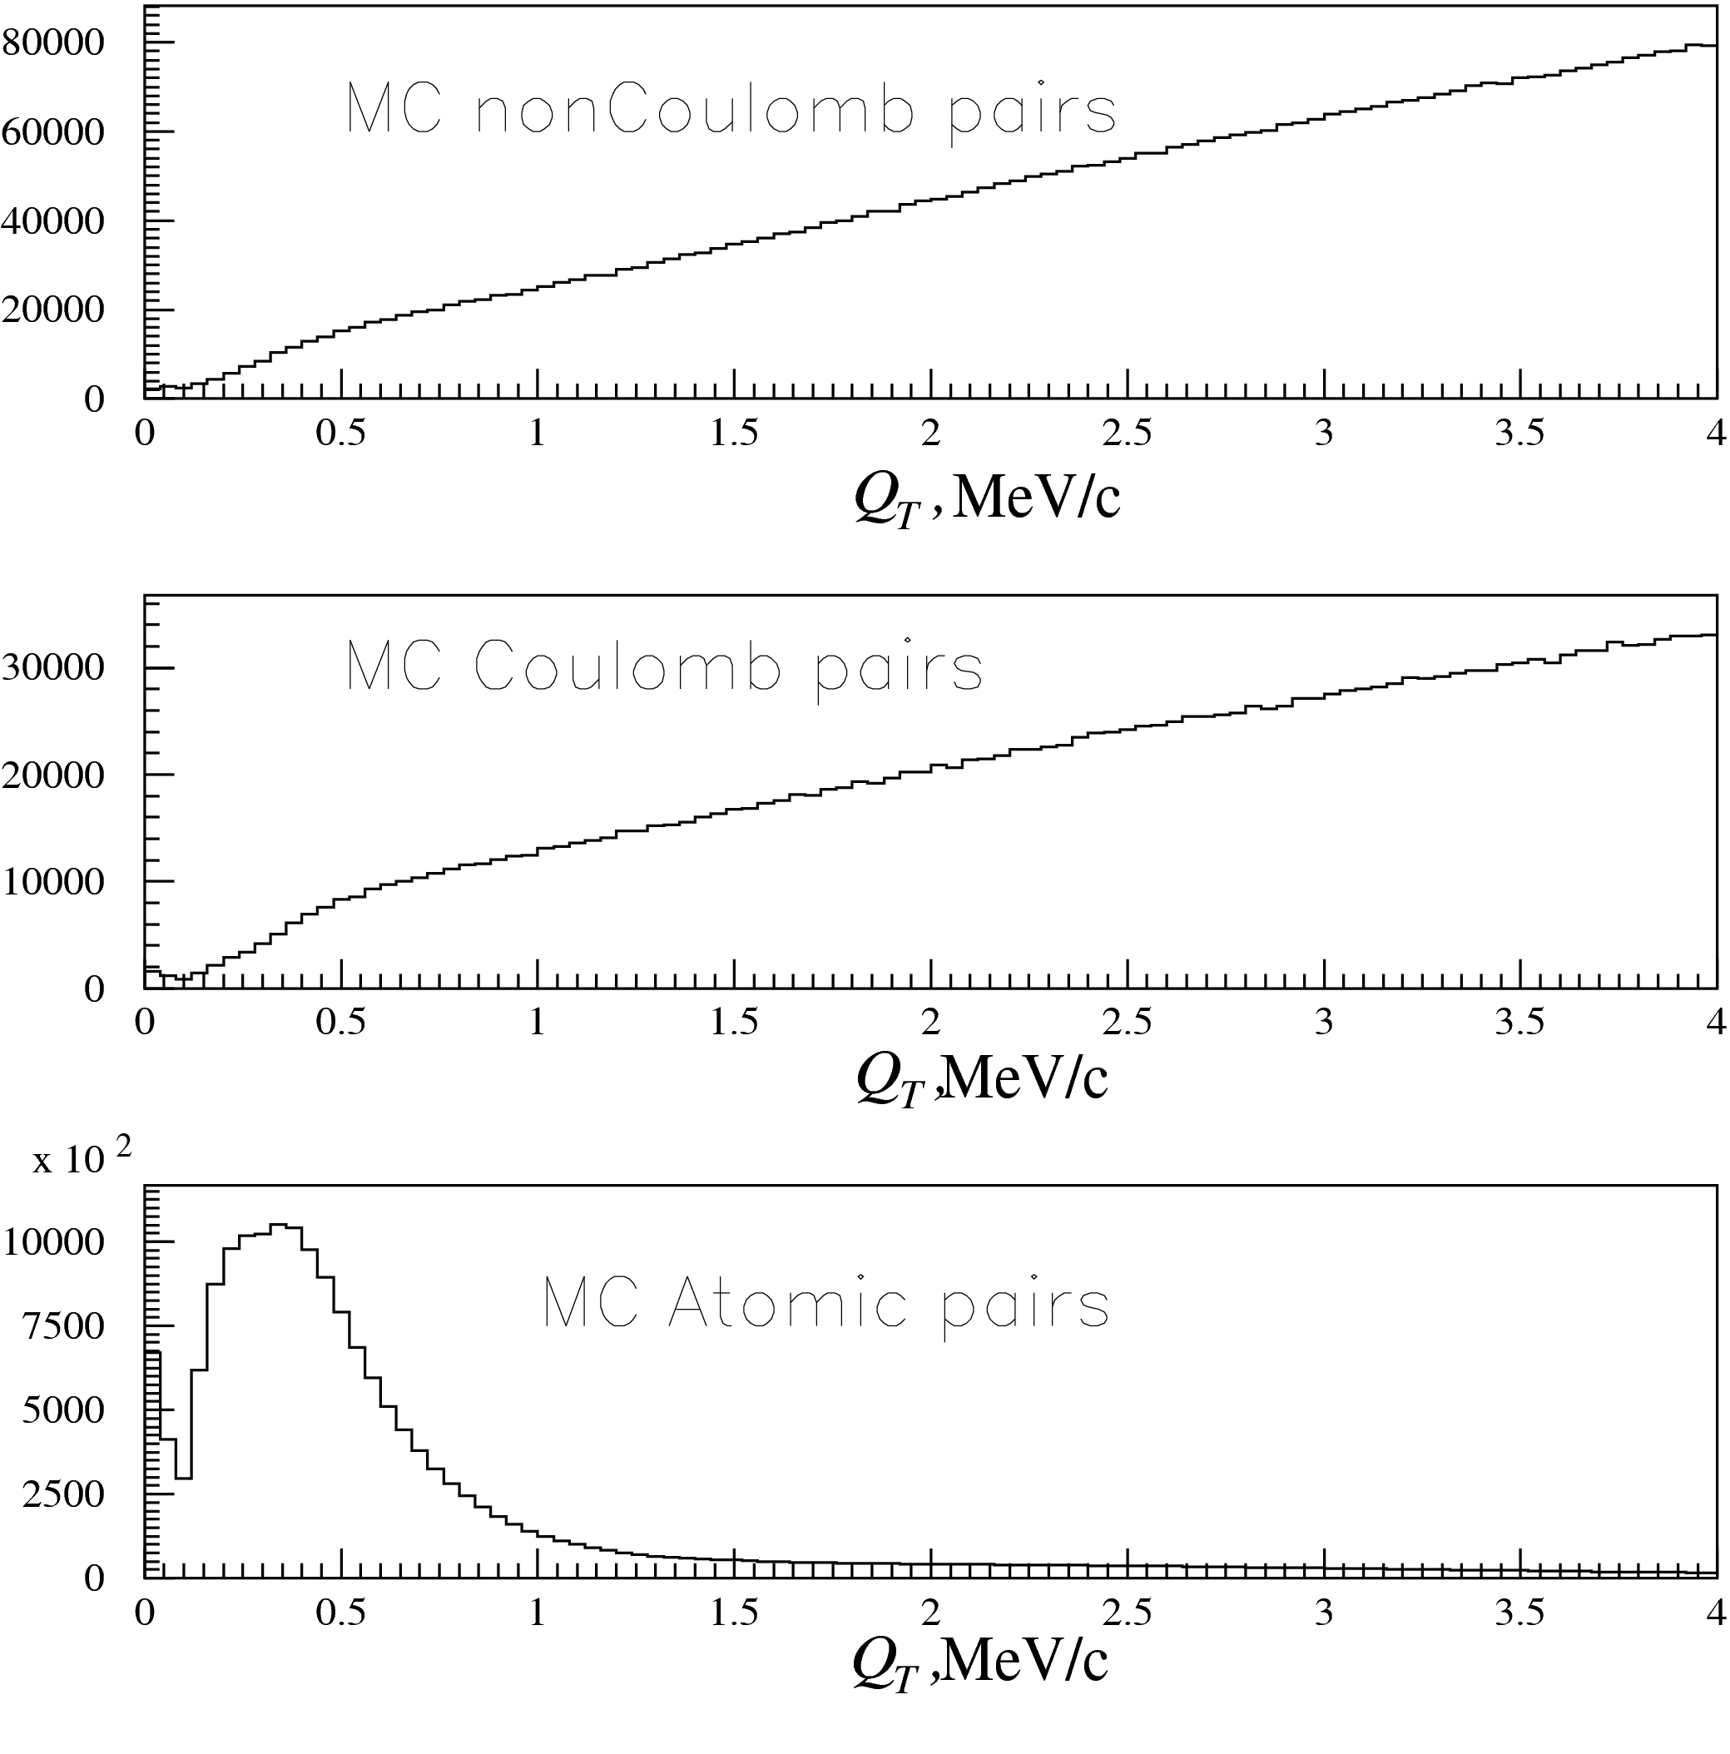
Simulation of π⁺π⁻ pairs from Beryllium target and “atomic pairs” from Platinum foil
Distributions of reconstructed values of Q_{T} for non-Coulomb, Coulomb pairs and pairs from metastable atom

Slide 54
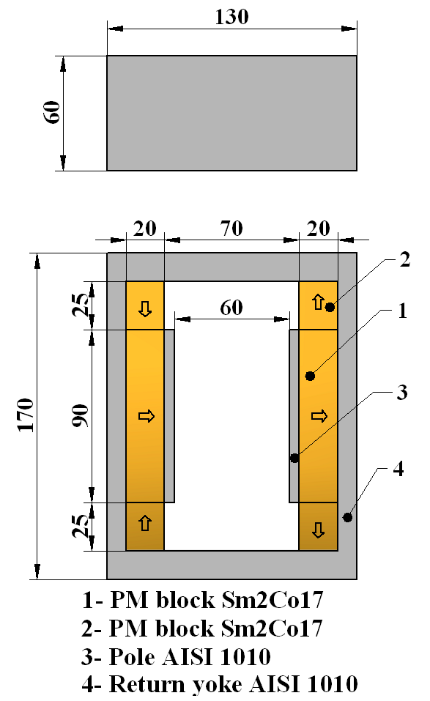
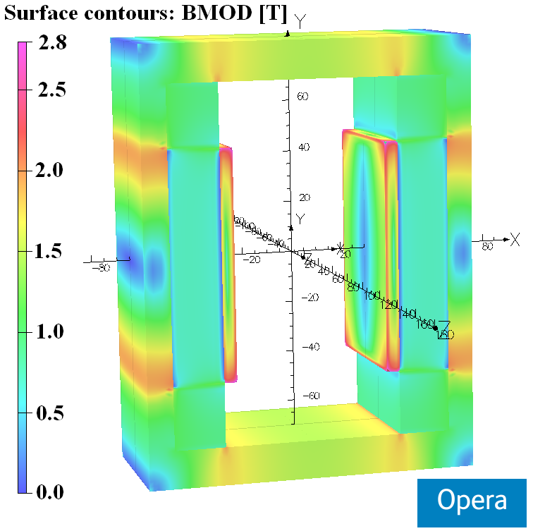
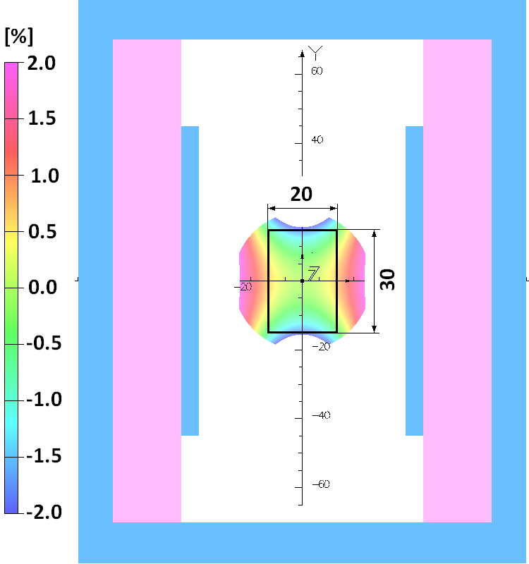
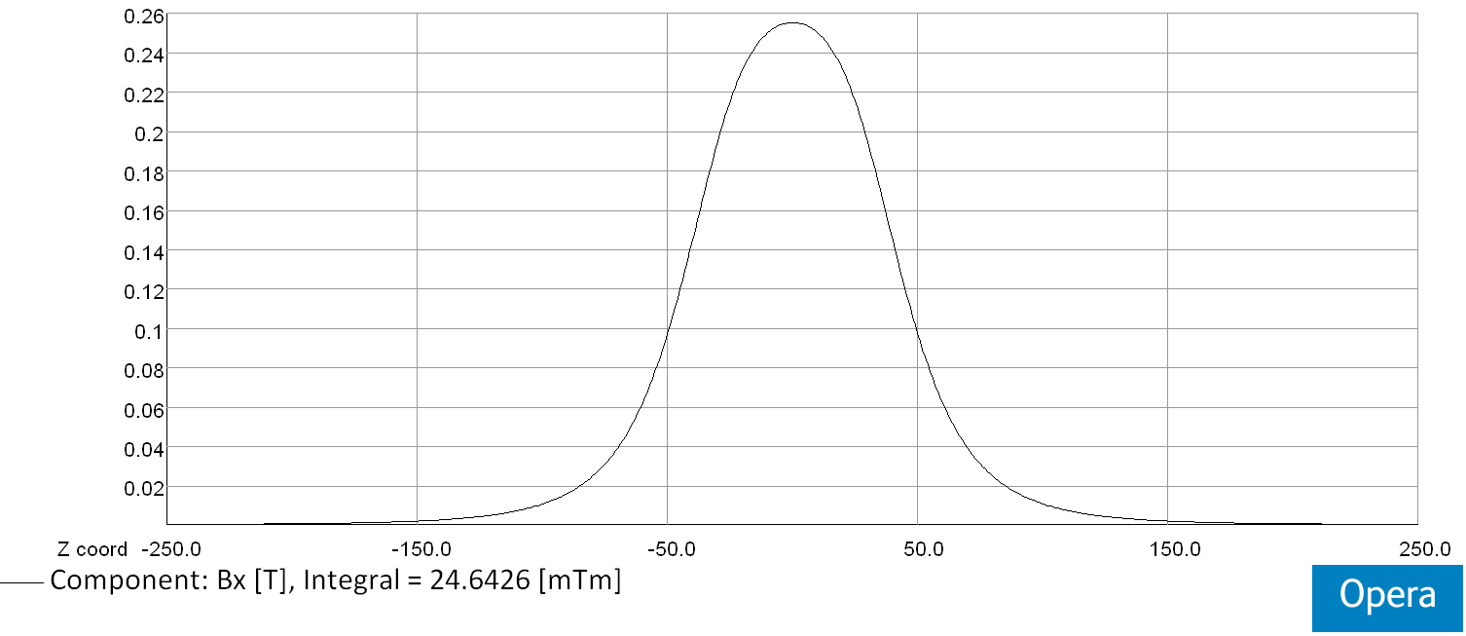
Magnet was designed and constructed in CERN (TE/MCS/MNC)
Layout of the dipole magnet (arrows indicate the direction of magnetization)
Integrated horizontal field homogeneity inside the GFR X х Y = 20 mm х 30 mm:
∆∫Bxdz/ ∫Bx(0,0,z)dz [%]
Opera 3D model with surface field distribution
Horizontal field distribution along z-axis at X=Y=0 mm
∫Bx(0,0,z)dz = 24.6x10⁻³ [Txm]

Slide 55
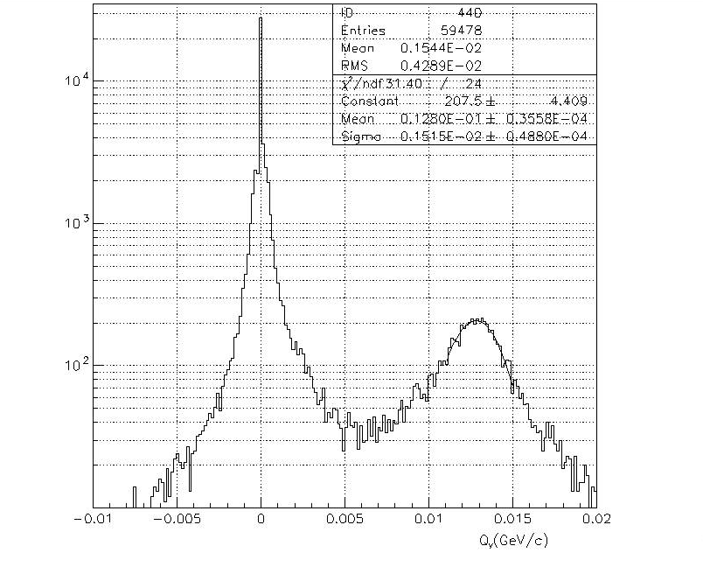
Q_{Y} distribution for e⁺e⁻ pair

Slide 56
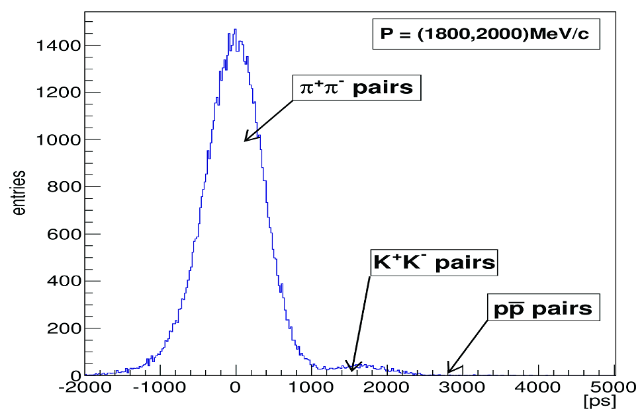
2010 data: distribution of pairs on (t₊+t₋)/2
for P=(1800, 2000) MeV/c
(t₊+t₋)/2

Slide 57
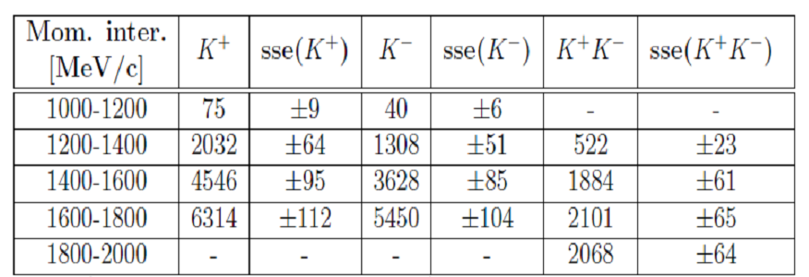
2010 data: results for kaons and K⁺K⁻ pairs in low momenta
sse(K⁺), sse(K⁻), sse(K⁺K⁻) – standard statistic error for K⁺, K⁻, K⁺K⁻ pairs accordingly.
Total number of K⁺K⁻ pairs in low momenta 1200-2000 MeV/c is 6600.
Total number of K⁺K⁻ pairs in high momenta 3000-3800 MeV/c is 3200.
The sum of low and high energy kaon pairs is 9800.

Slide 58
K⁺K⁻ Coulomb pairs and K⁺K⁻ atoms
For the charged pairs from the short-lived sources and small relative momentum Q there is strong Coulomb interaction in the final state.
Κ⁺Κ⁻
(Κ⁺Κ⁻)
Coulomb pairs
Atoms
There is precise ratio between the number of produced Coulomb pairs (N_{C}) with small Q and the number of atoms (N_{A}) produced simultaneously with these Coulomb pairs:
From K⁺K⁻ pair analysis the Coulomb pair distribution on Q will be obtained, allowing to extract the total number of produced K⁺K⁻atoms.

Slide 59
Κ⁺Κ⁻ atom and its lifetime
The A_{2π} lifetime is strongly reduced by strong interaction (OBE, scalar meson f₀ and a₀) as compared to the annihilation of a purely Coulomb-bound system (K⁺K⁻).
τ (A_{2K}→ ππ,πη) | K⁺K⁻ interaction
1.2×10⁻¹⁶ s [1] | Coulomb-bound
8.5×10⁻¹⁸ s [3] | momentum dependent potential
3.2×10⁻¹⁸ s [2] | + one-boson exchange (OBE)
1.1×10⁻¹⁸ s [2] | + f₀’ (I=0) + πη-channel (I=1)
2.2×10⁻¹⁸ s [4] | ChPT
K⁺K⁻ interaction
complexity
References:
[1] S. Wycech, A.M. Green, Nucl. Phys. A562 (1993), 446;
[2] S. Krewald, R. Lemmer, F.P. Sasson, Phys. Rev. D69 (2004), 016003;
[3] Y-J Zhang, H-C Chiang, P-N Shen, B-S Zou, PRD74 (2006) 014013;
[4] S.P. Klevansky, R.H. Lemmer, PLB702 (2011) 235.

Slide 60
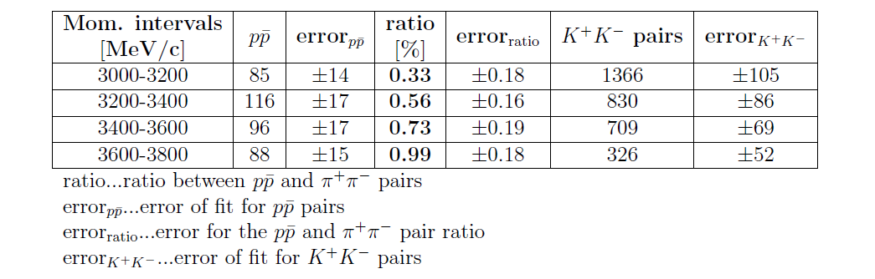
2010 data: results for K⁺K⁻ and pp pairs in high momenta
Total number of K⁺K⁻ pairs in high momenta is 3231.
The sum of low and high energy kaon pairs is 9806.

Slide 61
Κ⁺Κ⁻ atom and its lifetime
Interests in KK physics?
General:
non-understood KK interplay with the scalar mesons f₀[0⁺(0⁺⁺)] and a₀[1⁻(0⁺⁺)] & kaonium, the only double-mesonic atom with hidden strangeness, is decaying via strangeness annihilation
DIRAC experiment:
study of low-energy K⁺K⁻ scattering → estimate number of produced atoms A_{2K}
Kaonium decay width or lifetime “expected”:
Decay width Γ(A_{2K}) = [τ(A_{2K})]⁻¹ = -α³m_{K}² Im(a_{KK}) … A_{2K} structure dependent:
strong effects enter through the complex scattering length a_{KK} .
DIRAC experiment:
search for “atomic pairs” K⁺K⁻ from A_{2K} ionization
→ upper limit on τ(A_{2K}) → info about scattering length a_{KK} !

Slide 62
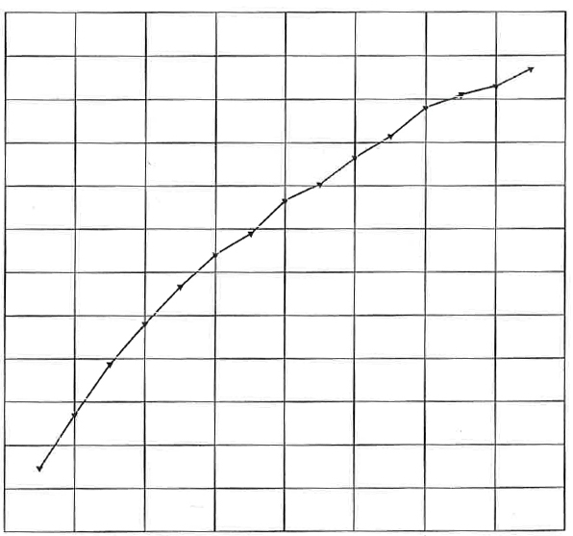
Κ⁺Κ⁻ atoms ionization probability
28 μm Pt
x 10⁻²
3.9
3.5
3.1
2.7
2.3
1.9
1.5
Ionization Probability
0 1 2 3 4
Life time τ in 10^{–18} s
Κ⁺Κ⁻ atoms Lorentz factor is γ = 18
Notes:
62

Slide 63
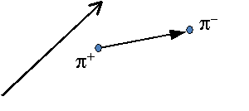
Lamb shift measurement with external magnetic field
L. Nemenov, V. Ovsiannikov, Physics Letters B 514 (2001) 247
Impact on atomic beam by external magnetic field B_{lab} and Lorentz factor γ
→
γ_{A}
→
E
…. relative distance between
π⁺ and π⁻ in A_{2π} system
→
B_{lab}
→
γ_{A}
→
B_{lab}
…. laboratory magnetic field
Λ_{2π},β = v/c
→
E
…electric field in A_{2π} system
→
p_{A}
→
| E | = βγ B_{lab}≈ γ B_{lab}

Slide 64
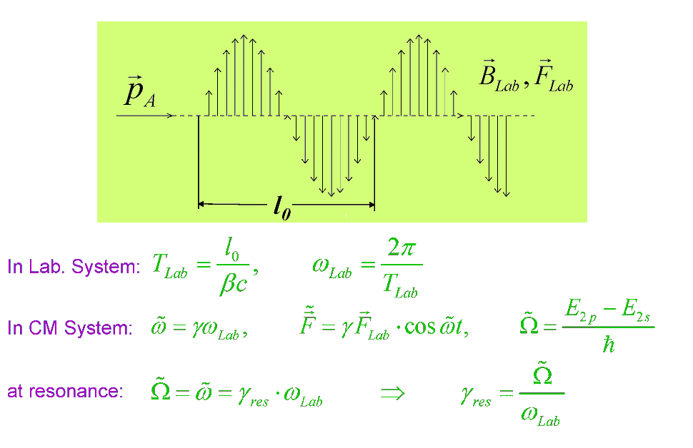
Resonant enhancement of the annihilation rate of A_{2π}
L. Nemenov, V. Ovsiannikov, E. Tchaplyguine, Nucl. Phys. (2002)

Slide 65
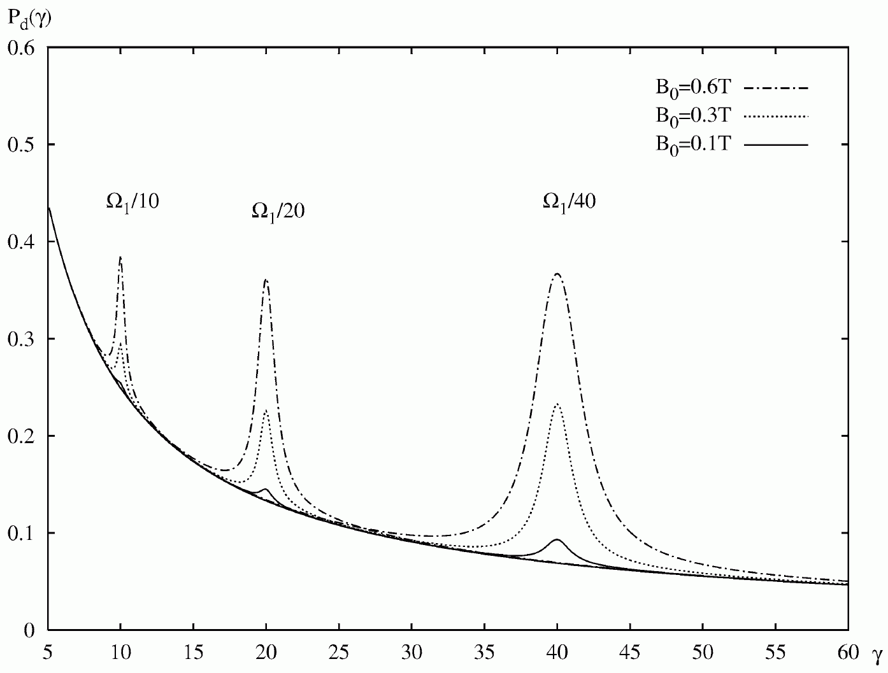
Resonant enhancement

Slide 66
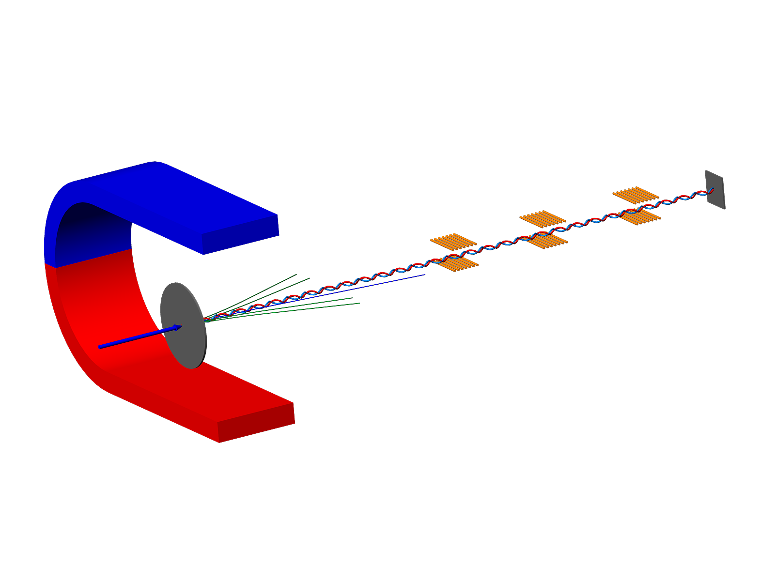
Resonant method
Resonators
π⁺
π⁰
π⁰
π⁰
A*_{2π} A*_{πμ} A*_{πΚ}
π⁻
π⁰
π⁰
π⁰
Pt foil
Proton beam
Charged secondary
γ_{res1}
γ_{res2}
γ_{res3}
γ_{res4}

