Slide 1
Experimental check of precise
predictions of QCD using
π⁺K⁻ , K⁺π⁻ and π⁺π⁻ atoms
L. Nemenov (JINR)
RD-51 collaboration meeting, September 2017

Slide 2
QCD Lagrangian and its prediction
The QCD Lagrangians use the SU(3)_{L}*SU(3)_{R} and SU(2)_{L}*SU(2)_{R} chiral symmetry breaking.
L(u,d,s) = L(3) = L_{sym}(3)+ L_{sym.br.}(3)
L_{sym.br.} is proportional to m_{q}
L(u,d) = L(2) = L_{sym}(2) + L_{sym.br.}(2)
QCD provides cross sections with 1% precision
Perturbation theory is working at high momentum transfer Q.
Unitarity condition.
At large Q, contribution of L_{sym.br.} to the cross section is proportional to 1/Q⁴. Therefore these experiments checked only the L_{sym} prediction precision.
To check the total L(3) Lagrangian predictions, we must study the
low momentum transfer Q processes.
Tools: Lattice calculations and Chiral Perturbation Theory (ChPT)
Lattice----- L(3), L(2) ChPT------Effective Lagrangians.
9/27/2017

Slide 3
Measurement of the πK scattering length
The S-wave πK scattering lengths a_{1/2} and a_{3/2} in the chiral symmetry world are zero. Therefore the scattering length values a_{1/2} and a_{3/2} are very sensitive to the L_{sym.br.}(3).
For Lattice QCD the πK interaction at threshold is a relatively simple process. It gives πK scattering length values with an average precision of 5%.
This precision will be improved in the near future.
There is only one experimental data: DIRAC collaboration observed 349±62 πK atomic pairs (Phys.Rev.Lett. 2016) and measured |a_{1/2}-a_{3/2}| with an average precision of 34% (Phys.Rev. 2017). This measurement was performed on PS CERN using proton beam with
P=24GeV/c.
9/27/2017

Slide 4
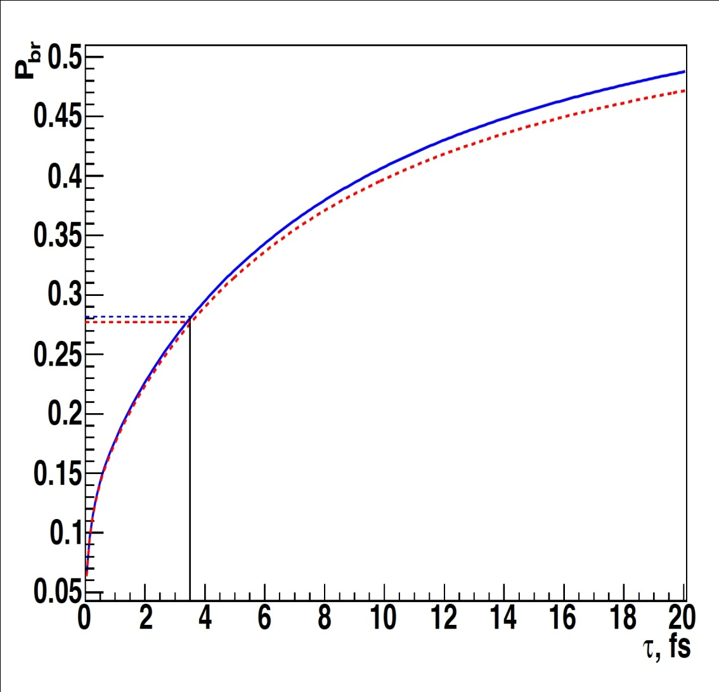
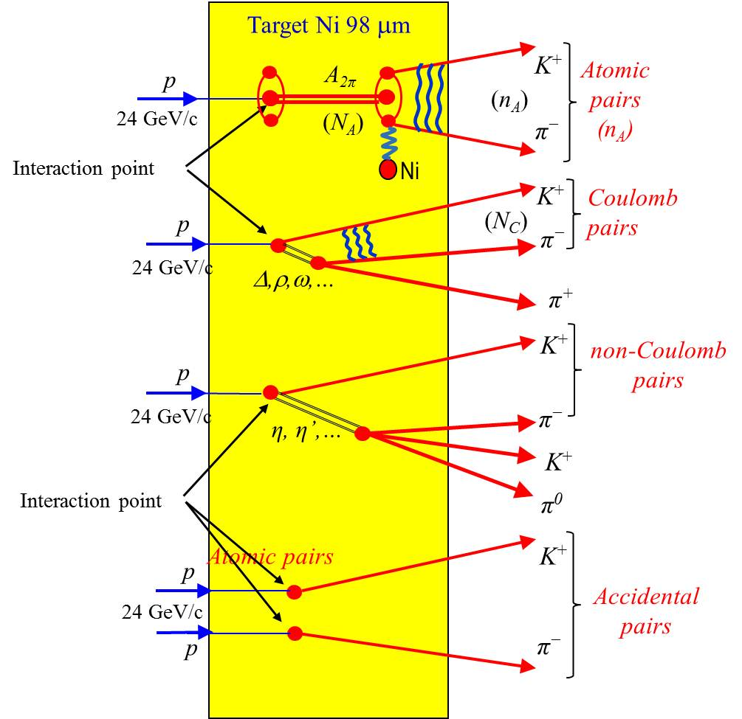
The πK atom lifetime and πK scattering length
$\frac{1}{τ}$ = R |a_{1/2}-a_{3/2}|²
τ_{th} =(3.5±0.4)×10⁻¹⁵ s. The evaluation error from this relation for |a_{1/2}-a_{3/2}| is 1%
9/27/2017

Slide 5
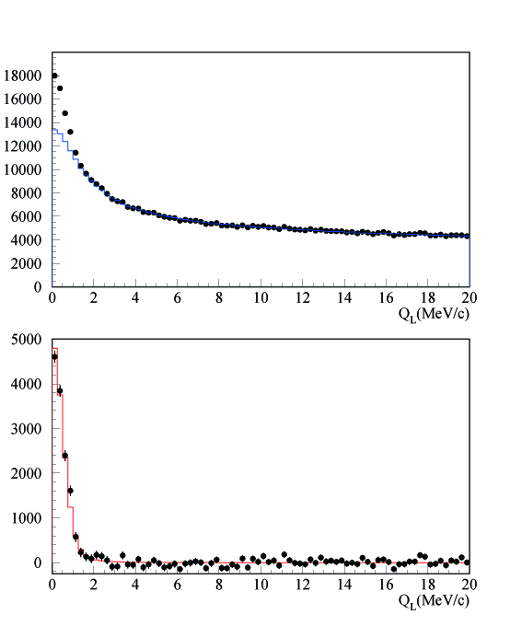
DIRAC results with GEM/MSGC
Q_{L} distribution
←All events
←After background
subtraction

Slide 6
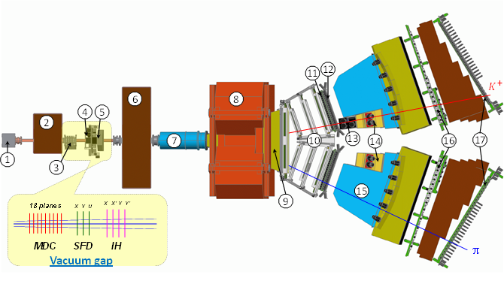
DIRAC upgraded Experimental setup
1 Target station ; 2 First shielding; 3 Micro Drift Chambers; 4 Scintillating Fiber Detector; 5 Ionization Hodoscope; 6 Second Shielding; 7 Vacuum Tube; 8 Spectrometer Magnet; 9 Vacuum Chamber; 10 Drift Chambers; 11 Vertical Hodoscope; 12 Horizontal Hodoscope; 13 Aerogel Čerenkov; 14 Heavy Gas Čerenkov; 15 Nitrogen Čerenkov; 16 Preshower; 17 Muon Detector
M. Pentia IFIN-HH

Slide 7
Measurement of the πK scattering length
The number of produced A_{2π} , A_{π}⁺_{K}⁻ and A_{π}⁻_{K}⁺ per time unit at SPS CERN at p_{p} = 450Gev/c, will be 12±2, 53±11 and 24±5 times higher than in the DIRAC experiment( J.Phys. G: Nucl. Phys. 43 (2016), DIRAC note, 2016.)
For the setup with the same parameters as in the DIRAC experiment and running time 5 months the expected number of πK atomic pairs:
n_{A}=13000.
The statistical(sysematic) precision in these conditions for πK scattering length is ~5% (2%).(The DIRAC error is 34%)
The expected number of π⁺π⁻ atomic pairs n_{A}=400000 . The
statistical(systematic) precision of the π⁺π⁻ scattering length will be: 0.7% (2%).
The PBC Committee is discussing in 2017:
to measure πK scattering lengths with precision better than 5% and
to check with this accuracy the Lattice calculation of the total QCD Lagrangian L(3).
9/27/2017

Slide 8
QCD and Chiral Lagrangian predictions check with long-lived π⁺π⁻ atoms
The DIRAC collaboration (Adeva et al., Phys.Lett.(2015) observed 436±61(7.1 sigma) pion pairs from the long-lived
(τ ≥ 1×10⁻¹¹ sec) π⁺π⁻ atom breakup (ionisation).
The study of these excited atoms allows to measure the Lamb shift depending on another ππ scattering length combination: 2a₀+a₂.
The theoretical restrictions are less than 10⁻³.
The SPS proton beam and the new experimental arrangements makes this measurements possible.
9/27/2017

Slide 9
Measurement of the πK scattering length
The PBC Committee is discussing in 2017:
to measure πK scattering lengths with precision better than 5% and
to check with this accuracy the predictions of the total QCD Lagrangian L(3).
-to measure π π scattering lengths with precision about 2% and
to check with this accuracy the predictions of the total QCD Lagrangian L(2).
The measurement should be performed with the 400 GeV/c SPS CERN proton beam with the new setup.
9/27/2017

Slide 10
DIRAC++ (Setup Isometric view)
9/27/2017

Slide 11
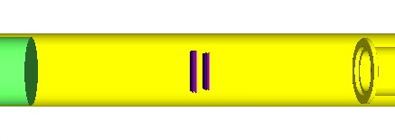
DIRAC++ Setup (top view)
π⁺
K⁺
K –
π–
9/27/2017

Slide 12
DIRAC++ (Detectors)
Setup element (number planes) | Aperture (cm) | Occupancy (s⁻¹ · cm⁻²) | X₀ % | Resolution
 |  |  |  | Coordinate (µm) | Time (ns)
1. Target Station (*) 2. Vacuum system (*) 3. Vertex detector (2 ÷ 4 planes) | 7.6 × 7.6 | (5 ÷ 20) · 10⁵ | 0.7 ÷ 1.5 | 50 | 0.2
4. RICH? | 9.0 × 9.0 | (4 ÷ 16) · 10⁵ | < 5 |  | < 1
5. SFD (3 planes) (*) | 10. × 10. | (3 ÷ 12) · 10⁵ | 2.7 | 60 | 0.3
6. Vacuum system (*) 7. Iron shielding wall (*) 8. Spectrometer magnet (*) | 155 × 50
9. Downstream Tracker (2 × 8) | 75 ÷ 110×44 | (1 ÷ 10) · 10⁴ | 4 ÷ 8 | < 80
10. Vertical Hodoscope (2 × 1 ÷ 2) (*) | 112 × 44 | (1 ÷ 8) · 10⁴ |  |  | < 0.7
11. Horizontal Hodoscope (2) (*) | 115 × 44 | (1 ÷ 8) · 10⁴ |  |  | < 0.5
12. Heavy Gas Cherenkov detector (2) (*) | 30 × 49 | (1 ÷ 8) · 10⁴ |  |  | < 1.0
13. Nitrogen Cherenkov detector (2) | 90 × 50 | (1 ÷ 10) · 10³ |  |  | < 1.0
14. Nitrogen Cherenkov detector (2) | 37 × 53 | (1 ÷ 8) · 10⁴ |  |  | < 1.0
15. PreShower detector (2) | 148 × 60 | (1 ÷ 8) · 10³ |  |  | < 1.0
16. PreShower detector (2) | 56 × 60 | (5 ÷ 40) · 10³ |  |  | < 1.0
--. Ionisation Hodoscope (4 planes) | 10. × 10. | (4 ÷ 16) · 10⁵ | 3
* - Existing parts of the Setup
? - Micro-Pattern Gas Detectors (MPGD)
9/27/2017

Slide 13
Thank you
9/27/2017

Slide 14
π⁺π⁻ atom lifetime
π⁺π⁻ atom (pionium) is a hydrogen-like atom consisting of π⁺ and π⁻ mesons:
E_{B} = -1.86 keV, r_{B} = 387 fm, p_{B} ≈ 0.5 MeV/c
π⁺
π⁰
The π⁺π⁻ atom lifetime is dominated by the decay into π⁰ π⁰ mesons:
π⁻
π⁰
a₀ and a₂ are the ππ S-wave scattering lengths for isospin I=0 and I=2.
≠ 0 for l = 0
A_{2π}(1s, 2s,…, ns)
π⁰π⁰
= 0 for l ≠ 0
γ
π⁰π⁰
A_{2π}(np)
A_{2π}(1s, 2s,…(n-1)s)
The np state lifetime depends on the transition np 1s, 2s,…, (n-1)s probability.
This probability is about 3 orders of magnitude less than for ns π⁰π⁰.

Slide 15
K⁺π⁻ and K⁻π⁺ atoms lifetime
Kπ-atom (A_{Kπ}) is a hydrogen-like atom consisting of K⁺ and π⁻ mesons:
E_{B}= -2.9 keV r_{B} = 248 fm p_{B} ≈ 0.8 MeV
The Kπ-atom lifetime (ground state 1S), τ=1/Γ is dominated by the annihilation process into K⁰π⁰:
K⁺
π⁰
K⁰
π⁻
**
(**) J. Schweizer (2004)
From Roy-Steiner equations:
If

Slide 16
L(2) and Chiral Lagrangian predictions check with short-lived π⁺π⁻ atoms
The QCD Lagrangian L(2) and Chiral Lagrangian describe processes with u and d quarks, using SU(2)_{L}*SU(2)_{R} chiral symmetry breaking.
From the ChPT prediction for a₀ and a₂, the π⁺π⁻ atom lifetime in the ground state, given by 1/τ = R|a₀-a₂|², is τ_{th}=(2.9±0.1)*10⁻¹⁵ s.
The evaluation error for |a₀-a₂| from this relation is 0.6%.
These Lagrangians predict the S-wave π⁺π⁻ scattering lengths a₀ and a₂.
9/27/2017

Slide 17
SPS beam time for πK scattering length measurement
The data at p_{p} = 24GeV/c and 450Gev/c were simulated, processed and analysed (V.Yazkov, DIRAC note, 2016 05).
Experimental conditions on SPS with Ni target
Thin Ni target, nuclear efficiency ~ 6x10⁻⁴.
The proton beam can be used for other experiments.
Proton beam intensity: 3x10¹¹ protons/s
(DIRAC worked at 2.7x10¹¹ protons/s)
Number of spills: 4.5x10⁵ with spill duration 4.5 s
Data taking: 3000 spills per 24 hours.
Running time: 5 months
The expected number of πK atomic pairs: n_{A}=13000
(In the DIRAC experiment was n_{A}=349±62)
The statistical precision in these conditions for πK scattering length will be: ~5%
The expected systematic error will be at the level of 2%
The expected number of π⁺π⁻ atomic pairs n_{A}=400000
The statistical precision of the π⁺π⁻ scattering length will be: 0.7%
The expected systematic error will be at the level of 2%
9/27/2017

Slide 18
L(2) and Chiral Lagrangian predictions check with short-lived π⁺π⁻ atoms
ChPT | a₀ and a₂ a₀-a₂ | 2.3% precision 1.5% precision | Colangelo et al. Nucl.Phys.(2001)
Lattice calculations | a₀ a₂ | 4-10% precision ~1% precision | K.Sasaki et al., Phys.Rev. 2014, Z.Fu, Phys.Rev.(2013), C.Lang et al.,Phys.Rev.(2012), Feng et al., Phys. Lett.(2010), T.Yagy at al., arXiv:1108.2970, S.Beame et al. Phys.Rev(2008)
Experimental values | a₀-a₂ | ~ 4% precision | J.R.Bateley at al., Eur. Phys. J. (2009), J.R.Bateley at al., Eur. Phys. (2010), Adeva et al., Phys. Lett. (2011)
 | a₀ a₂ | ~ 6% precision ~22% precision | J.R.Bateley at al., Eur. Phys. J. (2009), J.R.Bateley at al., Eur. Phys. (2010)
on SPS | a₀-a₂ | ~2% precision | DIRAC estimation
9/27/2017

Slide 19
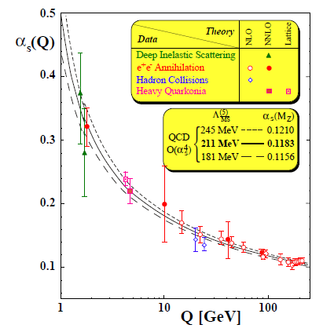
DIRAC search for strong interaction dynamics - Quark confinement
S. Bethke, J.Phys.G26:R27, 2000
α_{S} large – small Q²
“quark confinement”
perturbative QCD not suitable.
Lattice QCD solve field equations
on a space-time lattice by MC.
α_{S} small – large Q²
“asymptotic freedom”
and perturbative QCD
π⁺
π⁺
π⁰
π⁺
u
d
u
d
u
d
u
u
u
d
Small Δx distance;
quark degrees
of freedom
Energy fed
into the system
The released energy gets
out a quark-antiquark pair
from the Vacuum
Large Δx distance;
pion degrees of freedom
string breaks generate qq
pair to reduce field energy
“quark confinement”
DIRAC
“asymptotic freedom”
9/27/2017
Mircea Pentia IFIN-HH Bucharest

