Slide 1
Discussion on Studies at Test Stands
Roger Ruber
Uppsala University

Slide 2
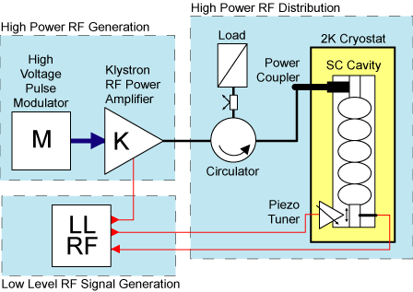
RF Generation and Distribution System
200 cavities (352 + 704 MHz)
200 RF systems: modulator, klystron, distribution, controls
5 MW beam → 20 MW RF, (losses and LLRF overhead)
R&D objectives
energy efficiency and operational costs reductions
produce technical design, with cost estimate, to start tendering
Notes:
2

Slide 3
Test Stand Objectives
Prototype baseline design and acceptance testing of production elements
ion source
RFQ, bunchers, DTLs, spokes and elliptical cavities
power couplers, tuners, cryo-modules
RF system including power sources, distribution and controls (LLRF)
200 Accelerating structures and RF distribution points
minor fault might create a major risk
must ensure low beam loss operation
to prevent activation of accelerator components
major part of the accelerator budget
must be cost, energy and resource effective for construction & operation
Training of future staff
participate in prototyping to prepare for operation

Slide 4
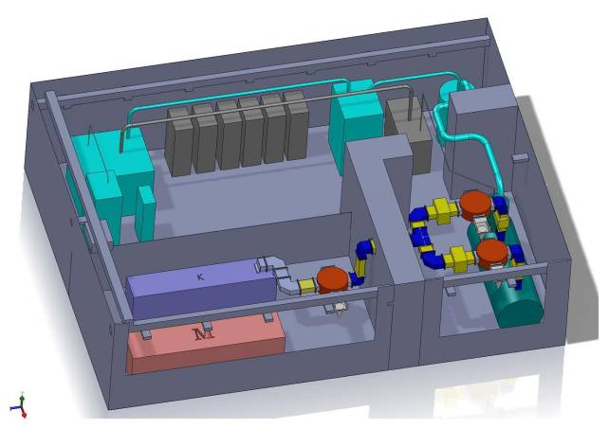
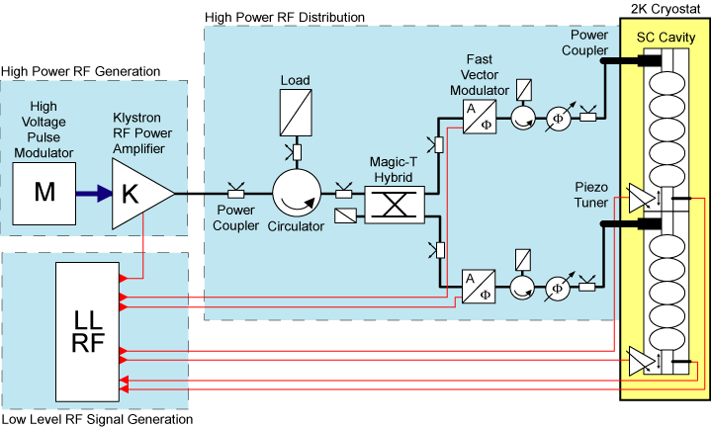
FREIA: RF and Cryogenic Facilities
Test Facility at Uppsala University
prototyping of LLRF and HLRF solutions
training of students and staff
4 Years development phase
2011 – 2012: design, tendering
2013 – 2014: commissioning, R&D RF systems (components & concepts)
2015 and beyond: energy efficiency, component testing
Hardware:
HV pulse modulator
704 MHz klystron (1.5 MW)
RF distribution system
LLRF system
2 SRF elliptical cavities
helium liquefier

Slide 5
Proposals for Possible Test Stand Program
Alternatives HLRF generation and distribution
prototyping, sufficient contingency in the design
test alternatives in relation to staging of beam power and energy
multiple cavities per klystron, min. overhead on possible vector modulator
multiple klystrons per modulator
Energy efficiency and recovery
higher efficiency klystrons (long long future)
energy recovery from klystron/load’s cooling water
Limits in cavity performance
HOM couplers: multipactoring and use as BPMs
multi-cavity field emission

