Slide 1
Test Stands
Roger Ruber
Uppsala University
ESS TAC4
16 Feb. 2012

Slide 2
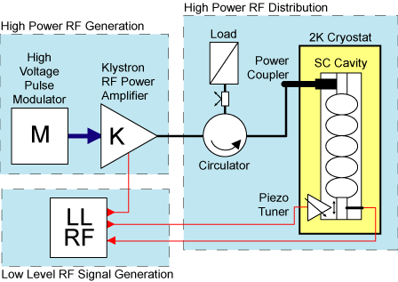
RF Generation and Distribution System
1 Ion source
~200 RF systems (352 + 704 MHz)
NC/SC accelerating cavity
RF source, amplifiers, distribution, controls
Auxillary systems
5 MW beam → 20 MW mains (losses and overhead)
Cryo, water and air cooling
Notes:
2

Slide 3
Objectives for Testing
Validation technical design and performance
design reliability & contingency: minor fault might create a major risk
must ensure low beam loss operation to prevent activation
Acceptance testing of production elements
ion source, accelerating cavities & components: power coupler, tuner
cryomodules
RF system: power source, amplifiers, distribution and controls
R&D towards increased operation efficiency and decreased cost
major part of the accelerator budget
must be cost, energy and resource effective for construction & operation
Training of future staff
participate in testing to prepare for operation

Slide 4
Some Issues to be Addressed
Limits in cavity performance due to field emission
Comprehensive design studies, prototyping and comprehensive tests of cavities and complete cryomodules
Poor reproducibility in cavity performance
Quality control during manufacturing and prototyping of a sufficient large number of cavities
Limits in RF system performance and reliability
Prototyping, sufficient contingency and ease of maintenance in design
Delivery and installation
Coordinate production and test flow, staging of installation

Slide 5
Possible Production and Test Flow
Step |  | Industry or Laboratory | Partner Laboratory | ESS Host Laboratory
Accelerator | integration
Cryo-module | acceptance
 | assembly
Components | acceptance
 | manufacture
SRF cavities | acceptance
 | manufacture
 | sub-components |  | procurement
Magnets | acceptance
 | manufacture
RF sources | acceptance
 | manufacture

Slide 6
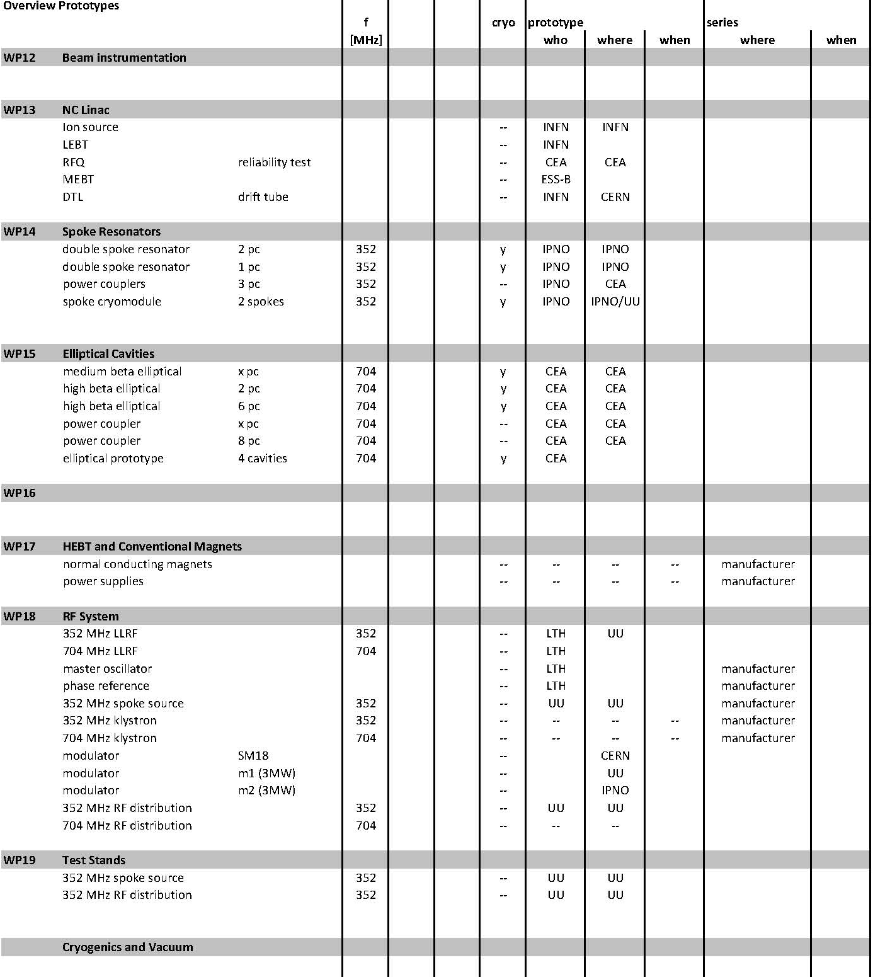
Overview Prototypes

Slide 7
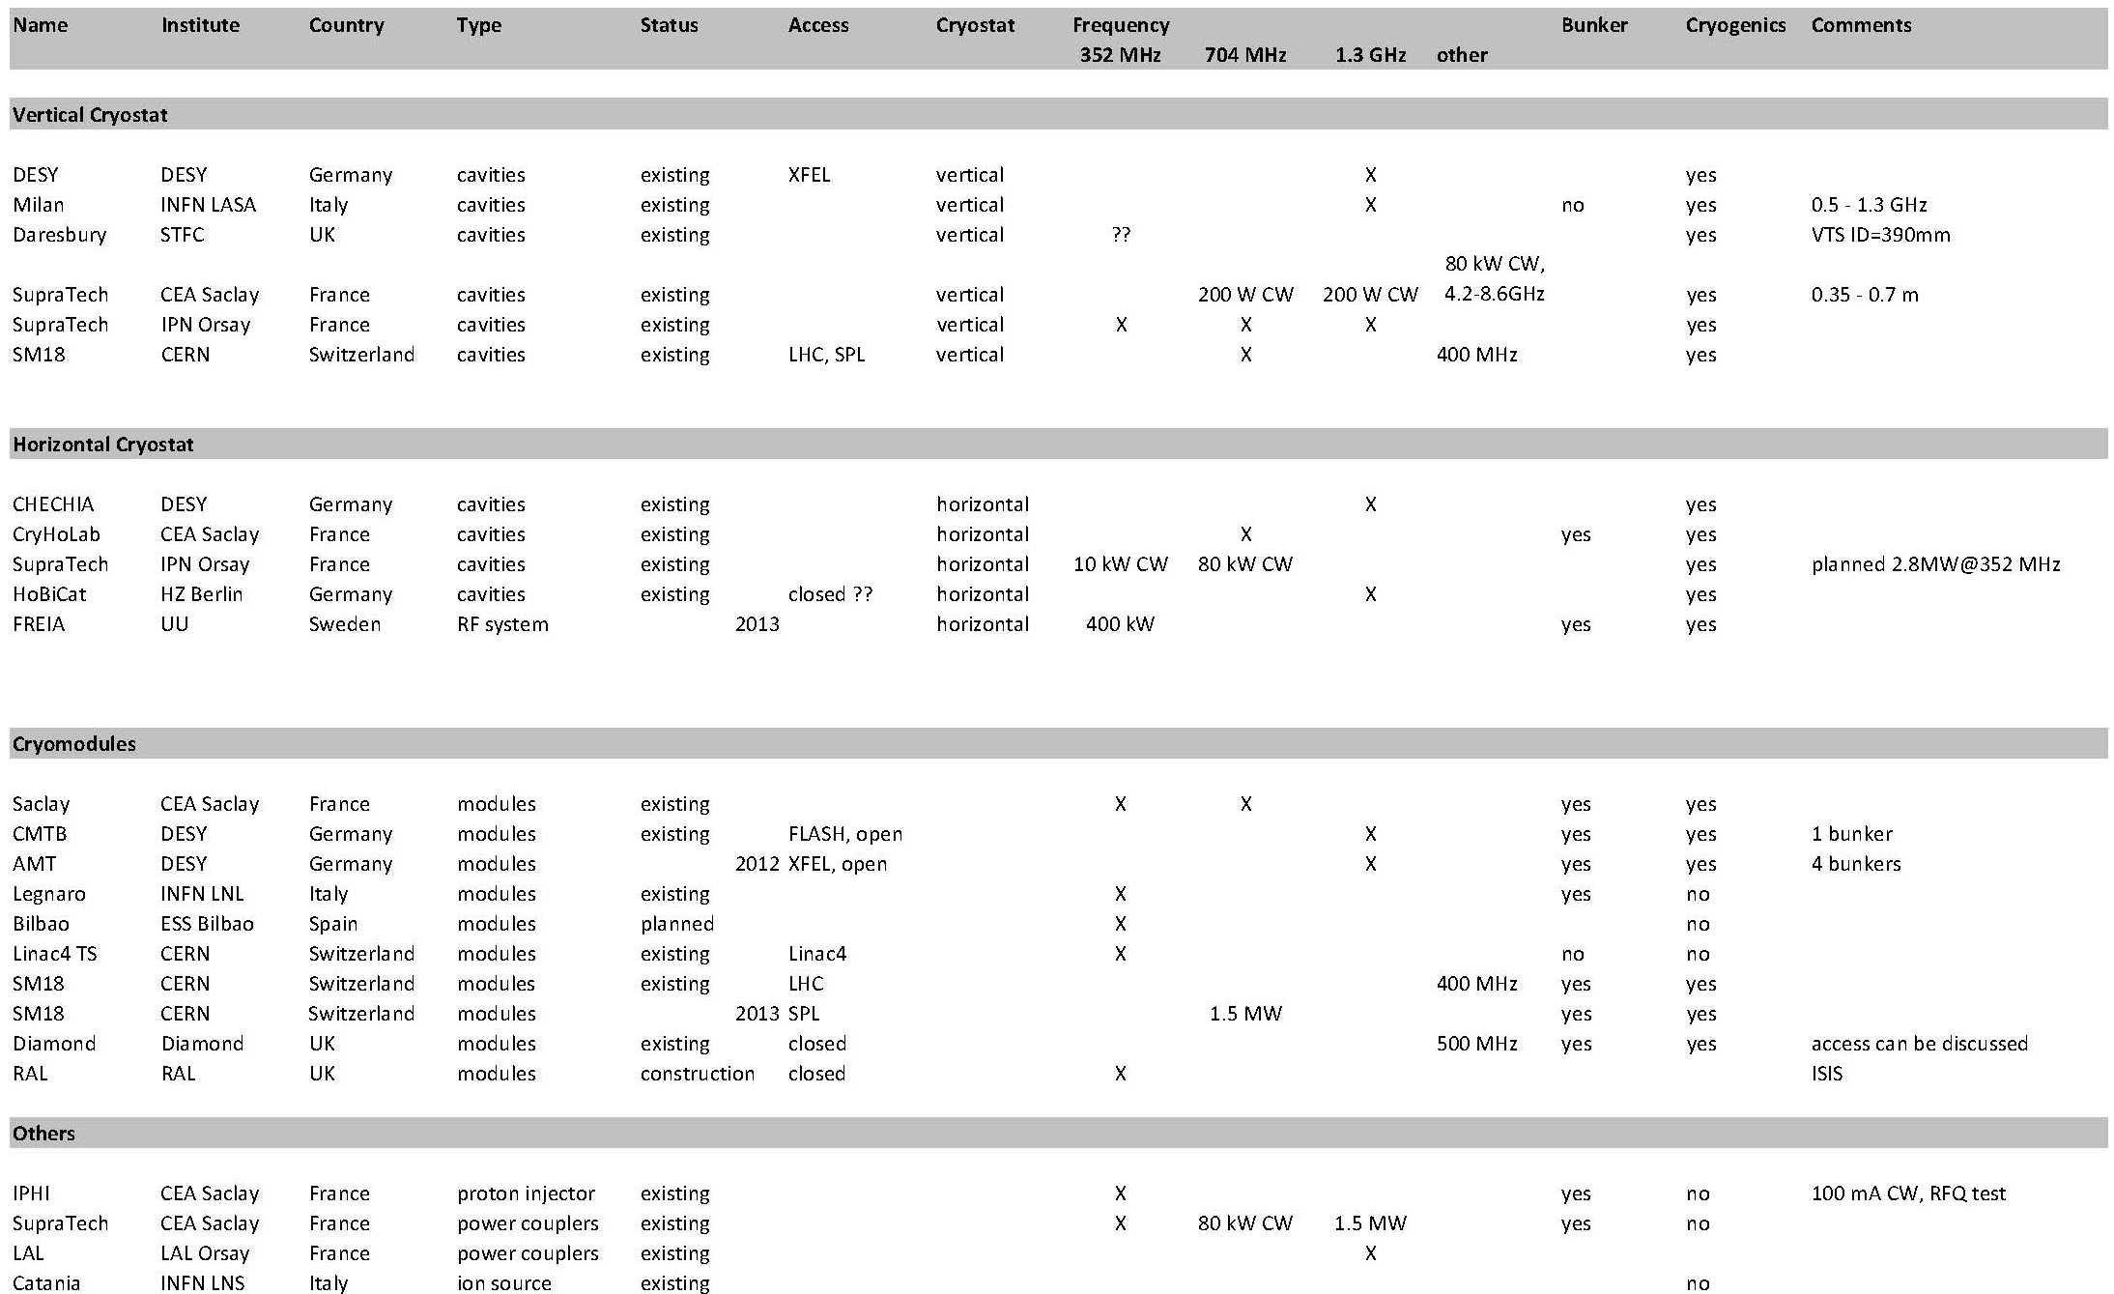
Test Stands Overview (not complete)

Slide 8
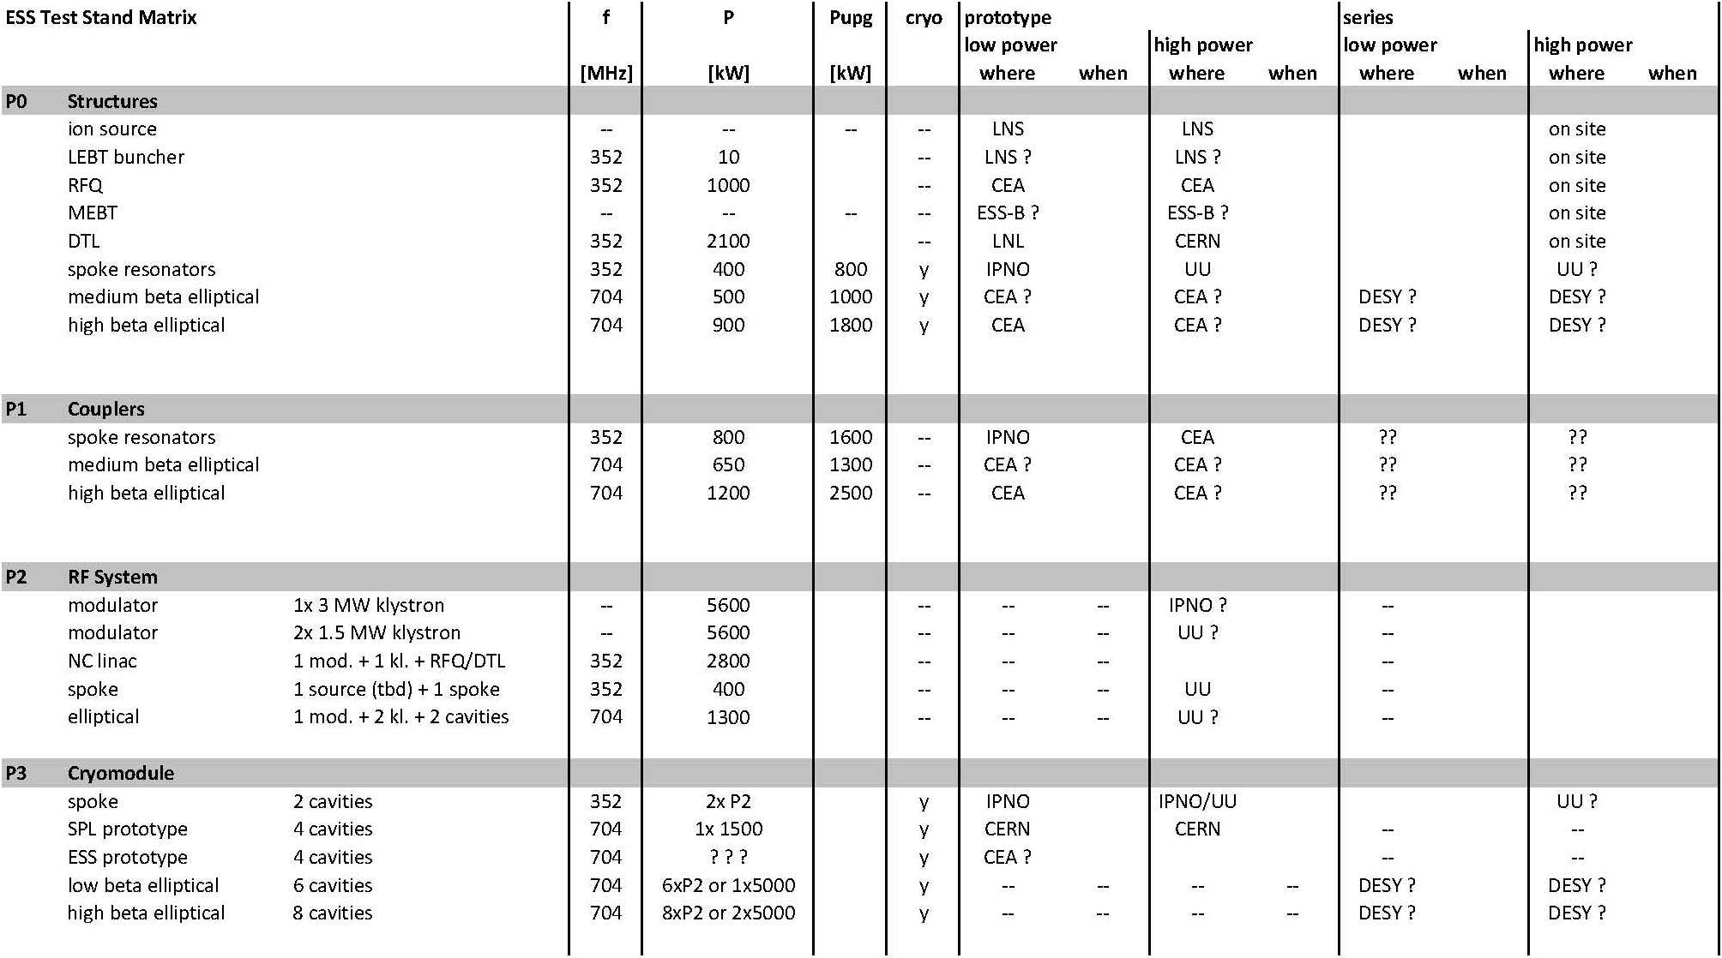
Test Stand Matrix

Slide 9
ESS-UU Collaboration
2009
ESS has need for R&D and test stand,
but small staff, no buildings, existing test stands occupied
start discussion with UU on 704 MHz RF development
proposal for ESS dedicated test facility at UU
2011
Spring:
ESS-UU contract on 704 MHz RF R&D
ESS changes to 14 Hz rep rate, 2.89 ms beam pulse
Fall:
ESS changes pulse modulator strategy → delays UU test stand
2012
UU starts work on 352 MHz RF for spoke resonators
keep 704 MHz for future

Slide 10
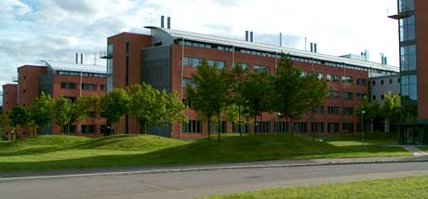
Accelerator Physics at Uppsala University
Concentrating on RF and instrumentation …
Cyclotron (since 1948)
CELSIUS ring (1984 – 2006)
CTF3 / CLIC
Two-beam Test Stand & RF breakdown issues
FP6-EuroTeV, FP7-EuCARD
NorduCLIC
FEL
FLASH Optical Replica Synthesizer,
XFEL Laser Heater
Stockholm-Uppsala FEL Centrum
ESS
...

Slide 11
ESS-UU Objectives
Develop 352 MHz RF amplifier for spoke resonators
validate prototype RF power amplifier
soak test with prototype LLRF (Lund Univ.) and spoke resonator (IPN Orsay)
Prototype complete RF system and cryomodule
complete RF system consisting of
two power amplifiers, RF distribution (Uppsala University)
LLRF (Lund University)
cryomodule with two spoke resonators, with tuners (IPN Orsay)
study high power behaviour, soak test
Lorenz force detuning, compensation by tuner
dynamic load, electron emission and multipactoring
LLRF controls, amplitude and phase stability
Training of future staff
for acceptance testing and operation

Slide 12
RF Development Proposal
Contribution to the Technical Design Report (WP8)
design concept 352 MHz spoke source
design concept RF distribution
Contribution to the construction planning effort (WP19)
survey test stand infrastructure and requirements
study of upgrade scenarios RF systems for ESS power upgrade
Development 352 MHz RF power amplifier for spokes (WP19)
1st prototype, test with water load and SRF spoke resonator, incl. LLRF
RF system test prototype spoke cryomodule (WP19)
high power test with 2nd RF power amplifier and LLRF
Acceptance testing spoke cryomodules
for all final cryomodules before installation
Development klystron pulse modulator
full test incl. klystron and RF system, if available with SRF cavity

Slide 13
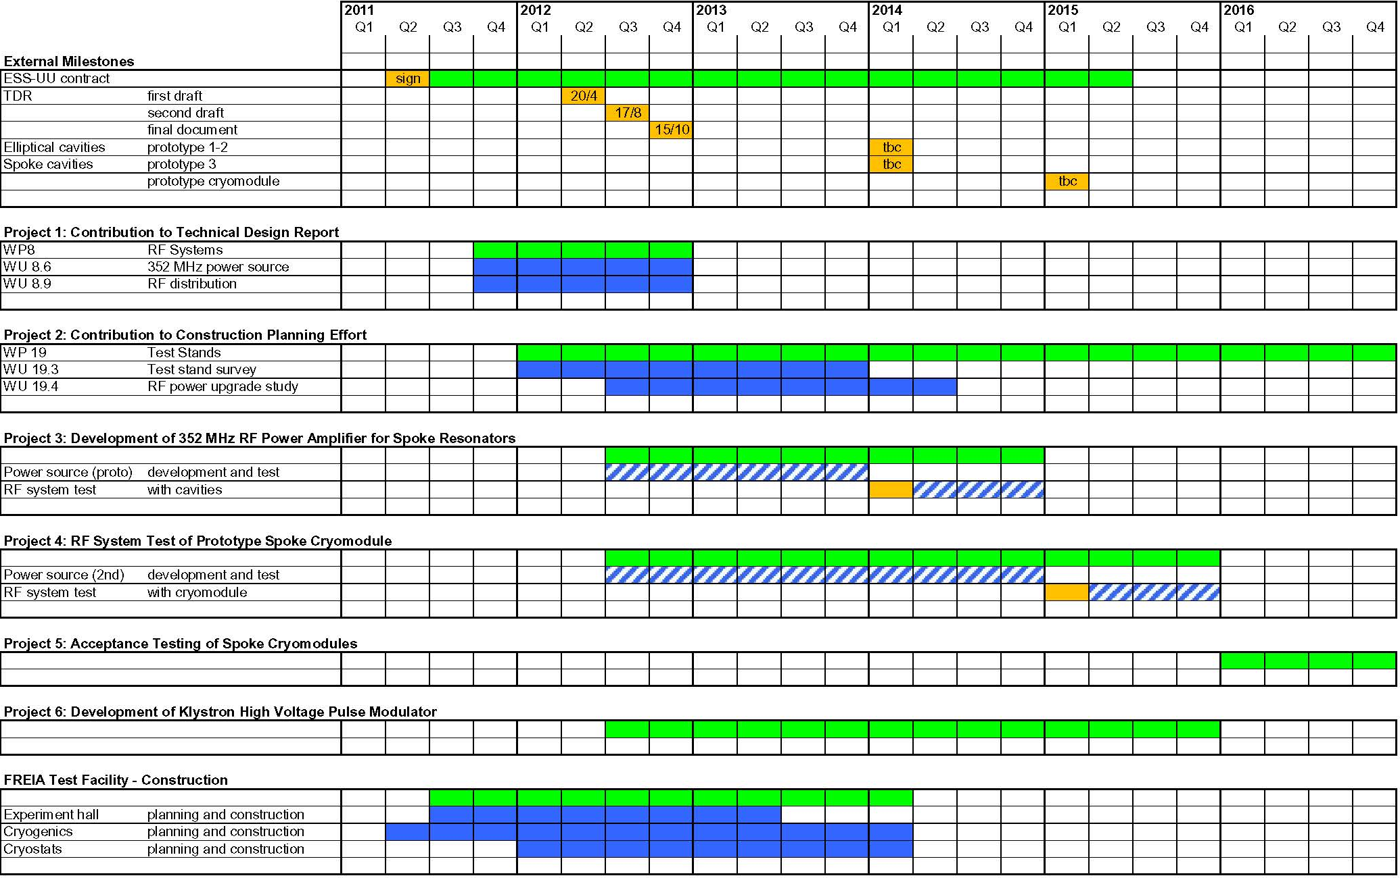
Projects and Timeline for Coming 5 Years

Slide 14
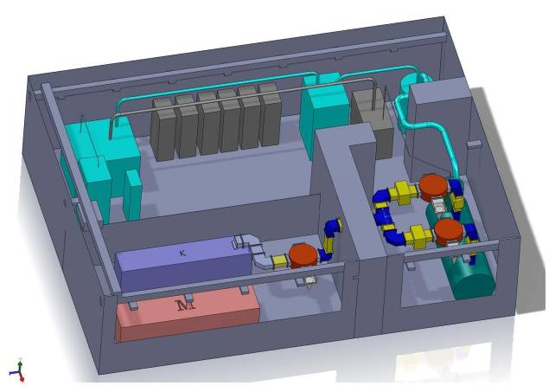
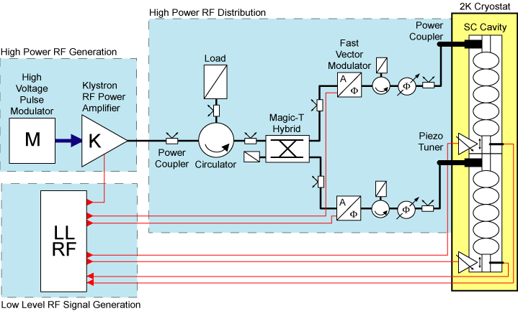
FREIA: Accelerator & Instrumentation R&D
New facility at Uppsala University
cryogenic center (LHe and LN₂ distribution)
RF development project for ESS
training of students and staff
Integrated with physics and astronomy
located at Ångström laboratory
new sub-department (head Tord Ekelöf)
12 staff (full and part-time)
multiple funding sources
Hardware
1000 m² hall
helium liquefier (>70 l/h)
test cryostat
test bunkers

Slide 15
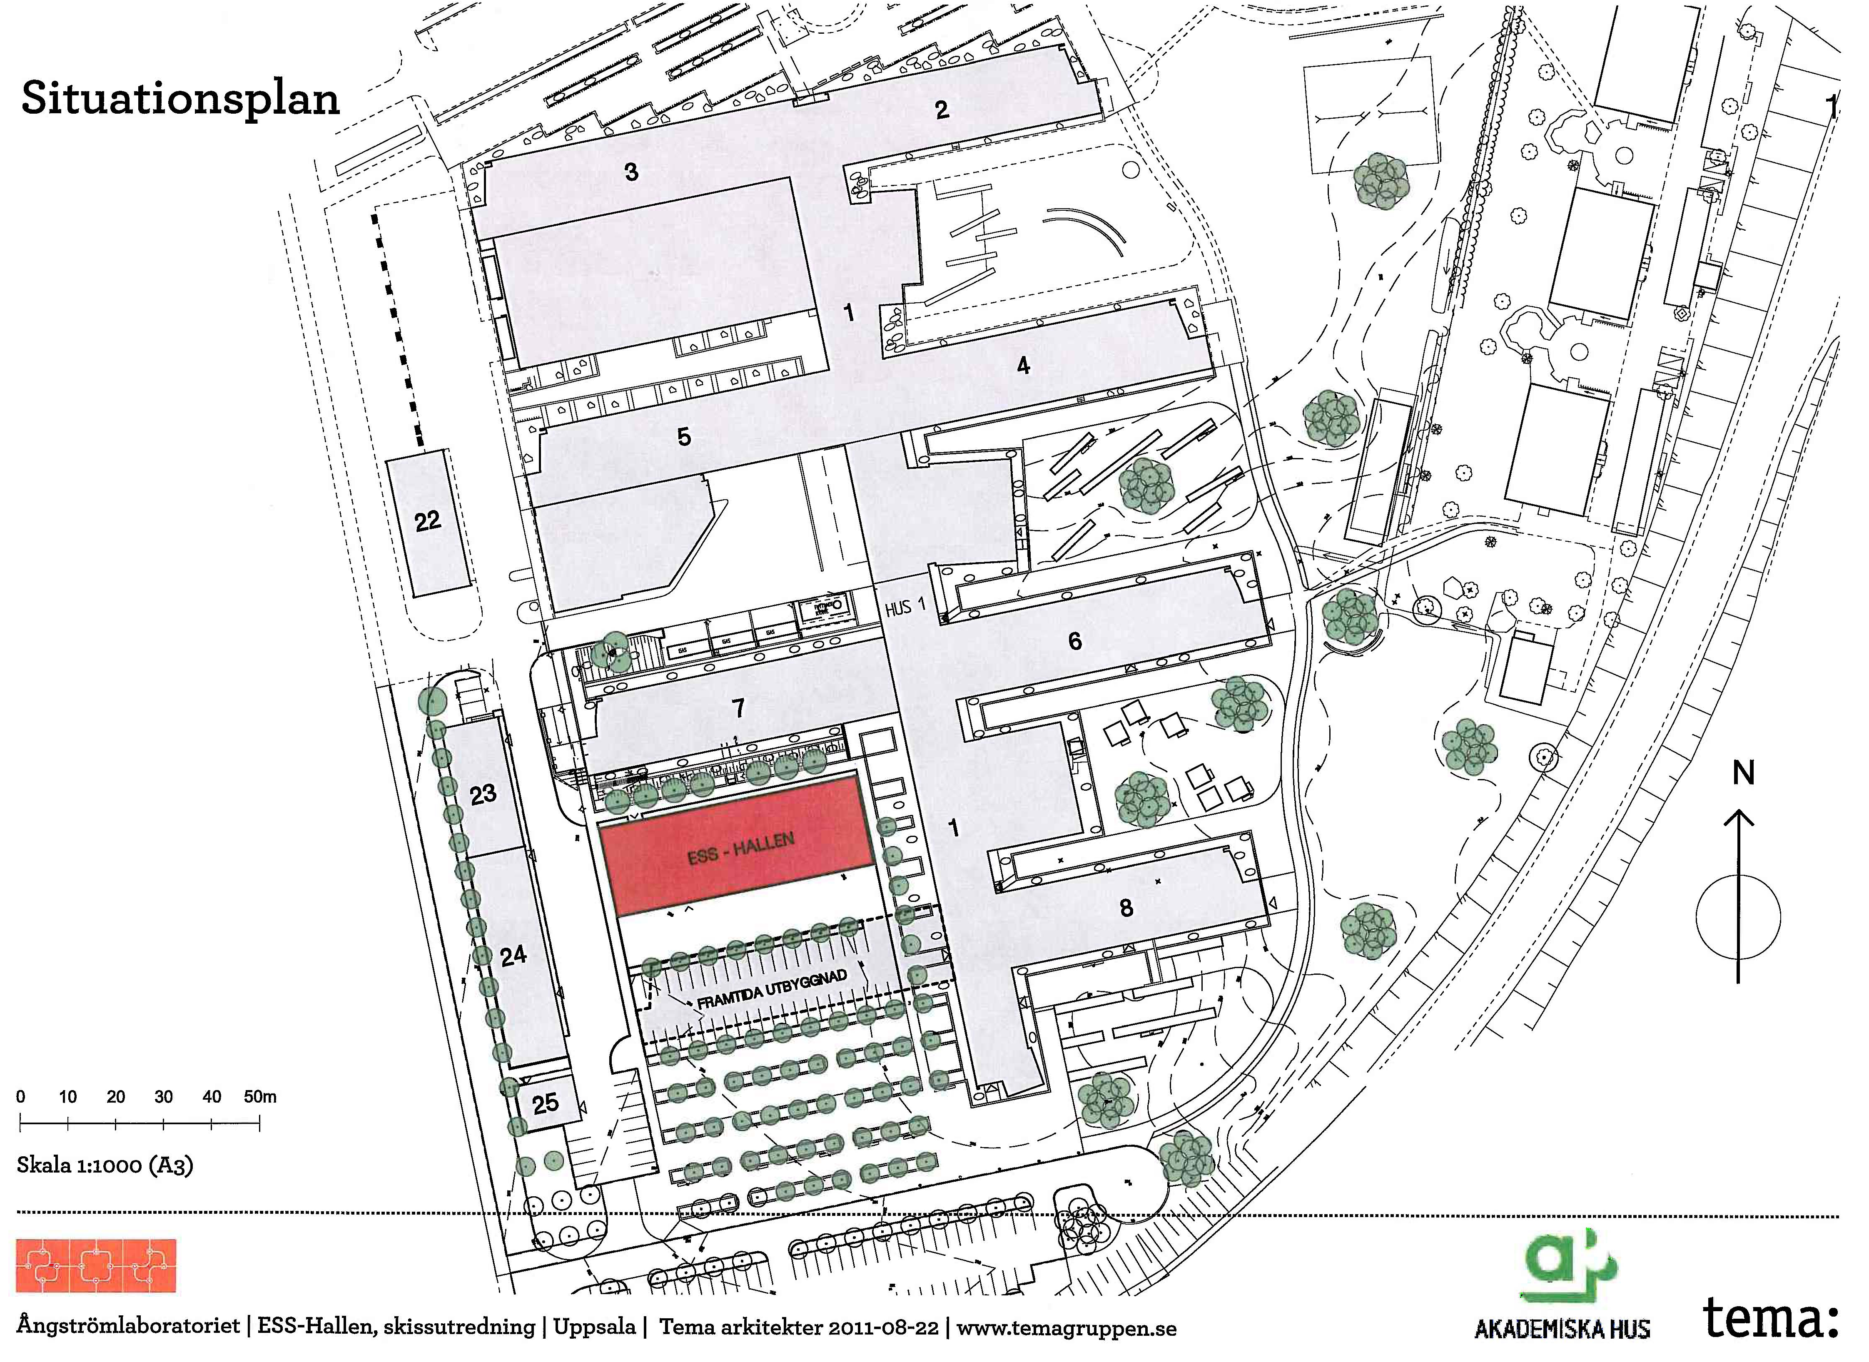
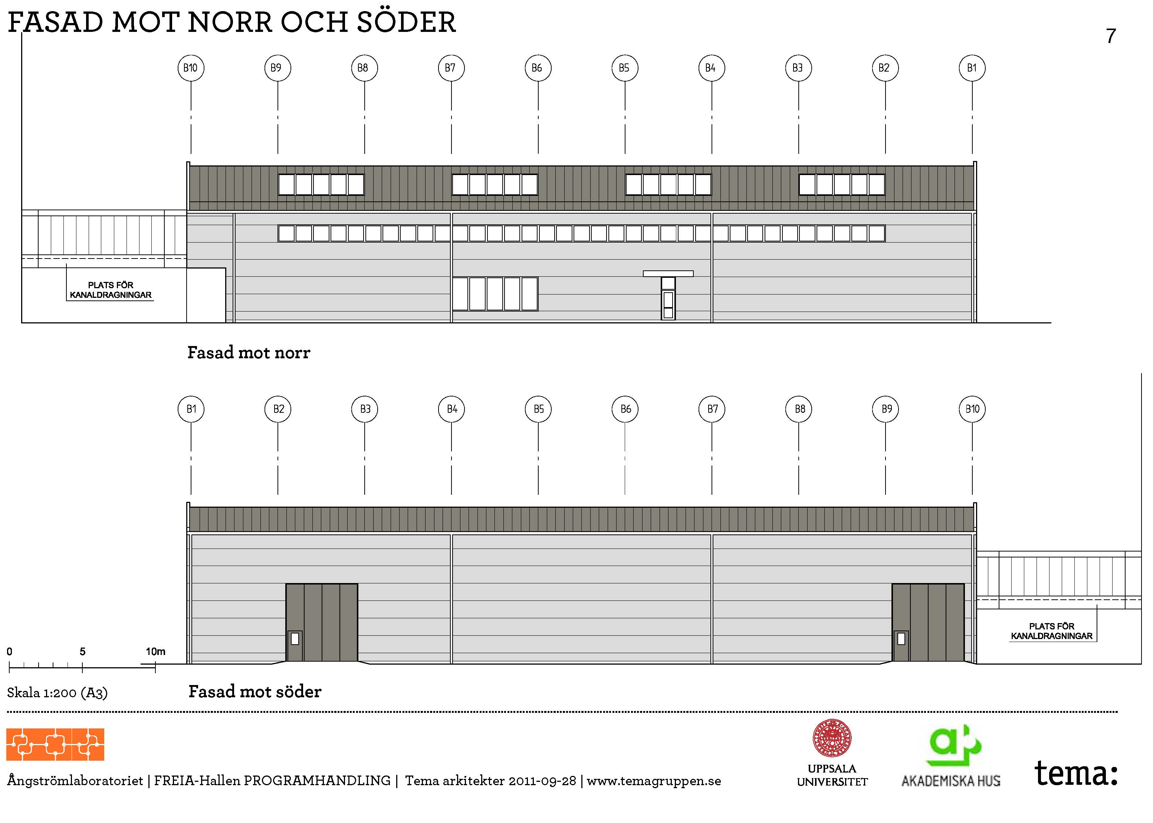
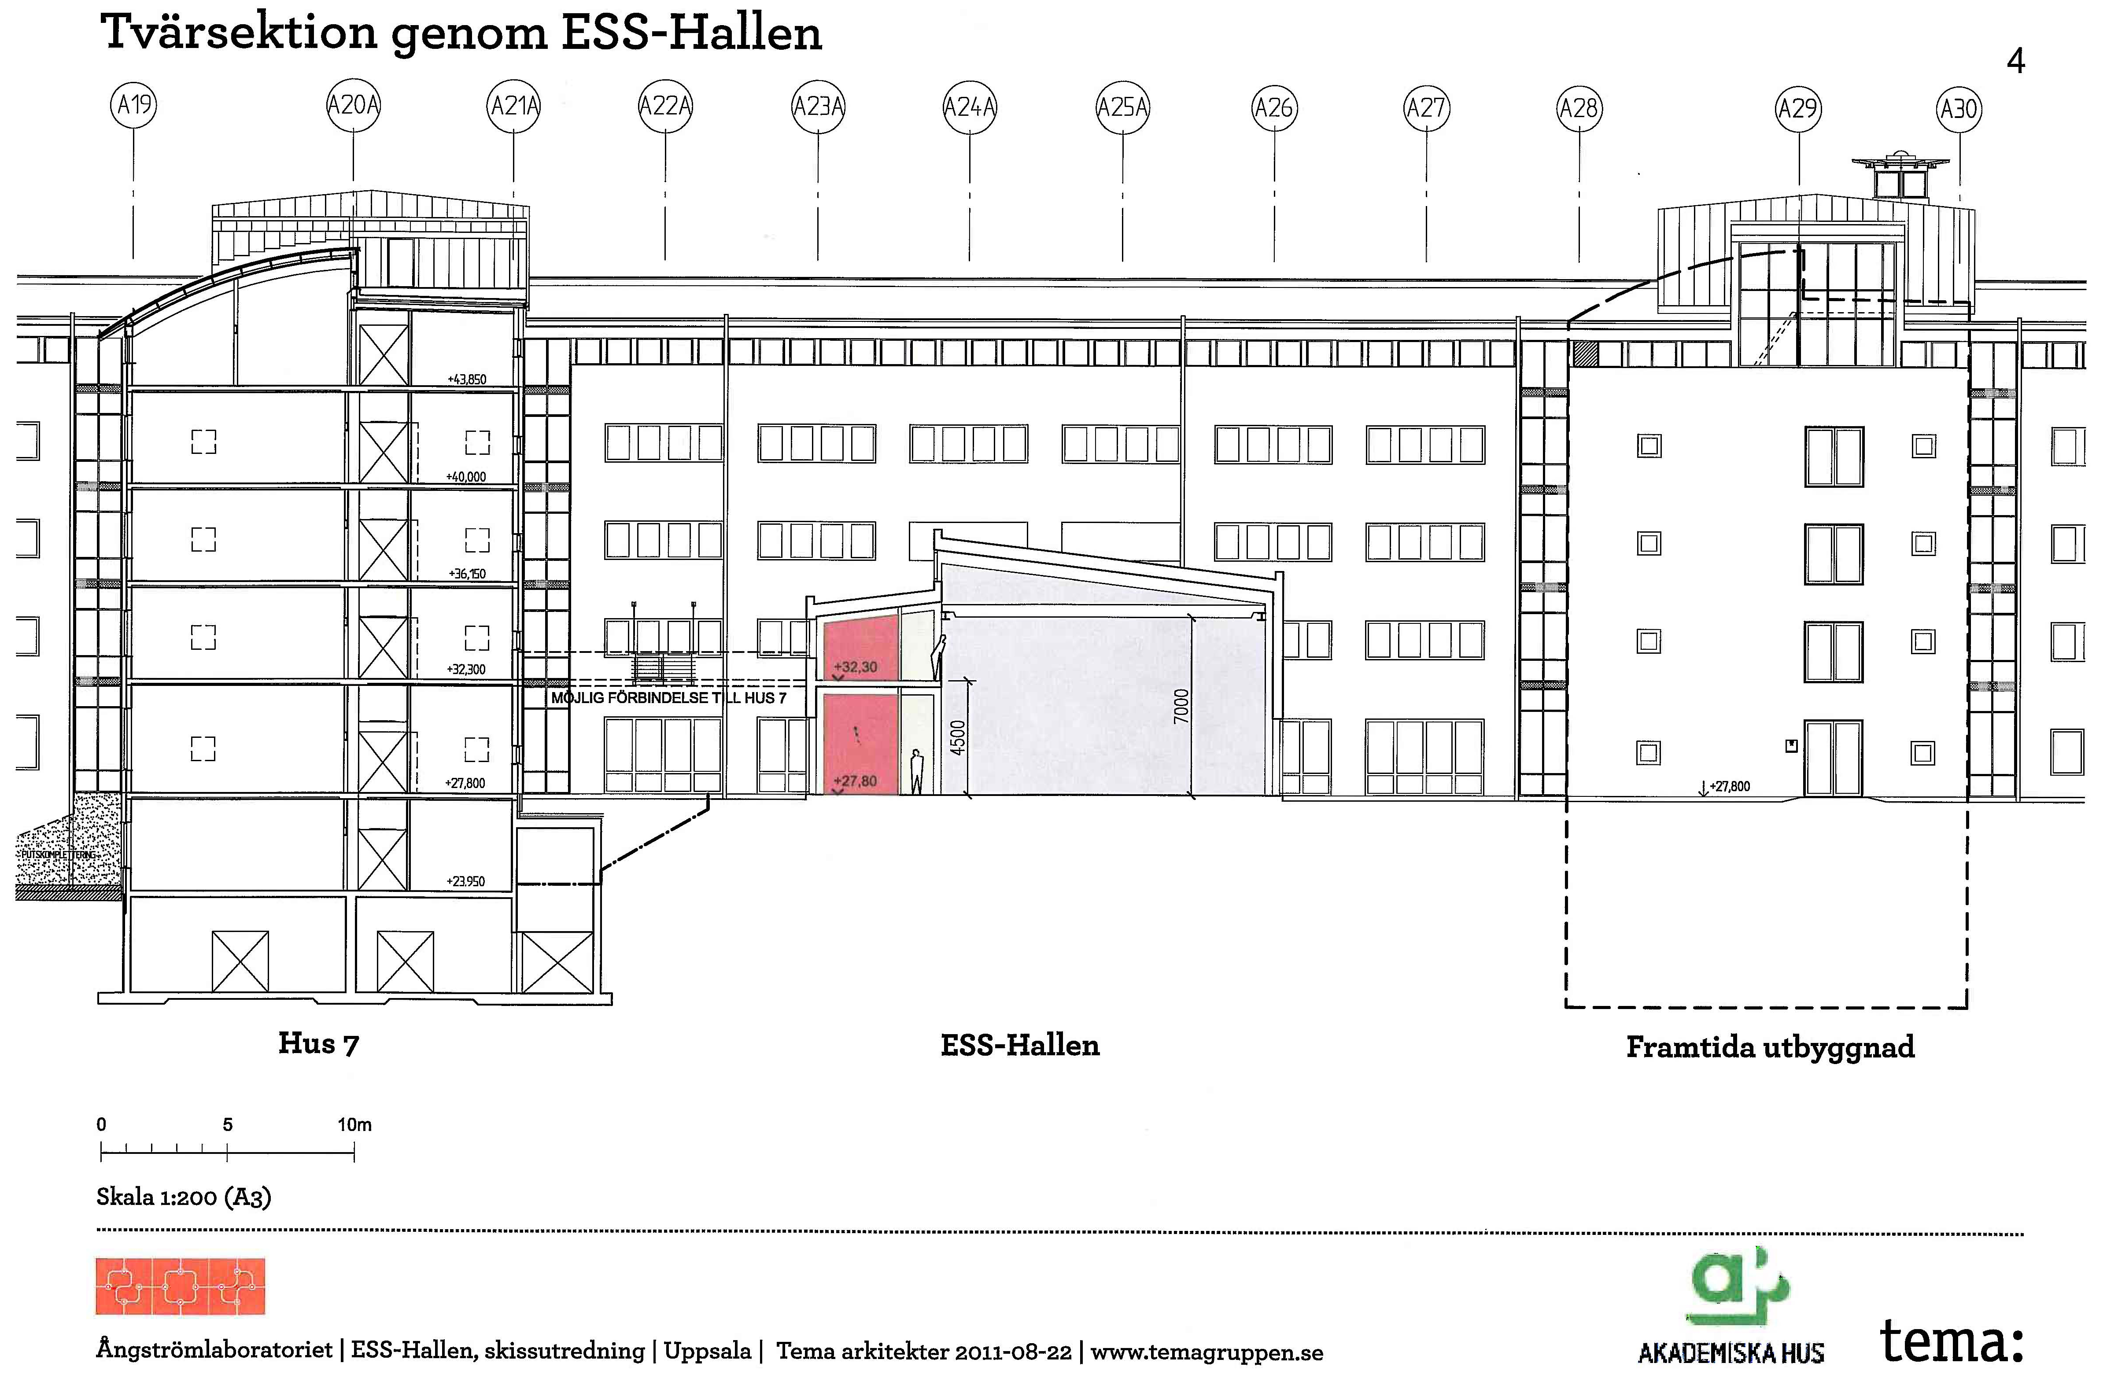
FREIA Hall Design

Slide 16
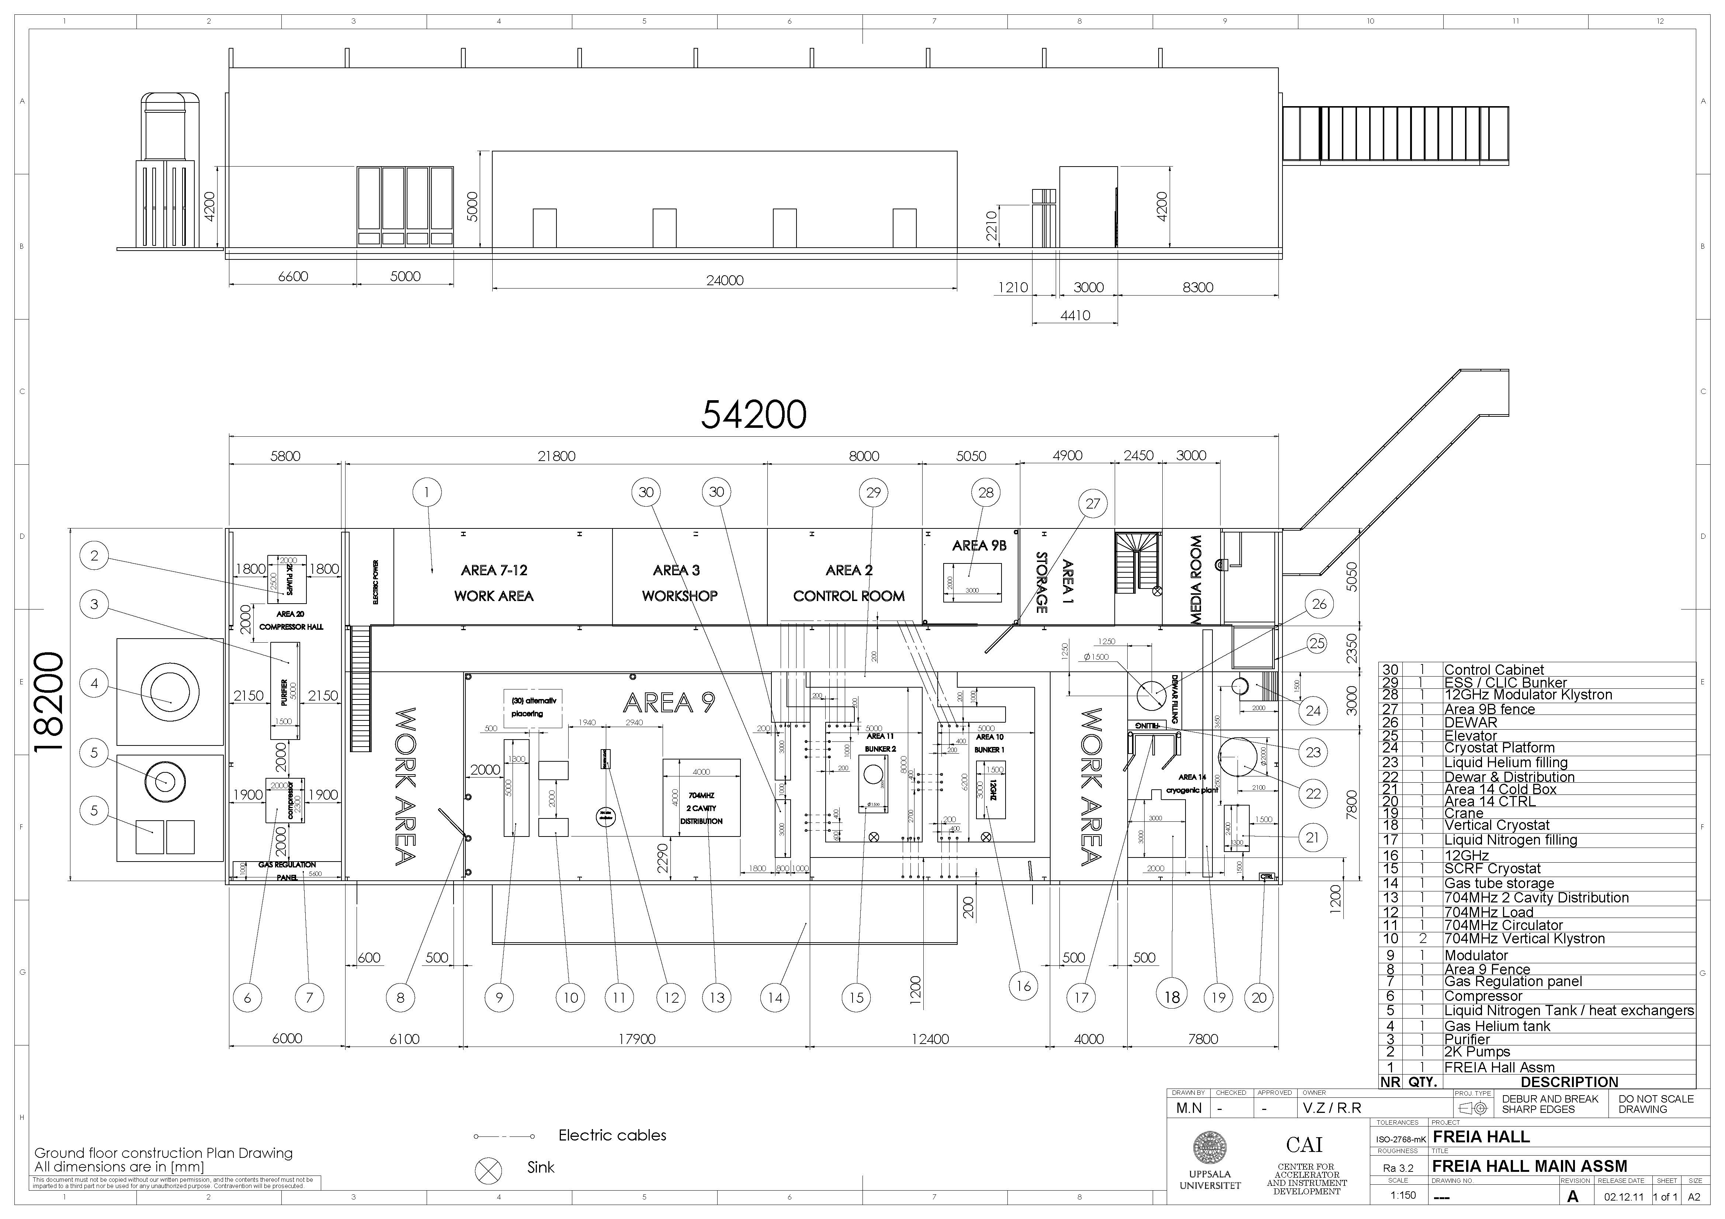
FREIA Hall Internal Layout
compressors
RF area
bunkers
cryo

Slide 17
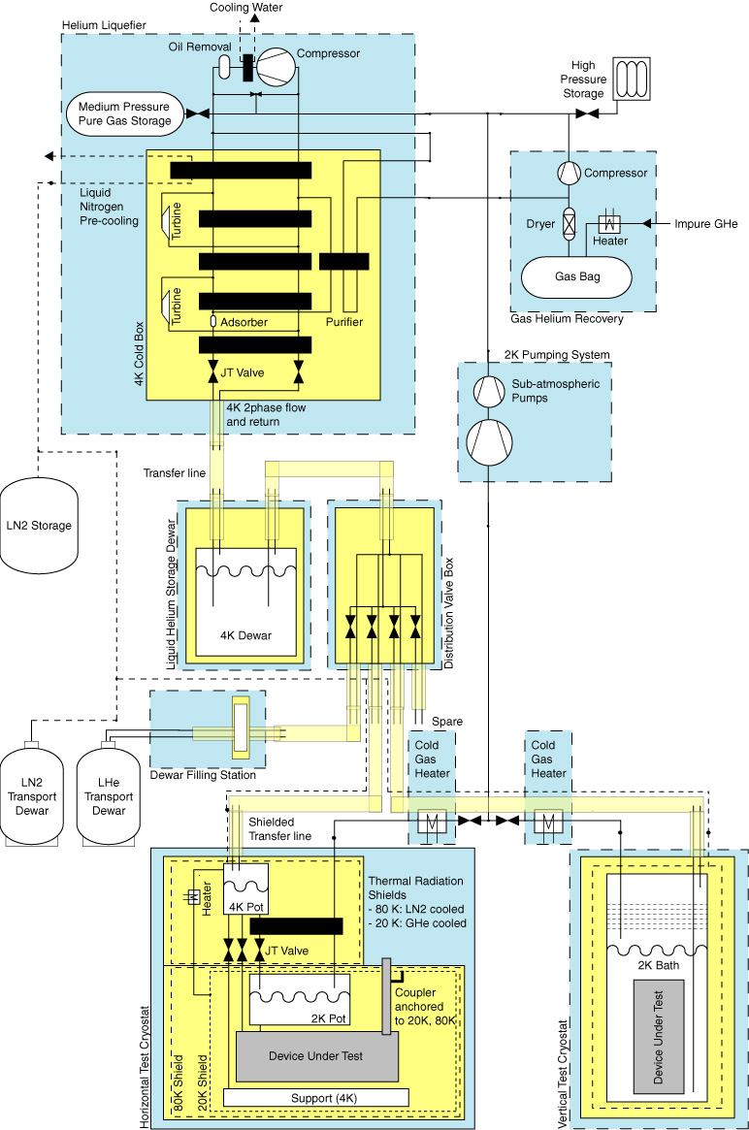
FREIA Cryogenic Infrastructure
Helium liquefier
100 l/h with LN2 pre-cooling
2000 l buffer
distribution box to users
Interfacing
dewar filling station
LHe and LN2 dewars
impure gas recovery from users
2K pumping station
General purpose test cryostats
horizontal, like HoBiCat
vertical

Slide 18
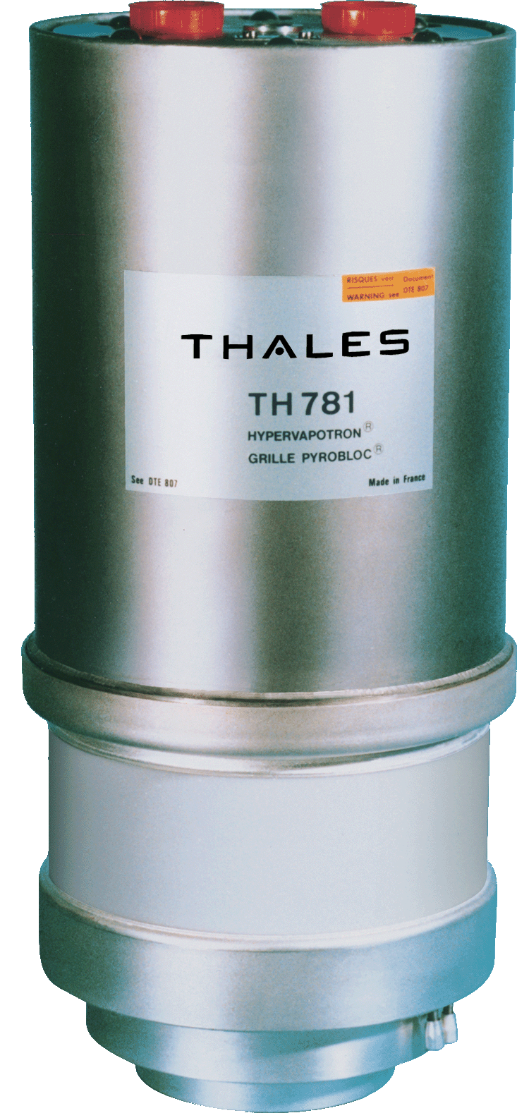
RF Development Project
352 MHz RF Source development
352 MHz ~350 kW for ESS double spoke resonators
possible candidate: TH781
requires test at 352 MHz and an output cavity development,
400 kW pulsed should be ok (500 kW pulsed at 200 MHz),
water cooled
will study DC or pulsed power supply (energy saving)
test with water load,
full RF system test with spoke resonator
Spoke prototype cryomodule testing
build 2nd RF source
full RF system test with complete cryo-module prototype
enables cryomodule acceptance testing for construction phase
Test prototype pulse modulator
with klystron load

Slide 19
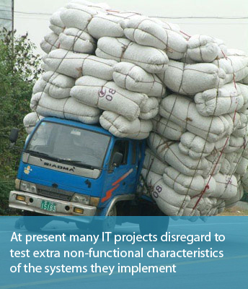
Conclusions
Uppsala RF development redefined to 352 MHz
continued contribution to TDR (in WP8)
RF source for spokes + RF distribution
prototyping (WP19 ”Test Stands”)
coordination, survey + RF system upgrade
soak test spoke source + cryomodule
proposal to extend with
acceptance testing spoke cryomodules
development klystron modulator
Uppsala FREIA project
engineering for experiment hall in full swing
negotiations b/w ESS and UU on contract change ongoing
UU fully commited, promised
”taking on such work with priority over work for other possible projects…” (ESS-UU contract agreement)
http://blog.qatestlab.com/2011/04/01/how-to-involve-non-functional-testing-in-your-project/

