Slide 1
BPMLHC
BPMLHC = BPMI (same electronics + FIFO)
Acquisition modes
FIFO (work-horse for Injection Test)
In parallel/parasitically:
Synchronous capture
(XPOC – post-mortem)
Good news and Issues
Outlook for future tests

Slide 2
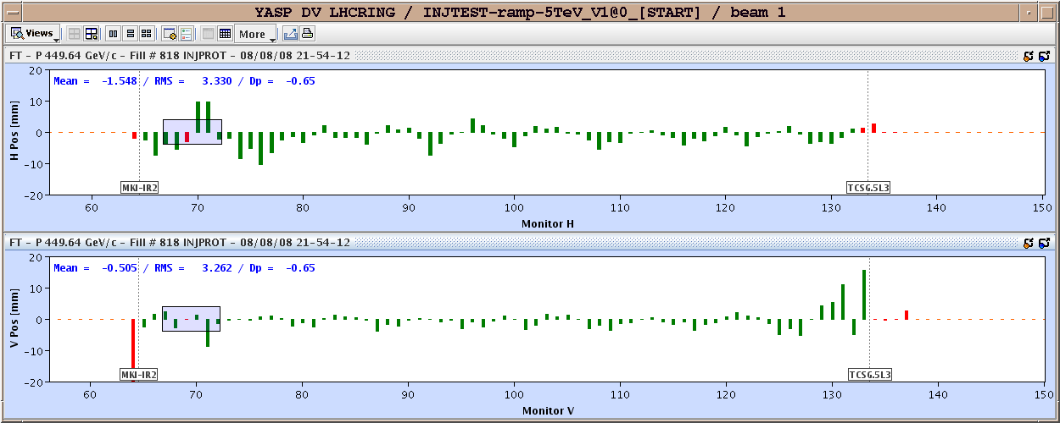
FIFO mode
Asynchronous FIFO (no fine timing needed)
Triggered with timing events (as for LTI)
BEAM
Start (-100 ms)
Stop/Read (+10 ms)
(don’t read too early!)
Read FIFO values (max = 1000), calibrate, calculate average position -> publish (LSA concentrator) ->

Slide 3
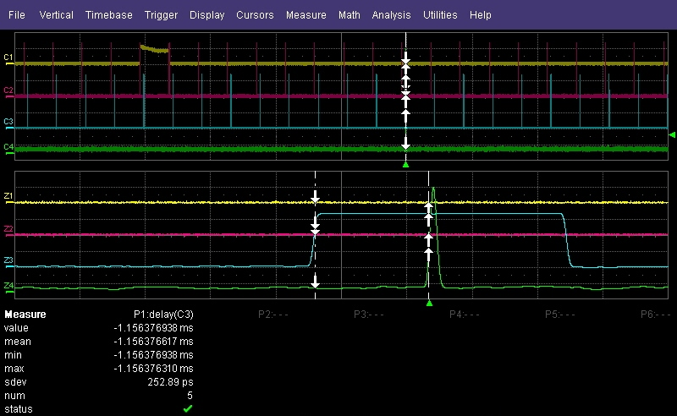
Capture mode
Synchronous (fine BST synchronization needed)
Only acquisition mode that allows bunch-selection (injected vs. circulating beam)
Requires selecting bunches and turns (operational settings)
Requires setting-up of bunch-delays and 40MHz phases
At injection will be triggered using LHC injection pre-pulses over BST provided by AB-RF
Produced sufficiently early (and without affecting the AB-BT pre-pulses) ..
Everywhere else in LHC cycle it will be triggered with LHC timing event
Issue with LSA concentrator to be solved ?

Slide 4
Capture results (B1RA system)
LHC Position | Position | ADC-Data | TDC | Bunch-ID
BPMSW.1R2.B1 | 32507 | 689 | 4 | 450
BPMSX.4R2.B1 | 32506 | 0 | 7 | 449
BPMYB.4R2.B1 | 32538 | 530 | 6 | 481
BPM.6R2.B1 | 32568 | 466 | 3 | 511
BPM.8R2.B1 | 32576 | 0 | 0 | 519
BPM.10R2.B1 | 32603 | 417 | 6 | 546
BPM.12R2.B1 | 32638 | 512 | 5 | 581
BPM.14R2.B1 | 32673 | 0 | 1 | 616
BPM.16R2.B1 | 32709 | 526 | 5 | 652
BPM.18R2.B1 | 32744 | 0 | 1 | 687
BPM.20R2.B1 | 32780 | 523 | 4 | 723
BPM.22R2.B1 | 32815 | 355 | 3 | 758
BPM.24R2.B1 | 32850 | 0 | 0 | 793
BPM.26R2.B1 | 32886 | 631 | 4 | 829
BPM.28R2.B1 | 32921 | 492 | 2 | 864
BPM.30R2.B1 | 32957 | 0 | 7 | 900
BPM.32R2.B1 | 32992 | 663 | 4 | 935
BPM.34R2.B1 | 33027 | 548 | 5 | 970
To get valid capture for TDC (1>X>7) requires changing 40MHz phase
Realignment of bunches requires changing bunch delay
These ‘expert’ settings that will hopefully not change very often
Algorithms presently being thought about

Slide 5
XPOC (PM) mode
Mainly used in LSS6 for LBDS systems:
For XPOC analysis, to observe closed-orbit position (turn-by-turn) prior to an emergency beam dump (BPMSE ++)
Basically seems to work fine, pending issue with alignment of turns (1024) in low-level software

Slide 6
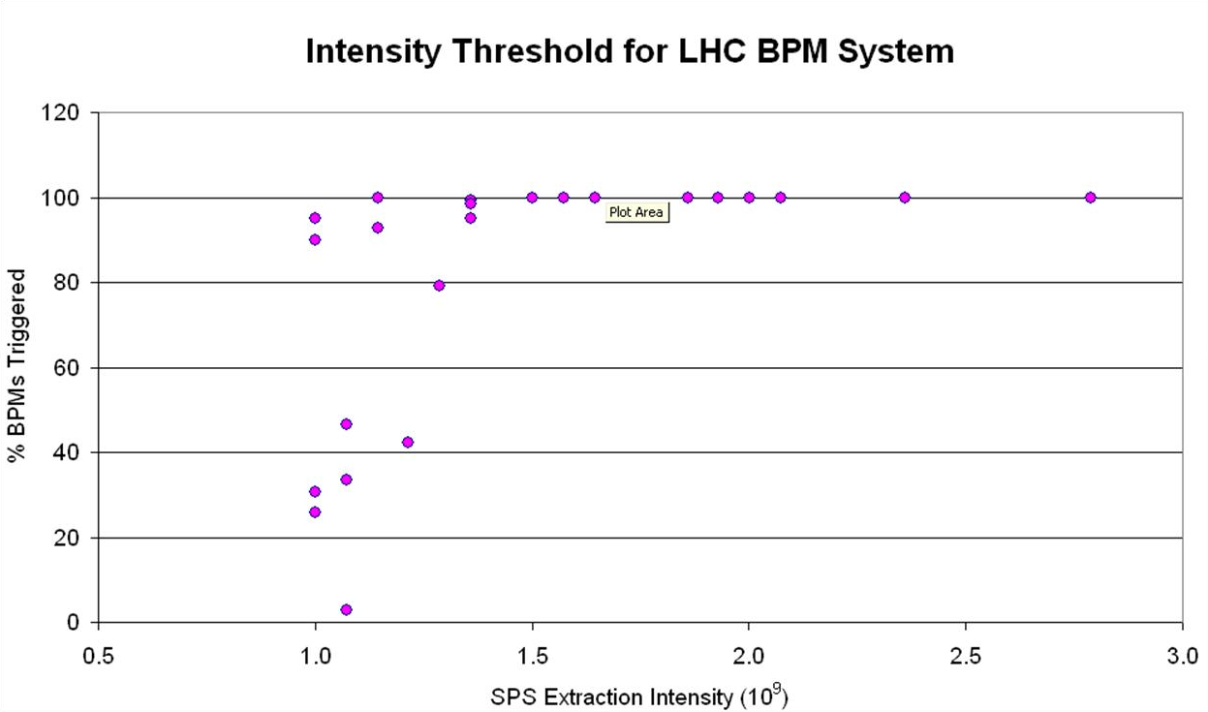
Good news & Issues
BPM calibration factors are OK to better than 10%
Workable intensity range as expected (low limit = 1.5E9 charges/bunch).
Low intensity pilots can be used for commissioning
Also important for physics beams (protons/ions).
Will involve a change of sensitivity below 4E10 charges/bunch (average)
Noise figures to be measured with beam
BPM Issues:
BPMI. 29504.V didn’t trigger
BPMSW.1L2.V noisy (was disabled)
BPM.33R2.V with H/V cable inversion
Wrong geometrical correction for warm BPMs (pt3), now OK

Slide 7
BPM Intensity modules
Were installed on Q8R2 and Q10L3
Less sensitive than expected due to non-linearity
These effects were not seen on previous hardware version (TT40/TT60/TI2)
Will be corrected (polynomial) to provide errors below 5%
A bit of commissioning with beam needed to get parameters right.

Slide 8
Outlook coming injection tests
BPM hardware commissioning on-going:
LSS8, 7-8, LSS7 (6-7, LSS6, TD62)
Required accesses requested
BPM Intensity modules to be installed:
Q8R7, Q10L7 and on BPMD (in TD62)
Dry-run to be planned next week

