Slide 1
Ring Aperture Measurements during second injection test
I. Agapov, R. Calaga, S. Redaelli, R. Tomàs, M. Giovannozzi et al.
Acknowledgements: Jörg, Thys, Injection team, shift crew

Slide 2
Measurement conditions
About two hours of measurements
Only H/V free oscillations in the arc (scanning on phase: 0º, 30º, 60º, 90º, 120º, 150º)
H plane: correctors in Q8-10 (left of IP8)
V plane: correctors in Q7-9 (left of IP8)
Frequent stops due to frequent spurious TI8 power converter surveillance interlocks. None of the given converters expose an out of tolerance. Possibly jitter of timing/gating of the current reference measurement.

Slide 3
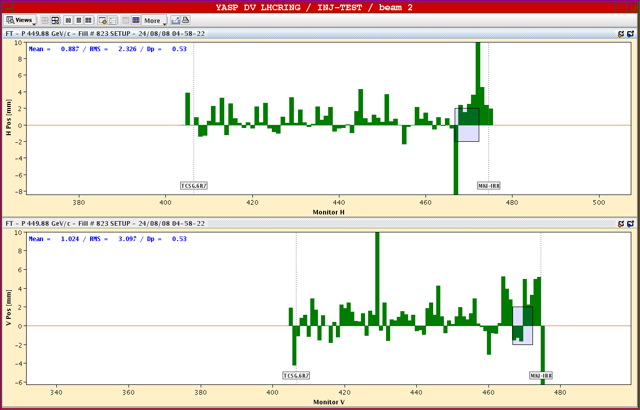
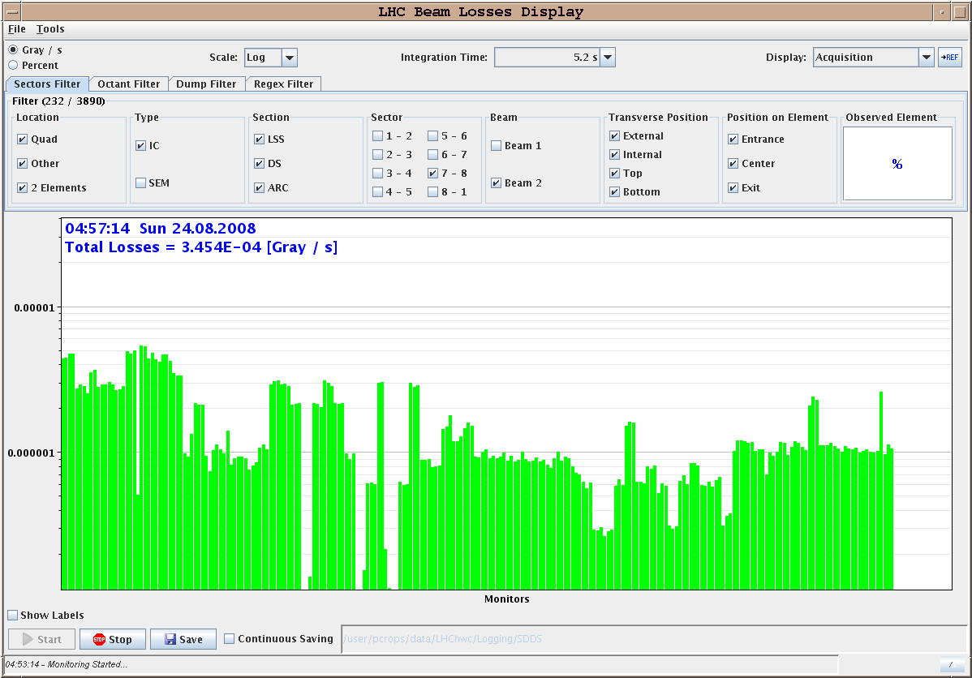
Initial conditions
Beam offset in D1

Slide 4
Selection of V-scan plots
12 σ free oscillation, 90º
Q11R7
Q19R7
Q11L8
Q27R7
Courtesy B. Dehning

Slide 5
Selection of H-scan plots
19 σ free oscillation, 60º
Q6R7
Q10R7
Q20L8
Q28L8
Q16L8

Slide 6
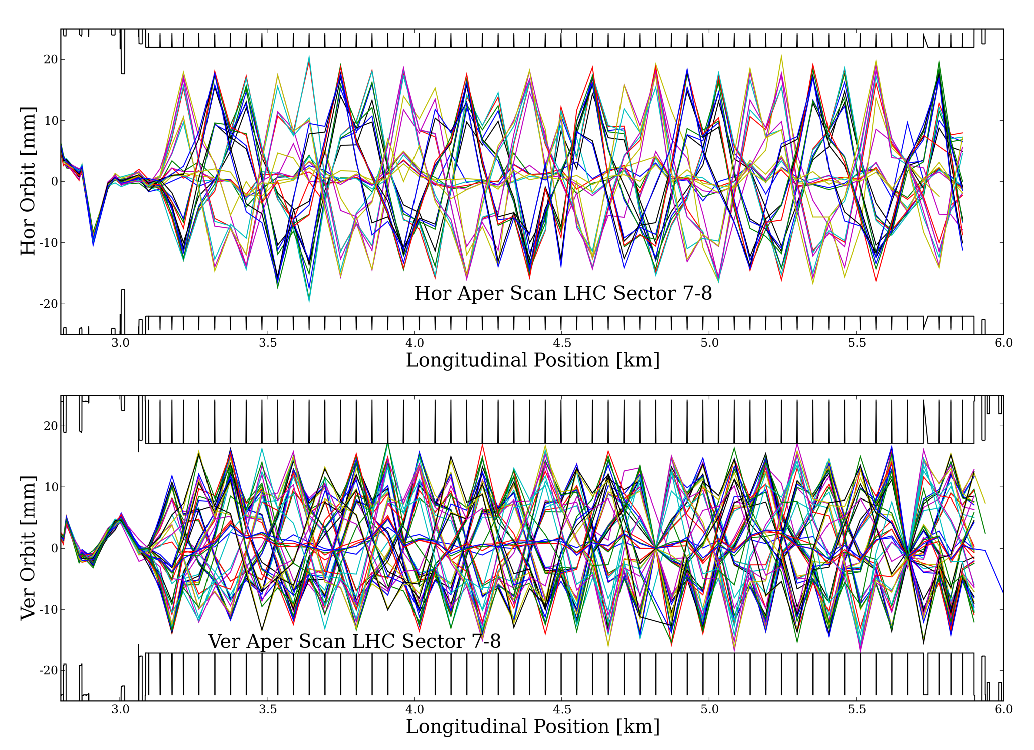
Global Picture
Courtesy R. Calaga

Slide 7
Conclusions (preliminary)
Horizontal aperture is around ±18 mm (confirmed value measured in first injection test).
Vertical aperture is around ±12 mm (slightly larger than in first injection test).

